Slide 1
Software
Re-Engineering

Slide 2
WHAT IS SOFTWARE RE-ENGINEERING
Reorganising and modifying existing software systems to make them more maintainable
Software Re-engineering is the examination, analysis and alteration of an existing s/w system to reconstitute it in a new form.
Re-structuring or re-writing part or all of a
legacy system without changing its
functionality
This process encompasses a combination of sub-processes such as reverse engineering, restructuring, re-documentation, forward engineering, and retargeting.

Slide 3
SOFTWARE RE-ENGINEERING and LEGACY SYSTEMS
Old systems that must still be maintained are sometimes called Legacy systems. Legacy systems are the old software systems which are essential for business process support.
Software re-engineering is concerned with re-implementing legacy systems to make them more maintainable. It may be the only viable way to ensure that legacy systems can continue in service.

Slide 4
When to re-engineer
When system changes are mostly confined to part of the system then re-engineer that part
When hardware or software support becomes obsolete
When tools to support re-structuring are
available
Note: As a part of this re-engineering process, the system may be re-documented or restructured. It may be translated to a more modern programming language, implemented on existing h/w technology.

Slide 5
Re-engineering advantages
Reduced risk
  As the software is already existing, the risk is less as compared to developing a new software.
Reduced cost
  The cost of re-engineering is often significantly less than the costs of developing new software

Slide 6
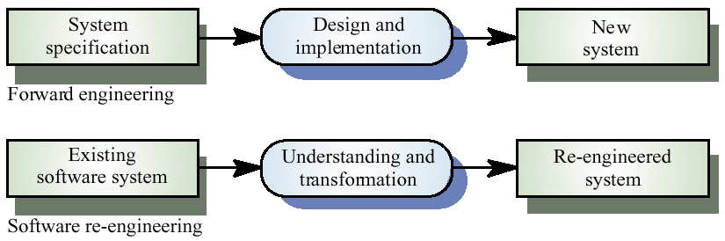
Comparison of New Software development with re-engineering

Slide 7
Steps involved in System Re-engineering
Source code translation
Reverse engineering
Program structure improvement
Program modularisation
Data re-engineering

Slide 8
Source code translation
Involves converting the code from one language (or language version) to another e.g. FORTRAN to C
The translated language may be an updated version of the original language or a completely different language.
May be necessary because of:
  Hardware platform update
  Staff skill shortages
  Organisational policy changes

Slide 9
Reverse engineering
Analysing software with a view to understanding its design and specification
Builds a program data base and generates information from this
Program understanding tools (browsers, cross-reference generators, etc.) may be used in this process

Slide 10
Program structure improvement
It is the process of improving the structure of the program to optimize memory use and the lack of understanding of s/w engineering.
Typically, programs develop this complex logic structure as they are modified during maintenance.
New conditions and associated actions are added without changing the existing control structure.

Slide 11
Restructuring problems
Problems with re-structuring are:
  Loss of comments
  Loss of documentation
  Heavy computational demands
The under standability of data-driven programs may not be improved by re-structuring

Slide 12
Program modularisation
The process of re-organising a program so that related program parts are collected together in a single module
Usually a manual process that is carried out by program inspection and re-organisation

Slide 13
Data re-engineering
Involves analysing and reorganising the data structures (and sometimes the data values) in a program to make it more understandable.
May be part of the process of migrating from a file-based system to a DBMS-based system or changing from one DBMS to another
Objective is to create a managed data environment

Slide 14
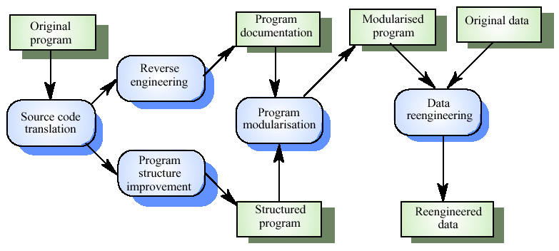
The re-engineering process

