Slide 1
Customer Life Time Value (CLV) Analysis
HOPMONK Gaming Company

Slide 2
V
Slide 1
Model Building
Problem Statement
Error Metric Evaluation
Data Insights
Data Pre Processing and Feature Engineering
Summary
AGENDA

Slide 3
Over View
Objective
Hopmonk Storage and the Approach
Using machine learning techniques analyze the data and predict the Customer Life Time Value CLV
that will enable Hopmonk to target and acquire customers based on the net potential as profit.
Hopmonk currently has a million customers on their Enterprise Data Warehouse (EDW) where the data
is spread across various tables.
Hopmonk has implemented both Oracle and Cognos solutions designed to enable their
business users to extract and analyze their data.
Hopmonk feels they have locked away valuable details on consumer behavior, segmentation,
demographics, and more.

Slide 4
DATA PRE-PROCESSING and Feature Engineering
Data Pre-Processing
Feature Engineering
Variables Extraction
7 Data frames are merged together based on the business problem and a final master data frame is made.
Based on the Variables business importance the missing NA values are been imputed.
A new Features are been extracted based on the existing variables.
New Features are:
Frequency, Recency, Average Order Value,
Purchase-frequency and Customer life time value.
Frequency=Sum(App+LF)
Recency=Recent value(App and LF
By using Hetcor function the variables which are highly corelated are been removed.
And using the Step Aic and VIF some of the variables are been removed.

Slide 5
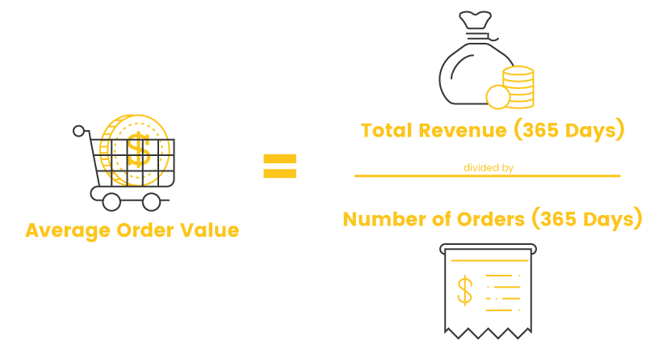
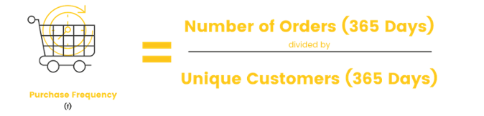
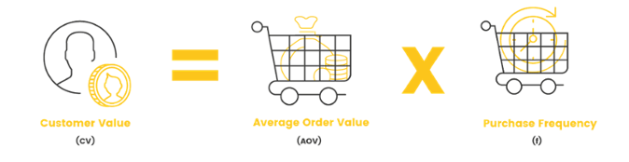
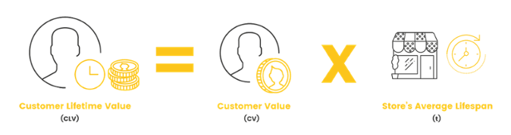
Feature Engineering
Target : Customer Value
Variables used:
Total Revenue Generated
Units bought
No. of Unique Customer.

Slide 6

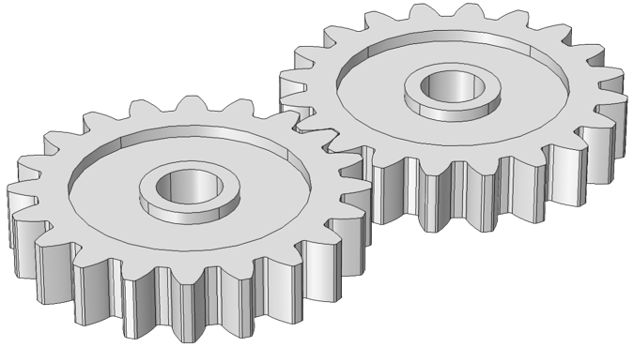
Demo graphs of the Final Data Frame
Pre-Processed Data Frame With
56660 by 103
Feature engineered Data Frame With
29271 by 83
Transformation
Customer Centric | Business Centric | Customer Demo graphs
Games Played, | Favourite Source | Age
Time | Favourite Channel | Country
Units |  | No of Children
Recency, Frequency
Hopmonk Dataset Summary:
Total Observations : 29271
Total variables : 24
Split : 70-30
Target Variable : Customer_value
Scaling : Based on the model

Slide 7
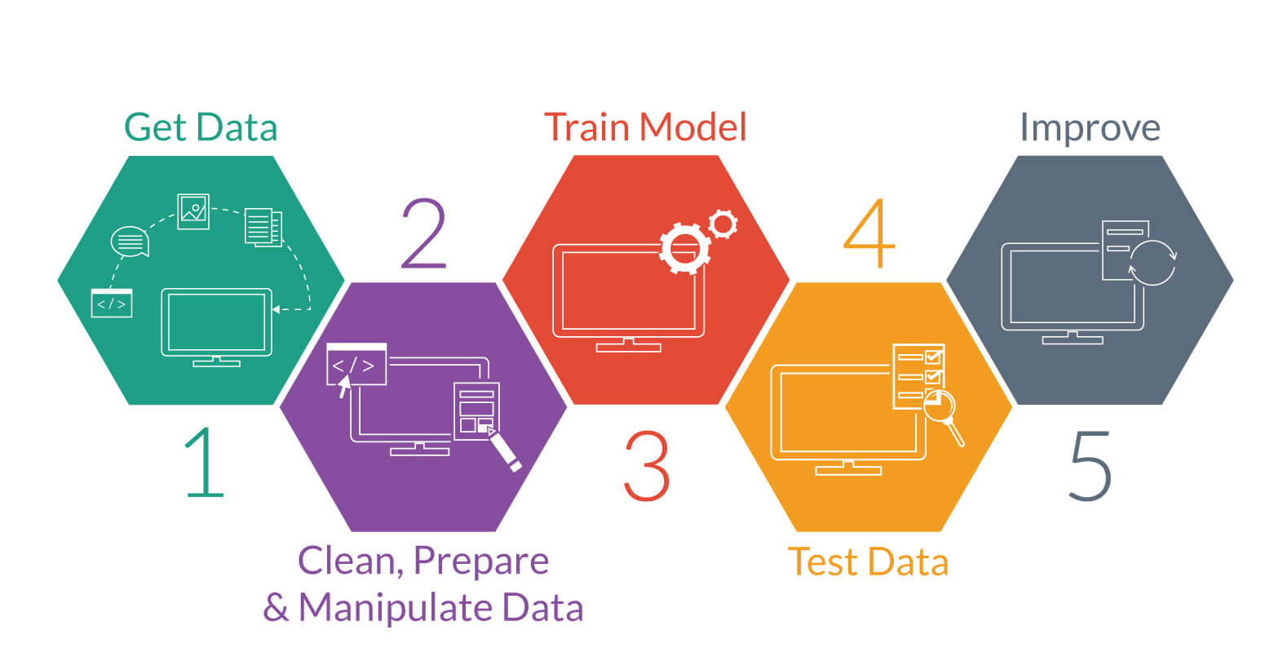
Model Building

Slide 8
Simple Linear Regression
Simple Linear Regression:
The errors were computed based on the simple linear regression.
Mape stood almost same for various types of regression models.
The Adjusted R2 is Around 0.90 so even the model is good.
There is some non-linearity in the data as the data is heavily skewed.
Did the transformation on the target variable such as sinh(x),Log(x), x2 and Sqrt(x).
The model gave optimum values over the transformation of sqrt over other transformation.

Slide 9
Decision Tree
Decision Tree Model:
The tree was made to grow without any constraints due to which the model got overfit.
Then went for the optimal cp value based on the x–relative error.
Then tuning the number of minimum split gave the least rmse and mape and stable over both train and test.
As decision tree uses works with the greedy approach some sort o information might be left to get so going for the other models.

Slide 10
Random Forest

Slide 11
SVM
SVM Regression:
The values are separable well in the linear kernel and even the rmse of train and test is stable.
The Tuning Parameter were not taken in account at the cost of time to tune in spite of errors being stable over train and test.
But, in radial in hyperplane its not generalising well as the data might be linearly separable in linear SVM

Slide 12
ADA AND XG BOOST
ADA and XG Boost:
As ADA Boost take the class vectors did the range normalisation and predicted the probabilities.
Then did denormalization of the probabilities and got the train and test error nearly about zero.
XG Boost errors mape is generalised on train and test but the error deviation is high on both train and test due to which rmse is high when compared to other models.

Slide 13
Error Metric Evaluation Based on Median RMSE
Final Model :SVM Model

Slide 14
Summary and Data Insights

Slide 15
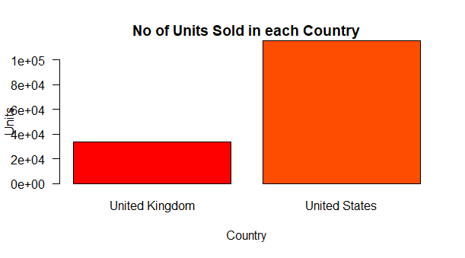
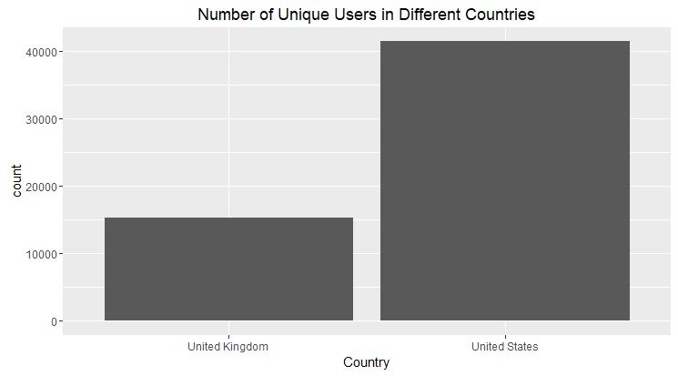
Data Insights Before Pre-Processing

Slide 16
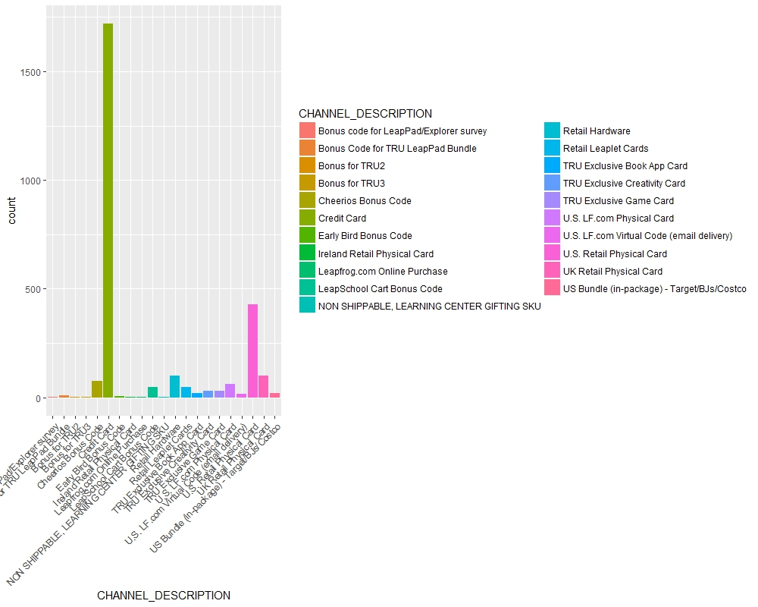
Data Insights Before Pre-Processing
Favourite Channel of Transactions

Slide 17
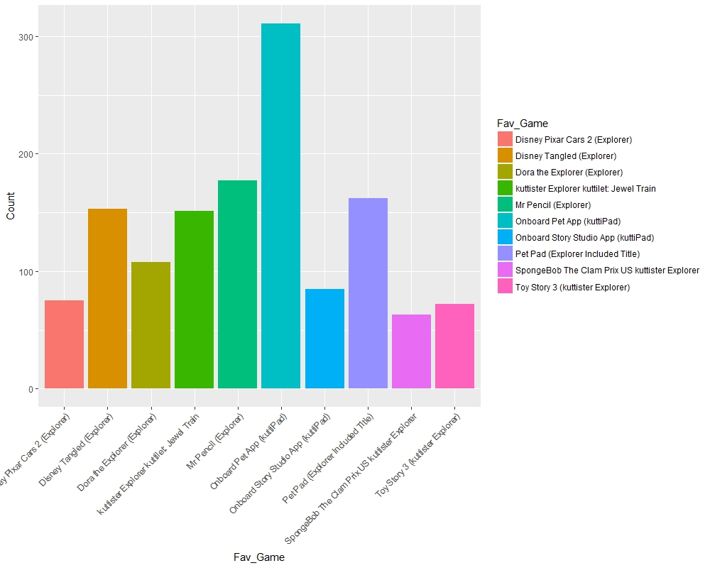
Data Insights Before Pre-Processing
Favourite Game

Slide 18
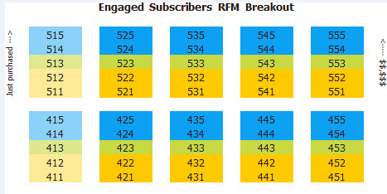
Data Insights Before Pre-Processing
RFM Analysis Table

Slide 19
Summary
As per the business constraints the Customer Life Time value has to be predicted and the SVM model is stable over others when compared in terms of Errors.
As there is huge difference in the markets of US and UK the marketing strategies has to be improve a lot in UK market to scale up the profitability.
As more customers are been inclined to the credit card as the channel of transaction company should make the portal highly secured.
As there is a game named Disney Pixar car2 which is played a lot when compared to others a gamed around that themes will make the company to generate more revenue.
There should be customers centric marketing strategies to retain the them and increase the revenue.

Slide 20
Q&A

Slide 21
THANK You

