Slide 1
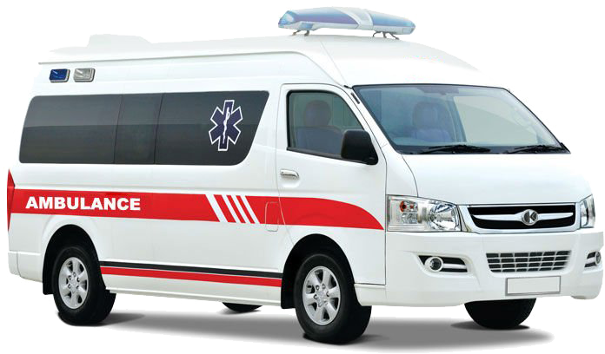
“Re-admission possibility of a patient into the hospital”
Health Care Industry

Slide 2
V
Slide 1
Data Insights
Problem Statement and Business Overview
Model Building
Metric Evaluation & Patterns
Data Pre Processing and Feature Engineering
Summary
AGENDA

Slide 3
Over View
Objective
Company Statement
In order to avoid the readmission of the treated patient with in that time period we will be going to make a model to predict the readmission of the patients. So, that a proper action can be taken in order to take a precautionary action to reduce the patients from readmitting.
They have old records of every patient and needed us to predict the customers readmission based on the condition which where recorded in the past.
They need to predict the class labels of every patient so that a proper action can be taken into consideration for lowering the readmission.

Slide 4


Business Problem
Every business needs to be in top in every domain but the problem with health care industry mainly with hospitals is that patients readmission with in 30days due to which the hospitals image is at stake.
Treatment
Discharge
H
Major issue is readmission due to which hospital image gets down.
Hospitalisation
No-Readmission
Readmission

Slide 5
DATA PRE-PROCESSING and Feature Engineering
Data Pre-Processing
Feature Engineering
Variables Extraction
Three Datasets were clubbed and a final data frame of 34650 datapoints and 45 variables.
Few columns have more than 40% na values and where dropped.
The columns which were dropped are:
Weight
Payer code
Medical Speciality
The discharge disposition of 11,19,20,21
A new Features are been extracted based on the existing variables.
New Features are:
Sulfonylurea_9, Meglitinides_2, Thiazolidinediones_4,
Biguanide_5, Glucosides_2, Insulin,
No of days stayed, Releveling Attributes,
ICD 9 diagnosis Coding
By using the correlation plot between the various extracted variables and the target variables.
Even the chi-square analysis to taken only the important variables into consideration.

Slide 6
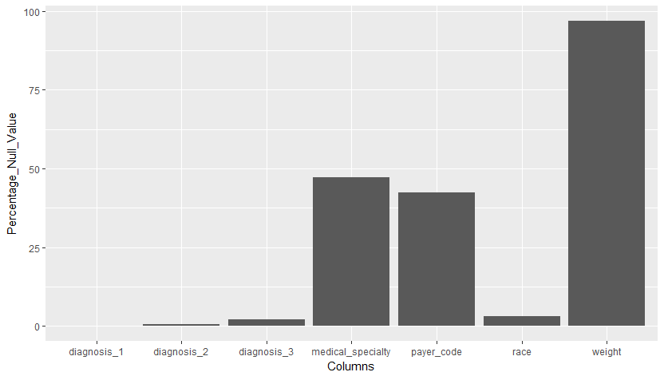
NA values Distribution in the dataset

Slide 7
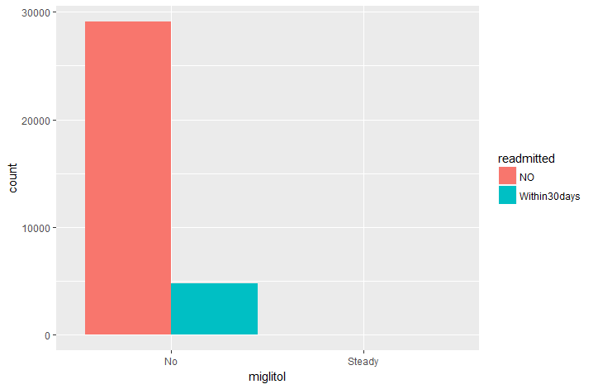
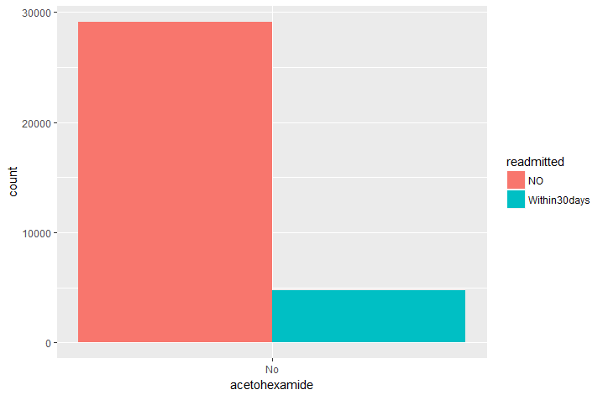
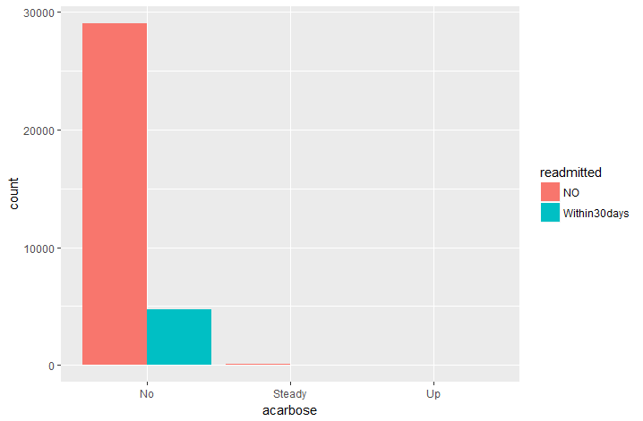
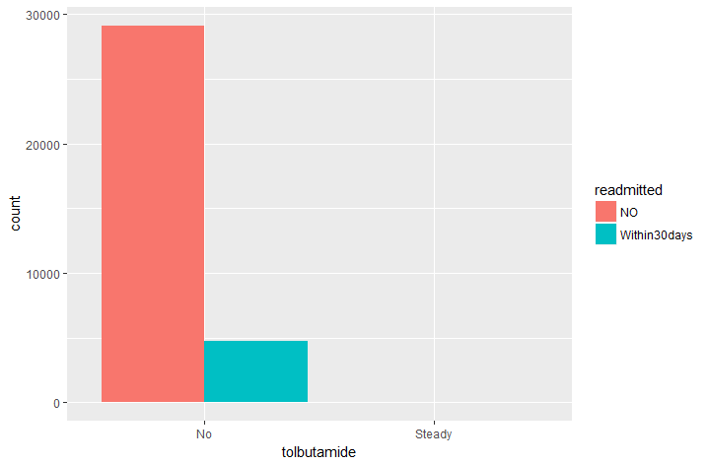

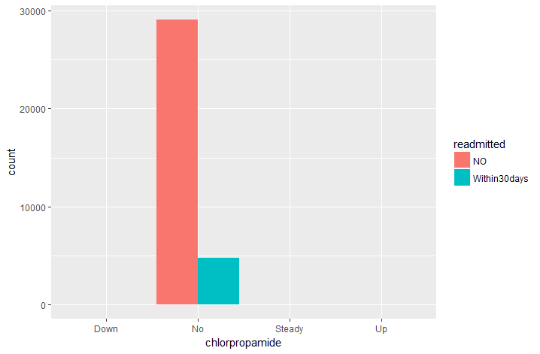
Drugs vs readmitted distribution

Slide 8
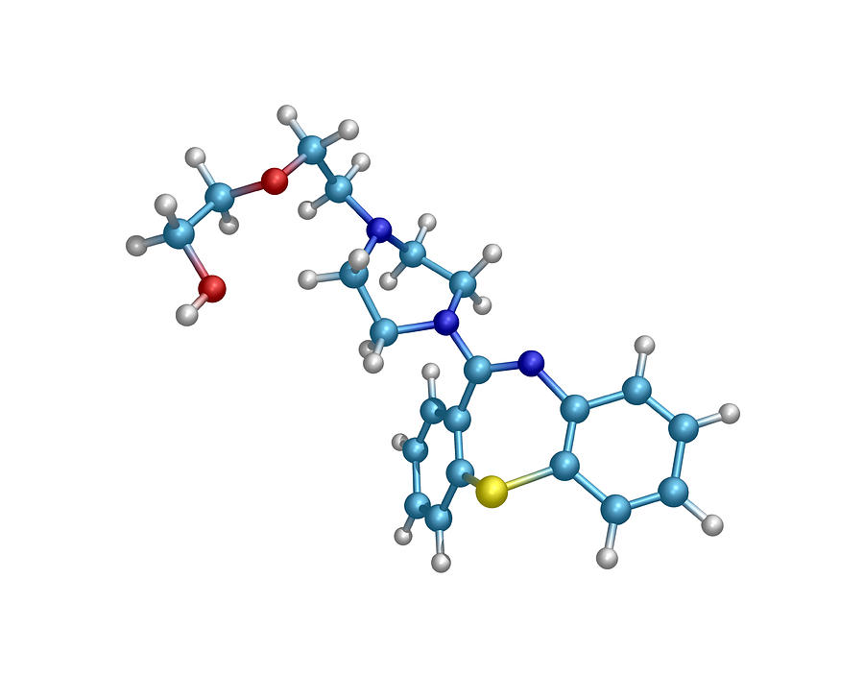
Feature Engineering
Chlorpropamide, Glimepiride, Acetohexamide, Glipizide, Glyburide, Tolbutamide, Tolazamide, Glyburide Metformin, Glipizide Metformin.
Metformin, Glyburide Metformin, Glipizide Metformin, Metformin Rosiglitazone, Metformin Pioglitazone.
Sulfonylureas
Biguanides
Pioglitazone, Rosiglitazone, Troglitazone, Metformin Rosiglitazone, Metformin Pioglitazone.
Repaglinide, Met glinide,
Acarbose, Miglitol,
Insulin
Meglitinides, Glucosides, Insulin
Thiazolidinediones

Slide 9
Feature engineering
No of days Stayed
Releveling Attributes
Discharge Date – Admission Date
ICD 9 Levels clubbing:
admission_source_id
26 levels to 12 levels
admission_type_id
8 levels to 2 levels
Age
Mean
discharge_disposition_id
29 levels to 14 discarding 4
A1Cresult and Ma Gluc serum
Clubbed into 3 levels
Diag 1, Diag 2, Diag 3 were more than 600 levels are combined to make 13 levels

Slide 10
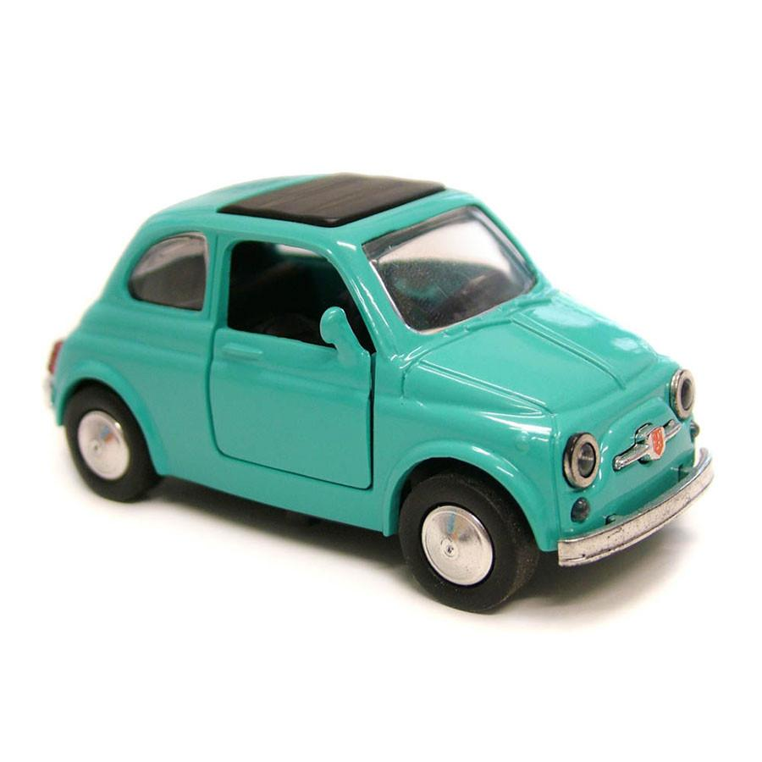
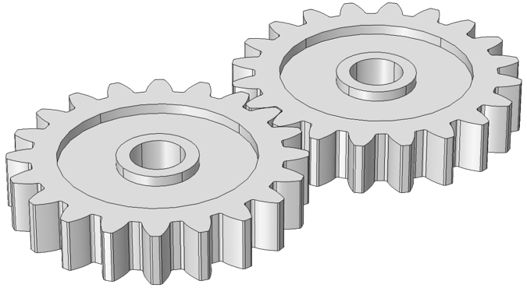
Demo graphs of the Final Data Frame
Feature engineered Data Frame With
33883 by 25 feature variables
Initial Data Frame with 34650 data points and 45 feature variables
Feature engineered Data Frame With
33883 by 38 feature variables
Transformation
Customer Centric | Business Centric | Customer Demo graphs
Race | Drugs | Gender, Age
Glucose, A1C | Procedures | Diagnosis Codes
Admission Type | Medications | Diabetes Med
 | No of Days Stayed
Dataset Summary:
Total Observations : 33883
Total variables : case1: 38 ; case 2: 25
Split : 70-30
Target Variable : Readmitted binary class
Evaluation Metric : Accuracy and ROC
Final Metric : Recall on seen data

Slide 11
Data Insights

Slide 12
Checking the class imbalance and NO of different type of attributes
Data balancing techniques were included to get the data balanced.
Various techniques are: Over, Under, Smote and Rose Smote.
Data types distribution.

Slide 13
Readmission Pattern with features
As age increases there is steep increase in the percentage of readmission and which will be driving factor to predict the readmission.
From the diagnosis graph it is shown that there is steep increase in the percentage of readmission as the number of diagnosis increases.

Slide 14
Readmission Pattern with features
As patients who are sent to another hospital, ICU, Rehabilitation and Psychiatric Centre then there is huge chance of readmission.

Slide 15
Readmission Pattern with features
As the number of days stayed increases there is a increase in readmission as this might lead to major health concerned patients.
Even the drug which is most of the time prescribed wad insulin and even other drugs year on year got decreased.

Slide 16
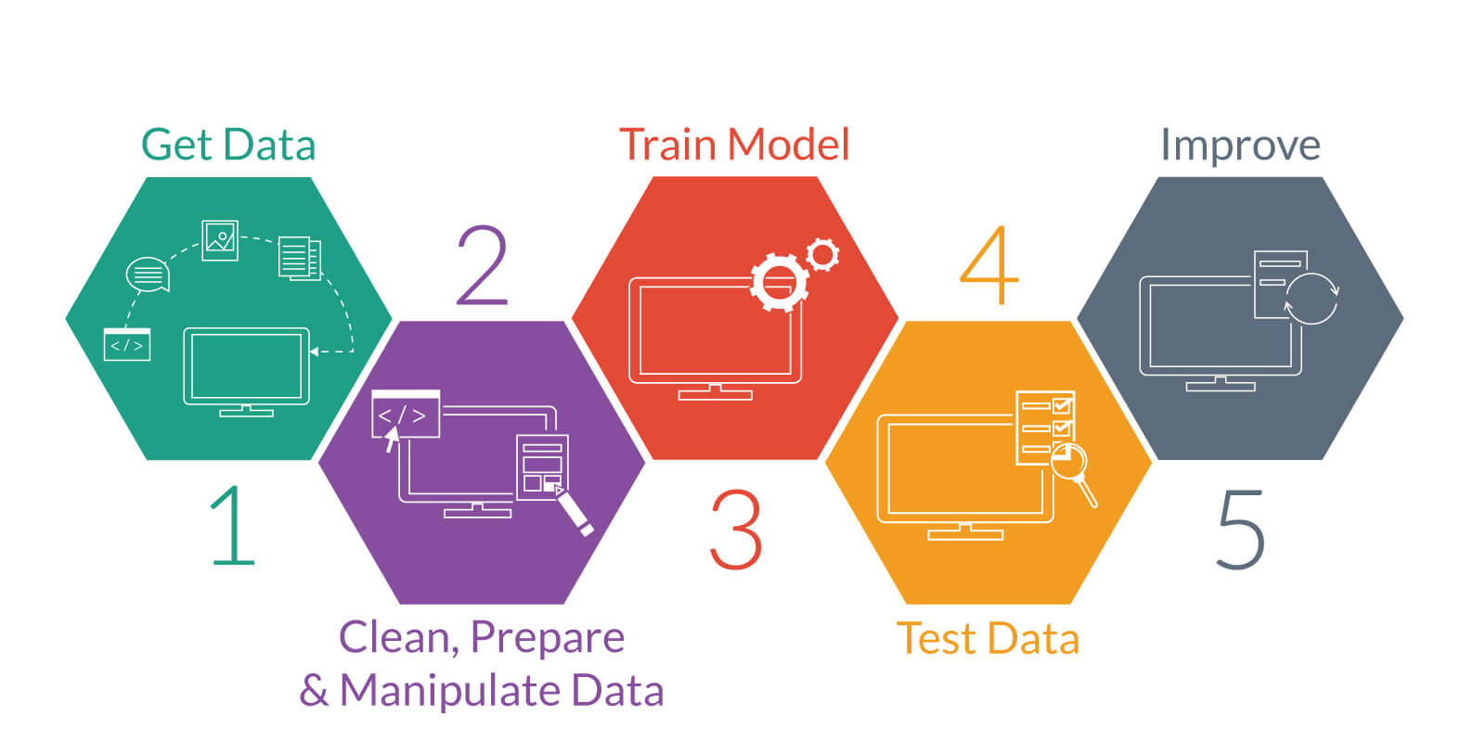
Model Building

Slide 17
Model Building approach 1 Base Line Classification of no and within 30 days
Patients Data Base
MODEL
Within30days
Output
NO
Removed variables with more than 30 levels
NO
Input
Predictions
Patients Data Base New
Input
NO
Within30days
New Data
NO
Target Labels

Slide 18
Model Building approach 2 Classification of no and within 30 days
MODEL
Patients Data Base
Within30days
Input
Output
NO
NO
Input
Predictions
NO
Within30days
New Data
NO
Target Labels

Slide 19
Case 1: Using all the variables and data sampling techniques
From this chart above its very clear that over sampling the minority class is working better and giving good consistent results when compared to the others.
Even the under sampling is giving good results but as of now we will not be considering that as it gives tremendous loss of information.

Slide 20
Case 1: Using all the variables and data sampling techniques
From the above charts it is clear that naïve Bayes is performing well on the dataset with all the variables.

Slide 21
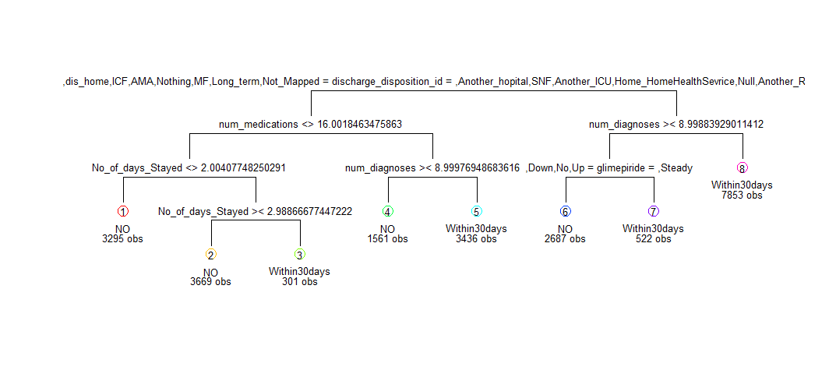
PATTERN EXTRACTION

Slide 22
Case 2: Using only feature variables and chi-square test
From this chart above its very clear that over sampling by using rose is working better and giving good consistent results when compared to the others.

Slide 23
Case 2: Using only feature variables and chi-square test
From the above graph it is clear the Logistic is giving better result the sensitivity in that data is very due to which this model will not be suitable to make as a base to predict the model.

Slide 24
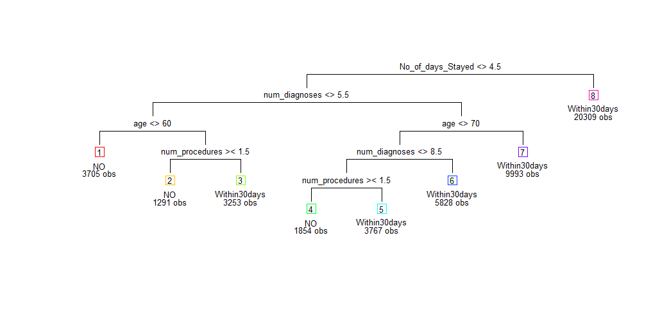
PATTERN EXTRACTION

Slide 25
Model Building approach 3 Sample Modelling technique (Ensemble)
Patients Data Base
Minority Class
New Data
M1 P1
Majority class
MODEL 2
MODEL 3
MODEL 1
M2 P2
Sample Majority class
M3 P3
Sample Majority class
Sample Majority class
Average Predicted

Slide 26
Ensemble model accuracy and roc
The Models was being designed by using the n sample out of the majority class and minority and making a n model.
As we are combing the week learners to make the strong learner to predict.
The Values which were predicted by the n models are been combined together and averaged out to get the final value.

Slide 27
Tools and Hyper parameters used in the model
Logistic Regression: Used the model by Cart and with Cross validation and no such hyper parameter used to tune it. Even the threshold was selected using the auc.
Naïve Bayes: Used the model by Cart and with Cross validation and no such hyper parameter used to tune it.
Decision Tree: Used the model by rpart and with Cross validation and hyper parameters which were tuned are Complexity parameter CP in order to avoid the overfitting of the model by proper pruning.
Ada Boost : Used the Baseline model in R and used the Cross Validation with Hyper parameter which where tuned are no of iterations and loss as logistic.
Ensemble: Used the model by Cart which is baseline were the hyper parameters are automatically tuned.
For visualisations Tableau, Excel, and R ggplot are been used.

Slide 28
FINAL MODEL COMAPRISON FROM THREE APPROACHES
Final Model:
Ensemble Nnet and Decision tree

Slide 29
SUMMARY
As there is strong urge for the interpretability then we will be going for decision tree as it gives more interpretability when compared to other models.
Even the Naïve Bayes is not being selected as it doesn’t capture the linear pattern in the data.
If Metric is important rather than interpretability then we will be going for the Neural net ensemble as it capture the non linear patterns and even the feature variables.
The Variables which are driving the decision the most are:
Number of days stayed
Number of Procedures
Number of medications
Number of Diagnosis
Age
Discharge Disposition ID

Slide 30
References
Ian H. Witten, Eibe Frank, Mark A. Hall, Data Mining: Practical Machine Learning Tools and Techniques, 3rd edition, Elsevier, 2011
http://topepo.github.io/caret/train-models-by-tag.html
https://www.analyticsvidhya.com/blog/2016/04/complete-tutorial-tree-based-modeling-scratch-in-python/
https://www.analyticsvidhya.com/blog/2017/09/naive-bayes-explained/
https://www.analyticsvidhya.com/blog/2015/11/beginners-guide-on-logistic-regression-in-r/
http://journals.plos.org/plosone/article?id=10.1371/journal.pone.0182900
Tamraparni Dasu and Theodore Johnson, Exploratory Data Mining and Data Quality, Wiley, 2004.
Wikipedia - https://en.wikipedia.org/wiki/AdaBoost
https://en.wikipedia.org/wiki/Receiver_operating_characteristic
http://www.rdatamining.com/examples/association-rules

Slide 31
Q&A

Slide 32
THANK You

