Slide 1

Case Study – Lending Club
Business Understanding :
You work for a consumer finance company which specialises in lending various types of loans to urban customers. When the company receives a loan application, the company has to make a decision for loan approval based on the applicant’s profile. Two types of risks are associated with the bank’s decision:
If the applicant is likely to repay the loan, then not approving the loan results in a loss of business to the company
If the applicant is not likely to repay the loan, i.e. he/she is likely to default, then approving the loan may lead to a financial loss for the company
The aim is to identify patterns which indicate if a person is likely to default, which may be used for taking actions such as denying the loan, reducing the amount of loan, lending (to risky applicants) at a higher interest rate, etc.
Submitted by –
Abhishek Paul

Slide 2
Data Understanding - Lending Club
Background:
To find out to whom bank can issue loans, depends on certain factors like
What is the income range of the individual?
What is the period of income (work experience) for the individual?
What is the rate of interest over which loans are being currently issued?
What is the duration or term of the loan taken?
Details about the past repayments.

Slide 3
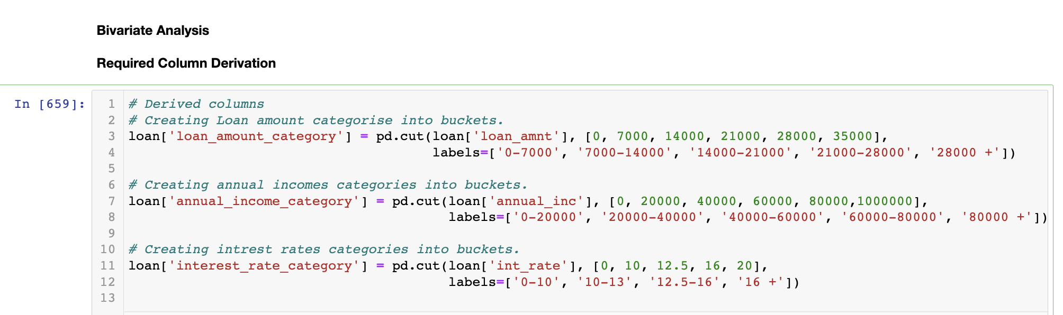
Data Cleaning and Manipulation - Lending Club
Actions Taken:
To find the result we go though a series of steps
Sourcing the data from CSV file
Cleaning the data like, removing certain special characters from those columns like ‘int_rate’ mentioned on the data dictionary
Dropping rows and columns which are empty like ‘il_util,all_util,ing_fi’ are some of the columns of such nature as mentioned in the data dictionary.
Dropping those columns which only have a single value across all its rows. Columns like ‘initial_list_status, policy_code, application_type’ are some of the columns of such nature as mentioned in the data dictionary
Standardizing columns like ‘loan_amnt, funded_amnt, installment, annual_inc’ are some among the others of such nature as mentioned in the data dictionary. Casting these quantitative variable to numerical types which would be used in Univariate and Bivariate Analysis.
Deriving columns like ‘loan_amount_category, annual_income_category and interest_rate_category’ which would be further utilized during Bivariate Analysis.

Slide 4
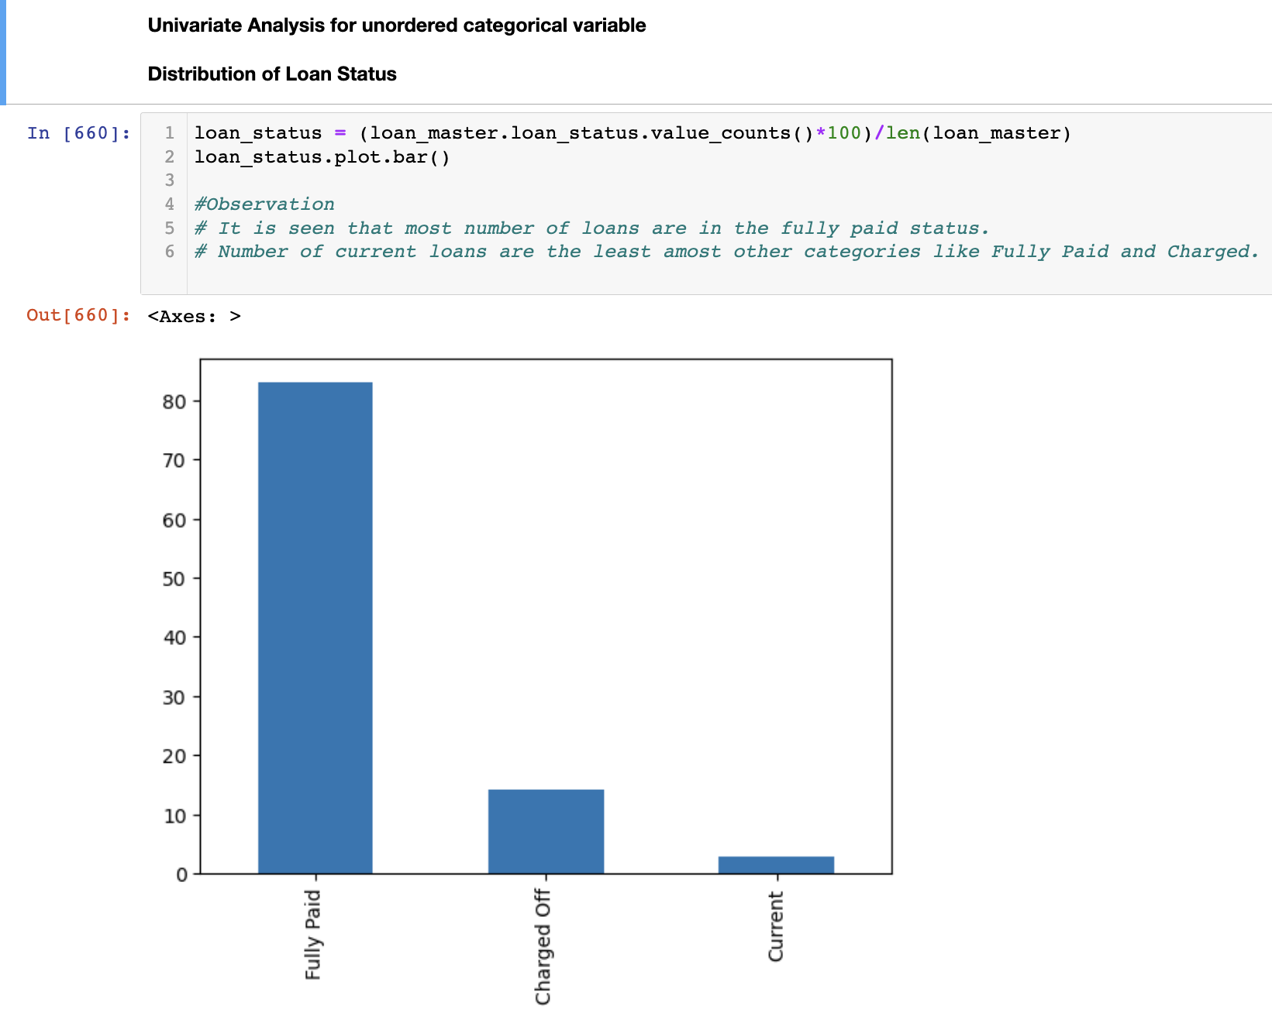
Data Analysis - Lending Club - Univariate Analysis
Univariate Analysis –
(Unordered Categorical Variable)
Distribution of Loan Status
Observation -
It is seen that most number of loans are in the fully paid status.
Number of current loans are the least amost other categories like Fully Paid and Charged.

Slide 5
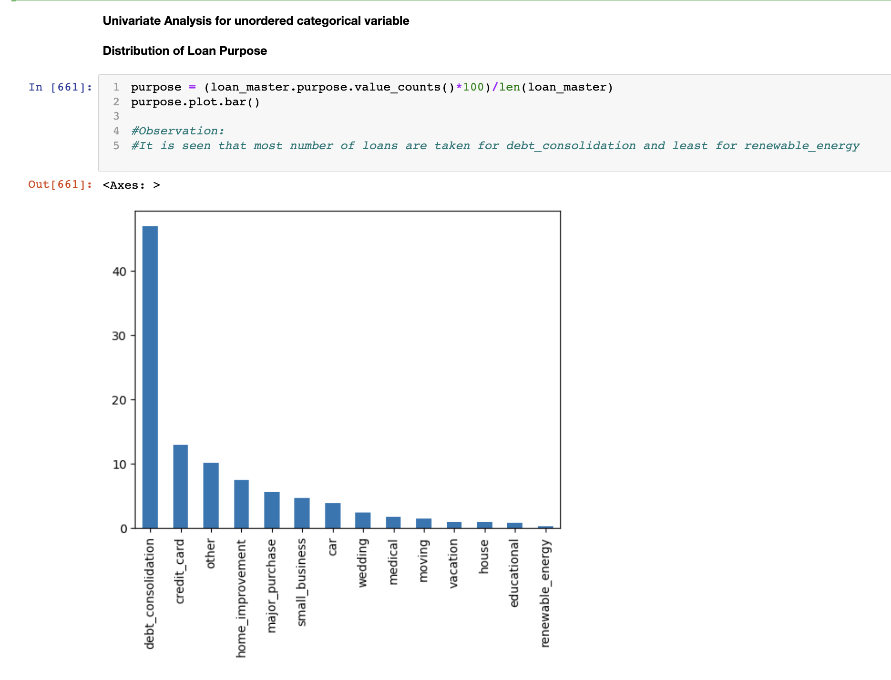
Data Analysis - Lending Club - Univariate Analysis
Univariate Analysis –
(Unordered Categorical Variable)
Distribution of Loan Purpose
Observation -
It is seen that most number of loans are are taken for debt_consolidation and least for renewable_energy

Slide 6
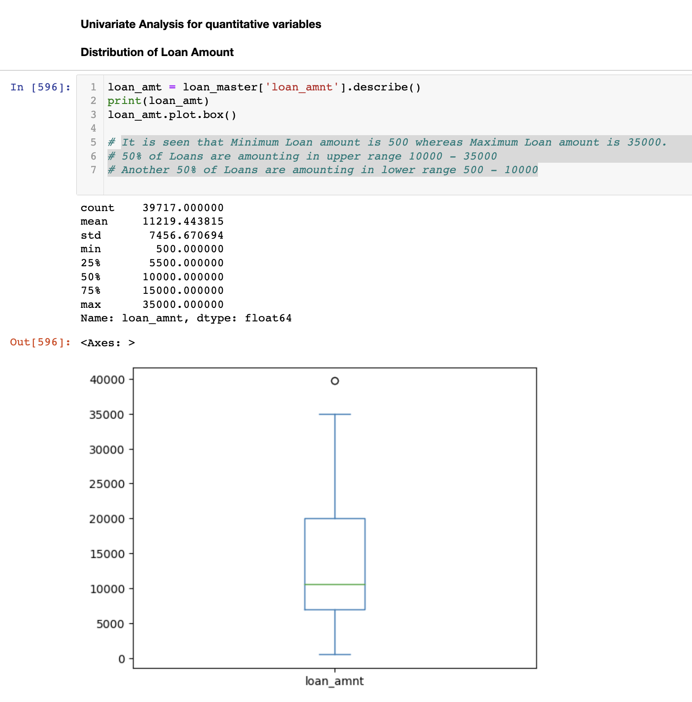
Data Analysis - Lending Club - Univariate Analysis
Univariate Analysis –
(Quantitative Variables)
Distribution of Loan Amount
Observation -
It is seen that Minimum Loan amount is 500 whereas Maximum Loan amount is 35000.
50% of Loans are amounting in upper range 10000 - 35000
Another 50% of Loans are amounting in lower range 500 - 10000

Slide 7
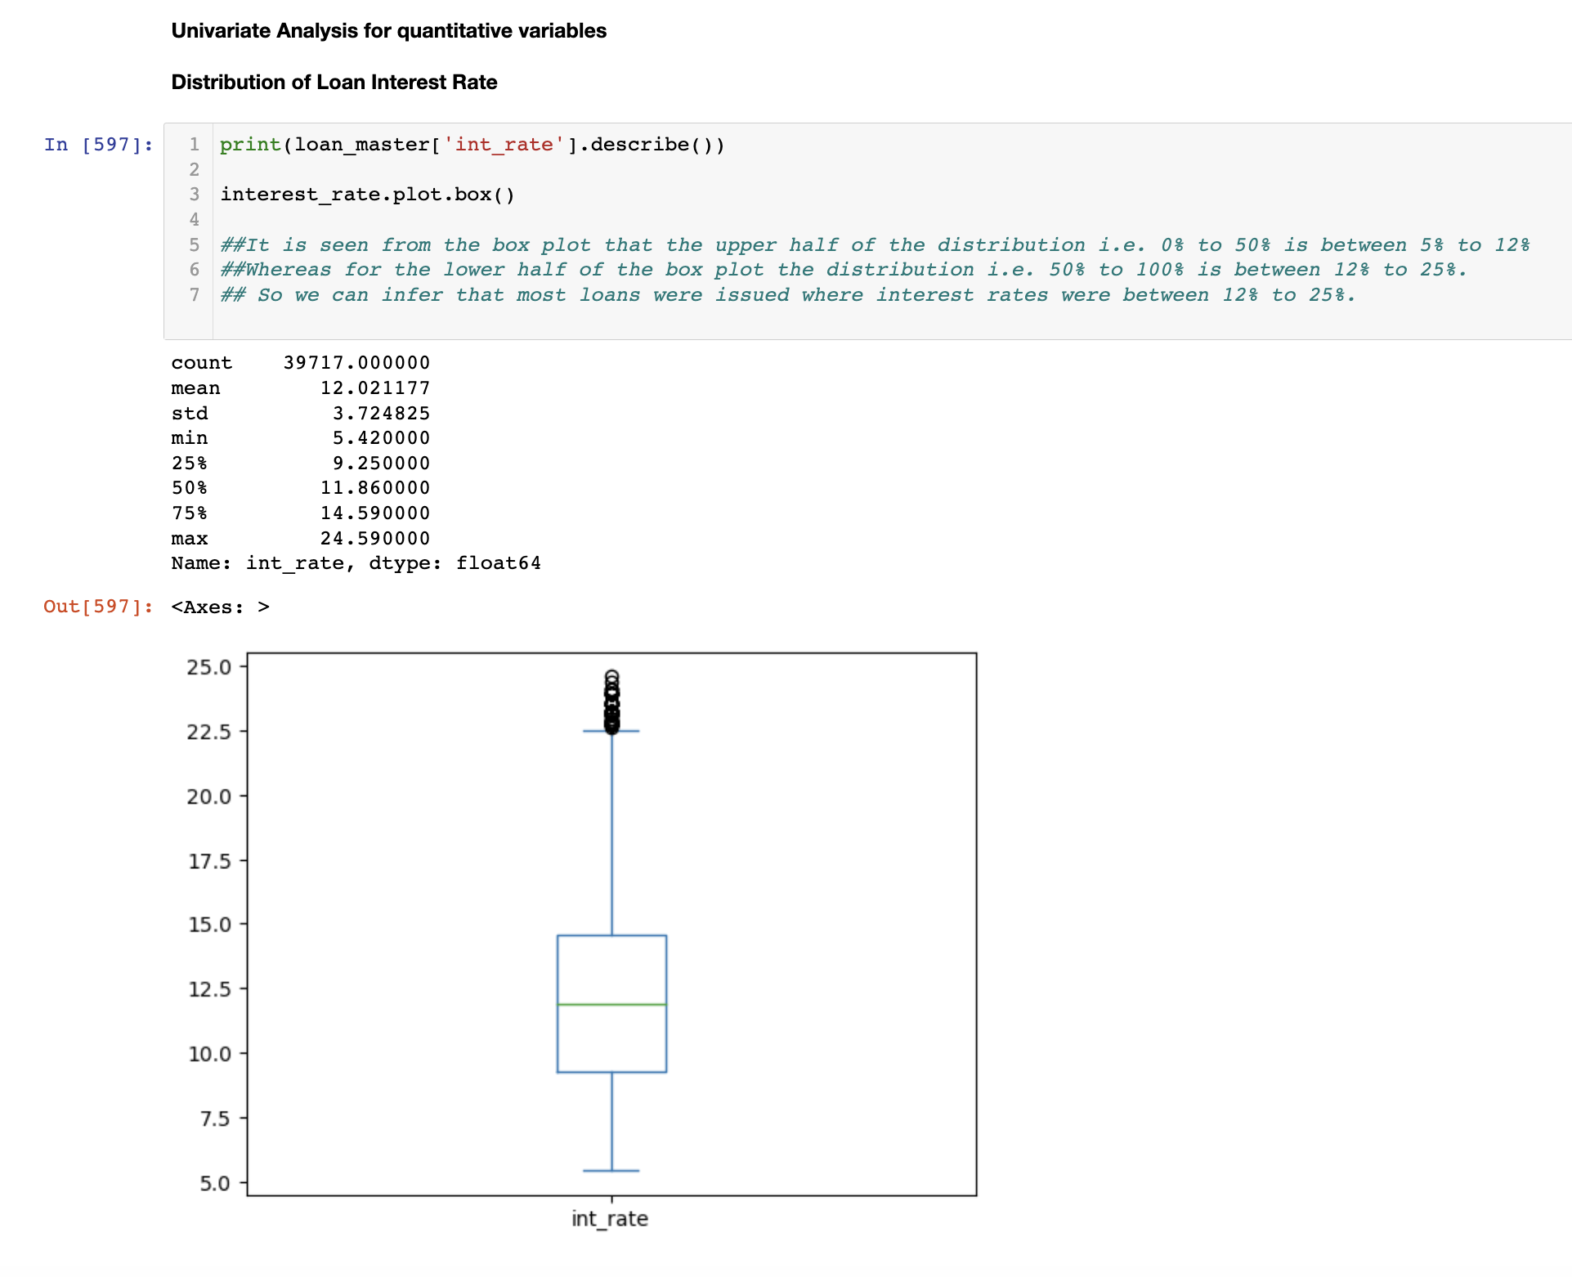
Data Analysis - Lending Club - Univariate Analysis
Univariate Analysis –
(Quantitative Variables)
Distribution of Loan Interest Rate
Observation -
It is seen from the box plot that the upper half of the distribution i.e. 0% to 50% is between 5% to 12%
Whereas for the lower half of the box plot the distribution i.e. 50% to 100% is between 12% to 25%.
So we can infer that most loans were issued where interest rates were between 12% to 25%.

Slide 8
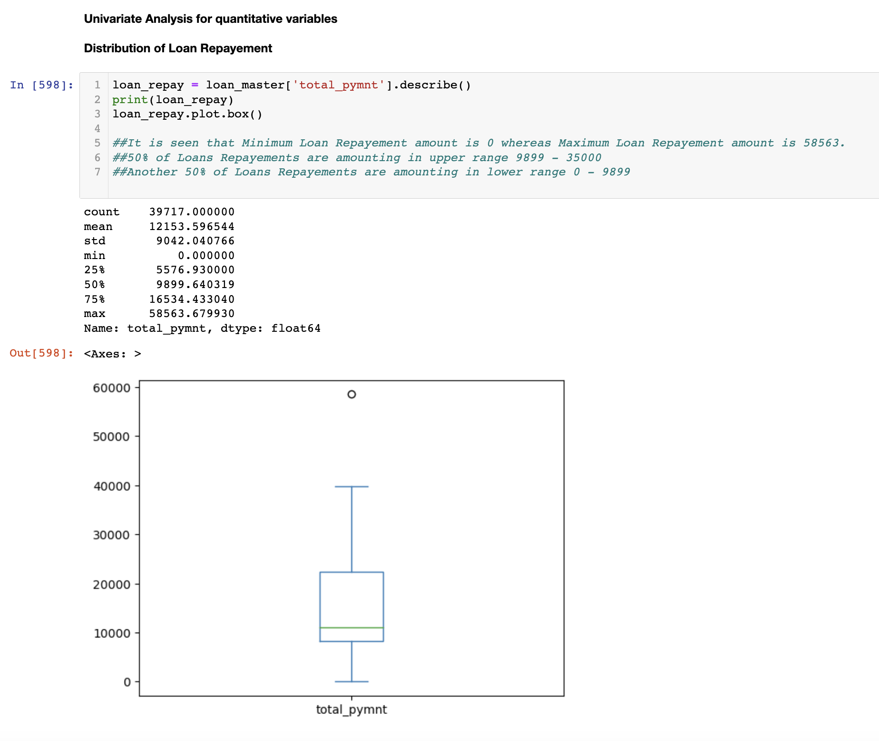
Data Analysis - Lending Club - Univariate Analysis
Univariate Analysis –
(Quantitative Variables)
Distribution of Loan Repayment
Observation -
It is seen that Minimum Loan Repayement amount is 0 whereas Maximum Loan Repayement amount is 58563.
50% of Loans Repayements are amounting in upper range 9899 - 35000
Another 50% of Loans Repayements are amounting in lower range 0 - 9899

Slide 9
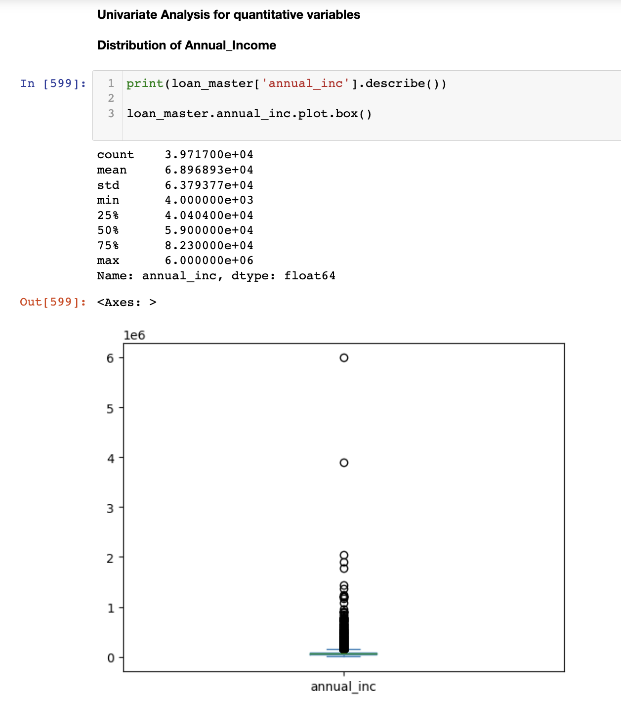
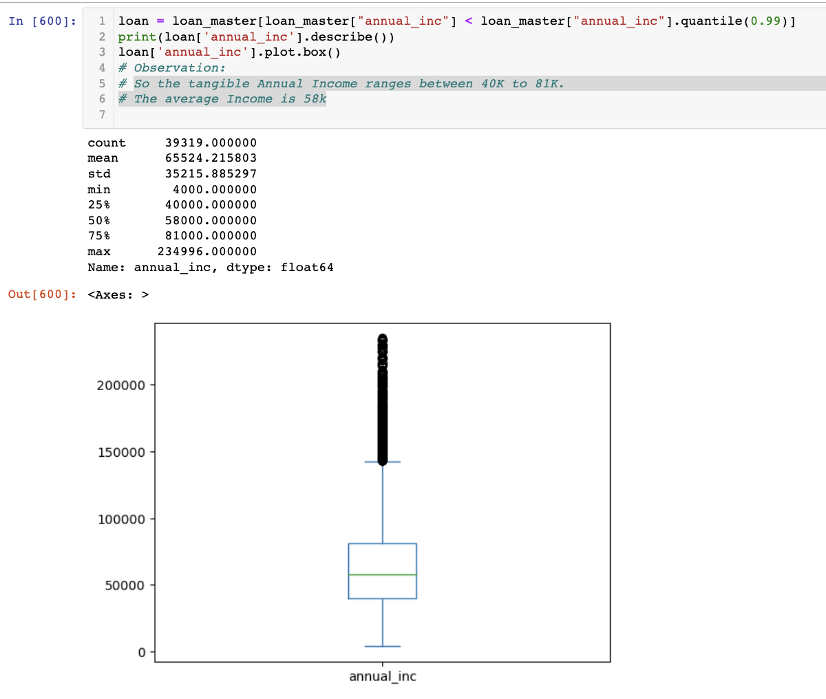
Data Analysis - Lending Club - Univariate Analysis
Univariate Analysis –
(Quantitative Variables)
Distribution of Annual Income
After Outlier treatment
Observation –
So the tangible Annual Income ranges between 40000 to 81000.
The average Income is 58000.

Slide 10
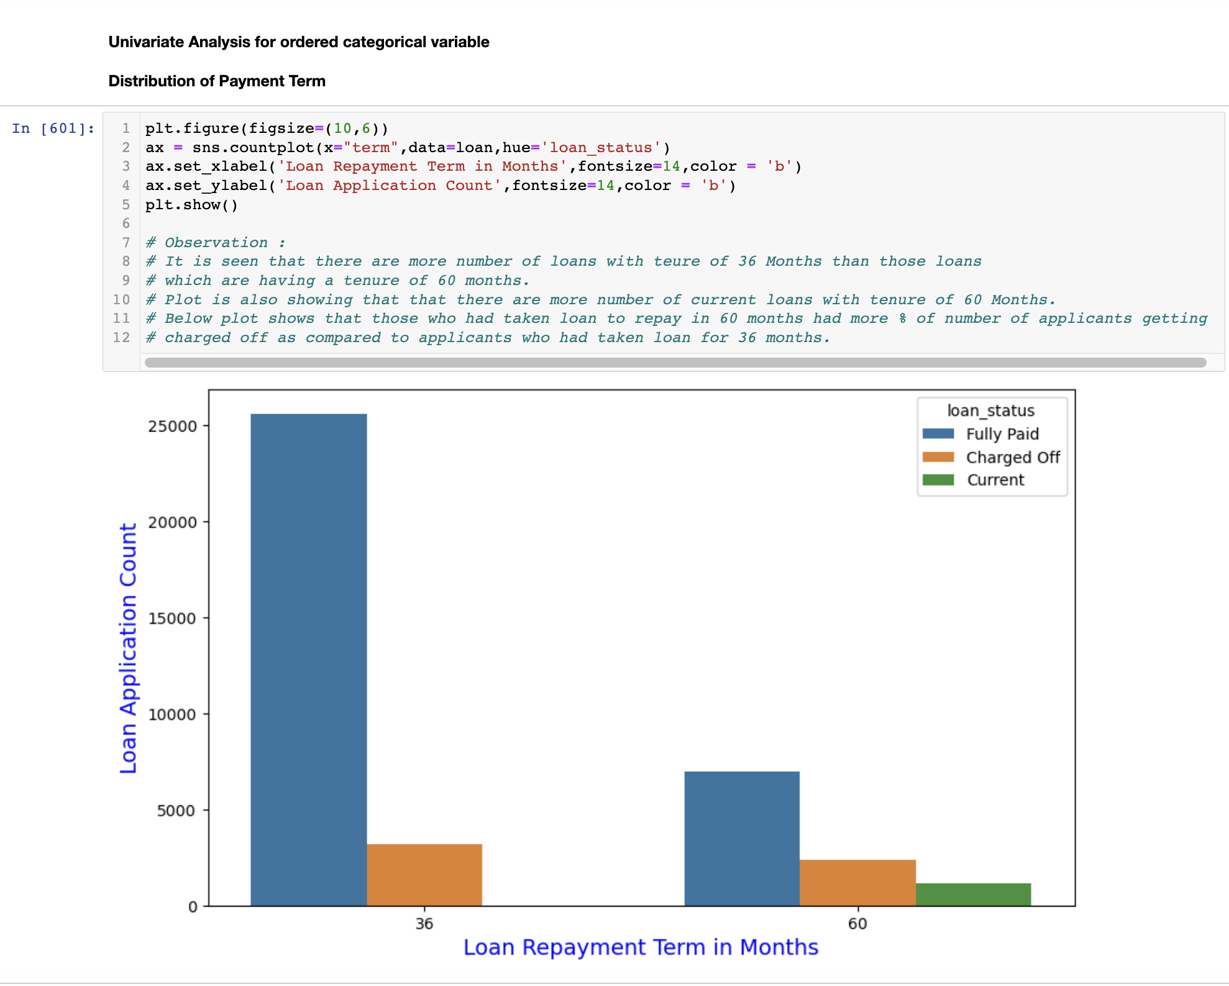
Data Analysis - Lending Club - Univariate Analysis
Univariate Analysis –
(Ordered Categorical Variables)
Distribution of Payement Term
Observation -
It is seen that there are more number of loans with teure of 36 Months than those loans
which are having a tenure of 60 months.
Plot is also showing that that there are more number of current loans with tenure of 60 Months.
Below plot shows that those who had taken loan to repay in 60 months had more % of number of applicants getting
charged off as compared to applicants who had taken loan for 36 months.

Slide 11
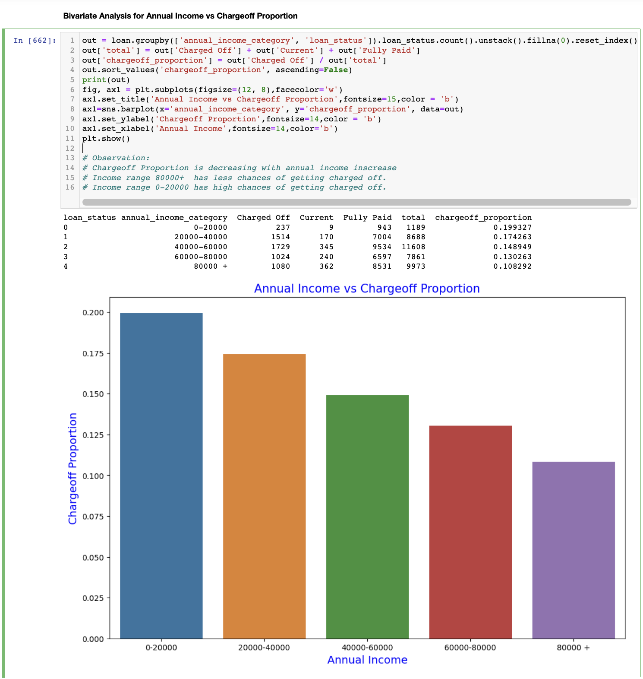
Data Analysis - Lending Club - Bivariate Analysis
Bivariate Analysis –
Annual Income vs Chargeoff Proportion
Observation -
Chargeoff Proportion is decreasing with annual income inscrease
Income range 80000+ has less chances of getting charged off.
Income range 0-20000 has high chances of getting charged off.

Slide 12
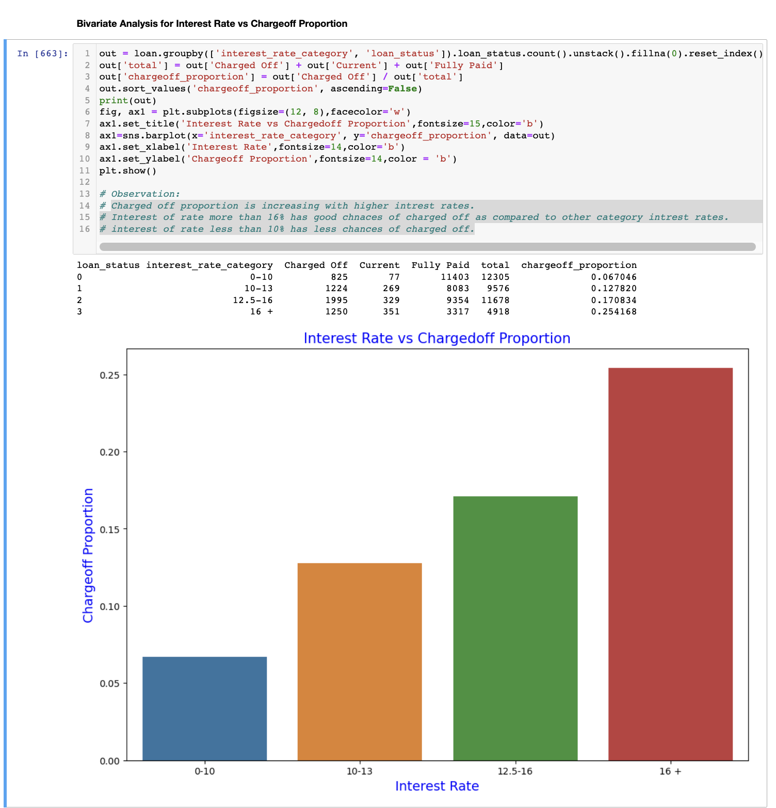
Data Analysis - Lending Club - Bivariate Analysis
Bivariate Analysis –
Interest Rate vs Chargeoff Proportion
Observation -
Charged off proportion is increasing with higher intrest rates.
Interest of rate more than 16% has good chnaces of charged off as compared to other category intrest rates.
interest of rate less than 10% has less chances of charged off.

Slide 13
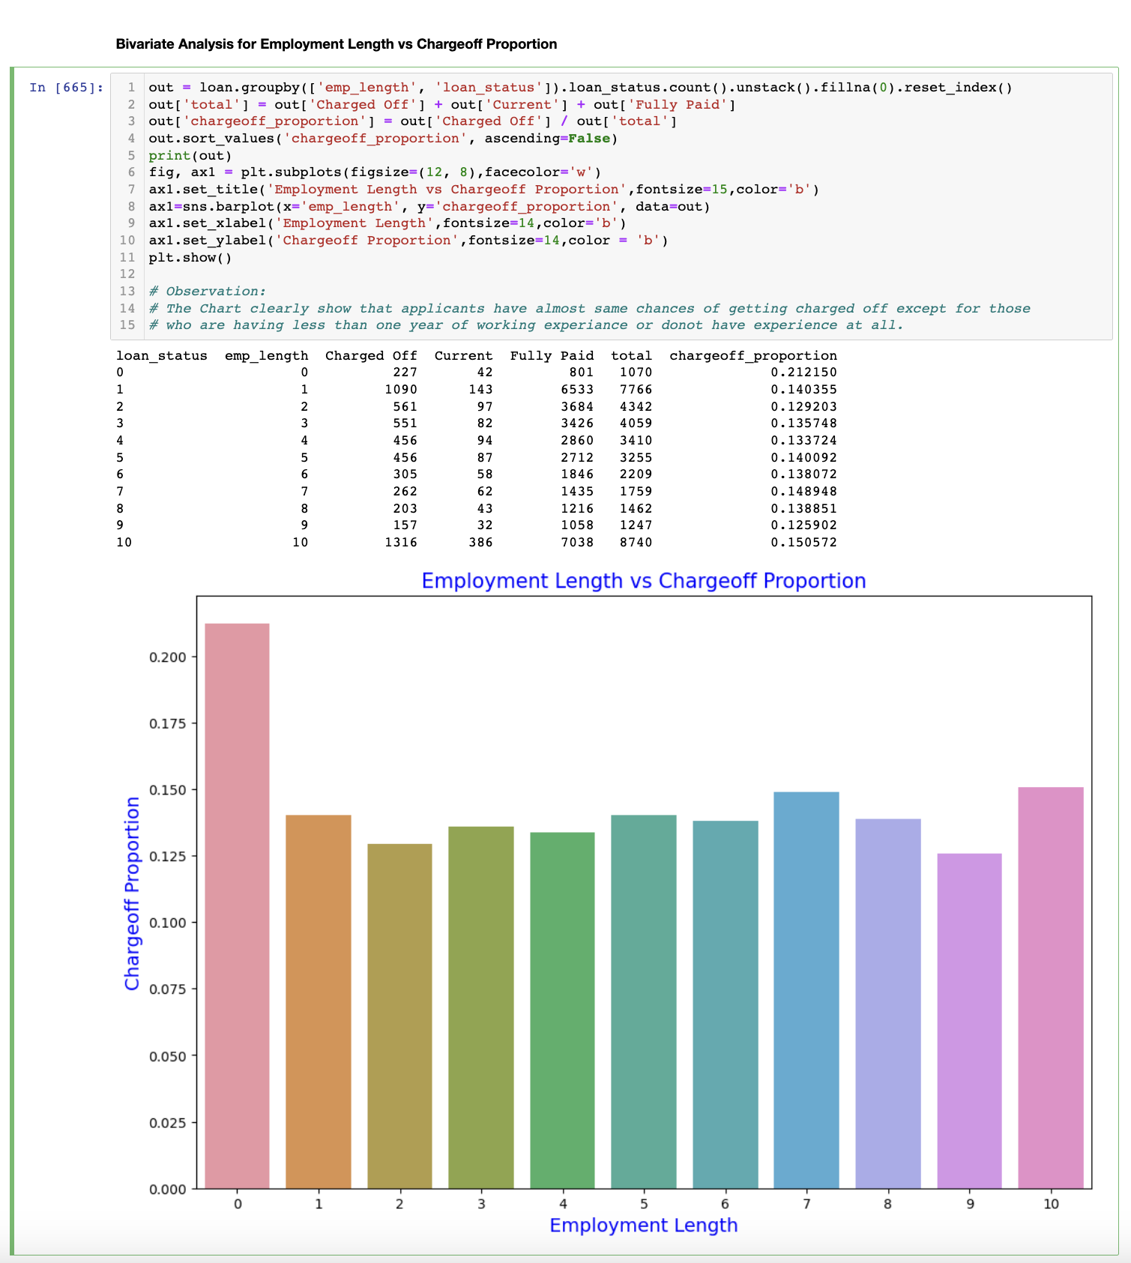
Data Analysis - Lending Club - Bivariate Analysis
Bivariate Analysis –
Employment Length vs Chargeoff Proportion
Observation -
The Chart clearly show that applicants have almost same chances of getting charged off except for those
who are having less than one year of working experience or don't have experience at all.

Slide 14
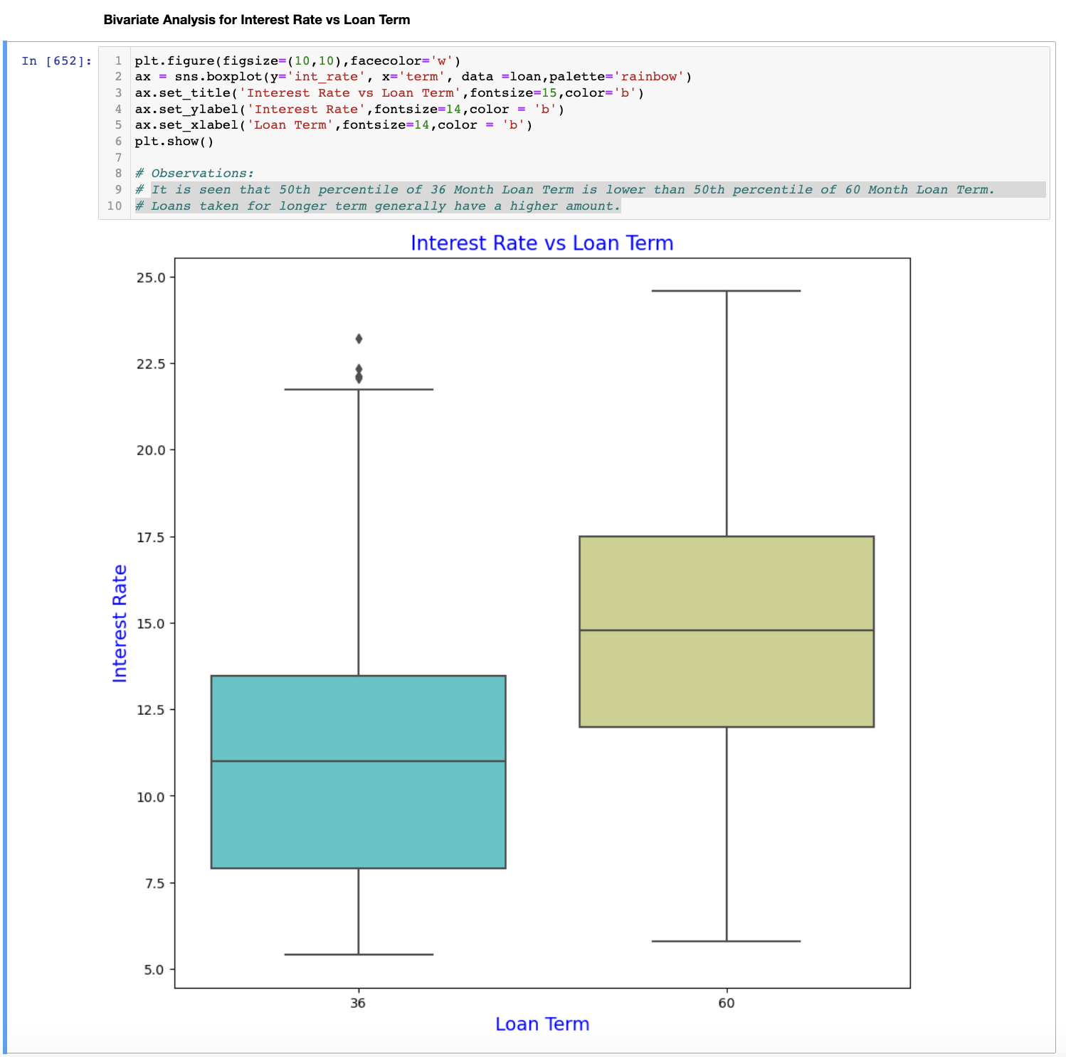
Data Analysis - Lending Club - Bivariate Analysis
Bivariate Analysis –
Interest Rate vs Loan Term
Observation -
It is seen that 50th percentile of 36 Month Loan Term is lower than 50th percentile of 60 Month Loan Term.
Loans taken for longer term generally have a higher amount.

Slide 15
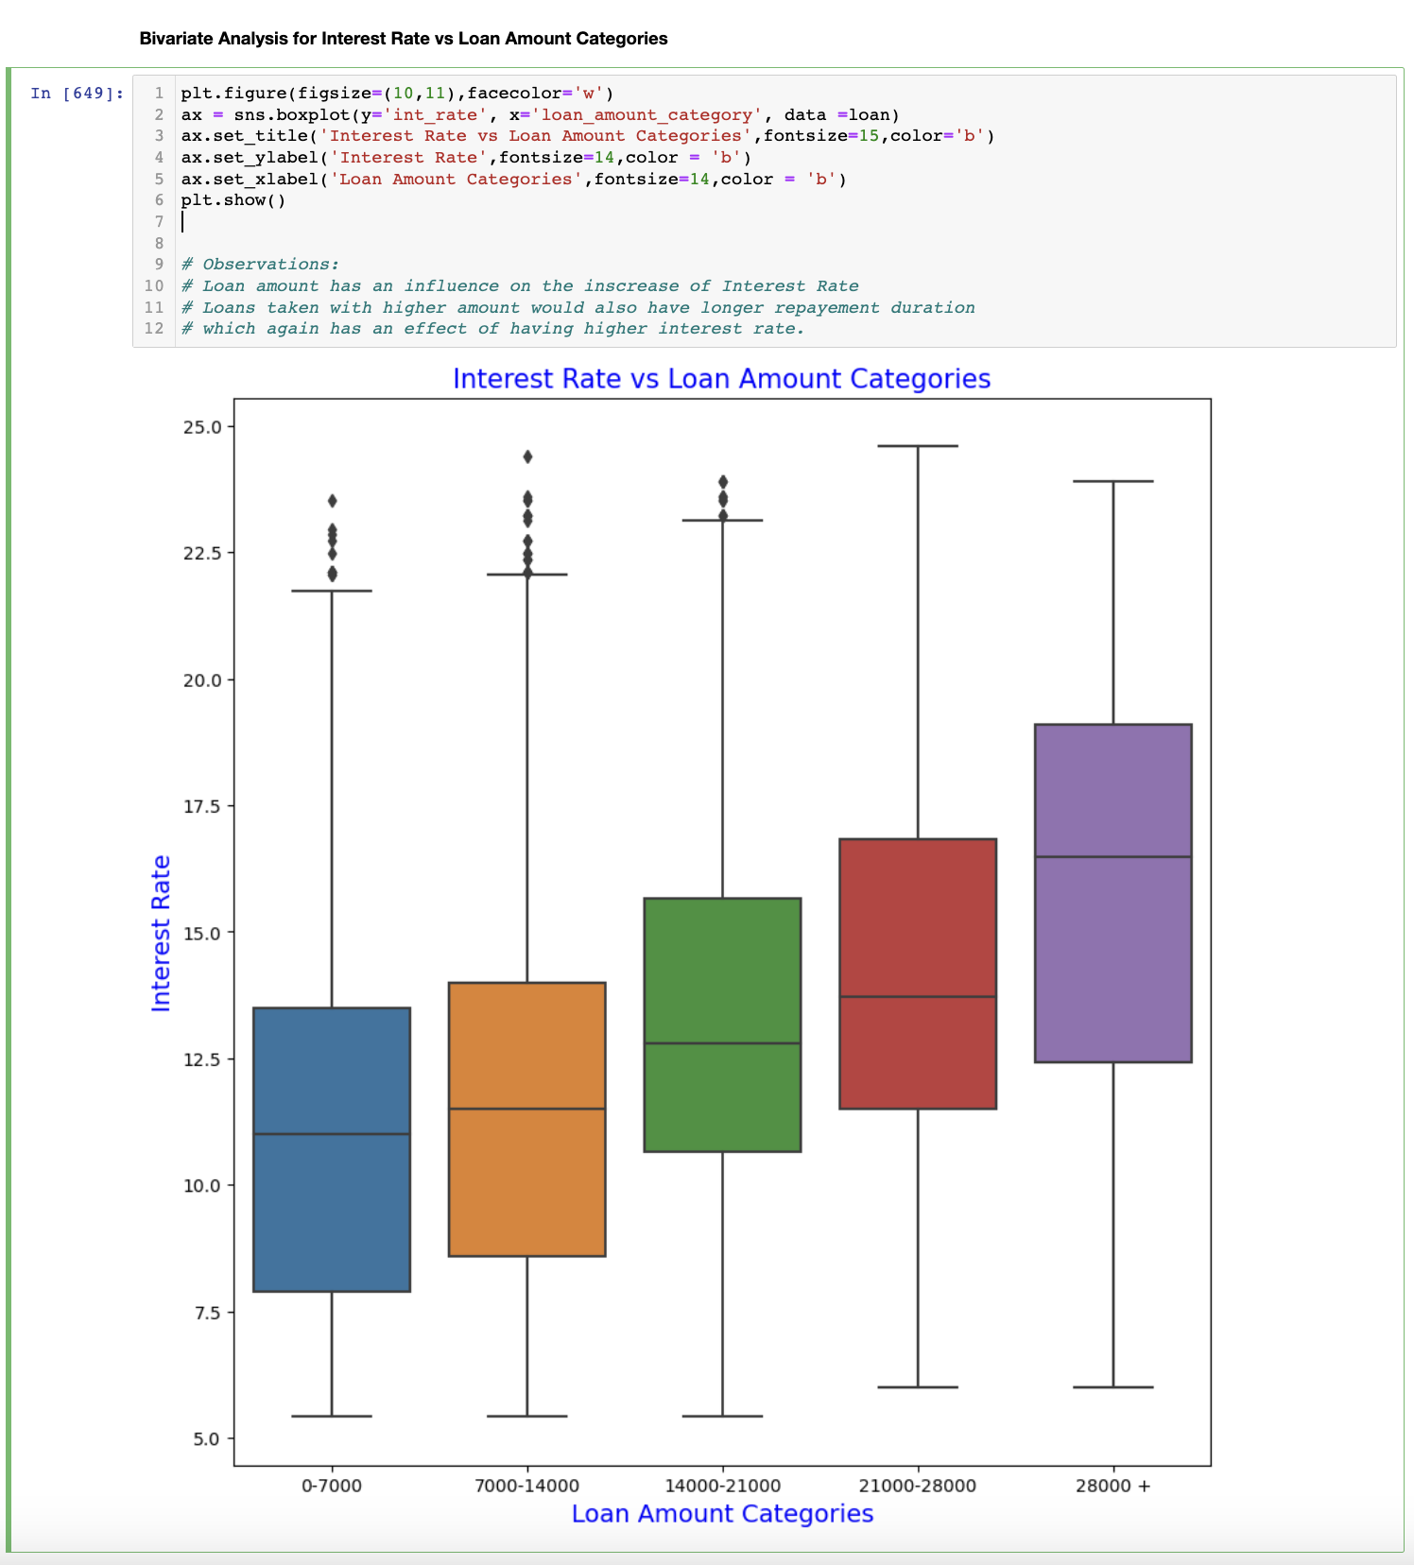
Data Analysis - Lending Club - Bivariate Analysis
Bivariate Analysis –
Interest Rate vs Loan Amount Categories
Observation -
Loan amount has an influence on the increase of Interest Rate
Loans taken with higher amount would also have longer repayment duration
which again has an effect of having higher interest rate.

Slide 16
Data Analysis - Lending Club - Conclusion
From the analysis we can conclude on the following –
The consumer finance company can lend amounts to borrowers who have a a higher income range
Amount can be lend to borrowers who have work experience more than 1 year.
Loan amounting to lower range can be lend to borrowers as they have higher chance of getting paid off.
Borrowers with lower loan term like 36 months can be considered more for lending amounts.
Borrowers who are given loans on lower interest rates have the least chances of getting charged off which is good for the finance company

Slide 17
Case Study – Lending Club
Thank You

