Slide 1

Our Founders
Dhalam AI
Anusha Jain
Co-founder · Systems Architect & Android Lead
AI Engineer, IBM | RVCE B.E. '24
Google Cloud GenAI Exchange Finalist
linkedin.com/in/anusha-jain-377773216
Real-Time Coercion &
Sideloading Defense
for Digital India
Abhyudaya Marya
Co-founder · Product Strategy & Business Architecture
Asst. Manager, Genpact | ex-Accenture
MBA BITS Pilani | B.E. VIT
When fear is weaponized, every second counts.
linkedin.com/in/abhyudaya-m-6209b51b3
AI-Powered Startup Innovation · Team: Ladydebuggers
Google DeepMind · Google Cloud · Hack2skill · NASSCOM · Headstart
Startup Buildathon India 2026 · Submission Deadline: 13 November 2026

Slide 2
Team Profile & The Human Cost of Digital Fraud
2
Who we are · Who we serve · Why this cannot wait
₹1,750 Cr+
350M+
1930
0 tools
Stolen from Indian
citizens Jan–Apr 2024
(MHA / I4C)
Active UPI users
vulnerable to
digital payment fraud
National cybercrime
helpline — many victims
don't know it exists
Existing apps that
combine AI scam triage
with live device telemetry
Who Is Building This — And Why
Anusha Jain — AI Engineer, IBM
Abhyudaya Marya — Asst. Manager, Genpact
Systems Architect & Native Android Lead
Product Strategy & Business Architecture Lead
Built Dhalam's native Android client in Jetpack Compose with live OS telemetry (AccessibilityManager, WorkManager, WindowManager capture detection). AI Engineer at IBM in the Client Engineering & AI Portfolio. RVCE B.E. '24, Google Cloud Gen AI Exchange Hackathon Finalist, IISc research internship. Has seen digital extortion target non-technical family members — and built a tool to fight back.
Architected Dhalam's B2B2C commercial model and regulatory grounding. Manages ₹4,000 Cr+ enterprise portfolio at Genpact; ex-Accenture supply chain architect. MBA BITS Pilani, B.E. VIT. Curated official RBI and I4C advisory corpus that grounds Dhalam's AI advice. Believes fraud prevention must be accessible to every Indian citizen, not just the technically literate.
Dhalam AI · Startup Buildathon India 2026 · Team: Ladydebuggers
Protecting vulnerable citizens through responsible AI

Slide 3
The Problem: Silence & Fear Are the Weapon
3
India's fastest-growing cybercrime is not a virus — it is psychological coercion
"A caller posing as a CBI officer told me I would be arrested in 20 minutes unless I sent money immediately. I was terrified. I didn't know who to call." — Victim, Bangalore, 2024
Digital Arrest Scams
Remote-Access Hijacking
Fraudsters impersonate CBI, Police, or Customs officers over WhatsApp video. They show forged arrest warrants and demand 'court verification transfers.' In Oct 2024, the Prime Minister of India issued a nationwide Mann Ki Baat warning: no government agency arrests citizens over video call. Yet it continues.
Under the guise of telecom disconnection or KYC renewal urgency, fraudsters instruct victims to install AnyDesk or TeamViewer — both legitimate, trusted apps. Within minutes of gaining screen access, they observe MPINs, OTPs, and drain bank accounts in real time.
→ India lost ₹1,750 Cr+ to such scams in just four months.
→ Antivirus gives AnyDesk a clean bill. It cannot detect human fear.
The AI Context Gap
Panic-Induced Paralysis
Generic chatbots evaluate a screenshot of a fake arrest warrant in complete isolation. They cannot see: Is AnyDesk running right now? Is screen recording active? Is an Accessibility Service reading every keystroke?
Without live OS context, an AI assessment is fatally incomplete.
A terrified mother cannot navigate Android Settings while a fake officer shouts. A first-time digital banking user cannot read a technical permission warning.
The person most at risk of losing their life savings is the least equipped to protect themselves with today's tools.
→ AI + telemetry together is the only answer.
→ Dhalam exists because dignity and calm guidance matter.
Dhalam AI · Startup Buildathon India 2026 · Team: Ladydebuggers
Protecting vulnerable citizens through responsible AI

Slide 4
Our Solution: A Calm, Grounded Second Opinion
4
Dhalam AI — Closed-Loop Coercion & Device Defense Platform
Central Insight: Fear is the attack vector. Dhalam breaks the cycle — combining Gemini's multimodal reasoning with live Android OS telemetry, so no citizen needs to face a scam alone.
Instant Threat Analysis
(Gemini on Vertex AI)
✓ LIVE
Live Device Telemetry
(Android OS Integration)
✓ LIVE
A frightened user submits a suspicious screenshot, SMS, or forwarded message. Gemini 3.8 Flash reads the coercive language, urgency markers, impersonation signals, and demanded actions — returning a plain-language verdict: STOP, PAUSE, or LIKELY SAFE. Never a vague 'could be risky.'
Dhalam checks in real time whether the scam has already reached the device: Is AnyDesk or any remote-access tool actively enabled as an Accessibility Service? Is screen recording currently active? The AI assessment is cross-referenced with this physical device state — not evaluated in a vacuum.
→ Verdict in under 2 seconds · RBI guidance cited when relevant
→ No other consumer app does this.
RBI-Grounded Advice
(sqlite-vec + gemini-embedding-001)
✓ LIVE
One-Tap Protection
(Closed-Loop Remediation)
✓ LIVE
Every piece of advice is anchored to official RBI fraud circulars — not hallucinated warnings. A vector search retrieves the most relevant RBI advisory, and a strict citation validator rejects any invented source ID. Users see the exact RBI circular title, date, and URL behind the guidance.
When a Digital Arrest or remote-access threat is confirmed, Dhalam surfaces an emergency action card with a single tap that opens the exact Android Settings screen to revoke the dangerous permission. Post-revocation, Dhalam re-scans to confirm the threat is neutralized — then generates a timestamped 1930 Incident Report ready to file with cybercrime.gov.in.
→ Zero hallucinated legal advice — by architecture, not by promise.
→ Calm, one-step rescue for panicked users.
6-Language Accessibility
(Noto Sans · Voice I/O)
✓ LIVE
WhatsApp Scam Triage Bot
(Meta Cloud API)
✓ LIVE
India's most vulnerable citizens are not always English speakers. Dhalam speaks Hindi, Marathi, Bengali, Tamil, Telugu, and English — with voice input (speak your question) and read-aloud output (hear the advice). Google Noto Sans renders every script without distortion.
For citizens who don't have the app installed, Dhalam's WhatsApp bot provides instant triage. Forward a suspicious message or photo to the bot with 'CHECK:' — receive a plain-language Gemini assessment and the 1930 helpline number, without installing anything.
→ 468 localized strings · Noto Sans typography · STT + TTS
→ Zero-install entry point · Same Gemini backend
Dhalam AI · Startup Buildathon India 2026 · Team: Ladydebuggers
Protecting vulnerable citizens through responsible AI

Slide 5
Technical Architecture
5
Three-layer defense: Android client → Google Cloud Run → Vertex AI
Android Client Layer · Kotlin / Jetpack Compose · com.dhalam.ap
• Google Credential Manager — one-tap Sign in with Google (zero password friction)
• AccessibilityManager capability scan — detects AnyDesk, TeamViewer, RustDesk by service flags
• Foreground Capture Monitor — WindowManager API 35 (Android 15) & Activity API 34 (Android 14)
• WorkManager Periodic Baseline Auditor — alerts on silent access escalation via ObjectBox
• Settings Deep-Link Controller — ACTION_ACCESSIBILITY_SETTINGS with post-revocation re-scan
• 6-Language UI (Noto Sans) · Voice STT dictation · TTS emergency read-aloud
Google Cloud Run · asia-south1 / Mumbai · dhalam-api (LIVE)
• FastAPI Gateway: 96 KB text / 5.7 MB image limits — protects against abuse
• Cryptographic Google ID Token verifier (google.oauth2.id_token.verify_oauth2_token)
• Sliding-window rate limiter: 10 req/min · 60 req/hr per verified user
• Pillow EXIF & GPS metadata stripper — user privacy before AI sees any image
• Pydantic ModelAssessment JSON schema — structured output, no hallucinated free-text verdicts
• Meta Cloud API WhatsApp webhook — CHECK: text & image triage bot (LIVE)
Google AI & Grounding Layer · Vertex AI · gemini-embedding-001
• Vertex AI Gemini 3.8 Flash — multimodal coercion triage with strict JSON schema decoding
• gemini-embedding-001 (768-dim) — semantic embeddings for in-process sqlite-vec retrieval
• 5 curated official RBI fraud circulars — digital arrest, KYC phishing, UPI fraud, remote-access
• attach_sources() citation validator — rejects any invented source ID (zero hallucination by design)
• Google Safe Browsing v4 API — real-time URL reputation (graceful degradation if unconfigured)
• Live endpoint: https://dhalam-api-xxpghctsqq-el.a.run.app · /health verified
Dhalam AI · Startup Buildathon India 2026 · Team: Ladydebuggers
Protecting vulnerable citizens through responsible AI

Slide 6
Google AI Tools & Developer Ecosystem
6
Dhalam is a showcase of Google's full-stack developer ecosystem
Google Technology
Role in Dhalam AI — Social Impact
Status
Vertex AI Gemini 3.8 Flash
Primary reasoning engine for multimodal coercion triage. Processes screenshots, SMS, and Hindi/English mixed documents. Strict JSON schema (ModelAssessment) prevents free-text hallucinations. ~$0.0008 per triage scan. roles/aiplatform.user IAM binding.
PRODUCTION
gemini-embedding-001
768-dimensional semantic embeddings powering in-process sqlite-vec retrieval of official RBI fraud circulars. Task types: RETRIEVAL_DOCUMENT (index-time) + RETRIEVAL_QUERY (request-time). Zero external DB cost.
PRODUCTION
Google Cloud Run (asia-south1 / Mumbai)
Serverless backend hosting in Google's Mumbai region — local Indian data residency. 512 MiB · 1 vCPU · concurrency 4 · zero-cost idle scaling. Live: dhalam-api-xxpghctsqq-el.a.run.app
PRODUCTION
Android Credential Manager
One-tap friction-free Sign in with Google via Google ID Token. Google's recommended modern Android identity architecture — replaces legacy GoogleSignInClient. Cryptographic token verified server-side.
PRODUCTION
Google Safe Browsing v4
Real-time URL threat classification against MALWARE + SOCIAL_ENGINEERING lists. Integrated as a gracefully-degrading reputation adapter — reports unconfigured state honestly, never fails silently.
PRODUCTION
Google Fonts — Noto Sans
Typographic fidelity across 6 Indic scripts: Hindi (हिंदी), Marathi (मराठी), Bengali (বাংলা), Tamil (தமிழ்), Telugu (తెలుగు), English. 468 localized UI strings. Bundled under OFL license.
PRODUCTION
Google AI Studio
Planned workspace for systematic prompt evaluation, failure-case analysis, and language-quality assessment across all 6 supported Indic languages before broader public deployment.
PLANNED
Google Agent Skills
Roadmap: package Dhalam's low-level device telemetry verification routines as Gemini tool-calling functions — enabling agentic fraud defense that autonomously monitors for coercion patterns.
ROADMAP
Dhalam AI · Startup Buildathon India 2026 · Team: Ladydebuggers
Protecting vulnerable citizens through responsible AI

Slide 7
Google AI Models
7
Gemini Multimodal Reasoning · Semantic Vector Embeddings · Privacy by Design
Model
Role for Citizens
Technical Integration
Why This Google Model
Gemini 3.8 Flash
(Vertex AI)
Reads the same message a fraudster sends — but explains the psychological manipulation tactics in plain language the user understands.
google-genai SDK · GenerateContentConfig(response_schema=ModelAssessment) · Strict JSON: severity enum, 35-word summary cap, ranked actions · ~$0.0008/scan
Superior multimodal reasoning on Indian official documents, stamps, regional text. Sub-second latency. Schema compliance prevents free-text harm claims.
gemini-embedding-001
(Google AI)
Anchors every piece of advice to an official RBI circular — so users receive verified guidance, not AI-fabricated warnings.
768-dim vectors · task_type=RETRIEVAL_DOCUMENT (index) + RETRIEVAL_QUERY (runtime) · sqlite-vec cosine ≤ 0.40 · attach_sources() rejects invented IDs
Multilingual semantic capture across English and Indic legal terminology. Zero external vector DB cost. Native genai SDK integration.
How We Protect the Most Vulnerable Users — Privacy & Safety Architecture
Consent Before Everything
Privacy Before AI Sees Your Image
Dhalam never uploads any content without an explicit user consent dialog. Every check requires a deliberate 'Send for analysis' tap. No background snooping.
Pillow strips all EXIF metadata, GPS coordinates, and device identifiers before any image reaches Vertex AI. Zero raw images persisted anywhere.
Hallucination-Proof Citations
Bounded, Honest Outputs
attach_sources() rejects any source_id Gemini returns that wasn't in the retrieved reference set for that exact request. Fabricated IDs → response discarded.
Pydantic ModelAssessment enforces concern_score (0–100), severity enum, 35-word summary cap, typed markers, and ranked actions. No free-form legal claims.
Dhalam AI · Startup Buildathon India 2026 · Team: Ladydebuggers
Protecting vulnerable citizens through responsible AI

Slide 8
Market Viability & Business Model
8
Protecting citizens is both a social imperative and a scalable B2B2C enterprise opportunity
TAM
SAM
SOM
(24 months)
₹3,600 Cr
($430M)
₹750 Cr
($90M)
₹45 Cr
($5.4M ARR)
800M+ smartphones · 350M+ UPI users · Cybercrime losses projected ₹15,000 Cr+ annually by 2026 (MHA/I4C)
150M digitally vulnerable users (seniors, Tier-2/3 city first-time digital banking) + 45+ scheduled commercial banks under RBI digital banking directions
3 Tier-1 banks (HDFC, ICICI, Axis) + 2 UPI apps + 4 digital NBFCs protecting 15–20M monthly active banking users
Commercial B2B2C Revenue Model — Aligning Profit with Protection
Primary · Embedded Banking
Telemetry SDK
Secondary · Transaction
Step-Up Verification
Acquisition Engine · Free
WhatsApp Scam Triage Bot
Economic buyers: CISOs & Heads of Digital Fraud at Indian banks/fintechs. Pre-transaction client-side device check before authorizing high-value transfers (>₹10,000). Flags active screen recording or accessibility hijacks → triggers step-up biometric auth. Prevents Authorized Push Payment (APP) fraud before funds leave the bank.
▶ $0.02 (₹1.65) per Monthly Active Protected User (MAU)
Per-high-value transaction micro-fee: ₹0.50 per step-up scan for transaction confirmation flows integrating the Dhalam SDK. Revenue tied directly to fraud-prevention outcomes — the bank pays only when Dhalam actively intervenes.
Zero-install entry point: forward any suspicious message to Dhalam's WhatsApp number with CHECK:. Bot replies with Gemini assessment and 1930 helpline. Free for citizens forever — drives brand awareness, trust, and enterprise discovery. Every consumer interaction is a potential enterprise lead.
~7 paise
$0.00
>85%
$0.00
Gemini Flash cost
per triage scan
sqlite-vec retrieval
(in-process, zero DB fees)
Gross margin at
$0.02/MAU/month
Cloud Run idle cost
(auto-scales to zero)
Dhalam AI · Startup Buildathon India 2026 · Team: Ladydebuggers
Protecting vulnerable citizens through responsible AI

Slide 9
Impact & Closing — Turning Fear into Clarity
9
Every Indian citizen deserves a calm, grounded second opinion when facing a scam
"Scammers weaponize fear and urgency to override human judgment. Dhalam returns agency to the citizen — with real AI, real device signals, and plain-language guidance in their own language."
Live Demo — Working Today
Production Infrastructure
User submits a fake CBI Digital Arrest notice → Gemini returns CRITICAL severity + RBI PR-58595 citation. Coercion Shield detects active screen recording. One tap revokes AnyDesk accessibility access via Android Settings deep-link. Post-scan confirms device secured. Timestamped 1930 Incident Report generated.
Google Cloud Run operational: dhalam-api-xxpghctsqq-el.a.run.app · Mumbai (asia-south1). Native Android APK running on API 36 emulator with Google Sign-In. Flutter Android/iOS clients built. WhatsApp triage bot: live with 2 approved testers.
Verified Test Coverage
Accessibility & Inclusion
47 backend test functions (61+ parametrized runs) · 49 native Android JVM unit tests · 30 Flutter test suites. Language switching, citation validation, evidence-binding, and consent gating verified.
English, Hindi (हिंदी), Marathi (मराठी), Bengali (বাংলা), Tamil (தமிழ்), Telugu (తెలుగు). 468 localized strings · Google Noto Sans typography. Voice STT input + TTS read-aloud — usable even when hands are shaking.
Next Milestones Toward Societal Impact
→ Physical-device demo: Coercion Shield detection + Bluetooth TV companion on two real phones
→ Structured user test: measure whether Dhalam guidance stops panic compliance & enables independent verification
→ Partner interview: one Tier-1 bank CISO or digital fraud team to validate SDK integration & compliance fit
→ City Buildathon (20–21 Nov 2026) → Grand Finale (2 Dec 2026, Google Bengaluru Campus)
Anusha Jain
Abhyudaya Marya
Live Backend
linkedin.com/in/anusha-jain-377773216
linkedin.com/in/abhyudaya-m-6209b51b3
dhalam-api-xxpghctsqq-el.a.run.app/health
Dhalam AI · Startup Buildathon India 2026 · Team: Ladydebuggers
Protecting vulnerable citizens through responsible AI

Slide 10
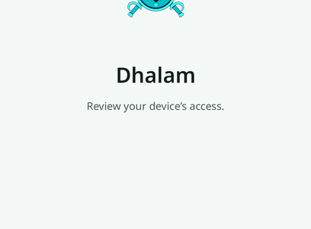
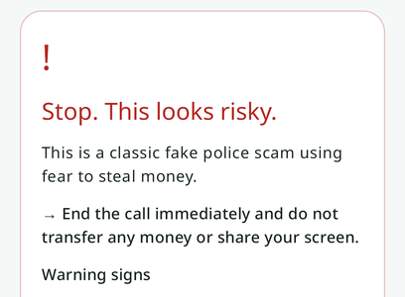
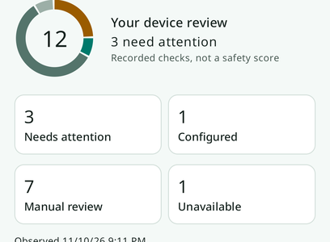
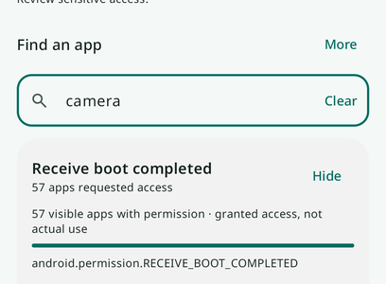
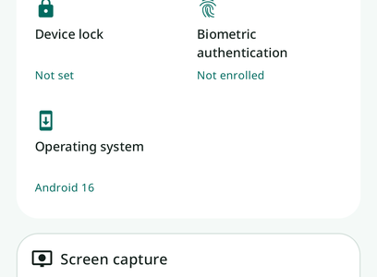
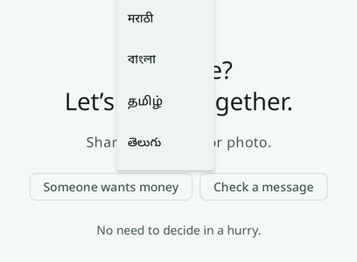
Dhalam In Action — Real Screenshots
10
Working app on Android API 36 emulator · WhatsApp bot live with approved testers
Sign-In Screen
Google OAuth + Biometrics
Scam Check Result
'Stop. This looks risky.'
Security Overview
Findings donut + category counts
Dhalam AI · Startup Buildathon India 2026 · Team: Ladydebuggers
Protecting vulnerable citizens through responsible AI
Device Access Review
Permission search with app labels
Device Snapshot
Capture monitor + biometric status
6-Language Support
All Indic scripts rendered via Noto Sans
📱 WhatsApp Triage Bot — LIVE
Forward any suspicious message with "CHECK:" to the Dhalam WhatsApp number. Gemini 3.8 Flash returns a plain-language verdict + 1930 helpline in seconds. No app install needed. Zero-install entry point for India's most vulnerable citizens.

