Slide 1


TEAM · DHALAM.AI
When fear is weaponized,
Your shield can’t wait.
Real-time AI scam triage + Device defense
Anusha Jain · Abhyudaya Marya | Team size: 2

Slide 2
Built by people who know both AI and the real world.
A two-founder team combining hands-on Android engineering with enterprise product strategy.
ENGINEERING + ANDROID
STRATEGY + COMMERCIAL
Anusha Jain
Abhyudaya Marya
Co-founder · Systems Architect & Tech Lead
Co-founder · Product Strategy & Business Architecture
AI Engineer at IBM · RVCE B.E. 2024 · Google Cloud GenAI Exchange finalist · IISc research internship. Built the native Jetpack Compose client, device signals and end-to-end AI integration.
Assistant Manager at Genpact · ex-Accenture · MBA BITS Pilani · B.E. VIT. Shaped the B2B2C commercial model, bank integration strategy and RBI advisory corpus.
linkedin.com/in/anusha-jain-377773216
linkedin.com/in/abhyudaya-m-6209b51b3
Two founders fused AI with real-world insight to build Dhalam, your shield against scams.
DHALAM.AI · STARTUP BUILDATHON INDIA 2026
02

Slide 3
PRODUCT CAPABILITIES
Six ways Dhalam protects a user.
The consumer app and WhatsApp bot share a common AI-backed safety engine.
Multimodal scam triage
Live Android telemetry
RBI-grounded guidance
Screenshot, text and forwarded-message analysis with clear, bounded verdicts.
Checks for remote-access and screen-capture risk signals.
Retrieves trusted fraud advisories and validates citation IDs.
Closed-loop protection
Six-language UX
Zero-install WhatsApp
Opens the right settings screen, then verifies the change.
English, Hindi, Marathi, Bengali, Tamil and Telugu; voice in/out.
Forward a message with CHECK: to get fast triage and the 1930 number.
DHALAM.AI · STARTUP BUILDATHON INDIA 2026
06

Slide 4
GOOGLE AI TOOLS
Built on Google’s developer ecosystem.
Production tools are separated from planned experimentation — no inflated claims.
Vertex AI · Gemini Flash
IN USE
gemini-embedding-001
IN USE
Multimodal reasoning and typed outputs
RBI semantic retrieval in sqlite-vec
Google Cloud Run · Mumbai
IN USE
Android Credential Manager
IN USE
Serverless FastAPI and WhatsApp webhook
Google Sign-In and verified ID tokens
Google AI Studio
IN USE
Antigravity
IN USE
Prompt and multilingual evaluation workspace
Antigravity as a code assistant for prototyping
DHALAM.AI · STARTUP BUILDATHON INDIA 2026
11

Slide 5
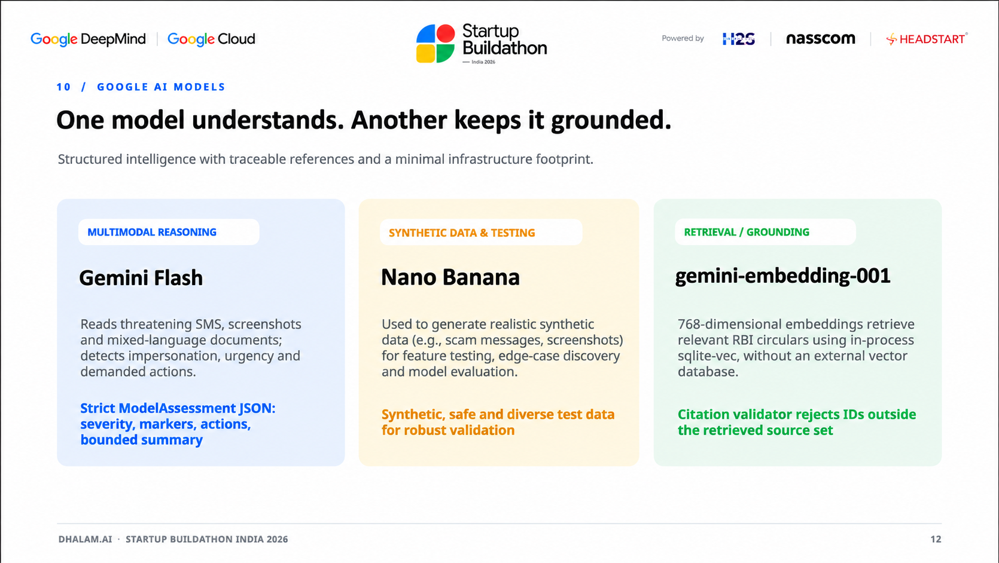

Slide 6
12 / MARKET OPPORTUNITY
From consumer trust to enterprise-scale protection.
B2B2C protection for banks, UPI platforms and digital lenders.
TAM
SAM
SOM · 24 MO
₹3,600 Cr
₹750 Cr
₹45 Cr
India-wide fraud prevention opportunity
Digitally vulnerable users + regulated institutions
Illustrative enterprise ARR ambition
Three ways to scale
01
Protected-user SDK
02
Transaction verification
03
Additional WhatsApp bot
$0.02 per protected MAU / month
₹0.50 per step-up check
Minimal acquisition cost and trust
DHALAM.AI · STARTUP BUILDATHON INDIA 2026
14

Slide 7
COMMERCIAL MODEL
Make better security a bank-level default.
Dhalam’s business model aligns revenue with fraud prevention rather than fear.
Embedded telemetry SDK
Trust-led acquisition
Banks and UPI apps run a pre-transaction device risk check for sensitive transfers. Active remote-control or capture signals can trigger step-up verification.
WhatsApp triage gives users a zero-install entry point. Enterprise partnerships distribute protection to people who may never discover a standalone safety app.
~7 paise
>85%
$0 idle
Estimated Gemini cost per scan
Target gross margin at $0.02/MAU
Cloud Run scales down when unused
DHALAM.AI · STARTUP BUILDATHON INDIA 2026
15

Slide 8

DHALAM.AI
When fear is weaponized, every second counts.

