Slide 1


TEAM NAME - DHALAM.AI
When fear is weaponized,
Your shield can’t wait.
Real-time AI scam triage + Device defense
Anusha Jain · Abhyudaya Marya | Team size: 2

Slide 2
Built by people who know both AI and the real world.
A two-founder team combining hands-on Android engineering with enterprise product strategy.
ENGINEERING + ANDROID
STRATEGY + COMMERCIAL
Anusha Jain
Abhyudaya Marya
Co-founder · Systems Architect & Tech Lead
Co-founder · Product Strategy & Business Architecture
AI Engineer at IBM · RVCE B.E. 2024 · Google Cloud GenAI Exchange finalist · IISc research internship. Built the native Jetpack Compose client, device signals and end-to-end AI integration.
Assistant Manager at Genpact · ex-Accenture · MBA BITS Pilani · B.E. VIT. Shaped the B2B2C commercial model, bank integration strategy and RBI advisory corpus.
linkedin.com/in/anusha-jain-377773216
linkedin.com/in/abhyudaya-m-6209b51b3
Two founders fused AI with real-world insight to build Dhalam, your shield against scams.

Slide 3
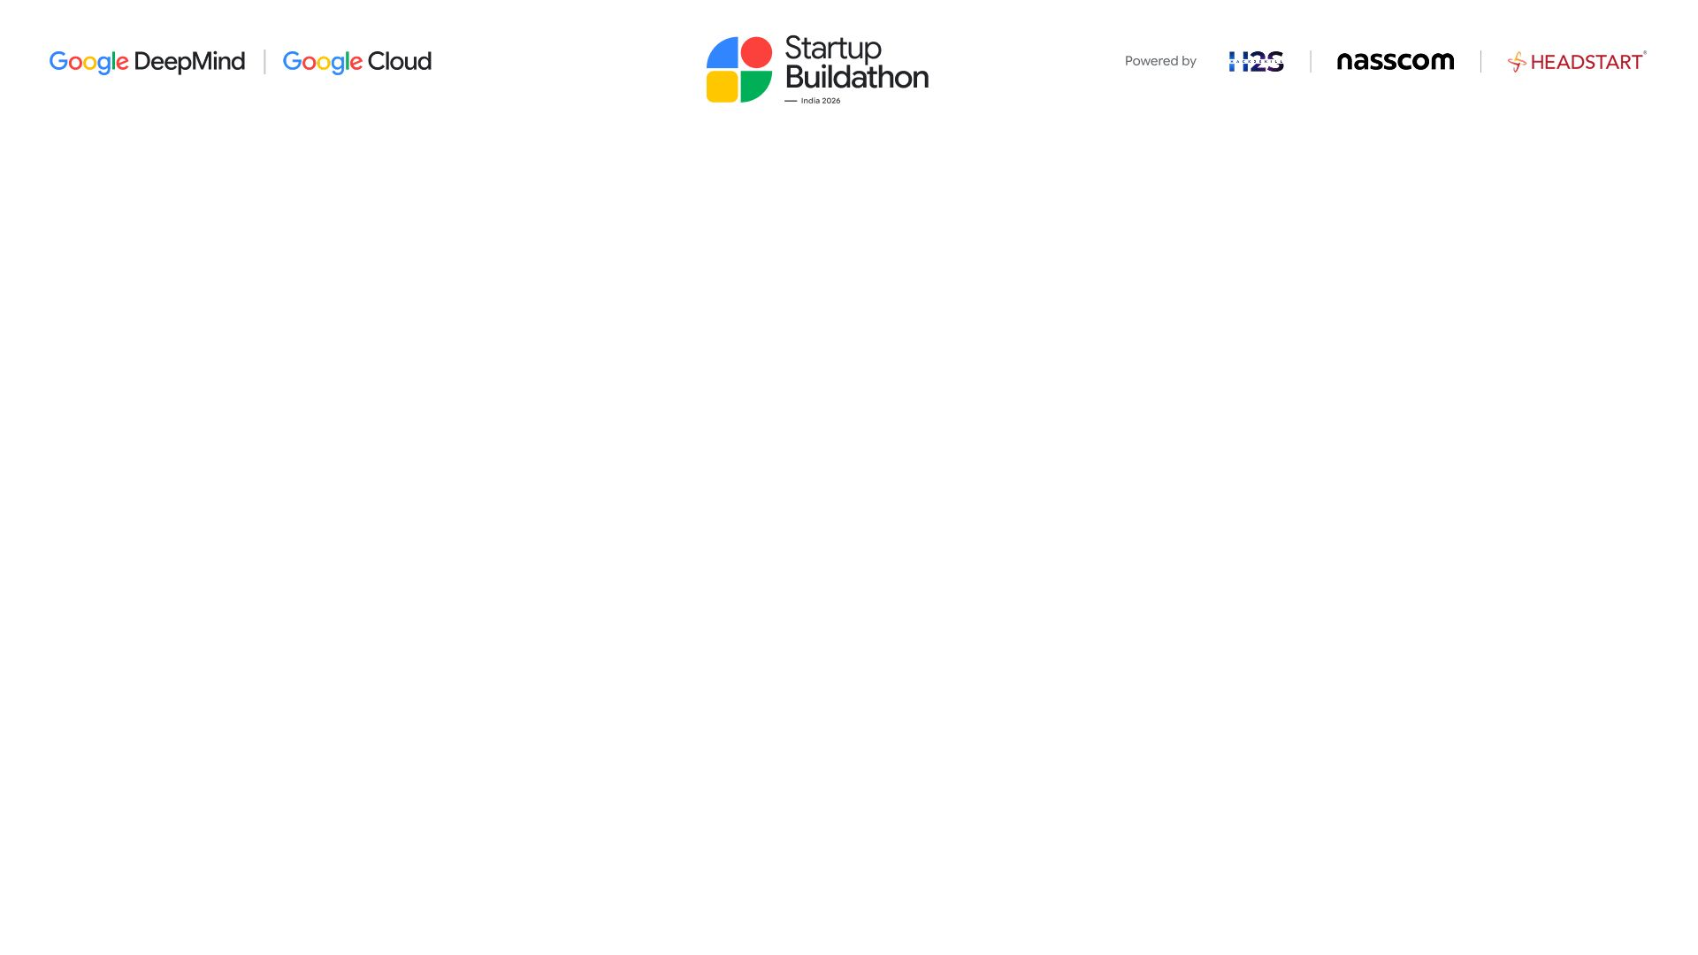
Problem Statement
A scam can empty an account. The damage rarely ends there.
₹22,495 cr
24.03 lakh
25% more
Cyber-fraud amount
reported in 2025¹
Financial-fraud complaints
on NCRP in 2025¹
Complaints than in 2024¹
The pressure is growing.
Fear. Lost sleep. Damaged trust.
IIT Madras interviews with 33 victims in five Indian cities describe shame, insomnia
and strained family relationships after financial cybercrime.²
When someone says “act now”, people need a safe pause.
¹ MHA / PIB, 11 Feb 2026, NCRP & CFCFRMS. Broader cyber-fraud figures; not a social-engineering-only count.
25% = rounded year-on-year growth from 19,18,835 to 24,02,579 complaints. Data is dynamic. ² IIT Madras, 29 Sep 2026; qualitative study.
Notes:
Sources:
1. Ministry of Home Affairs, PIB, “Cybercrime Reporting and Investigation”, 11 February 2026. https://www.pib.gov.in/PressReleasePage.aspx?PRID=2226441&lang=1&reg=1
2025: 2,402,579 financial fraud complaints on NCRP and INR 22,495 crore amount reported. 2024 complaints: 1,918,835. Derived growth: (2402579 / 1918835 - 1) * 100 = 25.2103%, rounded to 25%. Numbers describe reported financial cyber fraud, not exclusively social engineering; amounts are reported amounts, not adjudicated or net unrecovered losses. Data is dynamic.
2. IIT Madras, 29 September 2026. https://www.iitm.ac.in/hi/node/18007
Semi-structured interviews with 33 victims across five metros; qualitative and metropolitan in scope, not a national prevalence estimate. Psychological impacts are reported participant experiences. No direct quotation is used.
Repository reviewed: https://github.com/abhnovice/Dhalam-Hack2Skill/tree/main
Main branch commit: 91e895014973c00ca2842722200b115a5805ab79
Feature claims follow source code and repository documentation; no independent live deployment or outcome evaluation was performed for this deck.

Slide 4
Proposed Solution
Dhalam.AI gives people a second opinion before the next risky step.
01
02
03
04
Check the message
Understand the risk
Review app access
Take the next step
Text, links or screenshots.
Shared only with your consent.
Warning signs, concern level
and ranked safety actions.
Search permissions, enabled
services and access changes.
Ask about access, verify
independently or export a report.
THE WIN WE ARE BUILDING TOWARDS
Financial
Social
Psychological
A pause before paying
Clear evidence to discuss
Calm guidance in six languages
Built demo features shown above. Benefits are intended outcomes; financial-loss reduction has not yet been measured.

Slide 5
Solution Architecture
One simple journey: pause, check, understand, act.
USER JOURNEY · NATIVE ANDROID DEMO
Open Dhalam
Share & consent
Read the assessment
Choose what to do
Sign in with Google
Text • link • screenshot
Concern • reasons • next steps
Verify • export • 1930 help
Review device access
Ask Dhalam
GOOGLE AI + RAG
Permissions • enabled services • history
Permission-grounded Q&A with consent
Cloud Run → Vertex AI Gemini
RBI guidance → embeddings → retrieval
FUTURE VISION
A scalable, adaptive cyber-resilience ecosystem
Proposed: Pan-India scale · IoT intelligence · In-call triage · Microlearning · One-click reporting · Adversarial readiness

Slide 6
Six ways Dhalam protects a user.
Product Capabilities
Multimodal scam triage
Live Android telemetry
RBI-grounded guidance
Screenshot, text and forwarded-message analysis with clear, bounded verdicts.
Checks for remote-access and screen-capture risk signals.
Retrieves trusted fraud advisories and validates citation IDs.
Closed-loop protection
Six-language UX
Zero-install WhatsApp
Opens the right settings screen, then verifies the change.
English, Hindi, Marathi, Bengali, Tamil and Telugu; voice in/out.
Forward a message with CHECK: to get fast triage and the 1930 number.

Slide 7
Google AI Tools
Google AI Studio, Google Antigravity and Google Agent Skills (used or planned to be used).
Vertex AI · Gemini Flash
IN USE
gemini-embedding-001
IN USE
Multimodal reasoning and typed outputs
RBI semantic retrieval in sqlite-vec
Google Cloud Run · Mumbai
IN USE
Android Credential Manager
IN USE
Serverless FastAPI and WhatsApp webhook
Google Sign-In and verified ID tokens
Google AI Studio
IN USE
Antigravity
IN USE
Prompt and multilingual evaluation workspace
Antigravity as a code assistant for prototyping

Slide 8
Google AI Models
Google AI model(s) used or planned for the proposed solution.
MULTIMODAL REASONING
SYNTHETIC DATA & TESTING
RETRIEVAL / GROUNDING
Gemini Flash
Nano Banana
gemini-embedding-001
Detects threats across SMS, screenshots and multilingual content.
Generates synthetic scam examples to test features and uncover edge cases.
Retrieves relevant RBI guidance locally using sqlite-vec.
Structured risk assessments
Broader, safer test coverage
Source-validated citations
SAFETY & PRIVACY GUARDRAILS
Consent first
Image hygiene
Constrained output
Human agency
User-submitted content only
Remove EXIF and location data
Validated schema; ranked actions
Verify independently; call 1930

Slide 9
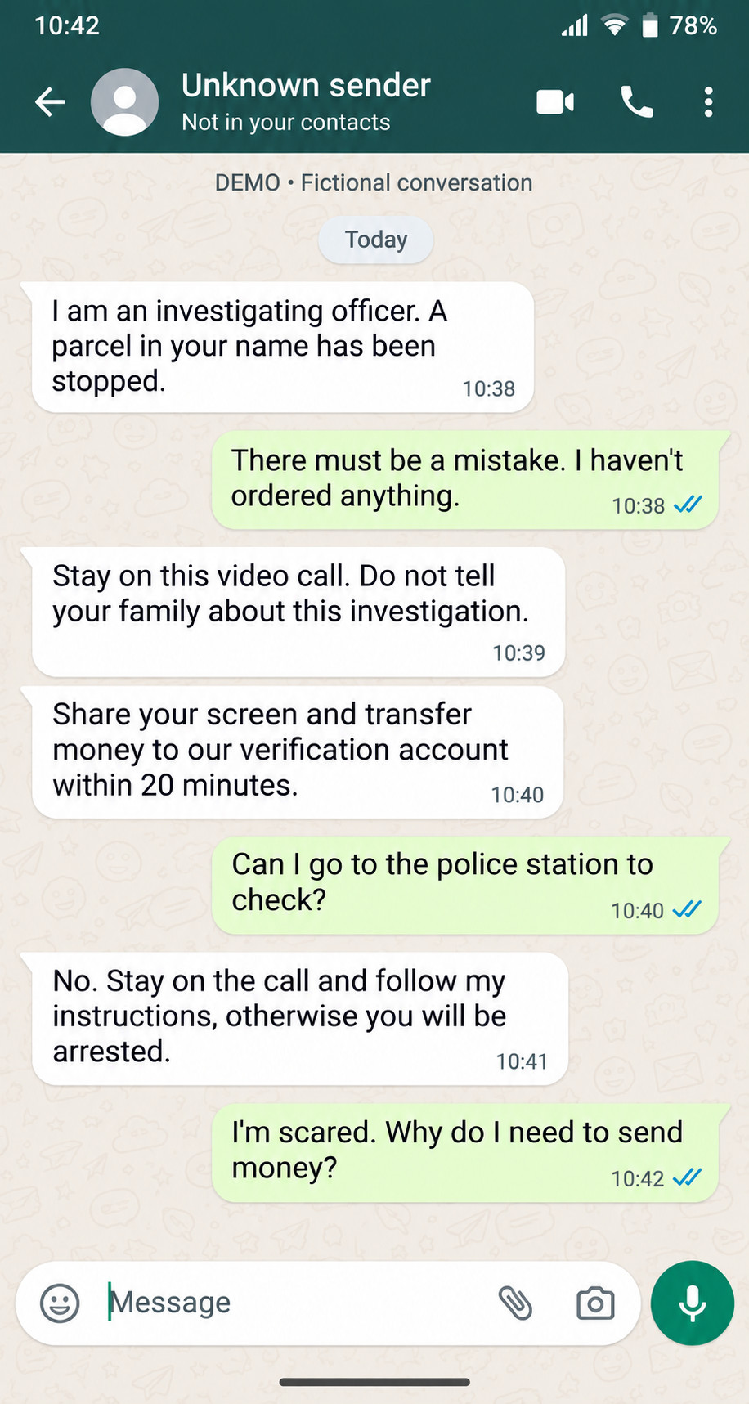
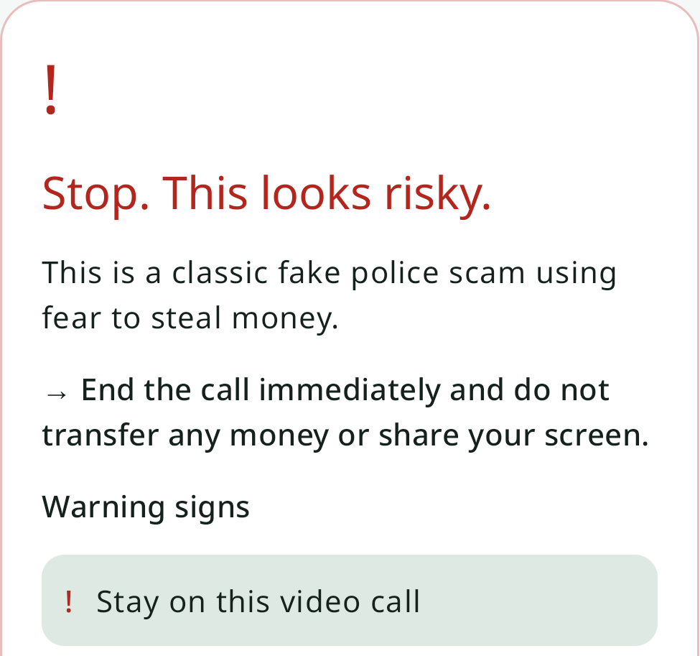
From a threat to a clear next step
A fictional “police” demand is flagged, with a practical first action.
FICTIONAL MESSAGE
THE APP RESPONSE · EXCERPT
A clear first action.
End the call.
Do not send money.
Do not share your screen.
Names the fear tactic.
Highlights the warning sign.

Slide 10
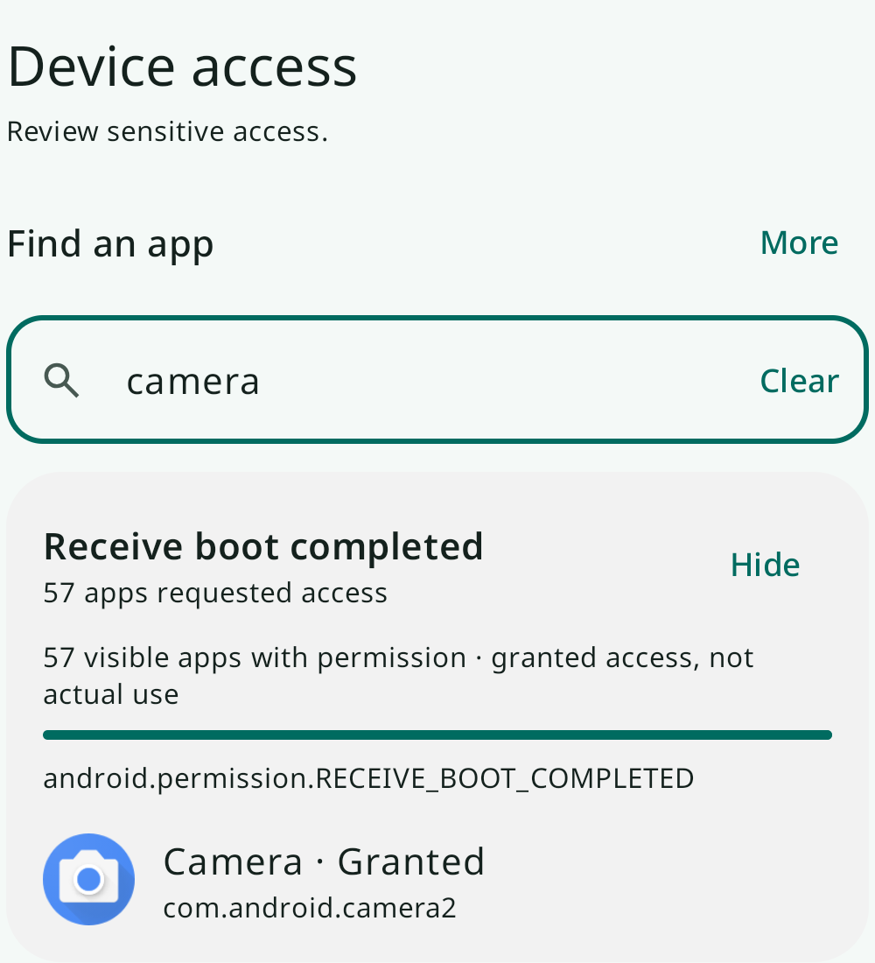
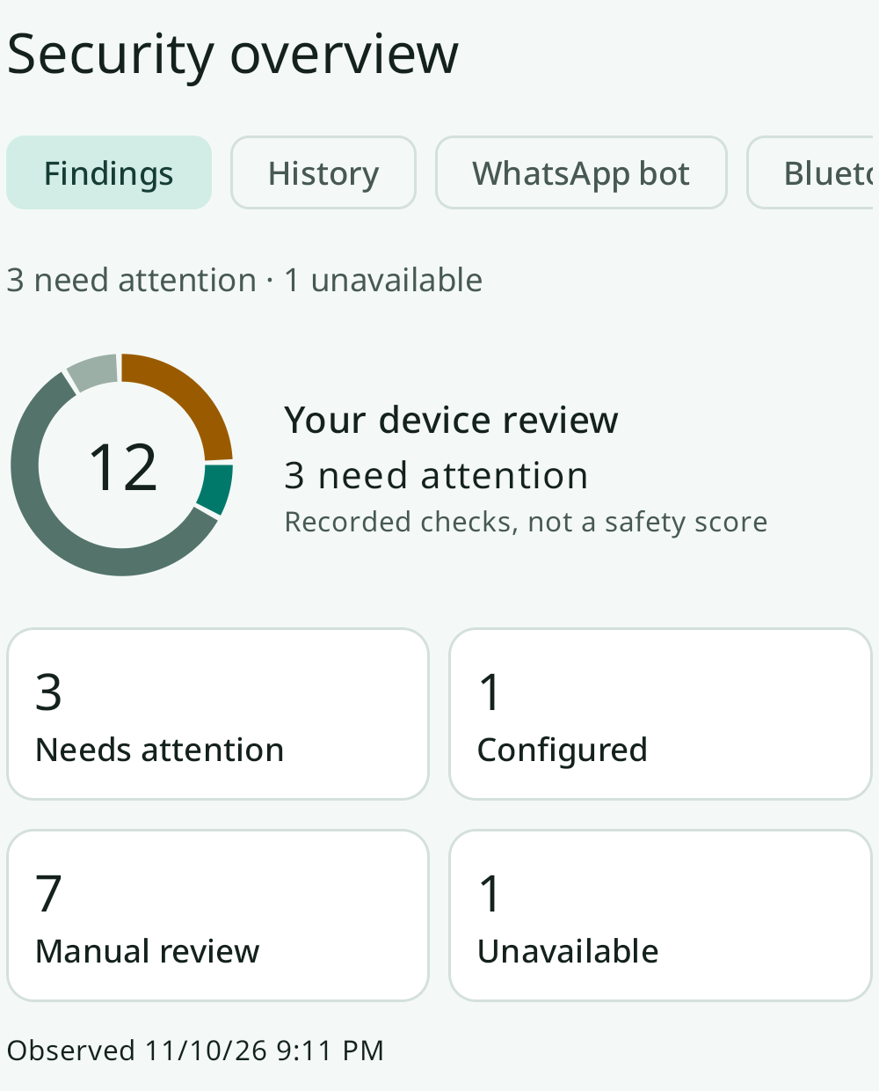
Device access you can explore
Find an app, inspect its permissions, and open findings that need review.
SEARCH & EXPAND
PRIORITIZE THE REVIEW
See what needs
your attention.
Search apps and permissions.
Expand a finding.
Review the next step.
Screens show one demo scan.

Slide 11
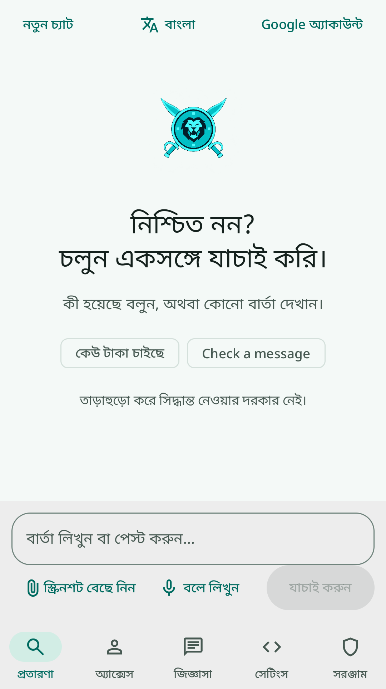
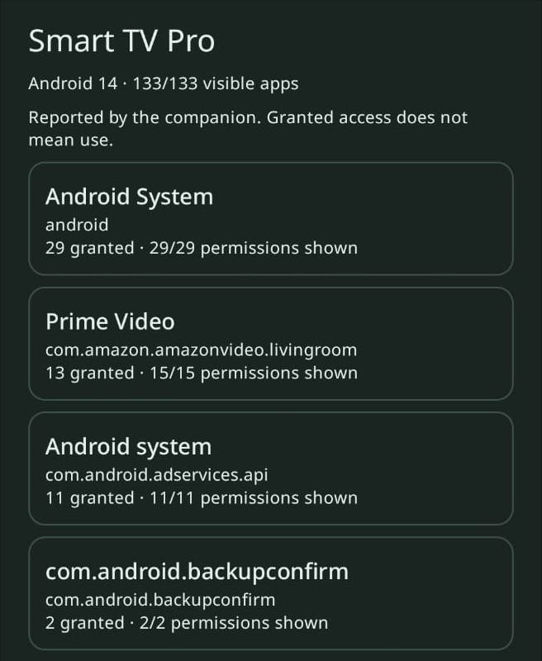
A familiar language. A wider device view.
Bengali interaction on the phone; companion-reported access on Android TV.
BENGALI INTERFACE
ANDROID TV COMPANION REVIEW
Six UI languages
Prompts and key controls adapt
to the selected language.
Bengali is shown here.
A paired TV, in view
Review apps and grants shared by the TV companion after approval.
TV review requires Dhalam on both supported Android devices and approval to share. Inventory visibility varies by device.

Slide 12
AS-IS (MVP) → TO-BE roadmap
From a working demo to a broader, more proactive defense.
AS-IS · MVP
TO-BE · PROPOSED ENHANCEMENTS
Today’s demo
Regional scale
Real-time, in-call triage
Scale service capacity across India’s geographies.
Detection, monitoring and reporting while on call.
User-submitted AI checks
Searchable device access
Bite-sized learning
One-click cybersecurity mail
Interactive microlearning for everyday scam awareness.
Package the incident for user-reviewed sending.
Phone + TV companion
Six-language interface
Broader IoT expertise
Proactive adversarial drills
Controlled demo
Extend risk guidance across connected-device categories.
Practice scam scenarios before a real attack.
An adaptive defense flywheel for an ever-evolving adversarial landscape.

Slide 13
From consumer trust to enterprise-scale protection.
B2B2C protection for banks, UPI platforms and digital lenders.
TAM
SAM
SOM · 24 MO
₹3,600 Cr
₹750 Cr
₹45 Cr
India-wide fraud prevention opportunity
Digitally vulnerable users + regulated institutions
Illustrative enterprise ARR ambition
Three ways to scale
01
Protected-user SDK
02
Transaction verification
03
Additional WhatsApp bot
$0.02 per protected MAU / month
₹0.50 per step-up check
Minimal acquisition cost and trust

Slide 14
Make better security a bank-level default.
Dhalam’s business model aligns revenue with fraud prevention rather than fear.
Embedded telemetry SDK
Trust-led acquisition
Banks and UPI apps run a pre-transaction device risk check for sensitive transfers. Active remote-control or capture signals can trigger step-up verification.
WhatsApp triage gives users a zero-install entry point. Enterprise partnerships distribute protection to people who may never discover a standalone safety app.
~7 paise
>85%
$0 idle
Estimated Gemini cost per scan
Target gross margin at $0.02/MAU
Cloud Run scales down when unused

Slide 15

Notes:
Original template Thank You page, preserved unchanged.

