Slide 1
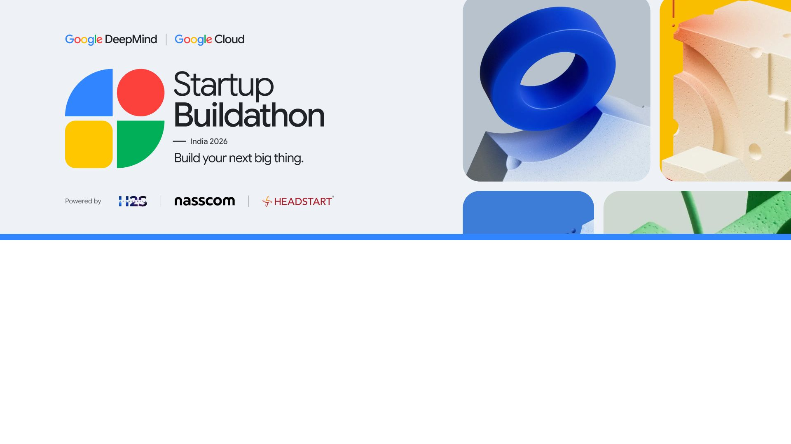
Team Name:
Dhalam.AI
Team Size:
2 members | Abhyudaya Marya and Anusha Jain
Problem Statement:
Scammers fake the urgency. The savings at risk are real.
Notes:
Team identity and membership supplied by the team. Cover preserves the original template artwork and field labels. One-line problem framing is editorial copy.
Repository reviewed: https://github.com/abhnovice/Dhalam-Hack2Skill/tree/main
Main branch commit: 91e895014973c00ca2842722200b115a5805ab79
Feature claims follow source code and repository documentation; no independent live deployment or outcome evaluation was performed for this deck.

Slide 2
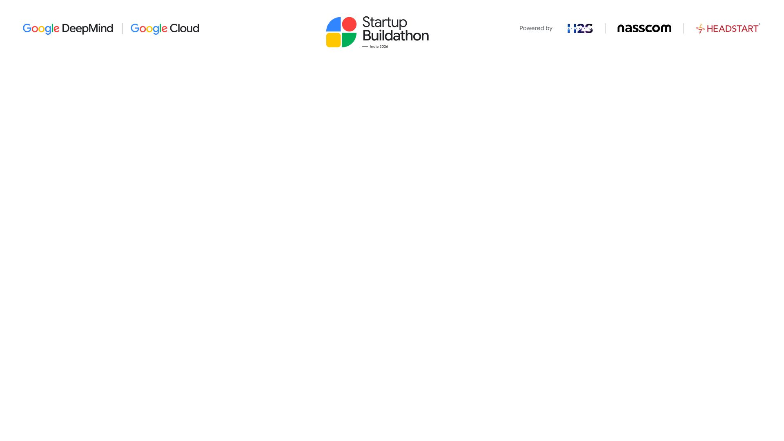
Problem Statement
A scam can empty an account. The damage rarely ends there.
₹22,495 cr
24.03 lakh
25% more
Cyber-fraud amount
reported in 2025¹
Financial-fraud complaints
on NCRP in 2025¹
Complaints than in 2024¹
The pressure is growing.
Fear. Lost sleep. Damaged trust.
IIT Madras interviews with 33 victims in five Indian cities describe shame, insomnia
and strained family relationships after financial cybercrime.²
When someone says “act now”, people need a safe pause.
¹ MHA / PIB, 11 Feb 2026, NCRP & CFCFRMS. Broader cyber-fraud figures; not a social-engineering-only count.
25% = rounded year-on-year growth from 19,18,835 to 24,02,579 complaints. Data is dynamic. ² IIT Madras, 29 Sep 2026; qualitative study.
Notes:
Sources:
1. Ministry of Home Affairs, PIB, “Cybercrime Reporting and Investigation”, 11 February 2026. https://www.pib.gov.in/PressReleasePage.aspx?PRID=2226441&lang=1&reg=1
2025: 2,402,579 financial fraud complaints on NCRP and INR 22,495 crore amount reported. 2024 complaints: 1,918,835. Derived growth: (2402579 / 1918835 - 1) * 100 = 25.2103%, rounded to 25%. Numbers describe reported financial cyber fraud, not exclusively social engineering; amounts are reported amounts, not adjudicated or net unrecovered losses. Data is dynamic.
2. IIT Madras, 29 September 2026. https://www.iitm.ac.in/hi/node/18007
Semi-structured interviews with 33 victims across five metros; qualitative and metropolitan in scope, not a national prevalence estimate. Psychological impacts are reported participant experiences. No direct quotation is used.
Repository reviewed: https://github.com/abhnovice/Dhalam-Hack2Skill/tree/main
Main branch commit: 91e895014973c00ca2842722200b115a5805ab79
Feature claims follow source code and repository documentation; no independent live deployment or outcome evaluation was performed for this deck.

Slide 3
Proposed Solution
Dhalam.AI gives people a second opinion before the next risky step.
01
02
03
04
Check the message
Understand the risk
Review app access
Take the next step
Text, links or screenshots.
Shared only with your consent.
Warning signs, concern level
and ranked safety actions.
Search permissions, enabled
services and access changes.
Ask about access, verify
independently or export a report.
THE WIN WE ARE BUILDING TOWARDS
Financial
Social
Psychological
A pause before paying
Clear evidence to discuss
Calm guidance in six languages
Built demo features shown above. Benefits are intended outcomes; financial-loss reduction has not yet been measured.
Notes:
Repository reviewed: https://github.com/abhnovice/Dhalam-Hack2Skill/tree/main
Main branch commit: 91e895014973c00ca2842722200b115a5805ab79
Feature claims follow source code and repository documentation; no independent live deployment or outcome evaluation was performed for this deck.
Evidence: README.md sections Technical progress and limits, Reference-backed advice, language support; backend/app.py /triage and /ask; backend/triage/schemas.py; app/src/main/java/com/dhalam/ap/AskDhalamViewModel.kt. Native Android hosted Google authentication was reported verified in the repository; Flutter hosted authentication remains incomplete. Six UI languages: English, Hindi, Marathi, Bengali, Tamil and Telugu. Report export is user-reviewed.
Financial, social and psychological wins are product intentions, not clinically or experimentally demonstrated benefits. Dhalam does not automatically block payments, cancel another app's capture, or file an official complaint.

Slide 4
Solution Architecture
One simple journey: pause, check, understand, act.
USER JOURNEY · NATIVE ANDROID DEMO
Open Dhalam
Share & consent
Read the assessment
Choose what to do
Sign in with Google
Text • link • screenshot
Concern • reasons • next steps
Verify • export • 1930 help
Review device access
Ask Dhalam
GOOGLE AI + RAG
Permissions • enabled services • history
Permission-grounded Q&A with consent
Cloud Run → Vertex AI Gemini
RBI guidance → embeddings → retrieval
FUTURE VISION
A scalable, adaptive cyber-resilience ecosystem
Proposed: Pan-India scale · IoT intelligence · In-call triage · Microlearning · One-click reporting · Adversarial readiness
Notes:
Repository reviewed: https://github.com/abhnovice/Dhalam-Hack2Skill/tree/main
Main branch commit: 91e895014973c00ca2842722200b115a5805ab79
Feature claims follow source code and repository documentation; no independent live deployment or outcome evaluation was performed for this deck.
User flow is a conceptual UI architecture rather than literal screen captures. Google Credential Manager handles sign-in. Authenticated FastAPI backend is served on Cloud Run in Mumbai; Vertex inference is deployment configured and not claimed to be India-only. Gemini produces bounded structured triage. gemini-embedding-001 creates embeddings for reviewed RBI guidance, stored using SQLite/sqlite-vec; retrieved source IDs are allowlisted before display. Five reviewed RBI summaries form the initial collection. User-submitted content is not added to the vector index. Device inventories are limited to what Android exposes. On-device Gemma and bank integration are explicitly incomplete in README.md. The demo provides guidance to contact 1930, not an automatic complaint submission.
Updated future-vision section: the former On-device Gemma and Bank integration callouts are superseded by the team’s slide-10 roadmap. The new marketing statement “A scalable, adaptive cyber-resilience ecosystem” is an aspirational product vision, not an implemented capability. Its six proposed themes map to regional scalability across India, broader IoT expertise, live-call detection/monitoring/reporting, interactive microlearning, one-click cybersecurity email, and proactive adversarial simulations. “One-click reporting” refers to the roadmap’s user-reviewed email concept, not automatic official complaint filing. No deployed live-call, universal IoT or automatic-learning capability is claimed. All other architecture content is unchanged.

Slide 5
Google AI Tools
Google AI Studio, Google Antigravity and Google Agent Skills (used or planned to be used).
GOOGLE TOOL / SERVICE | HOW DHALAM USES IT | STATUS
Google AI Studio | Planned prompt-evaluation workspace for false positives, safety failures, and quality across 6 languages.
Google Antigravity | Planned developer workflow to prototype, review, and test new app/backend features.
Google Agent Skills | Roadmap: reusable, auditable device-state checks as tool actions for a supervised Gemini workflow.
Vertex AI + Cloud Run | Implemented Gemini-based multimodal triage served through an authenticated FastAPI backend in Mumbai.
Google Credential Manager | Implemented Sign in with Google; backend verifies the Google ID token.
Google Fonts — Noto Sans | Implemented multilingual UI typography for English, Hindi, Marathi, Bengali, Tamil, and Telugu.
PLANNED
PLANNED
ROADMAP
BUILT
BUILT
BUILT
Notes:
Content and layout recreated from the user-supplied Google AI Tools screenshot, preserving all wording and statuses. Spellcheck underlines and editing outlines are omitted.
Repository reviewed: https://github.com/abhnovice/Dhalam-Hack2Skill/tree/main
Main branch commit: 91e895014973c00ca2842722200b115a5805ab79
Feature claims follow source code and repository documentation; no independent live deployment or outcome evaluation was performed for this deck.
The term Mumbai applies to the Cloud Run backend, not an India-only Vertex inference/data residency claim. Google AI Studio and Google Antigravity are PLANNED; Google Agent Skills is ROADMAP.

Slide 6
Google AI Models
Google AI model(s) used or planned for the proposed solution.
Gemini Flash via Vertex AI
gemini-embedding-001 for a RAG Pipeline
•
Multimodal analysis of suspicious messages, screenshots,
and mixed-language content.
•
Produces embeddings for retrieving relevant official RBI
fraud advisories with sqlite-vec.
•
Produces a bounded, structured assessment: concern
score, severity, key warning signs, and ranked safety
actions.
•
Retrieved source IDs are checked against an allowlist
before citations appear in user-facing guidance.
•
Grounding with RAG reduces fabricated references
•
Model version is deployment-config dependent.
SAFETY & PRIVACY GUARDRAILS
Consent first
Image hygiene
Constrained output
Human agency
User explicitly submits content
EXIF and location metadata
stripped
Pydantic schema + ranked
actions
Independent verification & 1930
help
Notes:
Content and layout recreated from the user-supplied Google AI Models screenshot, preserving all wording. Spellcheck and selection artifacts are removed.
Repository reviewed: https://github.com/abhnovice/Dhalam-Hack2Skill/tree/main
Main branch commit: 91e895014973c00ca2842722200b115a5805ab79
Feature claims follow source code and repository documentation; no independent live deployment or outcome evaluation was performed for this deck.
RAG reduces opportunities for fabricated references through retrieval and allowlisted source IDs; it does not eliminate all factual mistakes or establish the accuracy of a specific scam assessment. The reviewed collection currently contains five RBI summaries. Model version follows deployment configuration. The image hygiene statement refers to uploaded images.

Slide 7
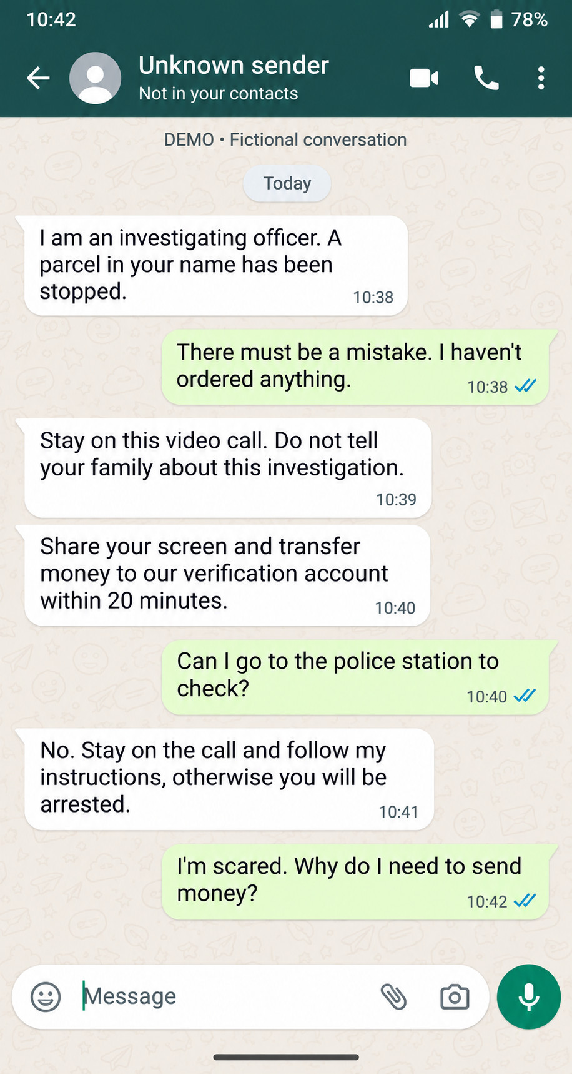
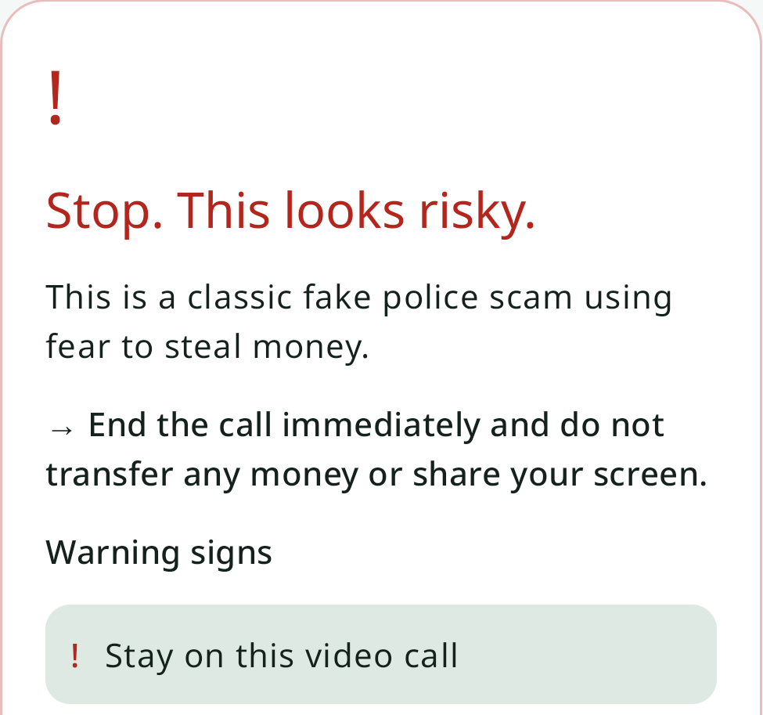
From a threat to a clear next step
A fictional “police” demand is flagged, with a practical first action.
FICTIONAL MESSAGE
THE APP RESPONSE · EXCERPT
A clear first action.
End the call.
Do not send money.
Do not share your screen.
Names the fear tactic.
Highlights the warning sign.
Illustrative demo, not an accuracy benchmark. A model assessment is not proof of fraud.
Notes:
Screenshots selected from main branch commit 649e50184b056ac404e591cafce04793caaf2fcb.
https://github.com/abhnovice/Dhalam-Hack2Skill/blob/649e50184b056ac404e591cafce04793caaf2fcb/docs/interact-with-app/synthetic-message.png
https://github.com/abhnovice/Dhalam-Hack2Skill/blob/649e50184b056ac404e591cafce04793caaf2fcb/docs/interact-with-app/Screenshot_1794325662.png
Slide purpose: show an input-to-response journey, rather than imply measured efficacy. The synthetic-message image visibly labels itself as a fictional conversation. The app response recognizes a fake-police scenario, recommends ending the call and avoiding transfers/screen sharing, and shows the warning sign “Stay on this video call”. Screenshots support a qualitative demonstration only.
Cropping: synthetic-message.png remains complete. Screenshot_1794325662.png is cropped to rectangle (53, 832, 1028, 1745) in the 1080x2400 source. This selects the assessment and one complete warning-sign row. The unsubmitted draft “I can detect deepfakes too” is outside the crop; no deepfake-detection capability is claimed.
Interaction context: https://github.com/abhnovice/Dhalam-Hack2Skill/blob/649e50184b056ac404e591cafce04793caaf2fcb/docs/interact-with-app/README.md

Slide 8
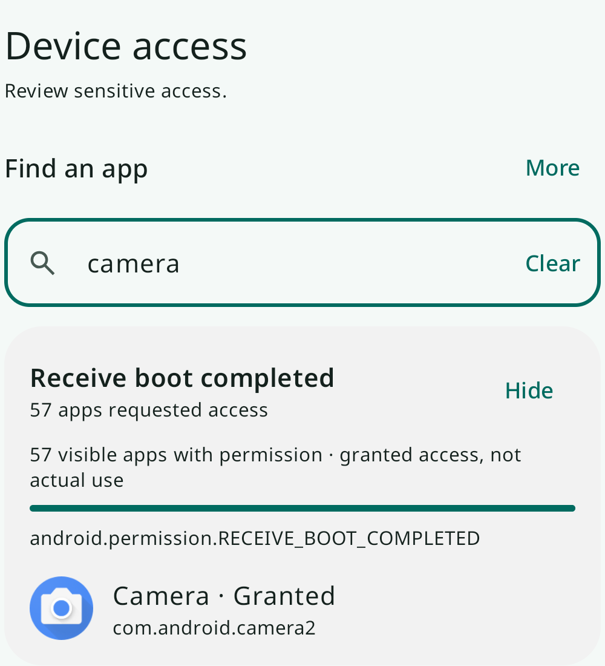
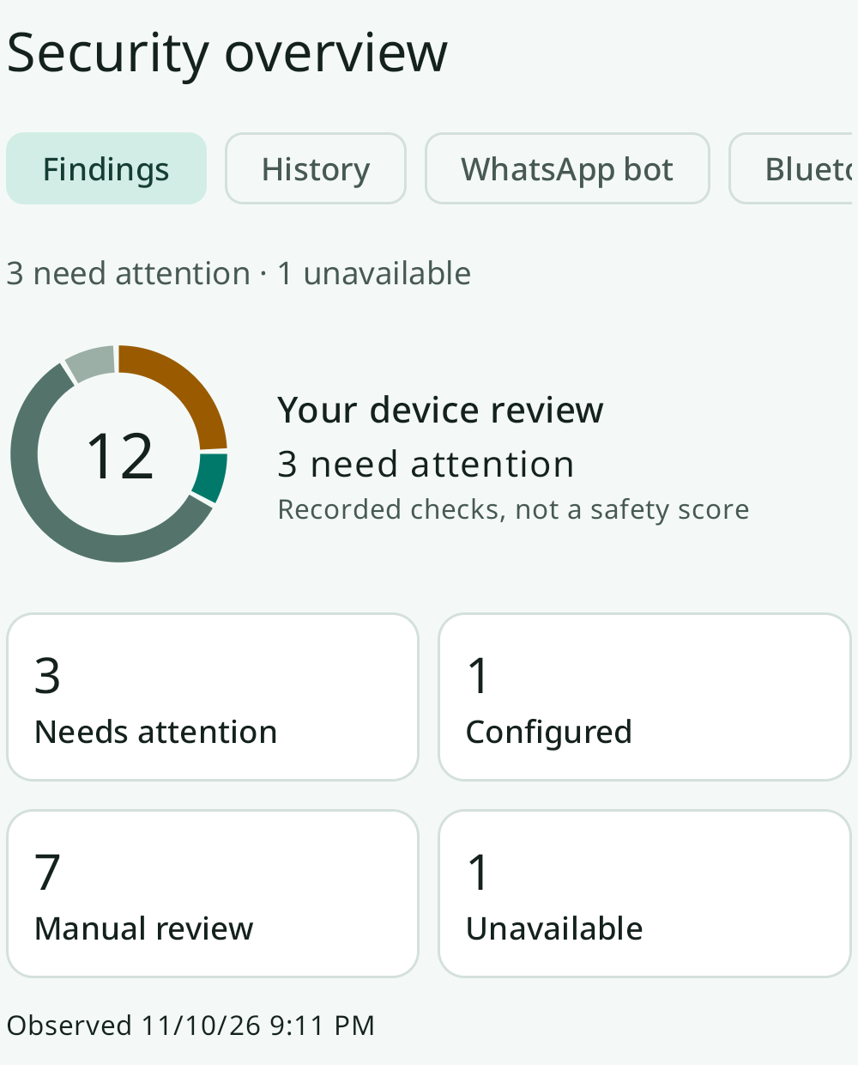
Device access you can explore
Find an app, inspect its permissions, and open findings that need review.
SEARCH & EXPAND
PRIORITIZE THE REVIEW
See what needs
your attention.
Search apps and permissions.
Expand a finding.
Review the next step.
Screens show one demo scan. Granted access does not prove use; the review count is not a safety score.
Notes:
Screenshots selected from main branch commit 649e50184b056ac404e591cafce04793caaf2fcb.
https://github.com/abhnovice/Dhalam-Hack2Skill/blob/649e50184b056ac404e591cafce04793caaf2fcb/docs/interact-with-app/Screenshot_1794325793.png
https://github.com/abhnovice/Dhalam-Hack2Skill/blob/649e50184b056ac404e591cafce04793caaf2fcb/docs/interact-with-app/Screenshot_1794325811.png
Slide purpose: show searchable app/permission inventory and expandable review findings. The left screen contains query “camera” and shows the Camera app’s grant for RECEIVE_BOOT_COMPLETED; it must not be described as proof of camera hardware usage. The right screen shows 12 recorded checks, including 3 needs-attention, 1 configured, 7 manual-review and 1 unavailable. These are demonstration observations, not a security efficacy score.
Cropping: Screenshot_1794325793.png rectangle (40, 650, 1040, 1750); Screenshot_1794325811.png rectangle (40, 400, 1040, 1640). Both crops preserve the relevant labels, controls, and interpretation qualifiers. No on-screen content was edited.
Feature context: https://github.com/abhnovice/Dhalam-Hack2Skill/blob/649e50184b056ac404e591cafce04793caaf2fcb/docs/interact-with-app/README.md

Slide 9
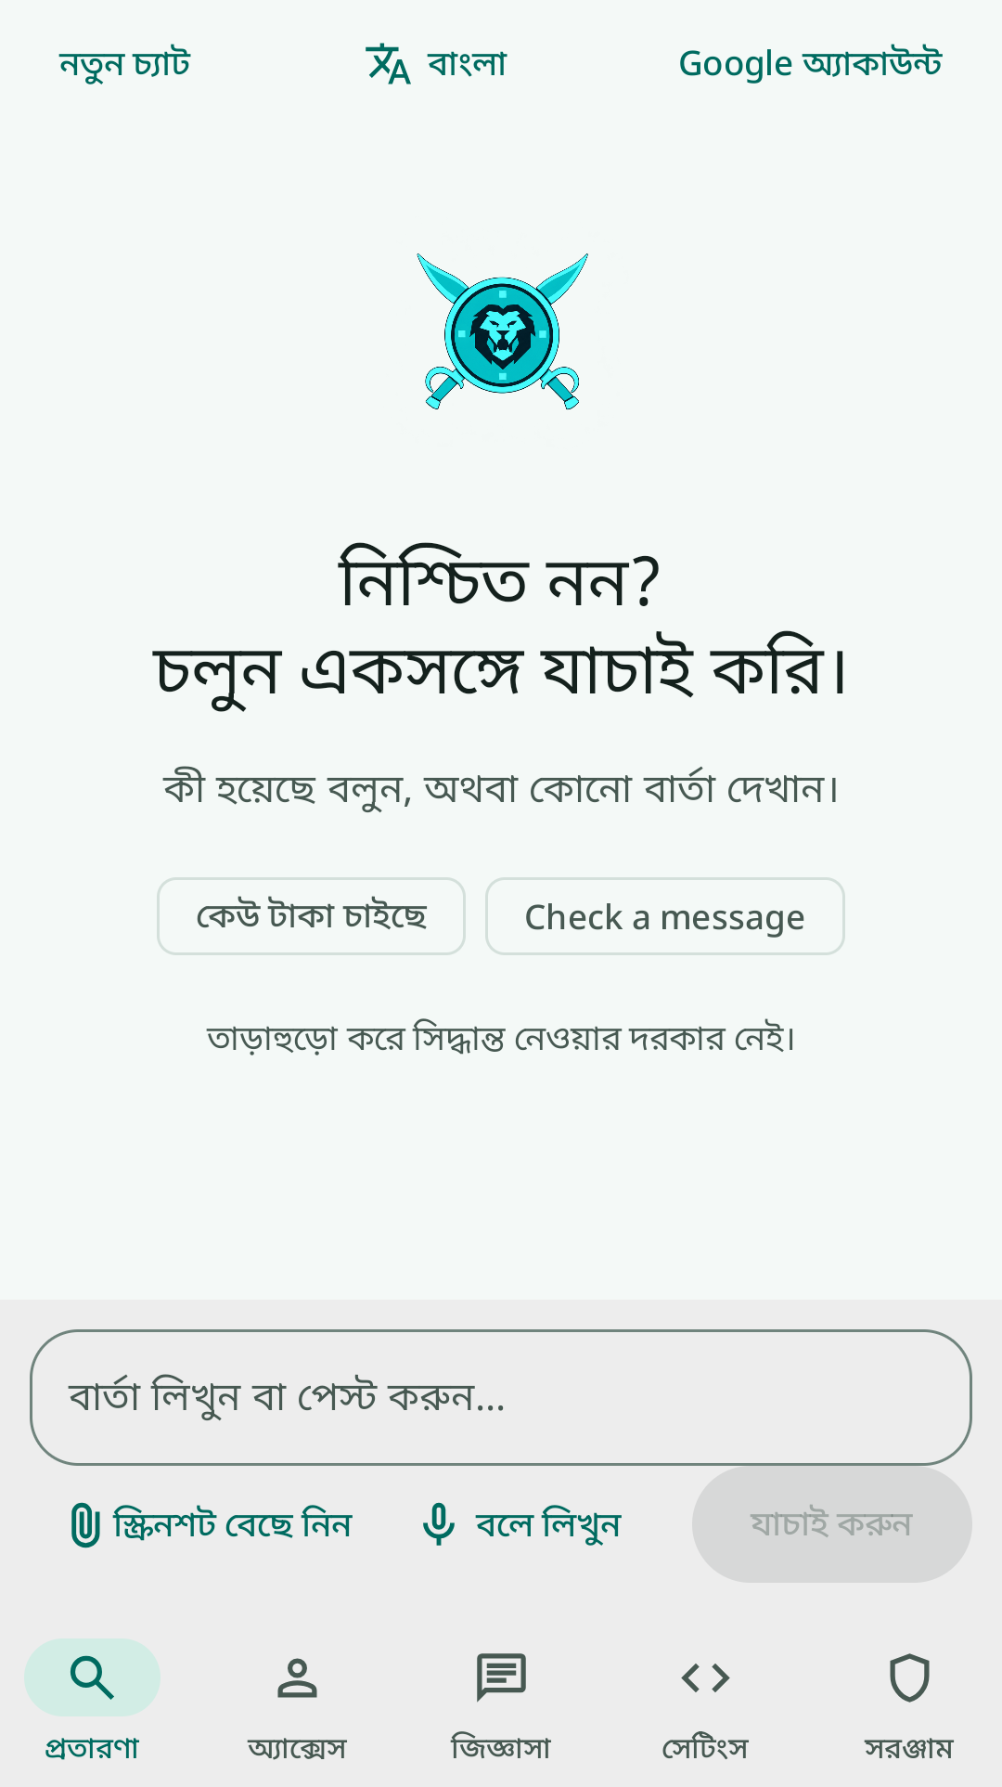
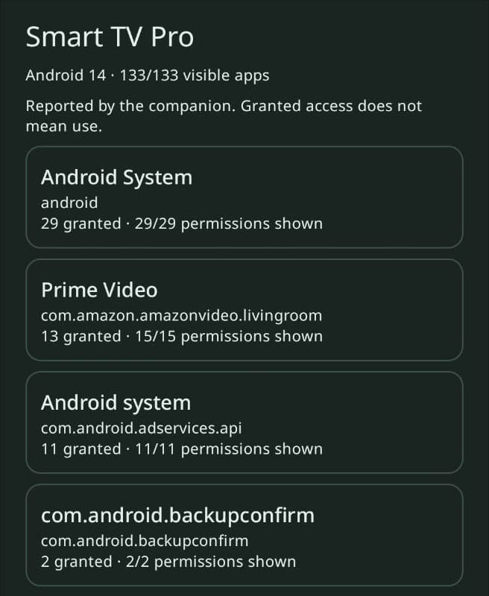
A familiar language. A wider device view.
Bengali interaction on the phone; companion-reported access on Android TV.
BENGALI INTERFACE
ANDROID TV COMPANION REVIEW
Six UI languages
Prompts and key controls adapt
to the selected language.
Bengali is shown here.
A paired TV, in view
Review apps and grants shared by the TV companion after approval.
TV review requires Dhalam on both supported Android devices and approval to share. Inventory visibility varies by device.
Notes:
Screenshots selected from main branch commit 649e50184b056ac404e591cafce04793caaf2fcb.
https://github.com/abhnovice/Dhalam-Hack2Skill/blob/649e50184b056ac404e591cafce04793caaf2fcb/docs/interact-with-app/Screenshot_1794326041.png
https://github.com/abhnovice/Dhalam-Hack2Skill/blob/649e50184b056ac404e591cafce04793caaf2fcb/docs/interact-with-app/WhatsApp%20Image%202026-11-13%20at%2000.16.39.jpeg
Slide purpose: show an actual Bengali UI state and the Android TV companion-reported inventory, not promise protection across every TV. Six UI languages are documented: English, Hindi, Marathi, Bengali, Tamil, Telugu. The TV screenshot shows Smart TV Pro, Android 14, 133/133 visible apps and per-app permission counts. Companion-reported data does not establish actual use, compromise, or complete package visibility.
Bluetooth review flow and limits: https://github.com/abhnovice/Dhalam-Hack2Skill/blob/649e50184b056ac404e591cafce04793caaf2fcb/BLUETOOTH_REVIEW.md
Both supported Android devices require Dhalam and Bluetooth Classic RFCOMM. The TV approves a one-time transfer; pairing alone cannot expose an arbitrary device’s inventory. The code describes authenticated encrypted local sharing. Screenshot evidence illustrates a reported inventory; this deck does not independently validate the radio exchange or claim cross-device fraud interception.
Cropping: Bengali source rectangle (0, 390, 1080, 2315); TV source rectangle (30, 284, 686, 1084). Crops retain the selected language/chat controls and the TV label, companion attribution and granted-access limitation. No on-screen content was altered.

Slide 10
AS-IS (MVP) → TO-BE roadmap
From a working demo to a broader, more proactive defense.
AS-IS · MVP
TO-BE · PROPOSED ENHANCEMENTS
Today’s demo
Regional scale
Real-time, in-call triage
Scale service capacity across India’s geographies.
Detection, monitoring and reporting while on call.
User-submitted AI checks
Searchable device access
Bite-sized learning
One-click cybersecurity mail
Interactive microlearning for everyday scam awareness.
Package the incident for user-reviewed sending.
Phone + TV companion
Six-language interface
Broader IoT expertise
Proactive adversarial drills
Controlled demo
Extend risk guidance across connected-device categories.
Practice scam scenarios before a real attack.
An adaptive defense flywheel for an ever-evolving adversarial landscape.
Proposed enhancements, subject to platform feasibility and user consent.
Notes:
Purpose: the user-requested AS-IS (MVP) to TO-BE roadmap, inserted after the three screenshot slides and before Thank You.
AS-IS follows the reviewed native Android MVP and companion screenshots: user-submitted AI triage, searchable device access, phone plus Android TV companion review, six UI languages, and controlled demo access. This does not claim passive live-call detection is currently built.
Source: https://github.com/abhnovice/Dhalam-Hack2Skill/tree/649e50184b056ac404e591cafce04793caaf2fcb
TO-BE is proposed product direction supplied by the team, not implementation evidence, delivery commitments, or validated outcomes. The six proposed capabilities are: scale to multiple geographies within India; bite-sized interactive educational content; expand from phone/TV into broader IoT expertise; real-time scam detection, monitoring and reporting during a call; one-click cybersecurity email; and proactive adversarial simulations before an incident.
The email concept means preparing an incident for user review and sending; no automatic official complaint submission or actual email transmission is claimed. Adversarial drills are an opt-in educational proposal, not covert targeting of users. Live-call monitoring/reporting and broader IoT coverage require platform feasibility, consent and deployment validation. No dates or universal device compatibility are implied.
Marketing point: “An adaptive defense flywheel for an ever-evolving adversarial landscape.” This expresses the ongoing need to adapt as adversaries change, not an implemented automatic-learning mechanism.
The original ten slides, their theme, content, screenshots and notes are preserved.

Slide 11

Notes:
Original template Thank You page, preserved unchanged.

