Slide 1
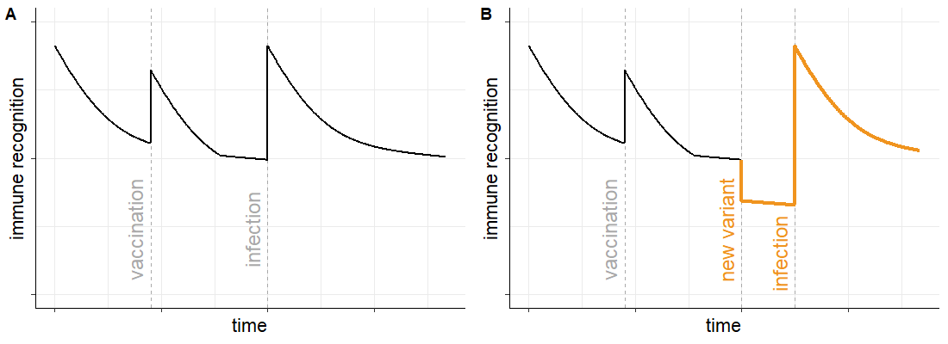
A
B
B
C
Scenario 1
vaccination to 65+
(vary timing)
10-year burn-in
0
6m
12m
I_{Case}
I_{ICU}
D
impact measured over 12m
S
E
I_{Mild}
I_{Hosp}
I_{HospR}
Scenario 2
vaccination to 65+
(fixed timing)
I_{Asymp}
10-year burn-in
0
6m
12m
variant replaces current circulating strain
impact measured over 12m

