Slide 1



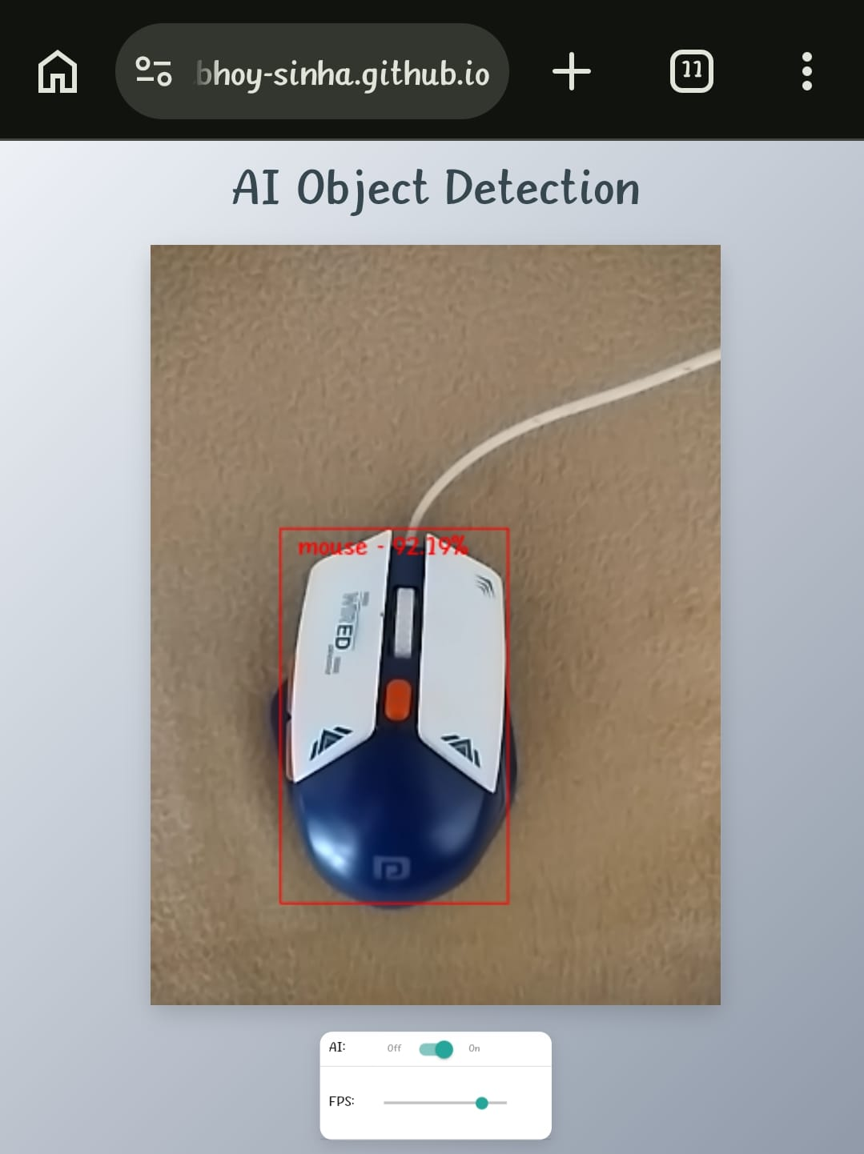
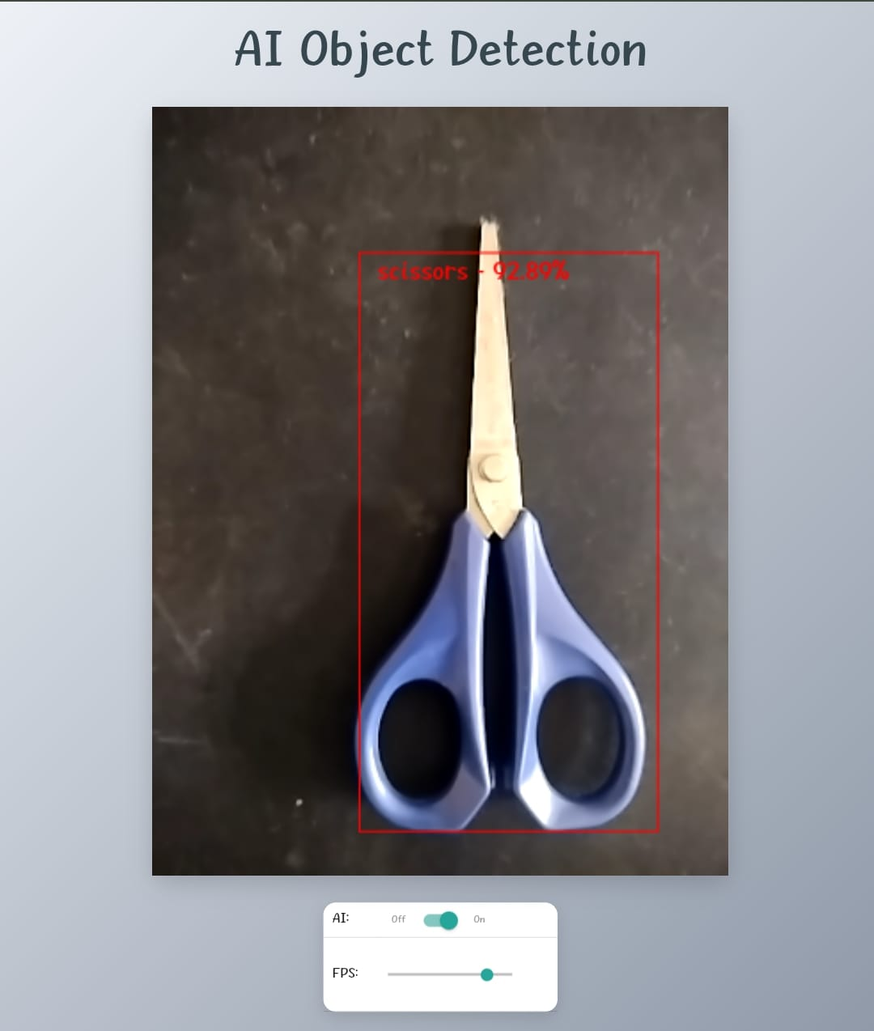
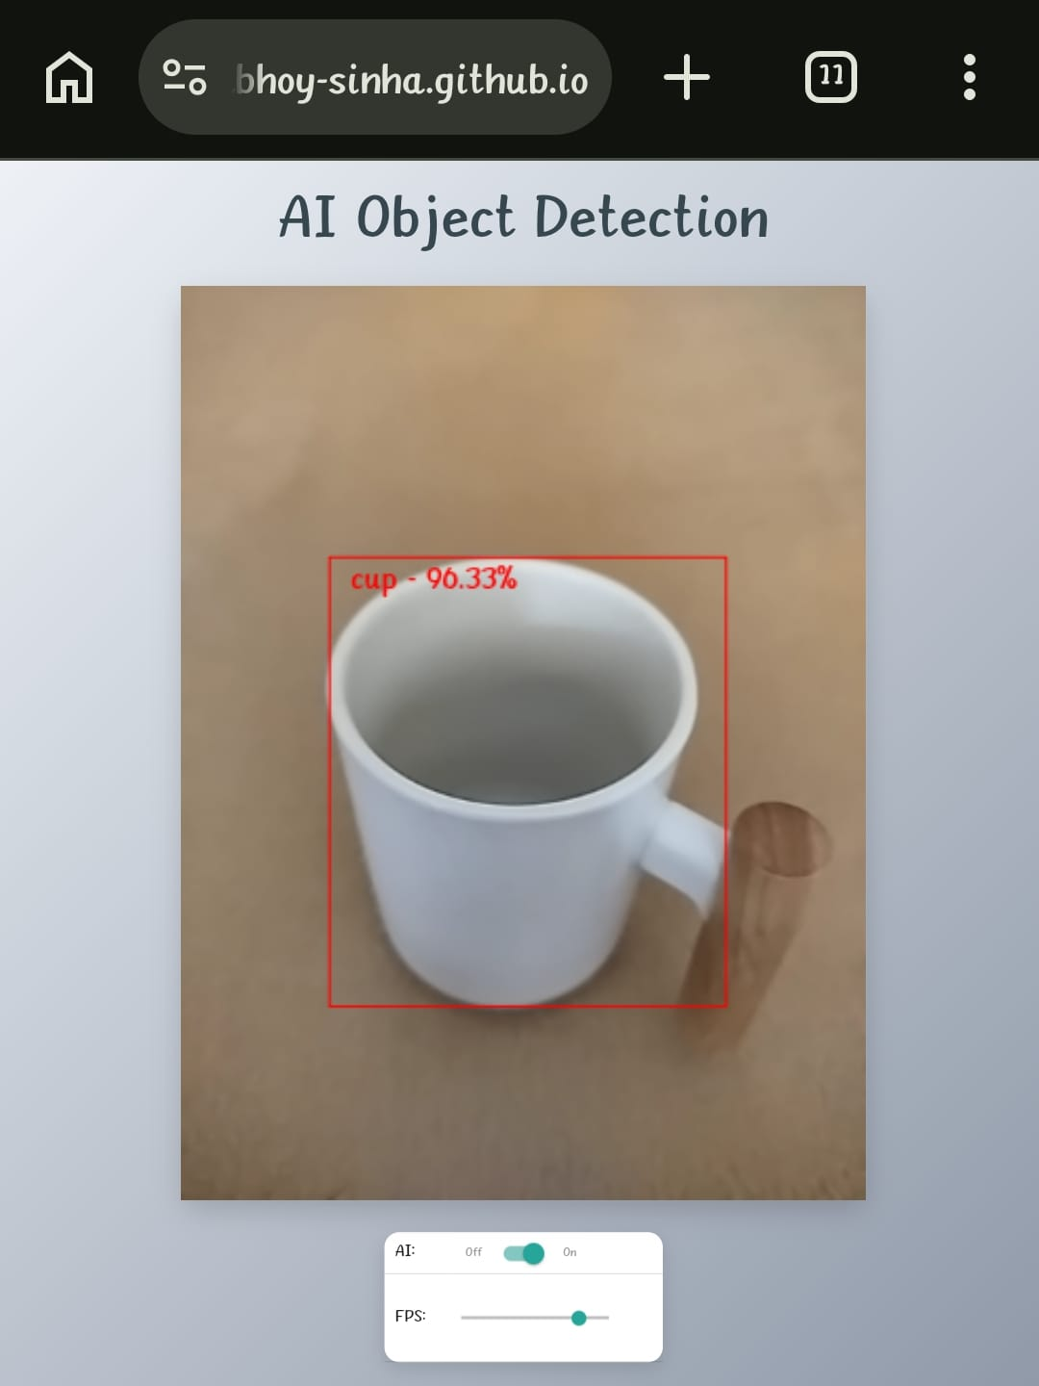
Project Summary
AI OBJECT DETECTION
This project presents a real-time AI Object Detection system that identifies and classifies objects using a live camera feed. The system uses a pre-trained machine learning model to detect common objects such as a person, mouse, scissors, and cup, and displays bounding boxes with confidence scores. It runs directly in a web browser, making it lightweight, fast, and accessible without requiring special hardware or software installation. The project demonstrates how AI and computer vision can be used to build intelligent real-time applications for practical use.
Program Feedback
The program provided a strong introduction to Artificial Intelligence and Machine Learning concepts. The theoretical sessions helped me understand core ideas, while the practical exercises allowed me to apply them in real projects. Through this internship, I gained hands-on experience in building an AI-based object detection system. I would highly recommend this program to students who want to develop skills in AI, ML, and real-time intelligent applications.
Final Outcome Screenshot
Abhoy Sinha
abhoysinhalive@gmail.com
School of Technology,
North Eastern Hill University, Shillong
#skillsbuild
Notes:
1

