Slide 1
Self-supervised models of human texture-discrimination
Our ability to interpret scenes depends upon segmenting images into same-texture regions, which are usually the same physical ‘stuff’.
How do we do this so immediately on arbitrary new images with textures never seen before, under varying lighting and geometry, with a visual system whose resolution degrades rapidly away from fixation?
We conduct the first direct measure of human ability to identify if two 1°×1° grayscale texture patches are the same ‘stuff’, when the textures are widely sampled to prevent learning specific textures.
The pair of patches are presented at the fovea (0 deg) and at three retinal eccentricities (1.6, 5, and 11.5 deg) picked to approximately correspond to the eccentricities where the spacing between ganglion-cell receptive fields is 2, 4, and 8 times that in the fovea.

Slide 3
Not done yet

Slide 4
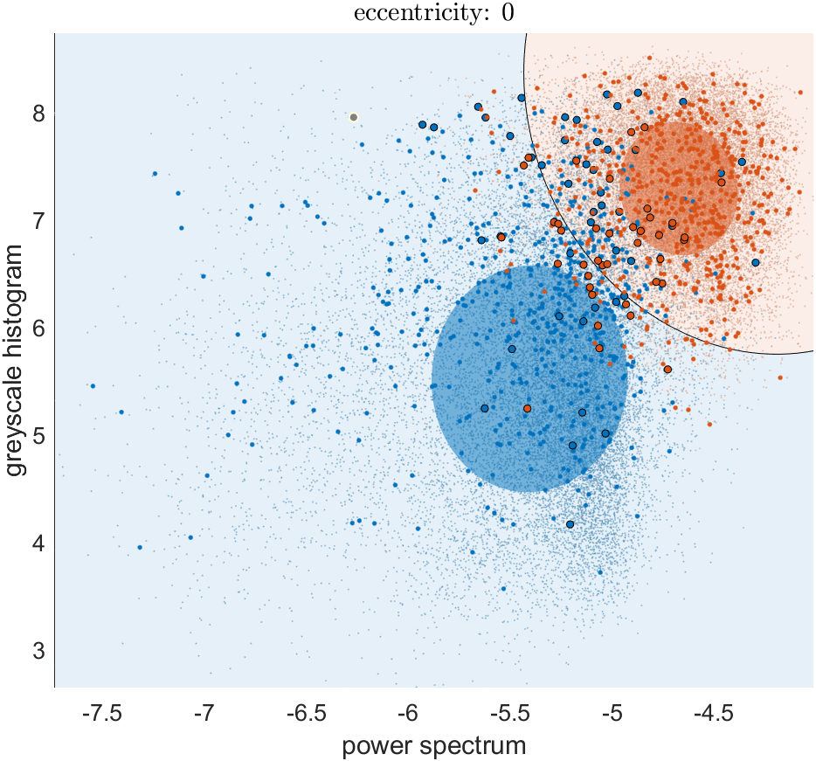
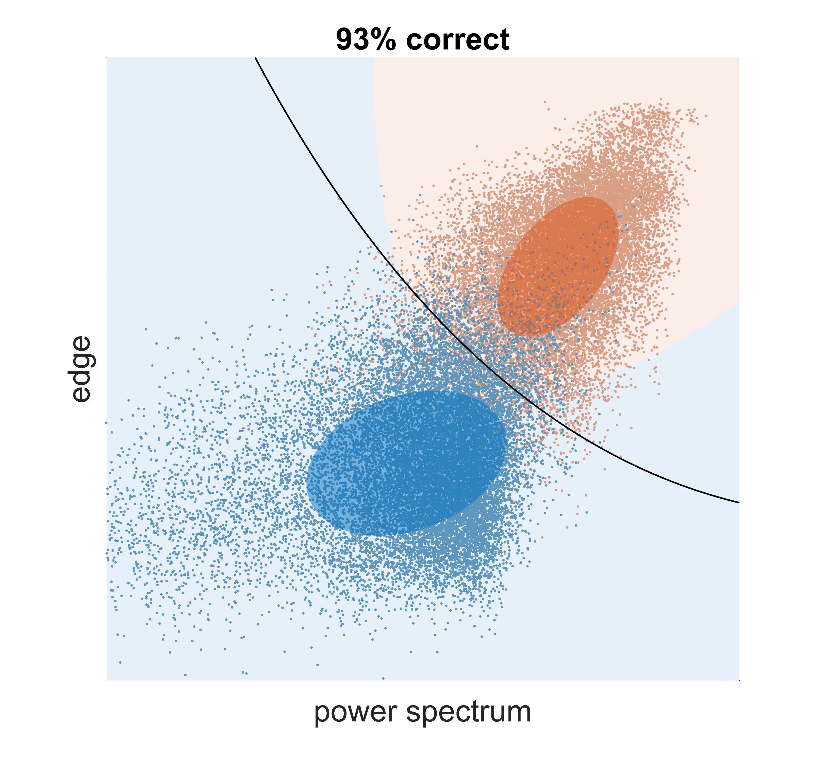
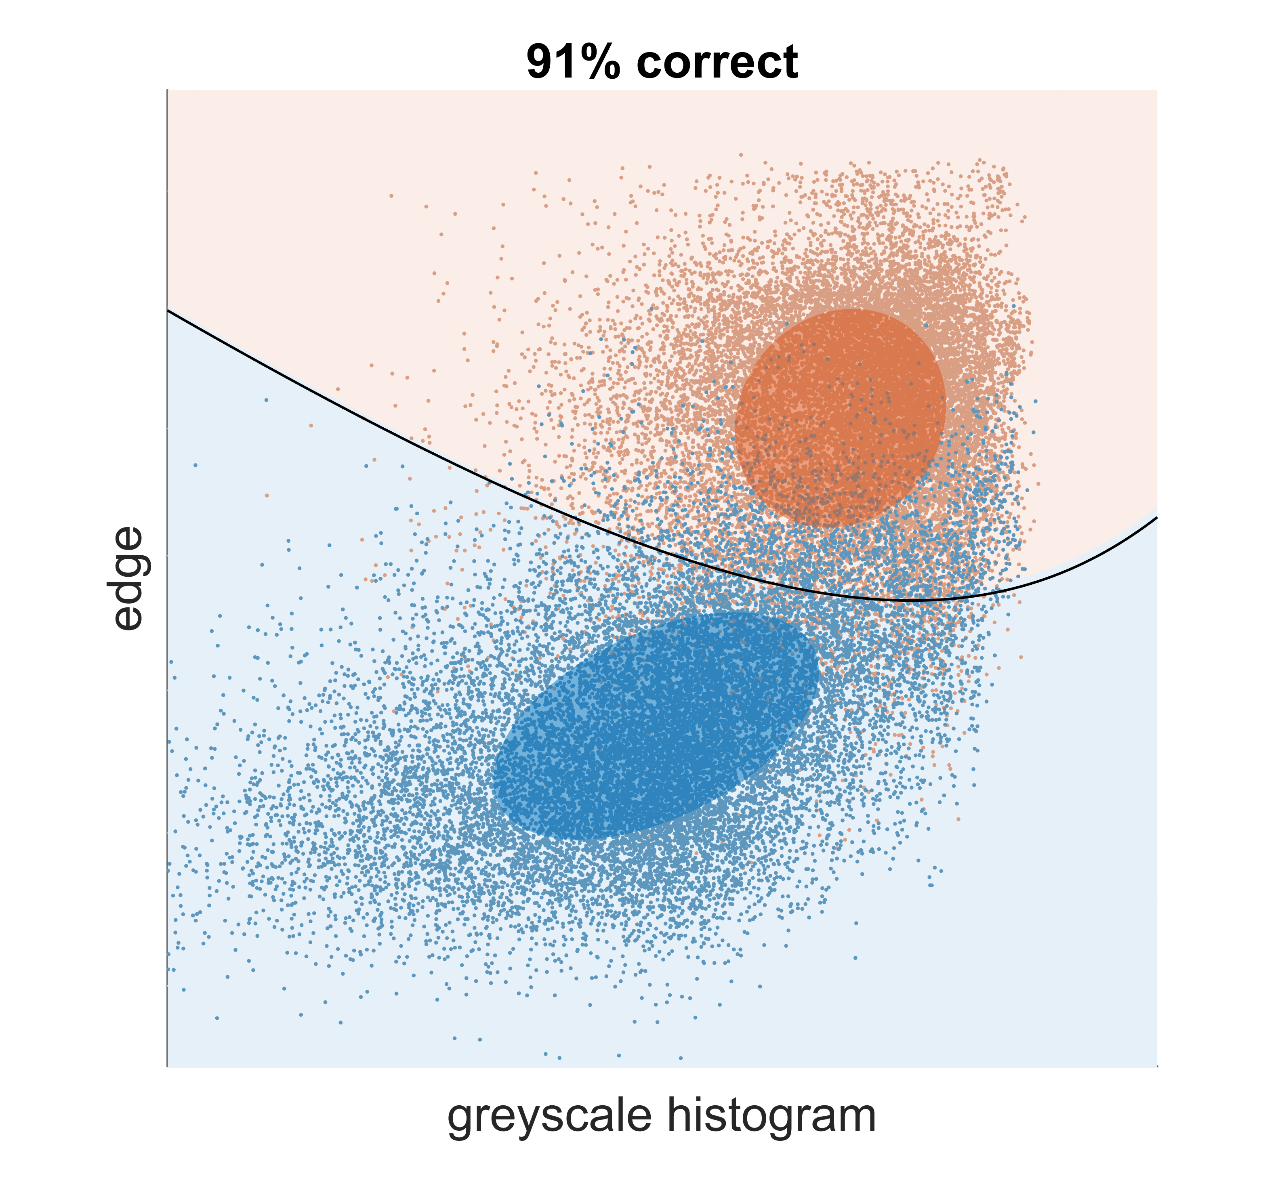
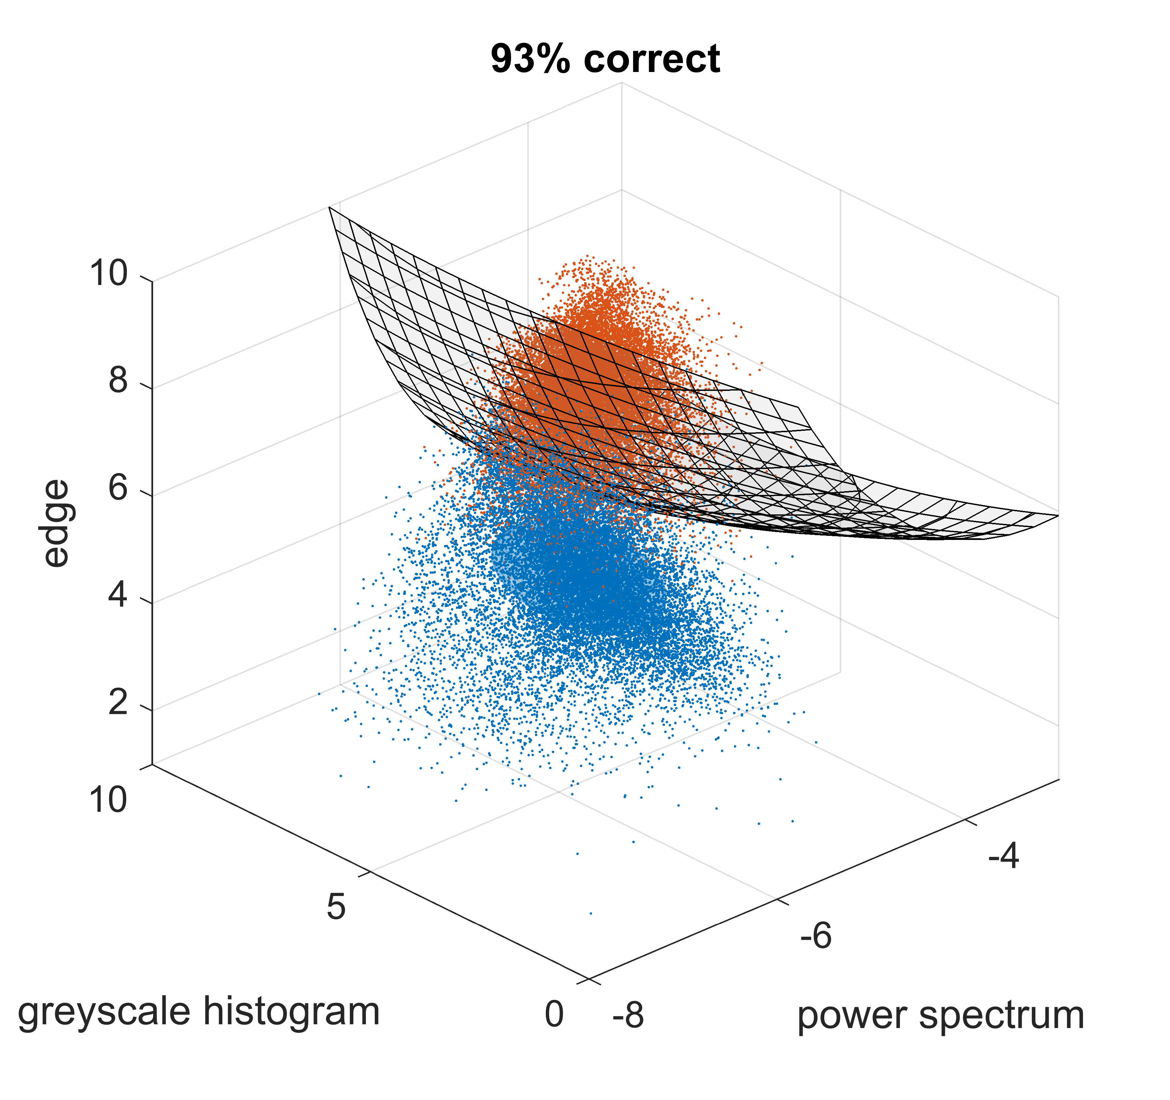
90% correct

Slide 5
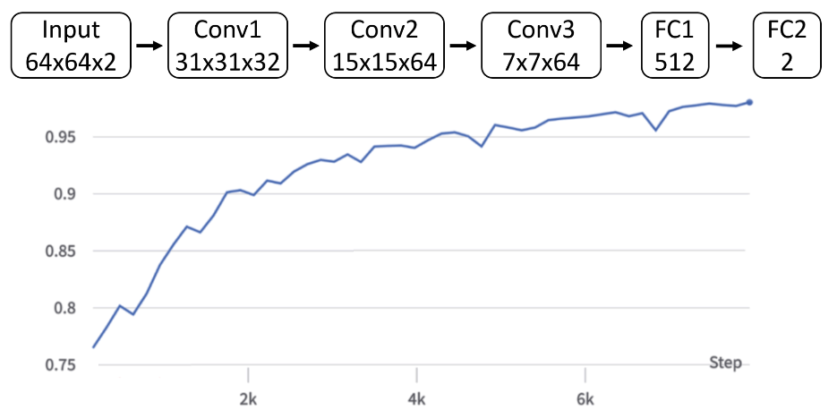
Simple CNN Model (first pass)
Model
Model: a simple CNN (similar to the DQN network)
Conv1 -> Conv2 -> dropout(0.25) -> Conv3 -> dropout(0.5) -> FC1 -> FC2.
Shape: 64x64x2 -> 31x31x32 -> 15x15x64 -> 7x7x64 (3136) -> 512 -> 2.
NLL loss, Adam optimizer (lr=1e-4), batch size=64, epoch=50.
Task 1 (discrimination)
Train: 100K pairs from 60 classes.
Test: 10K pairs from 60 classes.
Task 2 (generalization)
Train: 100K pairs from 50 classes.
Test: 10K pairs from 10 unseen classes.
To consider biologically plausible CNN architectures, read Yamins & DiCarlo review (2016 Nature Neuro)

Slide 6

label
(same/diff)
texture patch 1
$$∑$$
cross-entropy
loss
texture patch 2
subtract
feature vectors
add
features
conv
maxpool
fully
connect

