Slide 1
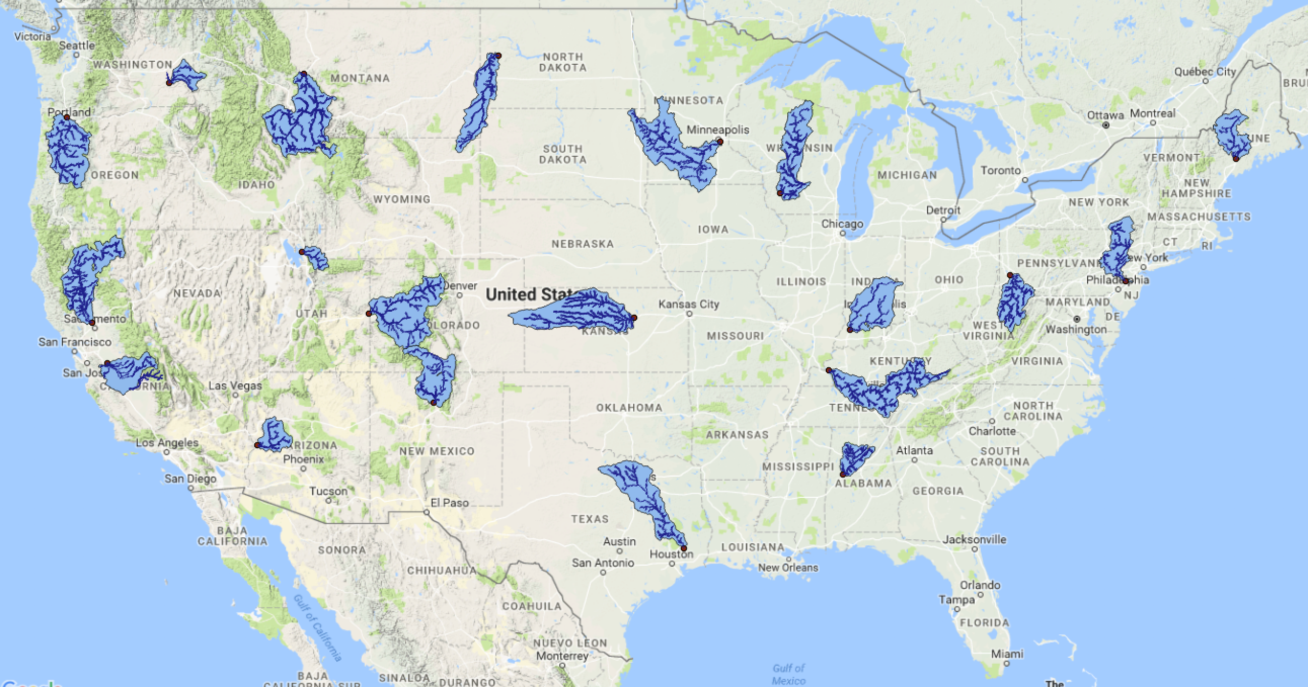
Watershed Name
Drainage area: xx
Landscape Stats:
Title: Xx
Title: Xx
Title: Xx
Title: Xx
Title: Xx
Link to NWC Portal 1
Link to NWC Portal 2
Link to NWIS
Water Budgets Across the Continental U.S.
Text here would explain the idea of a water budget and that this shows how much variation in water budgets there is across the us. Also explain caveats related to water budget closure and uncertainty in the data we are using. Highlight how we are working to close the water budget and improve data accuracy.

