Slide 2
Studied langchain chat with your data
>main venv should be activated
Any changes build is very important

Slide 3
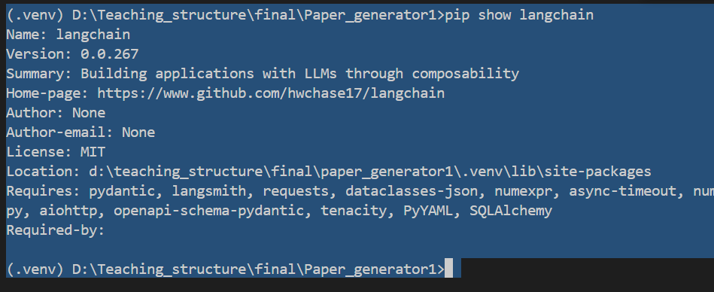

Slide 4
Checking of package and backend verification
Then checking the frontend verification.
Anaconda venv creatres lots of problem
Always use python –m venve unless required
Version dependency issue is there
All are connected with packages

Slide 5
Should always say to modify installation and file both.
And also should say to check stable versions
If something is giving V issue can download manual
Shoul;d always check compatibility carefully
Time taking and error prone

Slide 6
Where can I see the connections:questions

Slide 7
