Slide 2
Studied langchain chat with your data
>main venv should be activated
Any changes build is very important

Slide 3
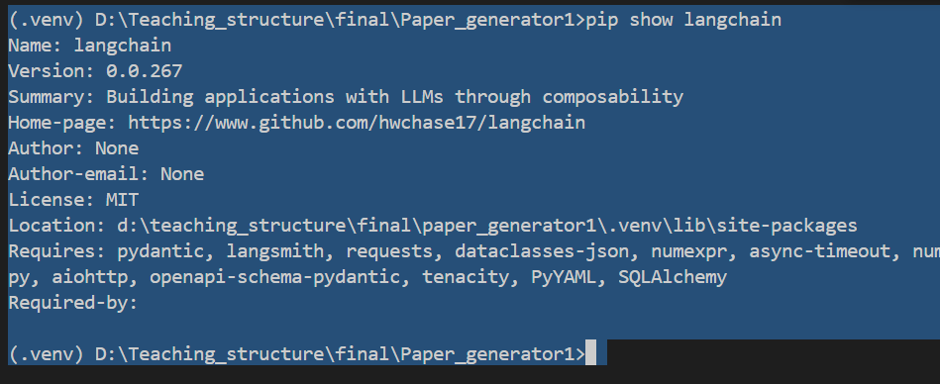

Slide 4
Checking of package and backend verification
Then checking the frontend verification.
Anaconda venv creatres lots of problem
Always use python –m venve unless required
Version dependency issue is there
All are connected with packages

