Slide 1
Battle of Neighbourhoods- A Capstone Project

Slide 2
Business Problem
For candidates who want to pursue their higher education abroad can apply for a university of their choice but to find a decent housing of rental basis or a good neighbourhood can be tricky. Same applies for a family migrating to some other country because of a job change or relocation it becomes important for them to look for a neighbourhood that is decent in price and has most of the facilities as required plus has good schools and colleges nearby them so as to continue the education of their children.
The aim of the Project is to help students/ parents explore different possibilities and take better decision on choosing the best neighborhood out of many neighborhoods in Scarborough city based on the various features in and around that neighborhood.

Slide 3
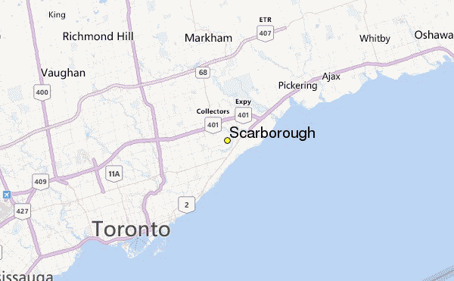
The Location : Scarborough

Slide 4
Data
Longitude and Latitude Data:
We will need geo-locational information about that specific borough and the neighborhoods in that borough. It is "Scarborough" in Toronto.
Dataset comprising latitude and longitude, zipcodes is already available through the previous notebook. The location of Scarborough would be filtered using the same:

Slide 5
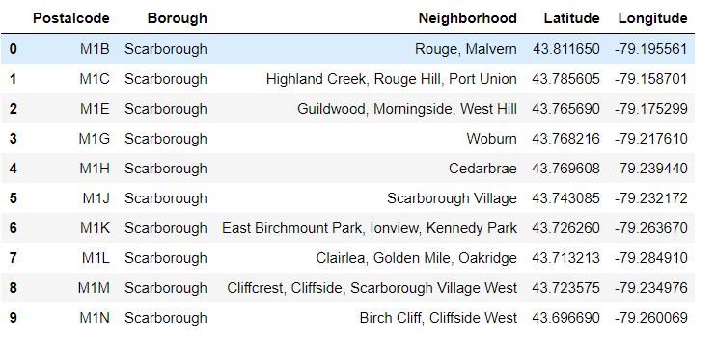
Data collected with it’s geocode

Slide 6
FourSquare API
Connecting to Foursquare and Retrieving Locational Data for Each Venue in Every Neighborhood
After finding the list of neighborhoods, we then connect to the Foursquare API to gather information about venues inside each and every neighborhood. For each neighborhood, we have chosen the radius to be 100 meter.

Slide 7
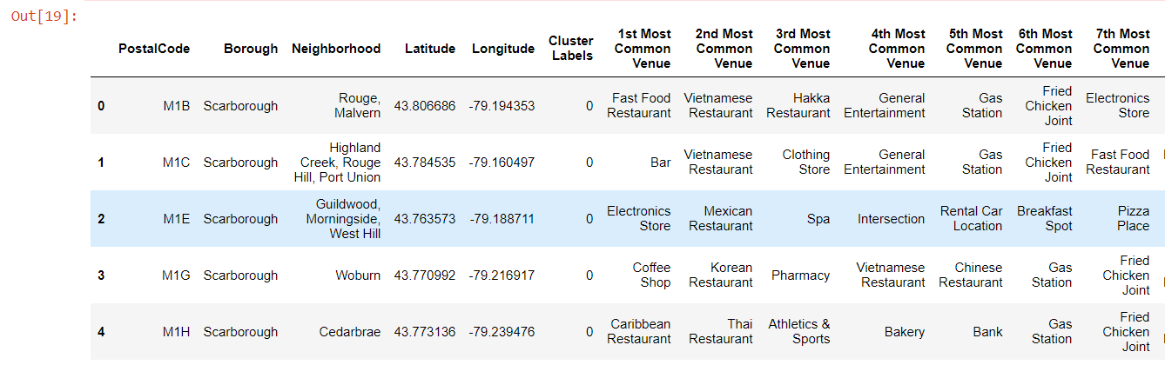
Finding Most Common Venues

Slide 8
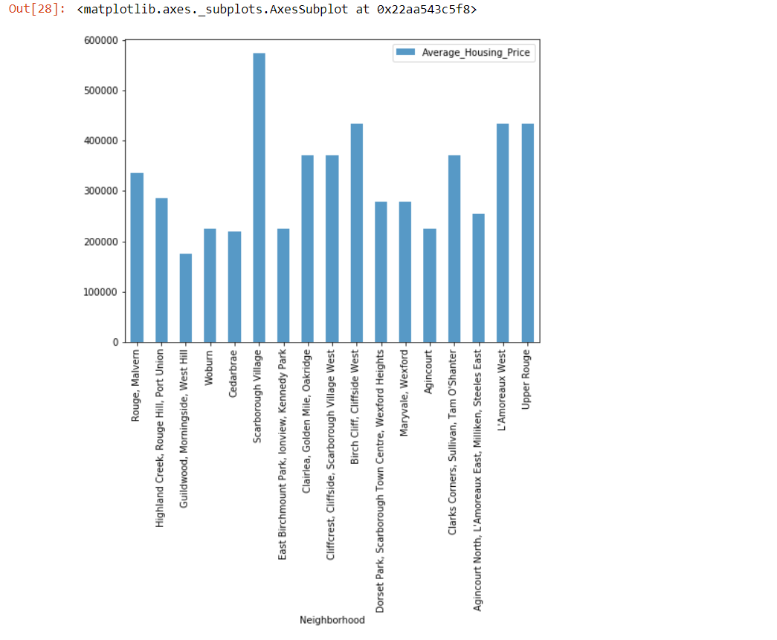
NEIGHBORHOOD MEDIAN HOUSING PRICES

Slide 9
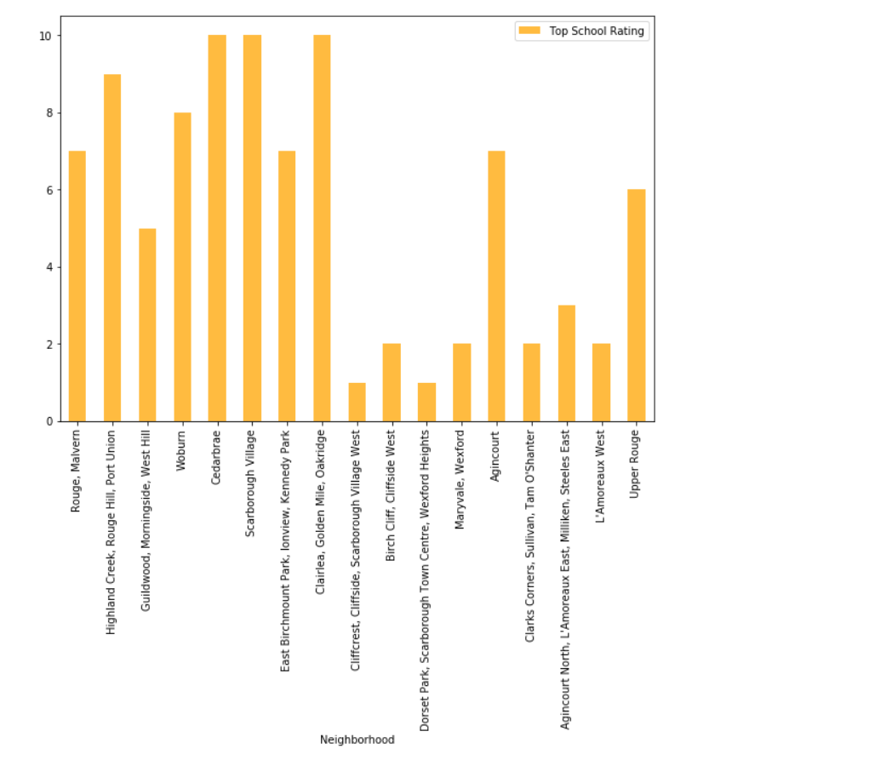
NEIGHBORHOOD SCHOOL RATINGS

Slide 10
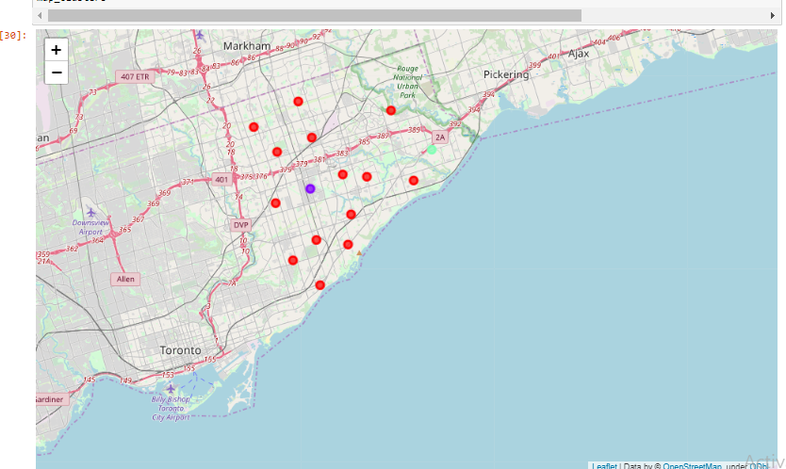
Conclusion
In this project, through a k-means cluster algorithm we separate the neighborhood into 03 clusters, which have similar neighborhoods around them. Using the charts above decision leading to a particular neighborhood based on average house prices and school rating can be made

