Slide 1
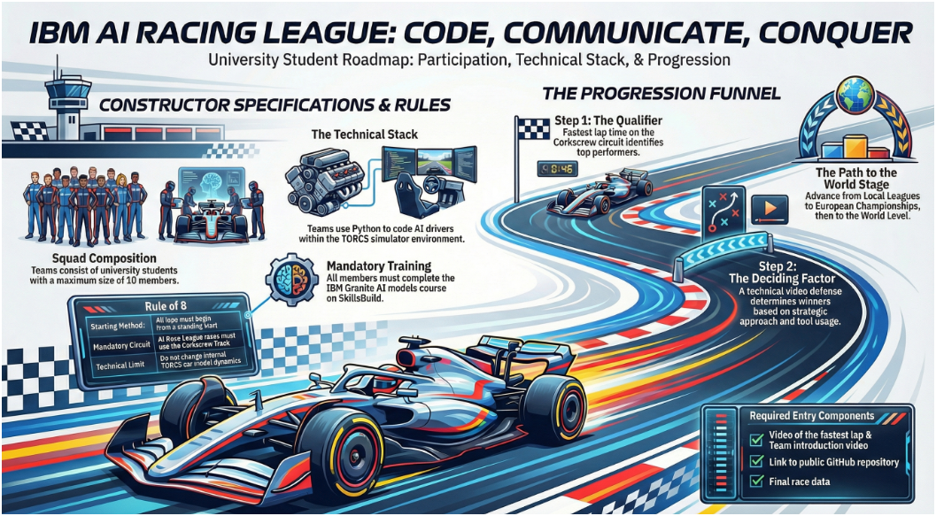
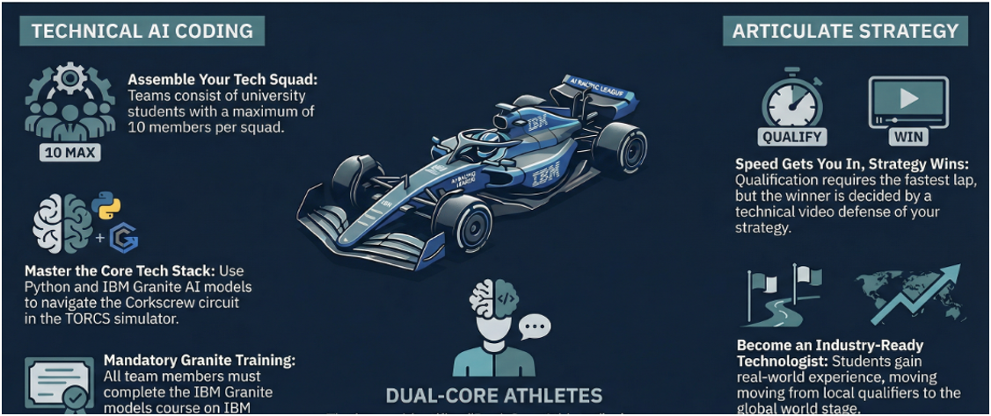
CODE, COMMUNICATE, INNOVATE
Start your engines: https://ibm.biz/TORCSRegtoSub

