Slide 1
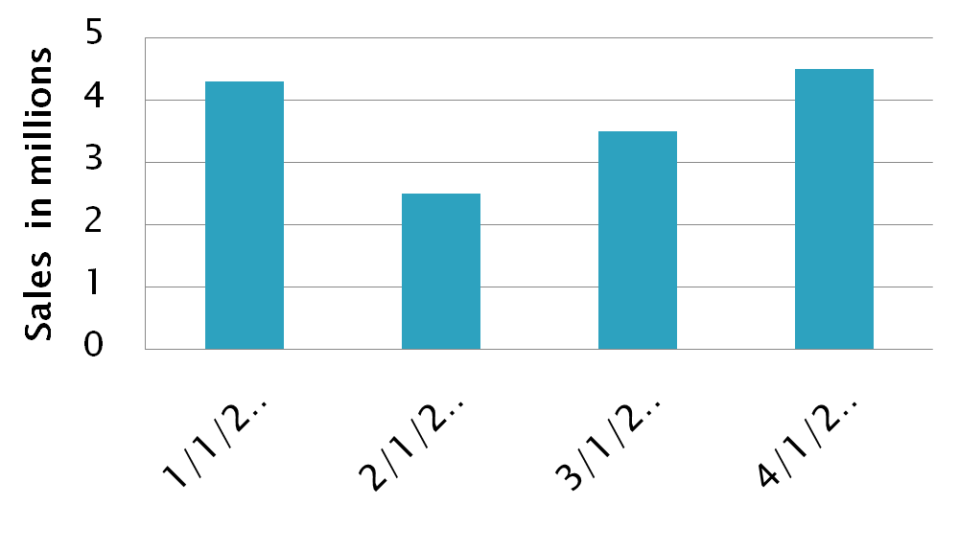
Graph
Different from the graph used in data visualizations.

Slide 2
Graph
Collection of points and lines connecting some subset of them.
34th Street
34th
Domus
Chestnut
Drexel Bookstore
34th
33rd
Dunkin
Walnut
Starbucks
Walnut
Moore
34th
Irvine Auditorium
33rd
Spruce
Franklin Field

Slide 3
Formal definition of a graph
The set of points usually called the vertex set V
The set of lines connecting vertices usually called the edge set E. An edge e = (v,w) means an edge that goes from v to w.
Graph will usually be mathematically denoted as G = (V,E)

Slide 4
Directed and undirected graphs
G = (V,E) is considered undirected if
for all p,q ∈ V,
There is an edge going from p to q if and only if there is an edge going from q to p

Slide 5
Directed graph – driving in Philly
34th Street
34th
Domus
Chestnut
Drexel Bookstore
34th
33rd
Dunkin
Walnut
Starbucks
Walnut
Moore
34th
Irvine Auditorium
33rd
Spruce
Franklin Field

Slide 6
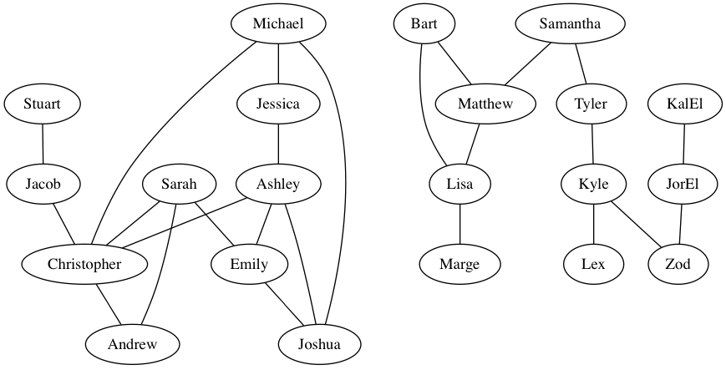
Example undirected graphs
Example friendship graph Courtesy cs.washington.edu

Slide 7
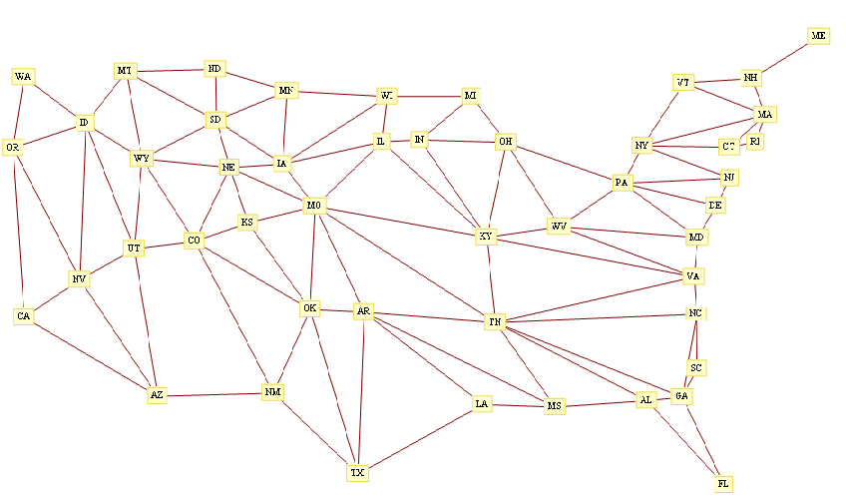
Example undirected graphs

Slide 8
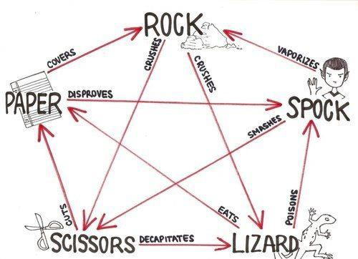
Example directed graphs

