Slide 1
Uncertainty-Aware Machine Learning for Microwave-Based Body Composition Assessment
M AST E R’ S TH E S I S
Student: Abhishek Yadav
Supervisors: Bappaditya Mandal & Robin Augustine
Department of information Technology, Uppsala University

Slide 2
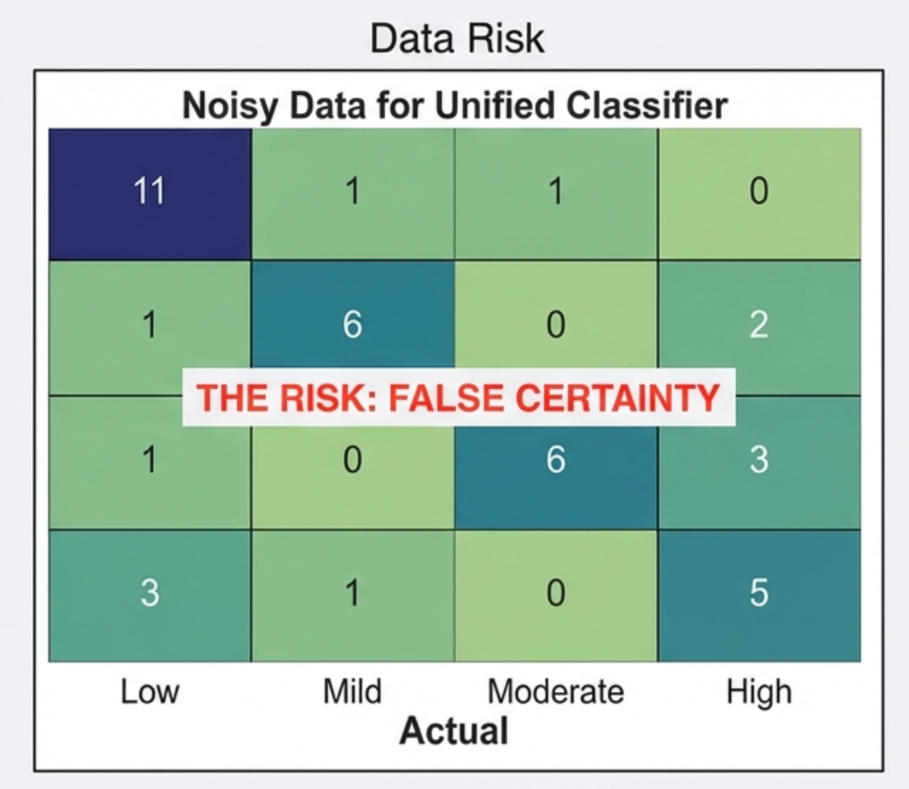
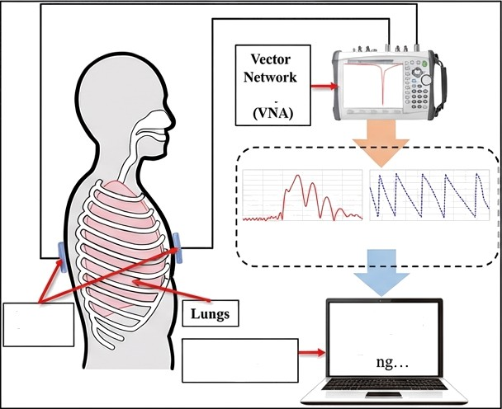
The ‘Trust Gap’ in Clinical Al
Physical Reality
Analyzer
521(Magnitude and Phase)
Antenna Sensors
High Risk
Right
Lu
XgBoost Baeed
Current State: Microwave Sensors + Deterministic XGBoost
The Problem: Point estimates hide model doubt
Clinical Need: System must flag uncertain predictions

Slide 3
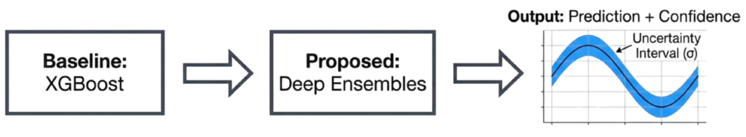
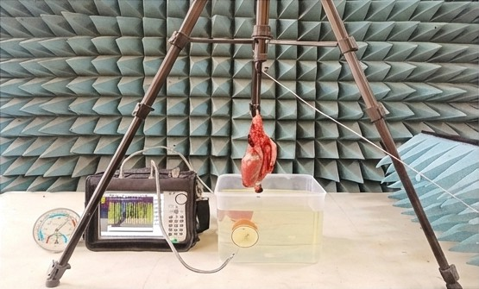
Methodology: From Black Box to Bayesian
Data Sources:
Homogeneous Liquid Phantoms
Ex Vivo Porcine Respiratory Organs
Volunteer Measurements

Slide 4
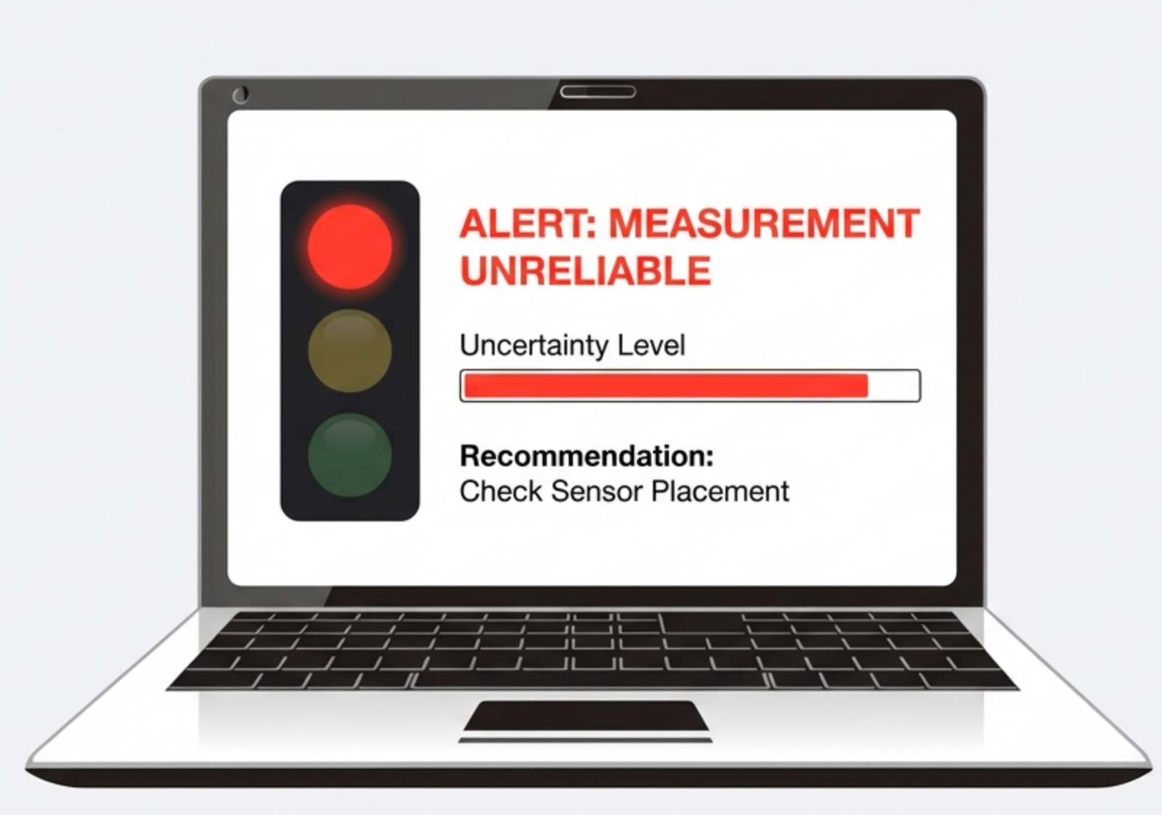
Expected Outcome: Enabling Safe Clinical Translation
Deliverable: Clinical Risk
Score
Mechanism: Automated flags for high uncertainty
Impact: Bridges the gap between lab capability and patient safety

