Slide 1
AUTOMATED ROOM LIGHTING SYSTEM

Slide 2
TEAM MEMBERS 1. Abhyanth.P
2. Rakshit R.K 3. Bharath N
4. Arun Kulkarni
GROUP 18

Slide 3
INTRODUCTION:
Why this project: As per normal human behaviour 70-80% of us keep the light on after we leave the room and hence wasting electricity on a small scale its ok that one light wont consume much power so that wont effect anyone but when we see it on a larger scale as a whole city or state there is huge wastage of electricity overall so in order to avoid this we are doing this project

Slide 4
Working:
Consider we are using this project in a bedroom we keep 2 IR sensor
One outside the room just close to the door from the outside (Ir-1)
Second IR sensor inside the room close to door but from the inside (Ir-2)
Now we program the Arduino such that at First we initialize the Ir sensor output to be 0
First stage we only concentrate on Ir-1 sensor If it detects any movement we check Ir-2 sensor if there also movement is detected then we turn on the lights as the person will go inside the room if only the Ir-1 sensor detects the movement and not Ir-2 then we don’t turn on the lights
Similarly during the second stage now the lights are on and the person is inside the room now we concentrate only on Ir-2 sensor If it detects any movement we check Ir-1 sensor if there also movement is detected then we turn off the lights as the person will go outside the room if only the Ir-2 sensor detects the movement and not Ir-1 then we don’t turn off the lights

Slide 5
What is an IR Sensor?
IR sensor is an electronic device, that emits the light in order to sense some object of the surroundings.
An IR sensor can measure the heat of an object as well as detects the motion.
Usually, in the infrared spectrum, all the objects radiate some form of thermal radiation. These types of radiations are invisible to our eyes, but infrared sensor can detect these radiations.

Slide 6
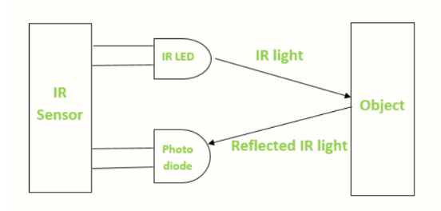
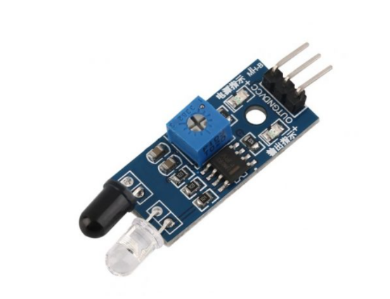

Slide 7
WORKING OF IR SENSORS
emitter is simply an IR LED (Light Emitting Diode) and the detector is simply an IR photodiode
Photodiode is sensitive to IR light of the same wavelength which is emitted by the IR LED.
When IR light falls on the photodiode, the resistances and the output voltages will change in proportion to the magnitude of the IR light received.
There are five basic elements used in a typical infrared detection system: an infrared source, a transmission medium, optical component, infrared detectors or receivers and signal processing.

Slide 8
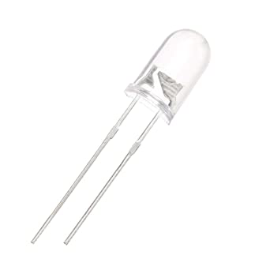
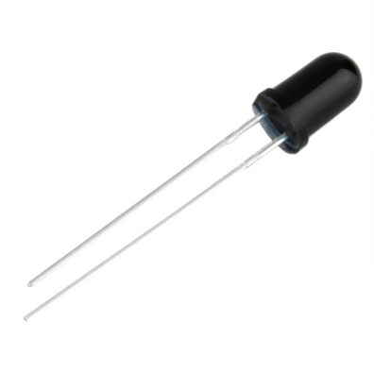
IR LED(emitter )
IR photodiode(detector )

Slide 9
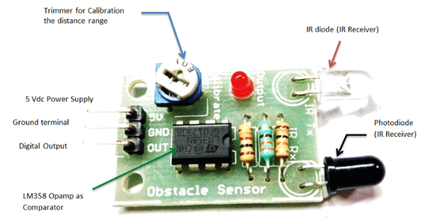
IR Sensor (Components and Pins)

Slide 10
Advantages of Infrared sensor
It provides secured communication due to line of sight or point-to-point mode of communication The battery used in infrared devices last for long duration due to lower power consumption.
Infrared motion sensors detect motion in daytime and nighttime reliably.
The sensor does not require any contact with the product to be sensed.
The infrared devices are more appropriate for targets which are close than 10 mm.
Infrared devices can measure distance to soft objects which may not be easily detected by ultrasound.
They are physically smaller in size and are more affordable.

Slide 11
It has response time faster than thermocouple.
It provides good stability over time.
No corrosion or oxidation can affect the accuracy of infrared sensor.
It delivers high repeatability.

Slide 12
Applications
Proximity Sensor
Item Counter
Burglar Alarm
Radiation Thermometers
Human Body Detection
Gas Analyzers

Slide 13
Arduino details
The Arduino Uno is an open-source microcontroller board based on the Microchip ATmega328P microcontroller
The board has 14 digital I/O pins (six capable of PWM output), 6 analog I/O pins, and is programmable with the Arduino IDE (Integrated Development Environment), via a type B USB cable.
It can be powered by the USB cable or by an external 9-volt battery, though it accepts voltages between 7 and 20 volts.

Slide 14
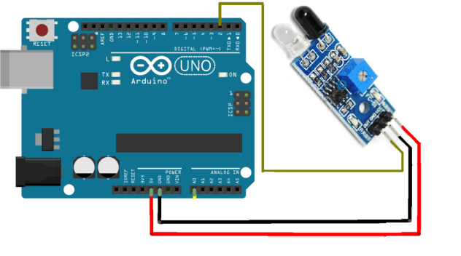

Slide 15
Sensor connections
1. The vcc pin of the IR sensor is connected to 5v of the arduino
2. The ground pin of the IR sensor is connected to the gnd of the arduino
3. The digital output of the sensor is connected to the digital pin of the arduino

