Slide 1
AUTOMATED ROOM LIGHTING SYSTEM

Slide 2
TEAM MEMBERS 1. Abhyanth.P
2. Rakshit R.K 3. Bharath N
4. Arun Kulkarni
GROUP 18

Slide 3
INTRODUCTION:
Now with increasing technology day by day all the work done by human is being automated to reduce errors, decrease the cost, high efficiency.
We prefer automation because the result quality increases labour decreases so that less money can be spent of labour and more on quality of the result .
Now what is home automation: Home automation or domotics is building automation for a home, called a smart home or smart house. A home automation system will control lighting, climate, entertainment systems, and appliances. It may also include home security such as access control and alarm systems,
Our project is an application of home automation which deals with automatic turning on the light when a person enters the room and turn off when the person leaves the room.

Slide 4
Cloud used: https://thingspeak.com/ Our project channel: https://thingspeak.com/channels/1223049

Slide 5
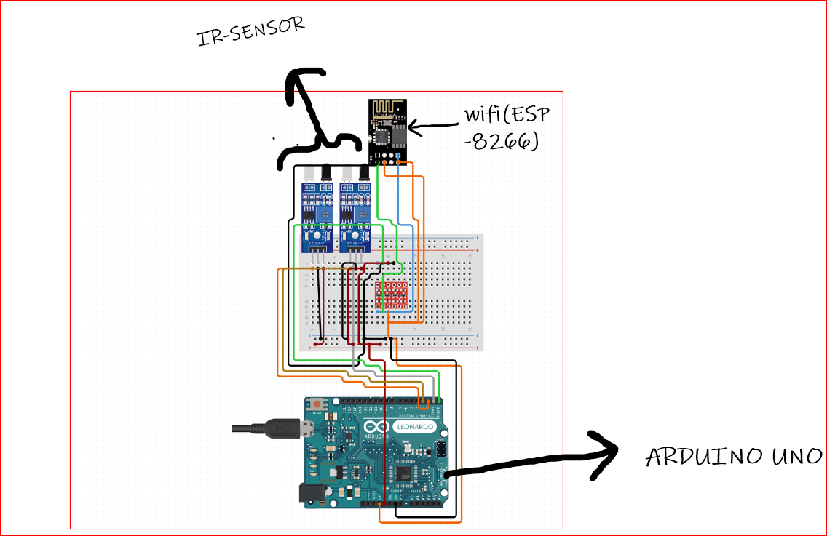
Transmitter:
Transmitter:

Slide 6
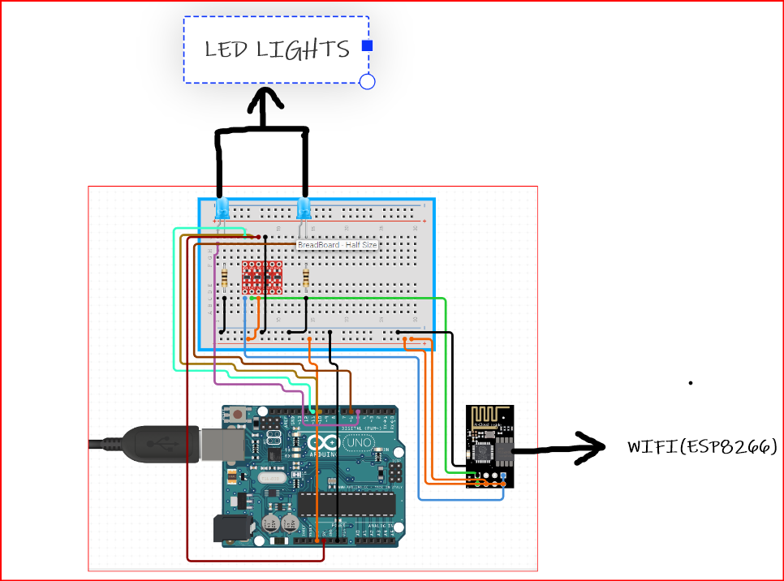
RECIVER:

Slide 7
PROGRAM
#include<SoftwareSerial.h>//for bluethooth and wifi module
#define ir_out1 6//ir sensor-1
#define ir_out2 7//ir sensor-2
SoftwareSerial bt(2,3);//(Rx,Tx)//the bluetooth pins
SoftwareSerial wifi(4,5);//(Rx,Tx)//wifi pins
String wifiname="helloo";
String pass="bye";
String data;
int res1,res2;

Slide 8
void setup() {
// put your setup code here, to run once:
pinMode(ir_out1,INPUT);
pinMode(ir_out2,INPUT);
bt.begin(9600);
wifi.begin(9600);
Serial.begin(9600);
espcmd("AT+RST");//attention command to reset the wifi module
espcmd("AT+CWMODE=1");//wifi module acts as a client
espcmd("AT+CWJAP=\""+wifiname+"\",\""+pass+"\"");//attention command to connect to local wifi network
while(!wifi.find("OK")){
//becomes false and exits the loop only after the wifi module is connected
}
delay(1000);
}

Slide 9
void loop() {
// put your main code here, to run repeatedly:
res1=digitalRead(ir_out1);//reads output from the first ir sensor
res1=digitalRead(ir_out2);//reads output from the second ir sensor
if(res1==1){
light_on();//user defined function to turn on lights
}
else if(res2==1){
light_off();//user defined function to turn off lights
}

Slide 10
void light_on(){//user defined function to turn on lights
espcmd("AT+CIPMUX=0");//attention command to specify number of devises to be connected
espcmd("AT+CIPSTART=\"TCP\",\"api.thingspeak.com\",80");//adhress of the cloud we are using
String data="/update?api_key=EG23Y36D9LLC1KRJ&field1=1";//read api key given by the cloud
espcmd("AT+CIPSEND="+String(data.length()+2));//attention comman to send data
wifi.find(">");
wifi.println(data);
espcmd("AT+CIPCLOSE=0");
delay(1000);
}

Slide 11
void light_off(){//user defined function to turn off lights
espcmd("AT+CIPMUX=0");
espcmd("AT+CIPSTART=\"TCP\",\"api.thingspeak.com\",80");//adhress of the cloud we are using
data="/update?api_key=EG23Y36D9LLC1KRJ&field2=1";//read api key given by the cloud
espcmd("AT+CIPSEND="+String(data.length()+2));//attention comman to send data
wifi.find(">");
wifi.println(data);
espcmd("AT+CIPCLOSE=0");
delay(1000);
}
void espcmd(String cmd){//function to write in the esp monitor
wifi.println(cmd);//used to print in the esp monitor
delay(1000);
}

Slide 12
THANK YOU

