Slide 1
AUTOMATED ROOM LIGHTING SYSTEM

Slide 2
TEAM MEMBERS 1. Abhyanth.P
2. Rakshit R.K 3. Bharath N
4. Arun Kulkarni
GROUP 18

Slide 3
Problem Statement: Write an Embedded C program for interfacing Infrared Sensorswith Arduino and its application scenario.

Slide 4
Problem Solution: We have used IR sensor to implement burglar detection system where we use 2 IR sensors one which is outside the door(IR-1) and one present inside the door(IR-2)

Slide 5
INTRODUCTION:
Now with increasing technology day by day all the work done by human is being automated to reduce errors, decrease the cost, high efficiency.
We prefer automation because the result quality increases labour decreases so that less money can be spent of labour and more on quality of the result .

Slide 6
Cloud used: https://thingspeak.com/ Our project channel: https://thingspeak.com/channels/1223049

Slide 7
URL for the IFTTT website:
https://ifttt.com/home

Slide 8
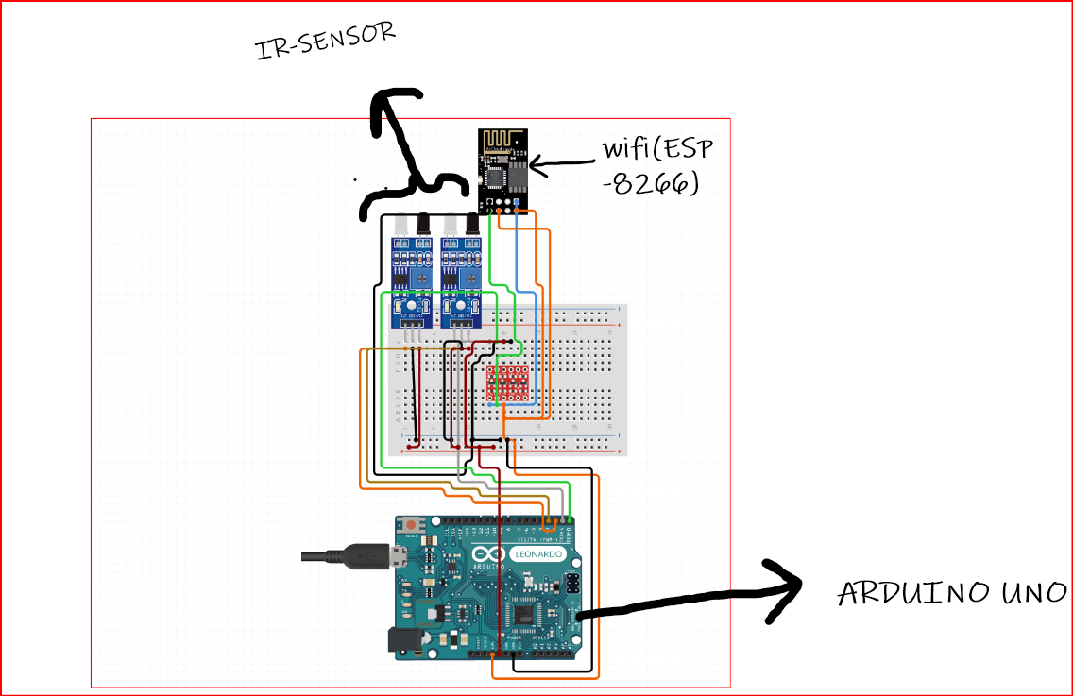
Circuit diagram:
Transmitter:

Slide 9
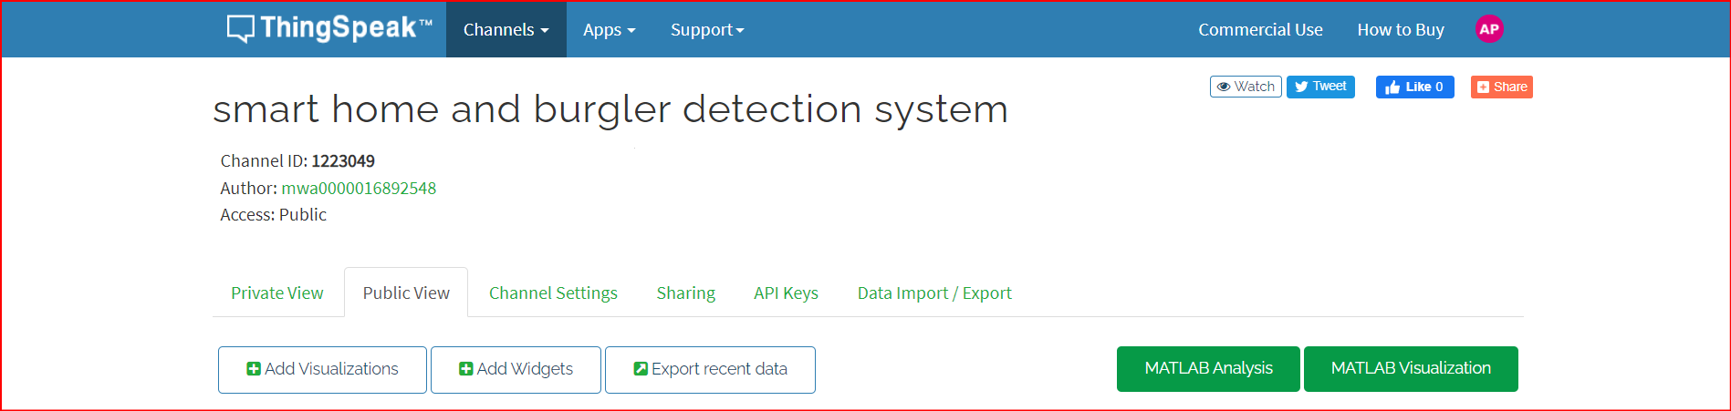
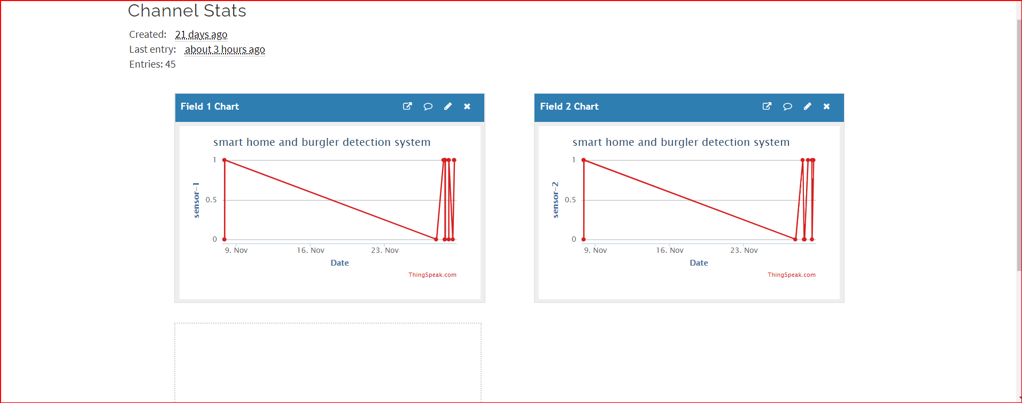
CLOUD:

Slide 10
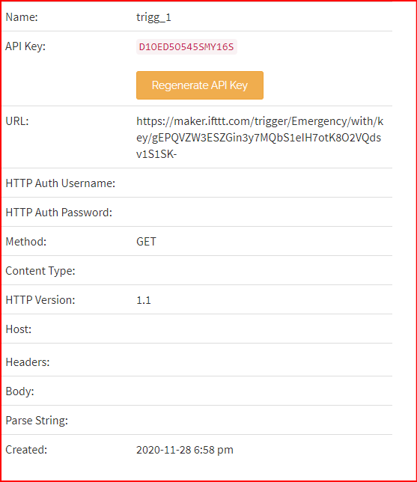
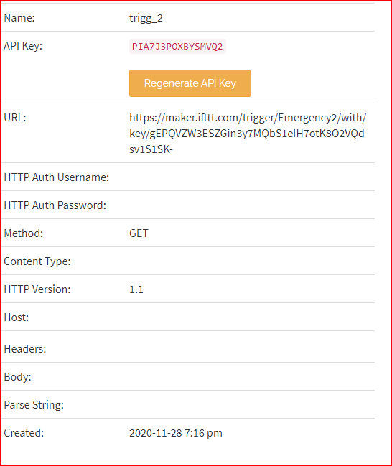
TRIGGERS

Slide 11
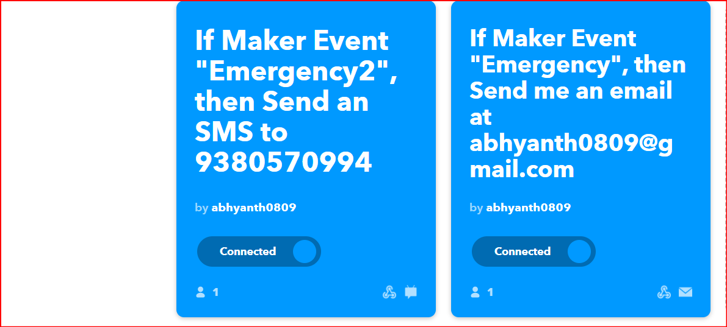
IFTTT

Slide 12
APPLICATION
This project can be used with image processing to see who is in front of the door and recognize if he is a threat or not

Slide 13
THANK YOU

