Slide 1




OWASP Top 10

Slide 2
Introduction
OWASP is an online international community on web application security
  Produces freely available methods, articles and tools on app security
  Led by the OWASP foundation in the United States
The OWASP Top 10 project is a standard awareness document for developers and web application security
Goal is to raise awareness on critical application security risks by ranking the top 10 risks
OWASP Community frequently publishes the most critical web application vulnerabilities
Companies are expected to adopt this document and start the process of ensuring that their web applications minimize these risks
OWASP – first developed in 2003
  Releases: 2004, 2007, 2010, 2013, 2017, 2021
2

Slide 3
Attack to Impact Path
Threat Agent
Attack Vectors
Security Weakness
Security Control
Technical Impact(s)
Business Impact(s)
3

Slide 4
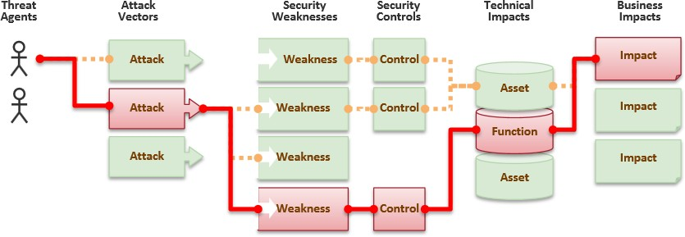
Attack to Impact Path
4

Slide 5
Attack to Impact Path (1/2)
Ref: http://owasptop10.googlecode.com/files/OWASP%20Top%2010%20-%202013.pdf
Analogy – consider different types of insects as Threat agents
Attack vectors can be human body, uncovered food. Consider mosquito bite as an
attack, then having a very sensitive skin is like security weakness
Mosquito to be able to bite on sensitive skin is threat agent taking hold of security
controls
Technical impacts can be reactions on skin like rashes. Business impacts can be not going to school / office hence missing study /facing loss of pay etc.
5

Slide 6
Attack to Impact Path (2/2)
Real Example – an employee trying to get hold over confidential data without an
approval is threat agent
Shared Folders, Databases, Codebases, Document bases are attack vectors
Shared folder location with public access or Database with exposed credentials is security weakness. If shared folders contains trade secrets, it would be threat agent taking over security controls
Technical impacts would be Trade secrets are no longer protected OR Database has got all data exposed where it shouldn’t. Business impacts are – entire business can go down of trade secrets make their way to competitors

Slide 7
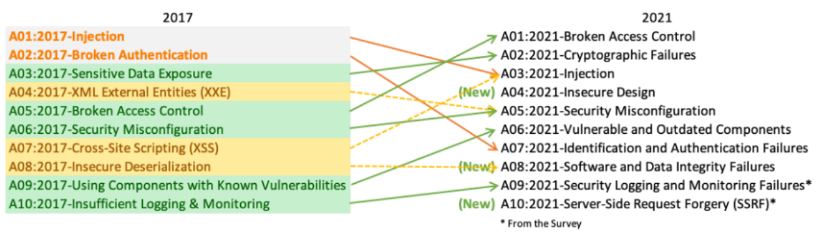
OWASP Top 10 Web App Application Security Risks
7

Slide 8
A1 – Broken Access Control
Users of the application can operate outside their defined permissions
Key Concepts
  Access Control → Process by which you disallow access → selectively restrict access
  Features or data require permissions to access them
  Authorization is the actual permission to access certain features or data
  Violation of Principle of Least Privilege
  Access to unauthorized information or specific features of the application is made available

Slide 9
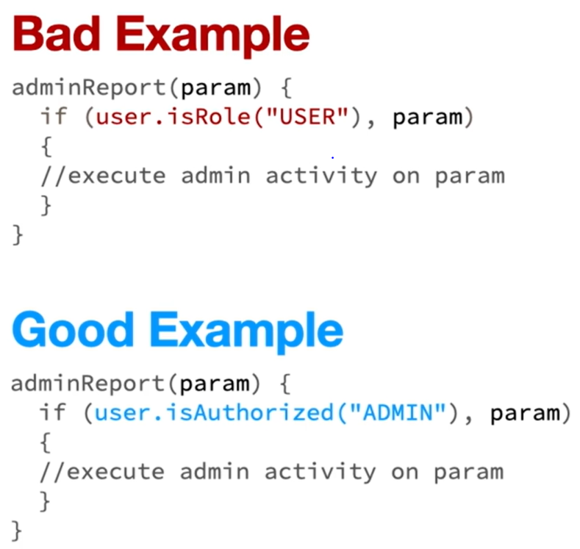
A1 – Broken Access Control

Slide 10
A1 – Broken Access Control
How to prevent?
  Except for public resources, deny by default
  Implement access control mechanisms once and re-use them throughout the application
  Disable web server directory listing
  Model access controls should enforce record ownership rather than accepting that the user can create, read, update, or delete any record
  Log access control failures, alert admins when appropriate

Slide 11
A2 – Cryptographic Failures formerly known as Sensitive
Data Exposure
The use of weak, deprecated or incorrect cryptographic algorithms
Key Concepts
  Data Protection → decide whether it’s required in transit or at rest
  Cryptography
    The art & science of keeping messages secured
  Encryption
    An algorithm for transforming messages (plain text) into secure messages (ciphertext) using a key
  Weakly protected data can be used to conduct identity theft and other crimes like credit card frauds, etc.
  Attackers do not break crypto directly, but they steal keys, do a man-in the middle attack, steal clear text in transit, etc.

Slide 12
A2 – Cryptographic Failures formerly known as Sensitive
Data Exposure
How to prevent?
  Don't store sensitive data unnecessarily. Discard it ASAP
  Make sure to encrypt all sensitive data at rest
  Encrypt all data in transit with secure protocols such as TLS, HTTPS, etc.
  Disable caching for response that contain sensitive data
  Encrypt passwords using hashing algorithms rather than encryption algorithms
  Reduce the number of people who have direct access to data/data backup

Slide 13
A3 – Injection
An instance where an attacker can supply untrusted data to a web app that is processed by the protocol as a command or query
Key Concepts
  New malicious commands → Can be added to an application/query via injection
  Use of untrusted data in the construction of vulnerable SQL calls
  Common injections → SQL, OS or command, Object Query, etc.
  Changes the execution flow
  Stealing of data from databases and other sources
  Running of malicious OS commands

Slide 14
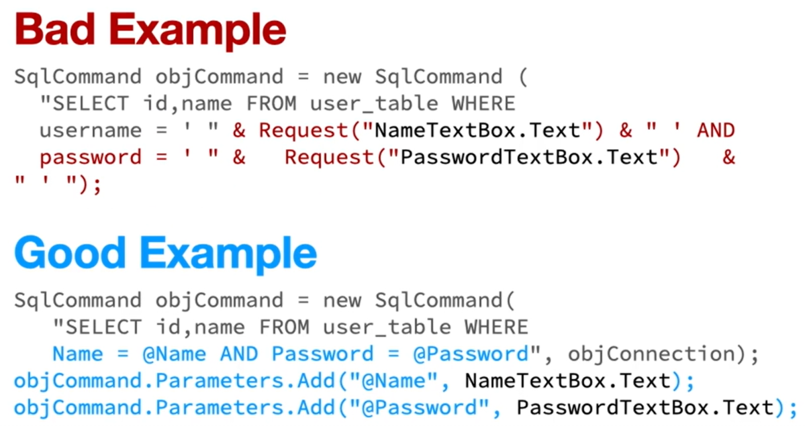
A3 – Injection

Slide 15
A3 – Injection
How to prevent?
  Use data sanitization techniques or parameterized SQL Queries instead of string concatenations
  Use Stored Procedures
  Enforce least privilege
  Validate input through whitelist/blacklist

Slide 16
A4 – Insecure Design (NEW)
The collection of security flaws within the web app that cannot be attributed to or fixed by implementation
Key Concepts
  Architectural Flaw
    Flaws of Omission → Ignoring a threat or requirement
    Flaws of Realization → Design is good, but errors in the implementation
  Insecure design is one in which needed security controls were never created to defend against specific attacks
  Is a broad category and highlights multiple weaknesses at the architectural level
  Examples
    Application data access with only user id
    No limit for incorrect login attempts
    Plan text password storage in the DB
    Not using secured connections
    Not encrypting sensitive data at rest, etc.
    Generation of error messages containing sensitive information

Slide 17
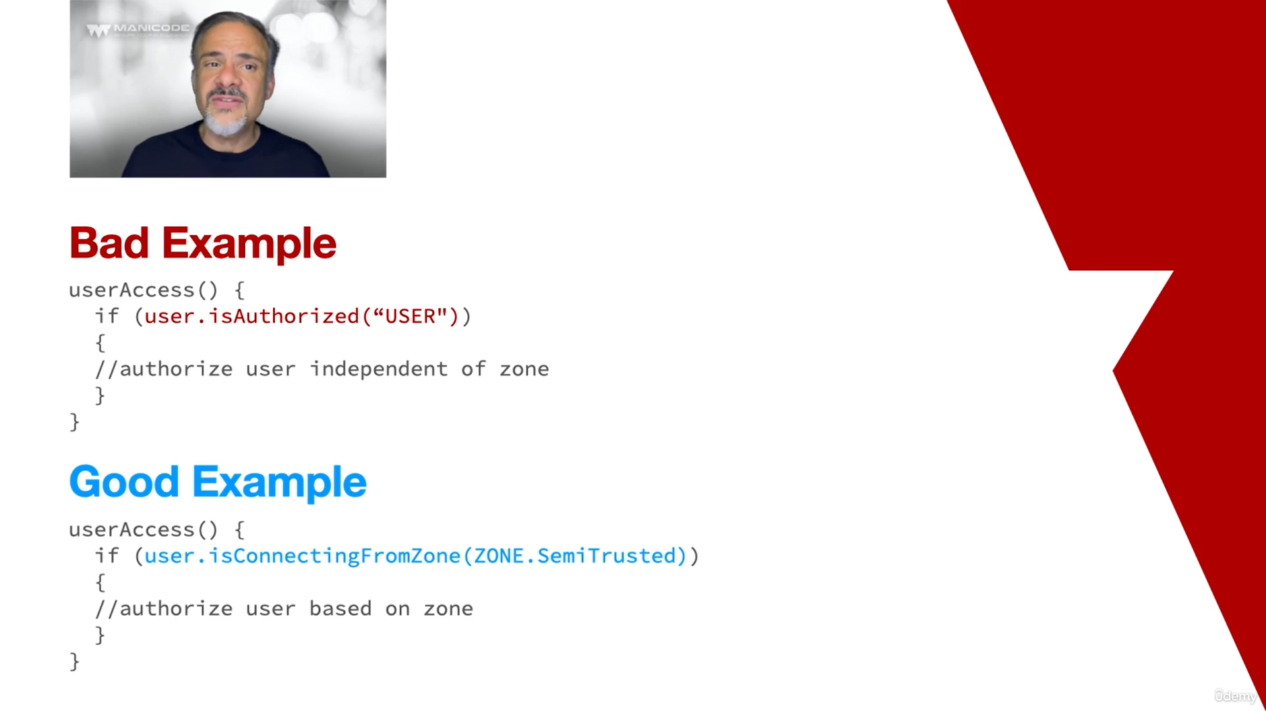
A4 – Insecure Design (NEW)
Insecured Design

Slide 18
A4 – Insecure Design (NEW)
How to prevent?
  Establish and use a secure development lifecycle with AppSec professionals to help evaluate and design security and privacy-related controls
  Use threat modeling for critical authentication, access control, business logic, and key flows
  Write unit and integration tests to validate that all critical flows are resistant to the threat model
  Use known design patterns

Slide 19
A5 – Security Misconfiguration
Failing to implement the necessary controls to secure the configurations of an app
Key Concepts
  Misconfiguration occurs because the configuration has not been hardened
  Can be at any level of an application stack, including the platform, Web Server, framework or custom code
  It’s the result of keeping default settings in place
  Developers & network admins must work together to ensure that the entire application stack is configured properly
How to prevent?
  Turn off extra features and ports
  Disable or change default accounts
  Configure web apps so as to disable exposing error details to the browser
  Keep application parameters secured
  Development, QA, and production environments should all be configured identically, with different credentials used in each environment

Slide 20
A6 – Vulnerable and Outdated Components formerly known as Using Components with known vulnerabilities
Having, in use, software components/plugins that are vulnerable, unsupported or out of date
Key Concepts
  Previous versions of software/components have security vulnerabilities, which may have been fixed in the next version
  End of Life and End of Sale
  Widespread use of open source components/plugins with known security vulnerabilities in modern day app development
    This includes the OS, web server, APIs, DBs, runtime environments, etc.
  Attacker identifies a weak component through scanning or manual analysis and may customize its behavior to exploit as needed

Slide 21
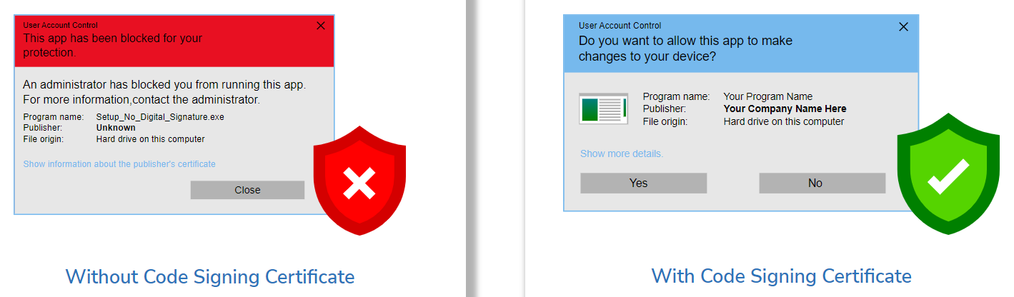
A6 – Vulnerable and Outdated Components formerly known as Using Components with known vulnerabilities
How to prevent?
  Remove unused dependencies, unnecessary features, components, files
  Only obtain components from trusted sources over secure links
  Monitor for libraries and components that are unmaintained or whether they have bug/security vulnerabilities fixes
  Subscribe to email alerts for security vulnerabilities related to components you use
  Continuously monitor sources like Common Vulnerability and Exposures (CVE) and National Vulnerability Database (NVD) for vulnerabilities in the components

Slide 22
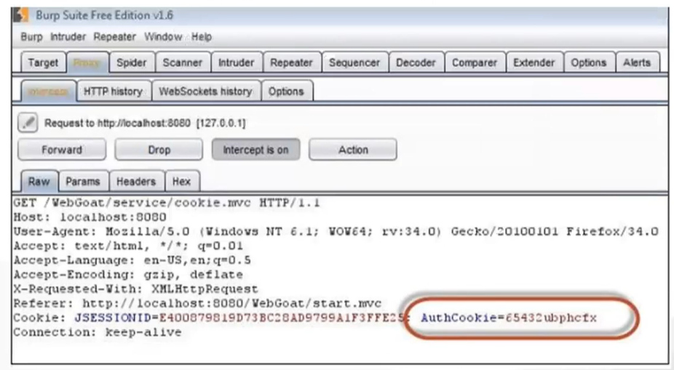
A7 – Identification and Authentication Failures formerly known as Broken Authentication
Being able to perform successful attacks that disclose identity attributes on the system or web app in use
Key Concepts
  Digital Identity → set of attributes like username, password, etc. that relate to a person or organization
  Identification → act of showing or sharing attributes related to your identity
  Authentication → process of validating/confirming the identity of the user
  Attackers use leaks or flaws in the authentication or session management functionalities (leaked session ids, user names, etc.) to impersonate users
  Attackers can use password cracking tools to get the password
    Credential Stuffing attack
    Brute Force attack
  Attackers can use sniffing/request monitoring tools to get the logged in user’s session id/authentication cookie/auth token details
    This can be used to make fake HTTP requests by passing the valid information via HTTP headers

Slide 23
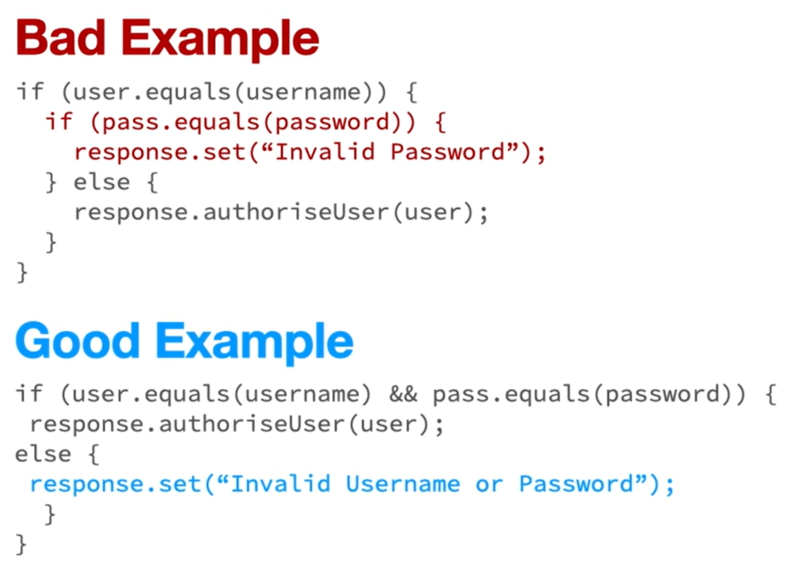
A7 – Identification and Authentication Failures formerly known as Broken Authentication

Slide 24
A7 – Identification and Authentication Failures formerly known as Broken Authentication
How to prevent?
  Implement MFA wherever possible
  Use secure communication channel (HTTPS)
  Implement password length, complexity, and rotation policies
  Avoid session ids for authentication. Use secured cookies (HTTPS)
  Limit or increasingly delay failed login attempts
  Log and alert administrators when brute force, or other attacks are detected

Slide 25
A8 – Software and Data Integrity Failures (NEW)
Having software code that does not prevent the inclusion of functionality from untrusted sources
Key Concepts
  Software Integrity Verification → Based on the principle of trust but verify
  Continuous Integration → Automated build, testing, code analysis, merging of all developers working copies
  Continuous Delivery → Process of releasing software in an automated manner without manual intervention

Slide 26
A8 – Software and Data Integrity Failures (NEW)
How to prevent?
  Always download software from trusted repositories
  Do not deserialize untrusted data
  Involve security teams when downloading software from untrusted sources

Slide 27
A9 – Security Logging and Monitoring Failures previously known as Insufficient Logging and
Monitoring
Having auditable events, warnings and errors within our web app which are not adequately logged
Key Concepts
  Event Logging → Centralized way of recording important software events, for example, OS events, etc. and storing them in an event log
  Event Monitoring → Process of collecting & signaling event occurrences for future analysis
  Security Logging and Monitoring → Logging and monitoring events that can impact the confidentiality or integrity of the software

Slide 28
A9 – Security Logging and Monitoring Failures previously known as Insufficient Logging and
Monitoring
How to prevent
  Ensure all login, access control failures, input validation failures are logged
  Effective monitoring and alerting when suspicious activities are detected

Slide 29
A10 – Server-Side Request Forgery
Force the server-side application to make requests to an unintended location
Key Concepts
  Server Side → Programs & operations that run on the server, like an API on the backend
  Request Forgery → A web request that appears legitimate, but contains malicious input
  SSRF → Occurs whenever a web application is fetching a remote resource without validating the user-supplied URL

Slide 30
A10 – Server-Side Request Forgery
How to prevent?
  Validate URL inputs
  Disable unused URL schemas
  Use DNS Domain Whitelisting
  Enforce internal authentication

