Slide 1

Fault-Tolerant All-Pairs Mincuts Undergraduate Project (UGP)
Presented by - Abhyuday Pandey
(BT/CSE/170039)
Supervisor : Dr Surender Baswana, Professor

Slide 2


Fault-tolerant Model
Given k nodes or edge failures. Report a specified query (shortest path, connectivity etc.) in presence of failures.
Aim
Data structure should be very compact.
Query time should be small.
Often a space-time trade-off.
Alice
Bob

Slide 3
Some classic fault-tolerance results
Shortest Path with single vertex/edge failure (directed weighted graph)
Demetrescu et al. [SIAMJ 2008] O(n²logn) space O(1) query time.
Bernstein and Karger [STOC 2009] O(n²logn) space O(1) query time.
Fault Tolerant Spanners for General Graphs
Chechik et al. [SIAMJ 2010]
Our results
All-pairs Mincuts with single edge failure (undirected unweighted graph)
O(n²) space and O(1) query time.*
O(m) space and O(min(m,nc_{s,t})) query time. *
*Surender Baswana, Abhyuday Pandey
Fault-Tolerant All-Pairs Mincuts. CoRR abs/2011.03291 (2020) submitted to STOC’21

Slide 4
Difficulty of the problem
Consider an undirected unweighted graph G=(V,E)
Fact: Failure of an edge affects the value of Mincut/Maxflow iff the edge lies in some mincut.
How many Mincuts are possible between a designated source and sink vertex?
Exponential [Picard and Quaryenne ‘80]
And we wish to deal with all possible pair of vertices.

Slide 5
Global Mincuts and (s,t)-Mincuts
V
V
. s
. s
. t
. t

Slide 6

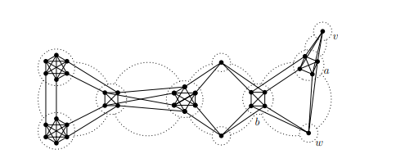
Dinitz, Karzanov and Lomonosov [1976]
All global Mincuts form a nice tree like structure called ‘cactus’.
A 2D cactus (two cycles intersect at at most one vertex)

Slide 7
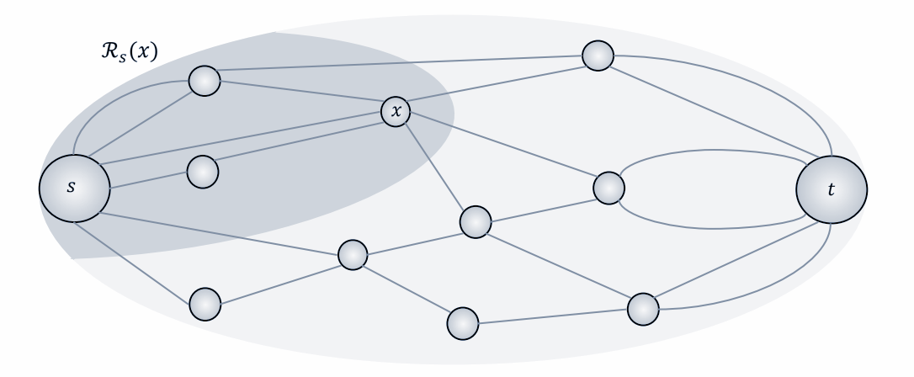
Picard and Quaryenne [1980] Dinitz and Vainshtein [1994]
All (s,t)-Mincuts can be stored in a strip (dag-like structure).
Each vertex has a 2 partition of edges incident on it.

Slide 8
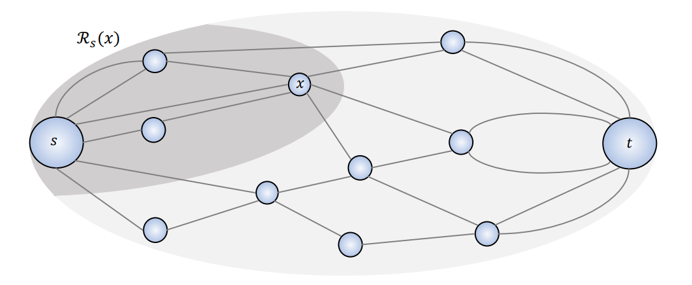
"Expanding out" in one of the partition (side-s) yields reachability cone in side-s represented as R_{s}(x)
Each (s,t)-mincut can be represented by union of reachability cones on side-s.
Any union of reachability cones (on side-s) forms a (s,t)-mincut.

Slide 9
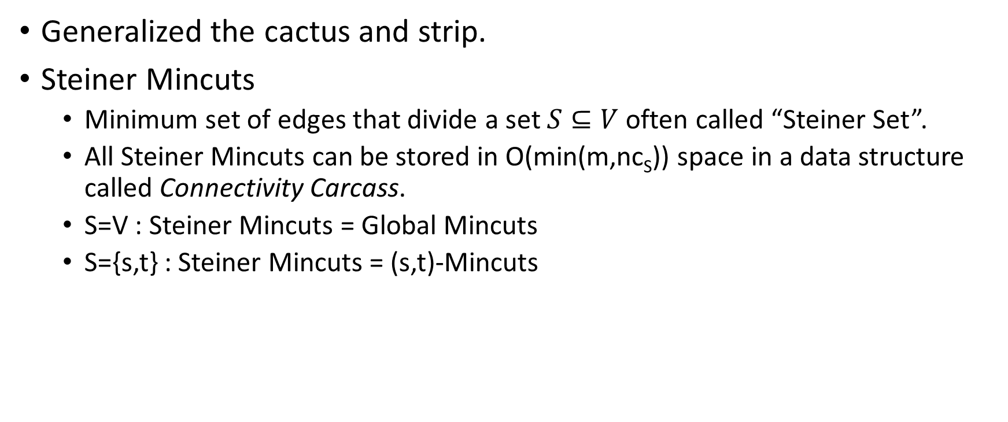
Dinitz and Vainshtein [1994]

Slide 10
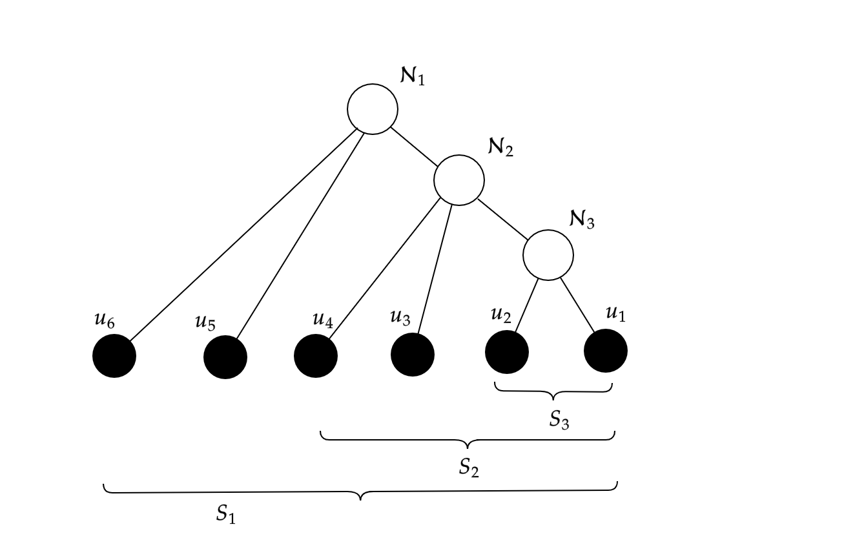
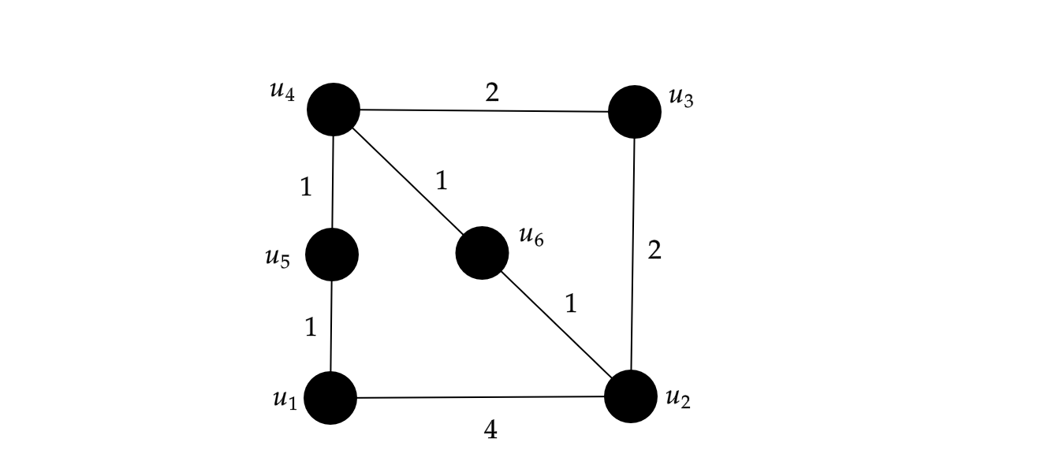
Katz Katz Korman Peleg [2004]
Hierarchical Structure of all connectivity classes.
[KKKP] Hierarchical Tree
Toy Graph G
Hierarchical Structure of vertices

Slide 11
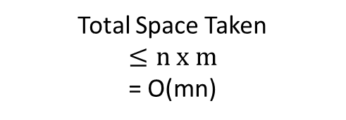
An O(mn) size DS for ft-all-pairs-mincuts
Connectivity Carcass (G,S₁)
Connectivity Carcass (G,S₂)
Connectivity Carcass (G,S₃)
[KKKP] Hierarchical Tree

Slide 12
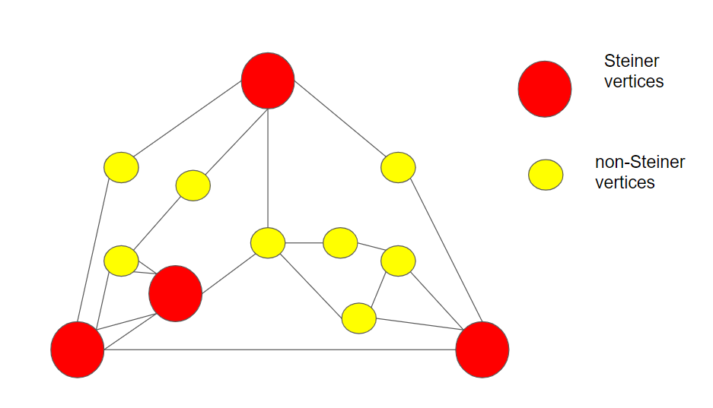
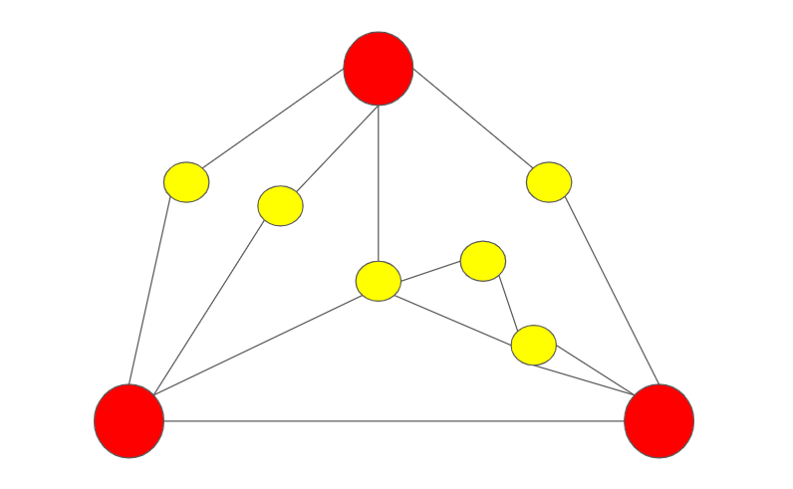
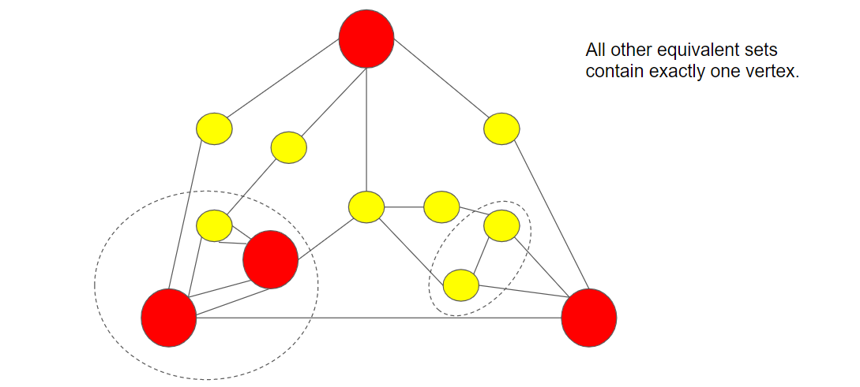
A closer look into the connectivity carcass …
G:=

Slide 13
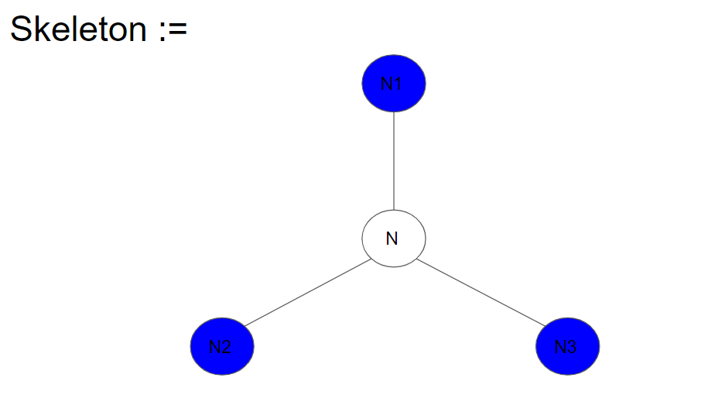
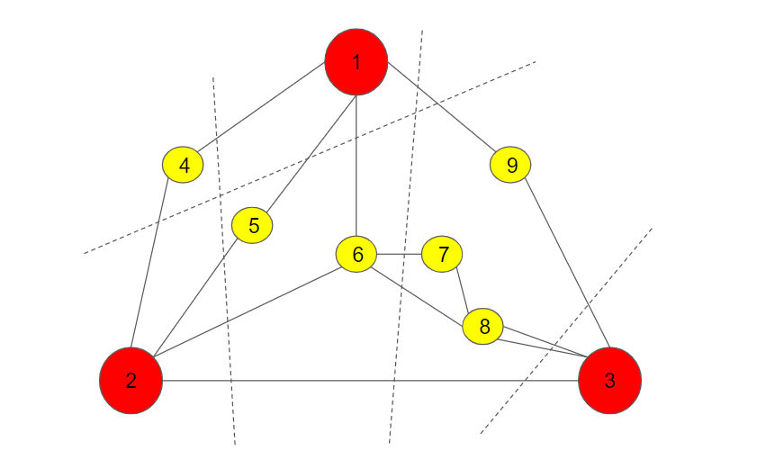
A closer look …
Flesh graph
Skeleton (cactus graph)
0
0
0
0
Mapping of flesh units to nodes/path
1
1
0
0
0
0
0
0
0
1
0
0
1
0
0
0
0
1
0
0
0
0
0

Slide 14

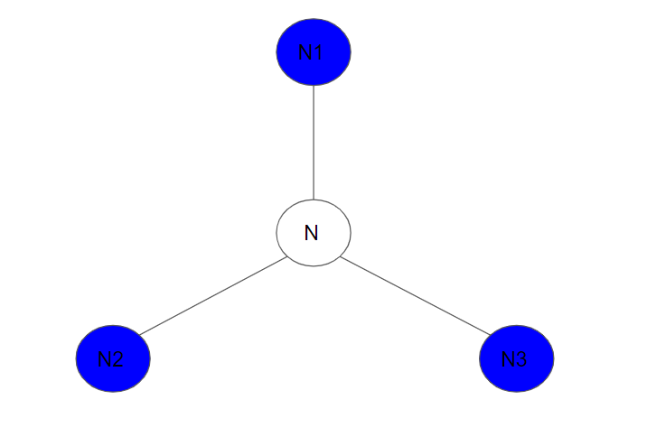


Extending the notion to mapping of an edge
An edge (u,v) lies in a (s,t)-mincut where s and t are separated by steiner mincut iff

Slide 15
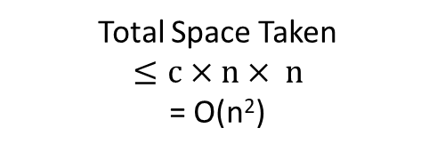
An O(n²) size DS for ft-all-pairs-Mincuts
Skeleton and Projection Mapping (G,S₁)
Skeleton and Projection Mapping(G,S₂)
Skeleton and Projection Mapping (G,S₃)
[KKKP] Hierarchical Tree

Slide 16
Insights into O(m) size DS
G:=
G
G’
G’:=
[KKKP] Hierarchical Tree
Working graph can be made smaller with graph contractions.

Slide 17
Central Ideas
Graph Contraction can be generalized for all levels.
Information about edges lost in contraction can be retrieved efficiently.
O(m) space and O(min(m,nc_{S})) query time.

Slide 18
Future Work
Turning the ft-DS into a sensitivity oracle.
Handling edge insertions as well in same time bounds.
Efficient construction of Data Structure.
A trivial construction will require m maxflow/mincut computations.
O(mn) algorithm may be possible.
Fully-Dynamic exact all-pairs Mincut.

Slide 19
Thanks for listening
Questions?

