Slide 1

SAMSUNG PRISM
Generative AI
Hackathon
3rd Edition 2026 – 27
Theme ID - 4 (Streaming Live RAG)
Team Name - Pokermons
College Name - VITV
Member Name & Email 1- Priyank Garg, priyank.garg2024@vitstudent.ac.in
Member Name & Email 2- Harshit Raj, harshit.raj2025@vitstudent.ac.in
Member Name & Email 3- Abhyuday Rai, abhyuday.rai2024@vitstudent.ac.in
Member Name & Email 4-
Submission Github link - https://github.com/abhyuday404/DuplexRAG
DuplexRAG - retrieve while the user is still speaking

Slide 2
Theme
Theme 04 · Streaming Live RAG
One utterance, three hidden questions
In a full-duplex voice conversation people speak one natural request, not a tidy query.
• Hidden intents - one utterance often carries several questions.
• Latency - waiting for the end of speech before searching leaves dead air.
• Late details - "actually it's fifty people" must refine the answer, not restart it.
• Not every turn needs search - "repeat that in two bullets" is formatting.
• Trust - every claim must be grounded in the provided corpus, and gaps must be said out loud.
Goal: a cheap, CPU-only engine that retrieves during speech, answers every hidden intent with citations, and keeps the answer alive across the conversation.
0.0 s "I need to plan a customer workshop in…"
0.8 s "…Pune for 30 people, and I need…"
1.6 s "…the cancellation policy and the catering options."
venue capacity for 30
cancellation terms
catering options
then: "Actually it's going to be fifty."
→ refine the capacity claim, keep the rest (v1 → v2)
then: "Can you repeat that in two bullets?"
→ no retrieval, same citations

Slide 3
Existing Solutions & Gaps
Approach | How it works | Gap for full-duplex voice
Turn-based RAG | waits for end of speech, one query for the whole utterance | dead air while searching; compound requests get one blurred query
LLM query rewriting / multi-query (RAG-Fusion, HyDE) | an LLM rewrites or splits the query after the user stops | adds an LLM call to every turn: more latency and cost, and it can invent queries
Agentic RAG (plan → search → read loops) | multi-step tool use by an LLM agent | heavy orchestration and unpredictable latency - the brief asks for simple and cheap
Chat-history RAG | concatenates history into the next query | late details restart the search; context drifts; old citations are lost
Intent-based voice assistants | classify intent → fixed skill | no grounding in documents, no citations, no answer for long-tail policy questions
The gap: nothing retrieves during speech, refines the answer in place and proves every claim - on a CPU budget, without an LLM in the loop.

Slide 4
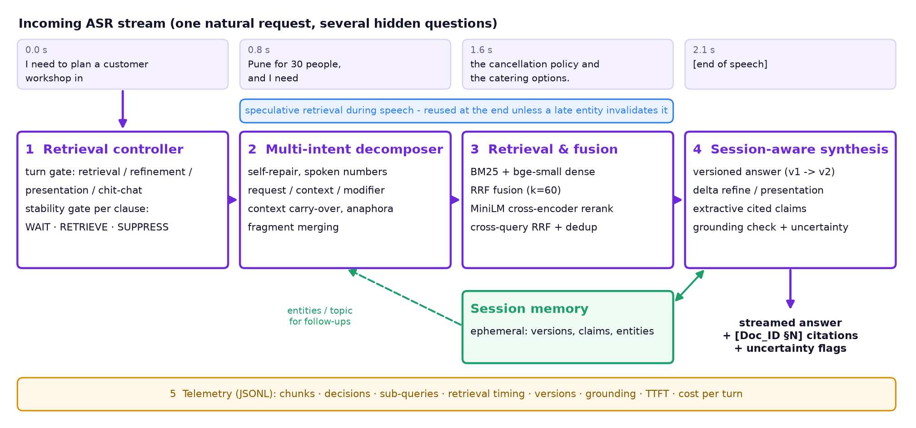
Our Solutions & Architecture Diagram
Event-driven: on_chunk() per ASR partial, end_turn() at end of speech; retrieval jobs run in the background while the user keeps talking.

Slide 5
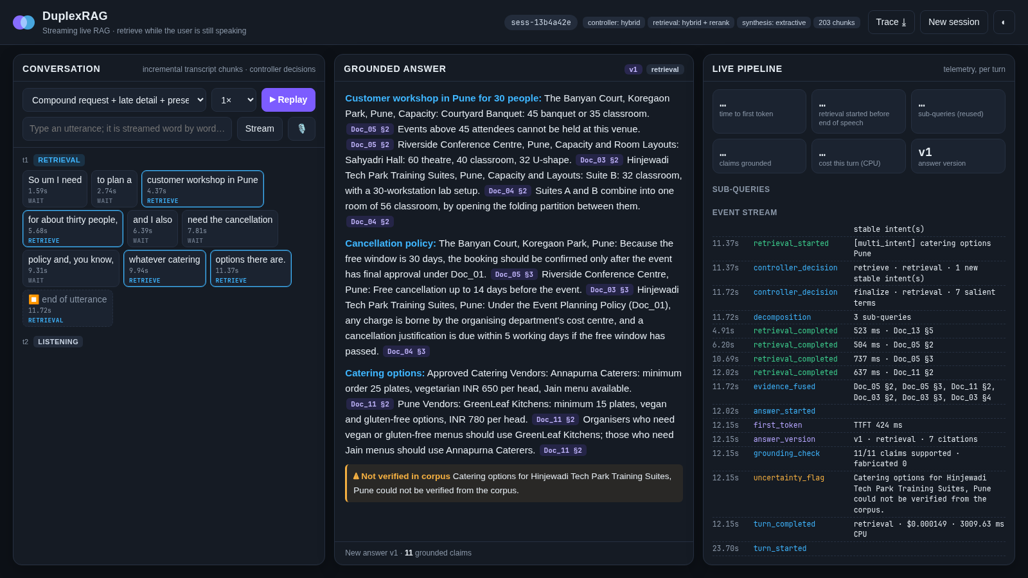
Demo & Product Walkthrough
1. Stream replay a scenario, type, or speak (Chrome mic) - chunks arrive every ~1 s
2. Watch the controller WAIT / RETRIEVE / SUPPRESS per chunk; provisional and multi-intent searches fire mid-sentence
3. Grounded answer one line per hidden intent, every claim cited; click a citation to see the source section
4. Late detail "actually fifty people" → v2 with a diff: added / retained / retired claims, delta search only
5. Format request "two bullets" → no retrieval, same citations; the trace and cost are downloadable
Demo video: submission/DuplexRAG_demo.mp4

Slide 6
Tools and tech stack used
Models (CPU, ONNX)
• BAAI bge-small-en-v1.5 - 33M bi-encoder
• ms-marco-MiniLM-L-6-v2 - 22M cross-encoder
• fastembed + ONNX Runtime, 4 threads
• no GPU, no API keys, runs offline
Retrieval
• Okapi BM25 (NumPy, in-house)
• dense cosine search
• reciprocal-rank fusion (k=60)
• cross-encoder rerank + sentence scoring
Language layer
• rule-based spoken-language decomposer
• turn gate: rules + NumPy softmax classifier
• self-repair, spoken numbers, anaphora
• optional OpenAI-compatible LLM (verified)
Serving & UI
• FastAPI + WebSocket (uvicorn)
• vanilla JS live UI, Web Speech API mic
• CLI: index / serve / replay / ask / bench
• JSONL telemetry + JSON Schema
Engineering
• Python 3.12, uv lockfile
• Docker Compose (one command)
• pytest + smoke test (G1)
• git, periodic commits
Evaluation
• discrete-event streaming replay
• 4 independently written benchmark splits
• baseline + 7 ablations, gates G1-G6
• matplotlib figures, Playwright demo capture

Slide 7
Impact & Use case
Voice assistants
answer 'how do I…' questions from manuals, policies and settings docs while the user is still talking - with a source for every claim
3.2 s
7 ms
median head start: retrieval begins before the user stops talking
median time to first token after speech
Contact-centre agent assist
surface the right policy clauses during a live call; refine as the caller adds details; no dead air
614 ms
$0.00007
same stack without speculation
compute cost per turn (CPU only)
Enterprise helpdesk (HR / IT / travel)
compound, messy questions answered in one turn with explicit 'not in the policy' flags
100%
0
Hands-free field work
technicians and drivers ask by voice; CPU-only, offline-capable, cheap to run
claims supported by their citation
fabricated citation IDs
held-out test split, laptop CPU (Ryzen 5 4600H)

Slide 8
Innovation highlights, results and limitations
Held-out test (30 sessions, 74 turns) | DuplexRAG | Baseline | Target
G2 retrieval starts before end of speech | 100% | 0% | >= 80%
G2 false triggers on no-retrieval turns | 9% | 100% | low
G3 compound turns: >= 2 intents isolated | 83% | 12% | >= 70%
G4 claims supported by citation | 100% | 100% | >= 85%
G4 fabricated citation IDs | 0 | 0 | 0
G5 refinements: versioned, delta-only | 88% | 0% | pass
G6 telemetry trace coverage | 100% | n/a | 100%
Retrieval hit@3 (gold section) | 89% | 69%
Key facts present in answer | 56% | 51%
TTFT p50 after end of speech | 7 ms | 11 ms
Innovation highlights
• speculative per-clause retrieval with entity-aware reuse
• refine-in-place answer versions with claim diffs
• grounded by construction; claim-level verifier
• entity x aspect gaps said out loud
• no LLM needed: about $0.0001 per turn
Limitations
• synthetic corpus (official corpus unavailable)
• extractive wording is less fluent than an LLM
• conservative 'not found': some unanswerables still get a related, cited answer
• speech simulated from transcripts (live mic in Chrome)
Baseline = turn-based RAG: waits for end of speech, one dense query, no rerank, no session memory. G1: one-command Docker build + automated replay; smoke test passes from a clean checkout.

Slide 9
What’s next
Plug in the official corpus + real ASR partials
streaming Whisper / on-device ASR; tune the stability gate on real partial-hypothesis revisions
Learned stability controller
train the retrieve / wait policy from ASR confidence, prosody and pauses
1
2
Small verified on-device LLM
fluent phrasing through the existing claim verifier; stream into TTS
Multilingual and code-mixed speech
Hindi-English, Korean; multilingual bi-encoder and cross-encoder
3
4
NPU / quantised models
int8 cross-encoder and cached sentence scores for sub-100 ms p95 on phones
Barge-in aware answers (with Theme 5)
stop, refine and resume the spoken answer when the user interrupts
5
6

Slide 10
Brownie points slide( differentiation)
Retrieves while you talk
median 3.2 s head start; searches fire mid-sentence and are reused
Zero fabricated citations
100% of claims verified against the cited section; IDs cannot be invented
CPU-only, about $0.0001 per turn
two small ONNX models, no GPU, no API keys, works offline in Docker
Refine, don't restart
versioned answers with added / retained / retired claims; only the delta is searched
Says what it doesn't know
"catering for Hinjewadi Tech Park could not be verified" - entity x aspect coverage checks
Measured honestly
discrete-event replay; each held-out set written independently after a freeze; earlier held-out runs are reported too

Slide 11
Checklist- Updated on Public GitHub
Working prototype code — public or shared GitHub repo (Y): https://github.com/abhyuday404/DuplexRAG
README with reproducible setup instructions (Y): README.md, Docker Compose, smoke test
Demo video, max 5 minutes (Y): submission/DuplexRAG_demo.mp4 in the repo
Presentation file (PPT or PDF) (Y): submission/VITV_Pokermons_Submission.pptx

Slide 12
Thank you
Organised by the Language AI Team and the PRISM Team, Samsung R&D Institute India
Notes:
Closing slide. Add the Google Form URL and a contact email before sharing. Edition 2 organising team for reference: Language AI - Sourabh Tiwari, Gaurav, Sanjeeth Pothireddy, Gorang Maniar; PRISM - Binny Lakra, Prakhar Chandrakar, Vishu Kumar; Kick-off and mentors - Giridhar Jakki, Deepraj Prabhakar Patkar (Language AI), Srimanu Prasad Nagaraju, Ashish Kumar (Tech Strategy).

