Slide 1
Nordic UiPath Framework
Espoo, Tomasz Pawlicki

Slide 2
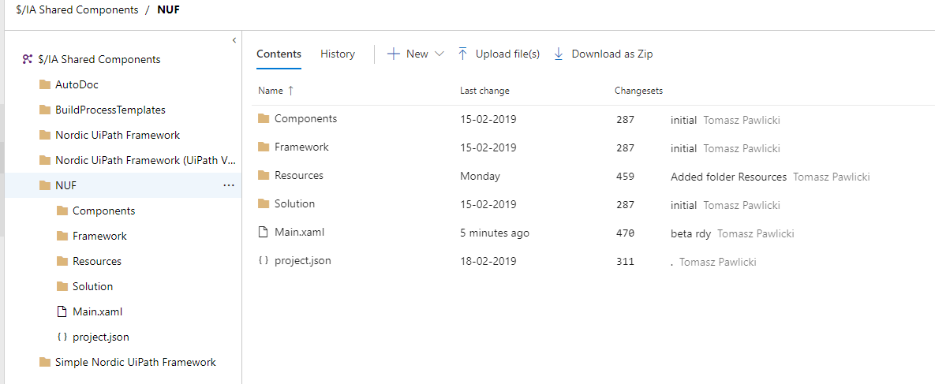
Where I can find it ?
Framework can be acquired through Azure DevOps, just follow this link,

Slide 3
First things first
Main features list
Framework allows you to focus on developing process specific features and not to worry too much about flow design and general exception handling,
Framework follow strict development practice through it’s own components, available components (as of 19-03-2019):
Applications
Actions (Open, Close, Restart, Kill, Info, Login, Logout)
Exception handling
Global variables
Supports Orchestrator and non orchestrator solutions
Queues (not ready)
Reporting (not ready)
Each framework component can be added through special workflow file <ComponentName>.Add which will guide you to provide necessary information,
Framework comes with most common project components, examples:
Generic – Take screenshot, string encrypt/decrypt, kill process etc.
Validate – Path, string, email address
If framework is using Orchestrator, all assets, queues are automatically created/updated when initialize/update workflows are used
Framework is aligned with AutoSDD tool
<MainProjectFolder>\Framework folder is not checked by this tool

Slide 4
Project framework template in details

Slide 5
About NUF
General
When you download NUF from DevOps you will see couple of directories and 3 files
Components – reusable piece of codes that can be used during developments. If you will add more components here please follow the same naming and logic convention
<ComponentCategory>\<ComponentCategory>.[Optional<Subcategory>].<ComponentMethodName>.xaml, example:
File\File.IsLocked.xaml
Orchestrator\Orchestrator.Asset.Create.xaml
Framework – templates and other NUF components. Here you can find all framework actions: Initialize, Update, <Component>.Add workflows. *Those workflows are not validated by AutoSDD tool.
Resources – third party or project/solution/temporary specific files or other resources
Framework – configuration files created by Initialize or Update workflow,
Files in Temp folder will be deleted at the end of process.
Solution – all solution specific workflows like, initialize all applications.
ExceptionHandlers – process specific exception handlers default implementation
[Optional] Queue – internal queue building logic workflows
[Optional] Reporting – internal reporting logic workflows
Main.xaml – main project file
ProcessTransaction.xaml – main process transaction logic
project.json – project configuration file. Update the project name and description before publishing it to Orchestrator.

Slide 6
About NUF
Framework components
Framework contains components that acts like templates. Those templates are utilized only by component Add workflow and should not be used/updated/modified/invoked any way.
Applications
Global variables
Queues
Reporting
Applications

Slide 7
About NUF
Application components – vol 1 - General
todo

Slide 8
About NUF
Application components – vol 2 – Exception building and handling
todo

Slide 9
About NUF
Global variables
todo

Slide 10
About NUF
Internal queues
todo

Slide 11
About NUF
Internal reporting
todo

Slide 12
About NUF
Exception handling
todo

Slide 13
Configuration
Initial setup and config file
Framework can work with UiPath Orchestrator or Excel as a configuration source. It is recommended to work with Excel all the time (even when Orchestrator is used) and running the Update workflow when changes are done to Assets, Queues and other available configuration.
Default configuration excel file location: <MainProjectFolder>\Framework\Configuration\Config.xlsx
(for more details about configuration excel open Config.xlsx file)
If framework has not been initialized , running the Main workflow will fail(by default)
Config.xlsx
example

Slide 14
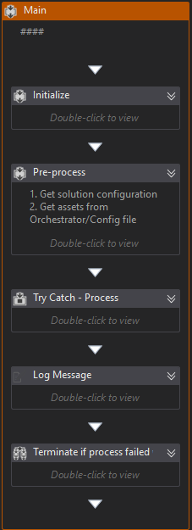
Main
Main is separated into phases:
Initialize – here are the solution specific variables are initialized
Pre-process – all validations, assets fetching
Get solution configuration – one that has been initialized and is stored in Resources\Framework\solution.configuration.json file
Request assets (global and solution specific) – from UiPath Orchestrator or excel configuration file
Get the IsProduction flag
Process – inside a try catch activity, here all process specific magic happens
Applications
Through this component you can easily add new application controllers with required actions and dedicated exception handler.
Controller added through this already has a default implementation that might work as is for Open, Close, Kill, Restart actions

Slide 15
Title (Work for 1 or 2 lines of title)
Subtitle
First level
Second level
Third level
Fourth level
Fifth level

Slide 16
Title (Work for 1 or 2 lines of title)
Header
Header
First level
Second level
Third level
Fourth level
Fifth level
First level
Second level
Third level
Fourth level
Fifth level

Slide 17
Title (Work for 1 or 2 lines of title)
Header
Header
Header
First level
Second level
Third level
Fourth level
Fifth level
First level
Second level
Third level
Fourth level
Fifth level
First level
Second level
Third level
Fourth level
Fifth level

Slide 18
Title (Work for 1 or 2 lines of title)
Header
Header
Header
First level
Second level
Third level
Fourth level
Fifth level
First level
Second level
Third level
Fourth level
Fifth level
First level
Second level
Third level
Fourth level
Fifth level
Header
Insert bullet point
Insert bullet point
Insert bullet point
Insert bullet point

Slide 19
Title (Work for 1 or 2 lines of title)
Header
Header
Header
Insert bullet point
Insert bullet point
Insert bullet point
Insert bullet point
Insert bullet point
Insert bullet point
Insert bullet point
Insert bullet point
Insert bullet point
Insert bullet point
Insert bullet point
Insert bullet point

Slide 20
Title (Work for 1 or 2 lines of title)
Insert name Insert Title/Role
Insert bullet point
Insert bullet point
Insert bullet point
Insert bullet point
Insert name Insert Title/Role
Insert bullet point
Insert bullet point
Insert bullet point
Insert bullet point
Insert name Insert Title/Role
Insert bullet point
Insert bullet point
Insert bullet point
Insert bullet point
Insert name Insert Title/Role
Insert bullet point
Insert bullet point
Insert bullet point
Insert bullet point

Slide 21
Title (Work for 1 or 2 lines of title)
1
Subtitle
 | TEXT | TEXT | TEXT | TEXT | TEXT | TEXT | TEXT
TEXT | Text sample | Text sample | Text sample | Text sample | Text sample | Text sample | Text sample
TEXT | Text sample | Text sample | Text sample | Text sample | Text sample | Text sample | Text sample
TEXT | Text sample | Text sample | Text sample | Text sample | Text sample | Text sample | Text sample
TEXT | Text sample | Text sample | Text sample | Text sample | Text sample | Text sample | Text sample

Slide 22
Title (Work for 1 or 2 lines of title)
Click to insert chart title
Click to insert chart title
Click to insert text
Click to insert text

Slide 23
Title (Work for 1 or 2 lines of title)
1
2
3
4
5
6
7
8
9
10
11
12
Text sample
Text sample
Text sample
Text sample
Text sample
Text sample
Text sample
Text sample

Slide 24
Title (Work for 1 or 2 lines of title)
Click to insert chart title
Click to insert chart title

Slide 25
Title (Work for 1 or 2 lines of title)
Click to insert title
Click to insert title
Click to insert title
Click to insert title
Click to insert title
Click to insert bullet point
Click to insert bullet point
Click to insert bullet point
Click to insert bullet point
Click to insert bullet point
Click to insert bullet point
Click to insert bullet point
Click to insert bullet point
Click to insert bullet point
Click to insert bullet point
Click to insert bullet point
Click to insert bullet point
Click to insert bullet point
Click to insert bullet point
Click to insert bullet point

Slide 26
Title (Work for 1 or 2 lines of title)
XX%
XX%
XX%
XX%
Click to insert text
Click to insert text
Click to insert text
Click to insert text
XX%
Click to insert text

Slide 27
Title (Work for 1 or 2 lines of title)
Insert Group Name
Click to insert bullet point
Click to insert bullet point
Click to insert bullet point
Insert Group Name
Click to insert bullet point
Click to insert bullet point
Click to insert bullet point
Insert Group Name
Click to insert bullet point
Click to insert bullet point
Click to insert bullet point
Group Name
Click to insert text
Click to insert text
Click to insert text
Click to insert text
Click to insert text

Slide 28
Title (Work for 1 or 2 lines of title)
60%
50%
35%
Click to insert text
Click to insert text
Click to insert text
Click to insert bullet point
Click to insert bullet point
Click to insert bullet point
Click to insert bullet point
Click to insert bullet point
Click to insert bullet point
Click to insert bullet point
Click to insert bullet point
Click to insert bullet point

Slide 29
Click to insert title
Click to insert title
Photo
Click to insert bullet point
Click to insert bullet point
Click to insert bullet point
Click to insert bullet point
Click to insert bullet point
Click to insert bullet point
Click to insert title
Name
Click to insert bullet point
Click to insert bullet point
Click to insert bullet point
Text
Education
Text

Slide 30
Section break

Slide 31
Section break

Slide 32
Section break

Slide 33
Colors
Primary
Secondary
Infographic only
Capgemini Blue
R 0
G 112
B 173
Vibrant Blue
R 18
G 171
B 219
Deep Purple
R 43
G 10
B 61
Tech Red
R 255
G 48
B 76
Zest Green
R 149
G 230
B 22
Capgemini Blue (-50%)
R 128
G 184
B 214
Vibrant Blue (-50%)
R 136
G 213
B 237
Bright Purple
R 109
G 100
B 204
Orange
R 255
G 99
B 39
Bright Green
R 200
G 255
B 22
Purple
R 126
G 57
B 186
Peach
R 255
G 126
B 131
Green
R 0
G 195
B 123
The colors are embedded in the masters (see on the right side of the slide).
Use the pipette to easily change the colors in the shape, charts, graphics.
Dark Purple
R 71
G 1
B 167
Light Claret
R 203
G 41
B 128
Bright Aqua
R 1
G 209
B 208
Claret
R 134
G 8
B 100
Aqua
R 15
G 153
B 156
Dark Green
R 21
G 99
B 107

Slide 34
World map
Texte
Texte
Texte
Texte
Texte
Texte
Texte
Texte
Texte
Texte

Slide 35
Icons

Slide 36
Icons

Slide 37
Graphic elements

