Slide 1

Skynet
Verifiable Drone Spray Coverage for Tamil Nadu Farmers
NIDHI-PRAYAS Prototype Grant Application
Innovator / Startup: Skynet
Location: Coimbatore, Tamil Nadu
Grant sought: ₹10,00,000
Duration: 6–8 months
Skynet • NIDHI-PRAYAS grant pitch deck • May 2026

Slide 2
The Problem
No proof of coverage
Farmers cannot verify spray execution, generating disputes and limiting trust.
Manual labour shortage
TN has acute farm labour gaps; drone spraying is essential.
Waste & cost risk
Over/under-spray reduces yield and raises input costs.
Smallholder access
Farmers need affordable DaaS, not expensive drone ownership.
Skynet • NIDHI-PRAYAS • Problem statement

Slide 3
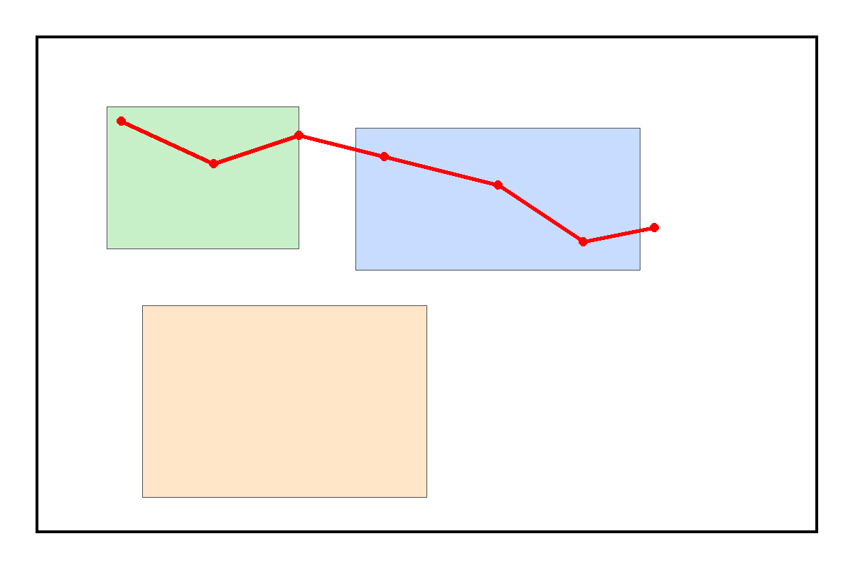
Our Solution
Proof-of-Coverage Verification Module (PCVM) Gen-1
• Captures GPS flight track on spray runs
• Stores tamper-evident offline logs
• Aligns coverage to farmer KMZ boundaries
• Produces exportable GPX/GeoJSON proof packets
Skynet • NIDHI-PRAYAS • May 2026

Slide 4
Innovation & Differentiation
Low-cost hardware + analytics for verifiable service proof
Offline-first field design with tamper-evident logging
Boundary alignment and gap detection for precision
Trust layer for DaaS, FPOs, and smallholder pilots
Skynet • NIDHI-PRAYAS • May 2026

Slide 5
Prototype Focus
Field-ready PCVM hardware logger for agricultural spray drones
GNSS tracker, MCU edge compute, rugged enclosure, field mount
Offline proof packet generation; easy drone integration
Built for 6–8 month NIDHI-PRAYAS prototype validation
Skynet • NIDHI-PRAYAS • May 2026

Slide 6
Market Opportunity
Tamil Nadu entry: Coimbatore → Western TN → Delta paddy belt
DaaS pricing band: ₹300–700/acre
Year-1 cluster economics: 500 farmers × 4 sprays × ₹400 = ₹8L GMV
Growth path: FPO contracts, service bundles, PCVM licensing
Skynet • NIDHI-PRAYAS • May 2026

Slide 7
Business Model
Per-acre service fee for verified spray delivery
Seasonal bulk pricing for FPOs and estates
PCVM rental/sale to pilot partners post-commercialization
Data services upsell (NDVI, monitoring) in Phase 2
Skynet • NIDHI-PRAYAS • May 2026

Slide 8
Competitive Edge
Hardware-verified proof, not just a booking app
Designed for rural offline conditions and smallholders
Built around FPO/CHC GTM and local pilot trust
Aligns directly with NIDHI-PRAYAS prototype criteria
Skynet • NIDHI-PRAYAS • May 2026

Slide 9
Roadmap
Month 1: Design freeze, BOM lock, procurement kickoff
Months 2–3: Lab prototype build and GPS log validation
Months 4–5: Drone integration and tethered tests
Months 6–7: 10+ field trials, farmer feedback, field hardening
Month 8: Final report, commercialization package, DST deliverables
Skynet • NIDHI-PRAYAS • May 2026

Slide 10

Budget Overview
₹10,00,000 budget aligned to NIDHI-PRAYAS heads
Sensors, electronics, and mechanical integration
Field trials, PRAYAS Shala prototyping, and compliance
Contingency for iteration and supply-chain risk
Skynet • NIDHI-PRAYAS • May 2026

Slide 11
Team & Execution
Lead Innovator: product + grant ownership
Hardware/IoT: sensor integration and prototype build
Agriculture advisor: TN farming and FPO relationships
Drone operations: licensed pilot support and test execution
Business/GTM: local market launch and FPO engagement
Skynet • NIDHI-PRAYAS • May 2026

Slide 12
Traction & Validation
Market research and PRD completed
Pre-grant status: prototype not yet built
Grant objective: build and validate PCVM Gen-1
Field validation: 10+ demo plots and 20+ stakeholder sessions
Skynet • NIDHI-PRAYAS • May 2026

Slide 13
IP & Compliance
IP to vest with applicant per PRAYAS/DST terms
Indian citizenship and NOC requirement captured
DGCA-aligned drone operations with licensed pilots
Prototype tests in controlled field conditions only
Skynet • NIDHI-PRAYAS • May 2026

Slide 14
Commercialization Path
Months 9–12: PCVM pilot batch (20–30 units) and beta partners
Months 12–18: FPO contracts and early unit economics
Year 3+: regional expansion, data services, PCVM licensing
Objective: TRL 6 field validation converted to market-ready offering
Skynet • NIDHI-PRAYAS • May 2026

Slide 15
The Ask
Request ₹10,00,000 for PCVM Gen-1 prototype and validation
Deliverables: field-tested physical prototype, proof reports, DST submission pack
Outcome: verified DaaS trust infrastructure for TN agriculture
Aligned with NIDHI-PRAYAS priority sectors: Agriculture + IoT
Skynet • NIDHI-PRAYAS • May 2026

Slide 16
Appendix & Submission Notes
Completed application form and supporting ID documents
Team & Eligibility details in team-and-eligibility.md
Prototype spec and BOM in prototype-spec.md
Detailed line-item budget in nidhi-prayas-budget.csv
Skynet • NIDHI-PRAYAS • May 2026

