Slide 1

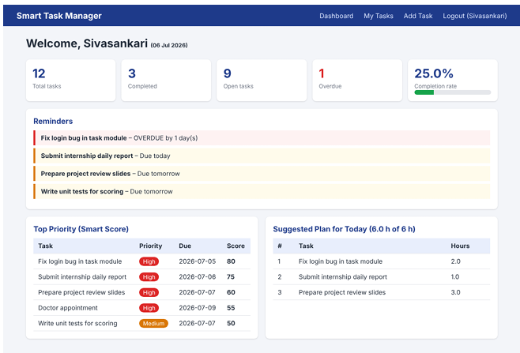
Smart Task Manager
UNIVERSITY COLLEGE OF ENGINEERING (BIT CAMPUS)
Anna University, Tiruchirappalli – 620 024
SUMMER INTERNSHIP REPORT | IT3711
A full stack web application to plan, prioritise and track daily work
MERN stack
JWT security
Smart ranking
Submitted by
Abinaya U – 810023205017
B.Tech Information Technology
Notes:
Good morning. I am Abinaya U. This presentation covers my summer internship project, Smart Task Manager, a full stack web application built at Innoknowvex Pvt Ltd.

Slide 2






Internship at Innoknowvex Pvt Ltd
INDUSTRY EXPERT (JOINT SUPERVISOR)
Mr. D. Kumaresan, Team Leader
INTERNSHIP DOMAIN
Full Stack Web Development
INTERNSHIP PERIOD
12 June 2026 – 12 July 2026 (30 days)
Innoknowvex Pvt Ltd
PROJECT COMPLETED
Technology and training company offering project-based internships with industry experts.
Smart Task Manager
LOCATION
HSR Layout, Bengaluru, Karnataka – 560102
Notes:
The internship was at Innoknowvex Pvt Ltd, Bengaluru, from 12 June to 12 July 2026, under the guidance of Mr. D. Kumaresan, Team Leader.

Slide 3






Why task management needs fixing
Scattered tasks
No priority guidance
No reminders
Notes, chats and files make tracking difficult
Lists never say which task to do first
Nothing alerts the user, so deadlines are missed
No progress view
Weak security
Complex or paid tools
Completed, pending and overdue work is unclear
Shared files and chats are not user-specific
Full project tools are heavy for personal needs
The need: one centralised, secure and intelligent task management system
Notes:
Most people use paper notes, chats and spreadsheets. These have no reminders, no priority guidance and no progress view, so deadlines are missed.

Slide 4




Proposed system and objectives
Centralised data
Secure access
Objectives
Tasks stored per user in MongoDB
Hashed passwords, JWT on every request
Build a full stack app from requirements to deployment
Develop REST APIs with CRUD using Node.js and Express
Secure user data with JWT and password hashing
Give smart priority suggestions and deadline alerts
Show task statistics on a dashboard
Task management
Smart suggestions
Create, edit, complete, search, filter
Priority score ranks pending tasks
Reminders
Dashboard
Due-soon and overdue tasks highlighted
Totals and completion rate at a glance
Notes:
The proposed system keeps all tasks in one secure place, ranks them with a priority score, highlights deadlines and shows progress on a dashboard.

Slide 5





Technology stack
Front end
Back end
Database
React, React Router, Axios, Tailwind CSS
Node.js, Express.js REST APIs
MongoDB, Mongoose ODM
Security
Dev tools
Version control
JWT tokens, bcrypt hashing
VS Code, Postman, MongoDB Compass
Git and GitHub
Runs on: Windows 10/11 · Core i3 or higher · 8 GB RAM · Node.js 18+ · MongoDB 6.0 · Google Chrome
Notes:
The project uses the MERN stack with Tailwind CSS for styling, JWT and bcrypt for security, and Git and GitHub for version control.

Slide 6
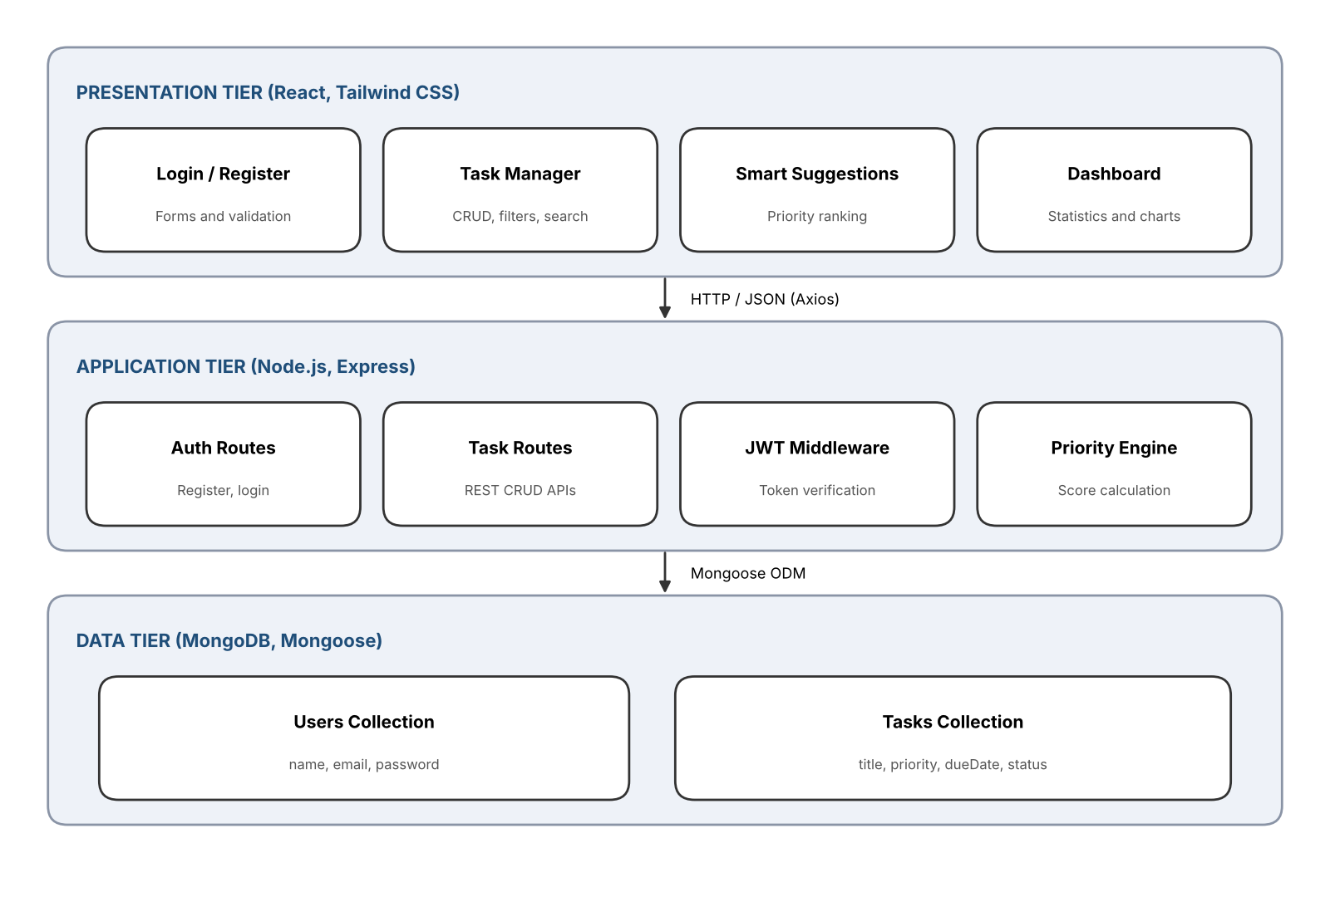
Three-tier system architecture
Presentation tier
1
React and Tailwind CSS: login, tasks, suggestions, dashboard
Application tier
2
Express API: auth routes, task routes, JWT middleware, priority engine
Data tier
3
MongoDB with Mongoose: users and tasks collections
Axios sends HTTP/JSON requests; Mongoose reads and writes MongoDB
Notes:
The React client sends requests to the Express API. JWT middleware verifies the user, controllers apply business logic, and Mongoose reads or writes MongoDB. The JSON response is shown as task lists, suggestions and charts.

Slide 7
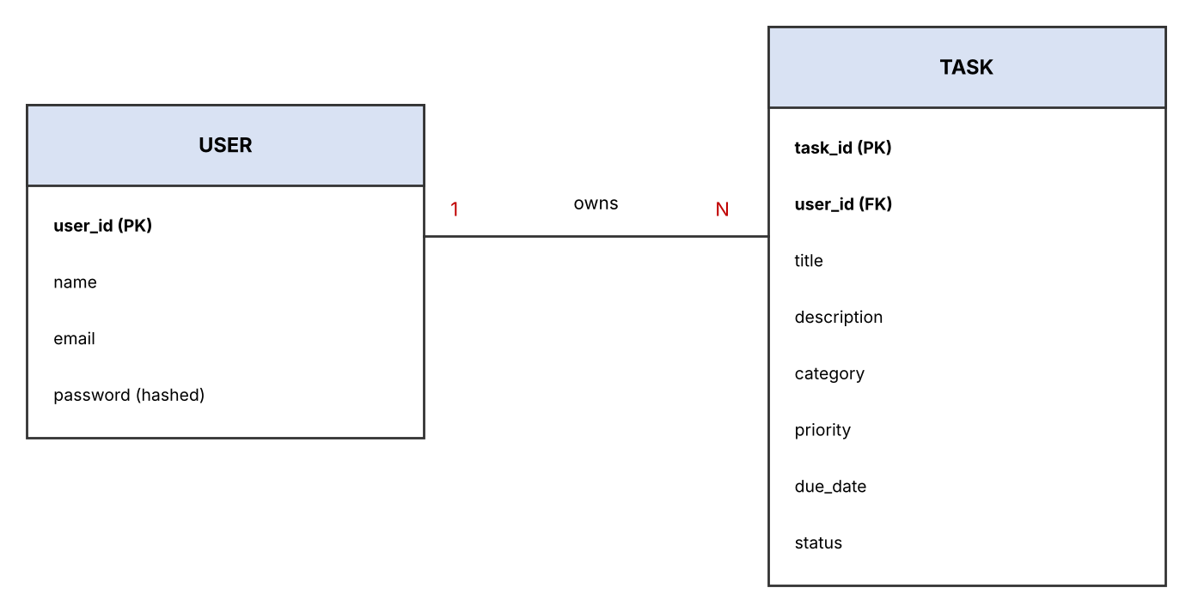
Database design
2
collections: User and Task
1 : N
one user owns many tasks
bcrypt
passwords stored only as hashes
User
Task
user_id, name, email (unique), password (bcrypt hash)
task_id, user_id (FK), title, description, category, priority, due_date, status, created_at
Notes:
Two collections: User and Task. Each task stores the id of its owner, so every query can be filtered by the logged-in user and data stays private.

Slide 8
30-day internship journey
1
2
3
4
5
Week 1
Week 2
Week 3
Week 4
Final days
Day 1 – 7
Day 8 – 14
Day 15 – 21
Day 22 – 28
Day 29 – 30
Orientation, requirements, scope, environment setup, architecture
Wireframes, ER diagram, Express setup, models, registration, login and JWT
Task CRUD APIs, search and filters, React setup, API integration
Priority algorithm, reminders, dashboard, responsive UI, testing, deployment
Key findings, validation, documentation and final report
30 days of project-based work, reviewed regularly by Mr. D. Kumaresan, Team Leader
Notes:
Week 1 was orientation and design. Week 2 covered the database and authentication. Week 3 was APIs and React. Week 4 added smart features, testing and deployment. The last two days were for the report.

Slide 9


Smart priority algorithm
PRIORITY WEIGHT
FORMULA
High
Medium
Low
score = (priority weight × 2)
+ urgency
3
2
1
URGENCY POINTS (BY DAYS LEFT)
EXAMPLE
High priority, due tomorrow
Overdue
≤ 1 day
≤ 3 days
≤ 7 days
Later
(3 × 2) + 4 = 10 = rank #1
5
4
3
2
1
Low priority, due in 10 days: (1 × 2) + 1 = 3
Pending tasks sorted high to low form the Smart Suggestions list.
Overdue if the due date has passed; Due Soon within 2 days
Completion rate = completed ÷ total × 100
Only pending tasks are scored and ranked
Notes:
Each pending task gets a score: priority weight times two plus urgency points. A high priority task due tomorrow scores 10 and appears first. Reminders mark tasks overdue or due within two days.

Slide 10



Secure authentication in code
routes/auth.js (Express + bcrypt + JWT)
bcrypt hashing
router.post("/register", async (req, res) => {
const { name, email, password } = req.body;
if (await User.findOne({ email }))
return res.status(400)
.json({ message: "Email already registered" });
const hash = await bcrypt.hash(password, 10);
await User.create({ name, email, password: hash });
res.status(201).json({ message: "Registered" });
});
router.post("/login", async (req, res) => {
const user = await User.findOne({ email: req.body.email });
if (!user || !(await bcrypt.compare(
req.body.password, user.password)))
return res.status(400).json({ message: "Invalid credentials" });
const token = jwt.sign({ id: user._id },
process.env.JWT_SECRET, { expiresIn: "1d" });
res.json({ token, name: user.name });
});
Passwords are never stored in plain text
JWT login
Token carries the user id and lasts 1 day
Auth middleware
Every task route verifies the token first
User isolation
Every query is filtered by the user id
Notes:
Registration hashes the password with bcrypt before saving. Login compares the hash and issues a JWT valid for one day. Middleware checks this token on every task route.

Slide 11
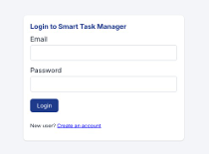
Login and dashboard
12
3
Total tasks
Completed
1
25%
Overdue
Completion rate
Notes:
Users register and log in securely. The dashboard shows total, completed, open and overdue tasks, the completion rate, reminders, the top priority tasks and a suggested plan for the day.

Slide 12
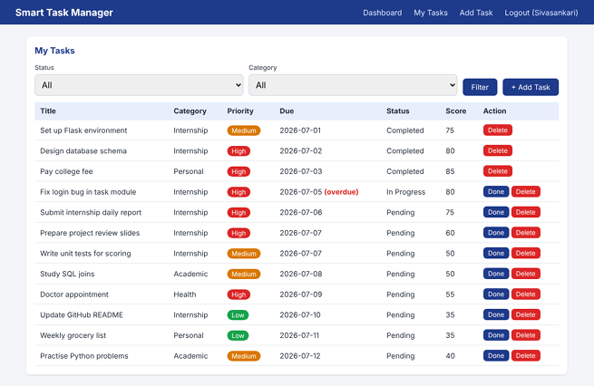
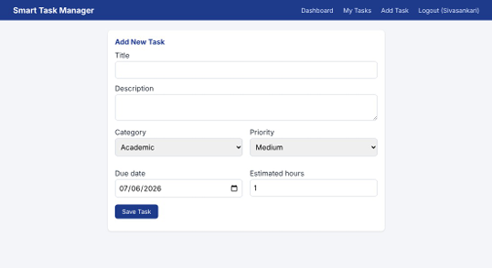
Task list and task form
Filter by status or category
Done and Delete actions on every task
Smart score shown for each task
Notes:
The task list shows category, priority, due date, status and smart score. The overdue task is flagged in red. The form lets users add tasks with category, priority, due date and estimated hours.

Slide 13
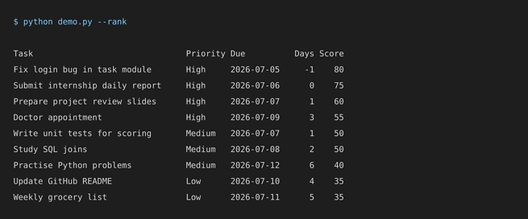
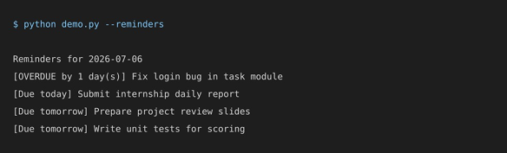
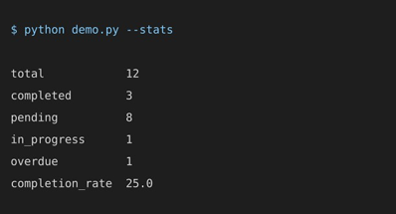
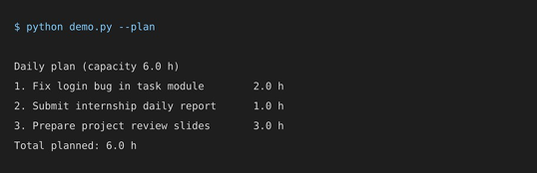
Smart ranking, plan and reminders
RANKED TASKS
REMINDERS
TASK STATISTICS
DAILY PLAN (6 HOUR CAPACITY)
25%
completion rate
3 of 12 tasks done
Notes:
The overdue task is ranked first, followed by high priority tasks due soon. The daily plan fits tasks into six hours. Reminders flag overdue, due today and due tomorrow tasks.

Slide 14
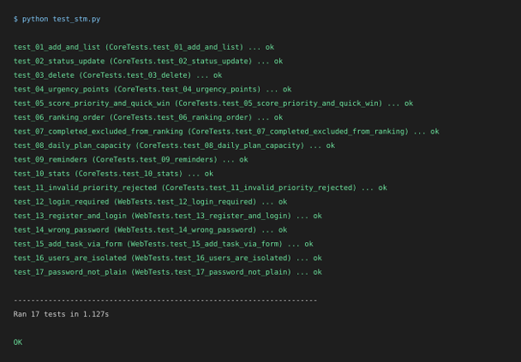
Testing and analysis
17 / 17
11 / 11
automated tests pass
manual test cases pass
Key findings
Overdue and high-priority tasks rise to the top of the suggestions
Passwords stay as bcrypt hashes and task routes need a valid JWT
Dashboard totals matched the task list; layout works on mobile
Challenges solved: CORS errors, lost login state on refresh, tasks visible to other users, time-zone date differences
Notes:
All 17 automated tests pass and all 11 manual test cases passed. The main challenges were CORS, keeping login state after refresh, user isolation and time zones.

Slide 15






Conclusion and future work
Conclusion
Future work
One secure, ranked task system replaces scattered lists and reduces missed deadlines
Covered the full web life cycle: design, APIs, authentication, testing, deployment
Gained hands-on skills in React, Node.js, Express, MongoDB and Git
Email, SMS and push alerts
Team workspaces and sharing
Drag-and-drop Kanban board
ML-based suggestions
Progressive Web App
CI/CD on a cloud platform
Thank you
Abinaya U – 810023205017
Anna University, Tiruchirappalli · Questions are welcome
Notes:
To conclude, the project delivers a secure, responsive task manager with smart prioritisation. Future work includes notifications, team features, Kanban, machine learning suggestions and cloud deployment. Thank you.

