Slide 1
Abishek V
Final Project
3/21/2024 Annual Review

Slide 2
Digit Recognition in ASL with CNNs
This project aims to develop a system for real-time detection and recognition of numerical signs in American Sign Language (ASL) using advanced machine learning techniques, specifically Convolutional Neural Networks (CNNs). ASL is a crucial mode of communication for individuals with hearing impairments, and recognizing numbers in ASL can greatly enhance accessibility in various contexts.
The CNN model has been trained on a dataset consisting of thousands of images of hand signs for numbers 0 to 9 in ASL. Through this extensive training, the model has learned to distinguish subtle variations in hand shape, position, and movement that correspond to each numerical sign.
3/21/2024 Annual Review

Slide 3


AGENDA
Problem Statement
Project Overview
Who are the end user?
Your solution and its value proposition
Wow Factor
Modelling
Result
3/21/2024 Annual Review

Slide 4

PROBLEM STATEMENT
The primary challenge addressed by this project is the real-time recognition of ASL number signs (0-9) from live video streams. Existing ASL recognition systems often lack the accuracy and speed required for practical use. By leveraging deep learning techniques, this project seeks to create a robust and efficient model capable of accurately detecting ASL numbers in real time.
3/21/2024 Annual Review

Slide 5

PROJECT OVERVIEW
The ASL Number Detection project aims to bridge communication barriers for individuals who rely on American Sign Language (ASL) by providing a real-time solution for recognizing ASL number signs. Using a combination of Convolutional Neural Networks (CNNs), including ResNet and leveraging the power of OpenCV for image preprocessing, the system accurately detects and interprets ASL number signs from live video feeds or static images. This project offers a user-friendly interface accessible on mobile devices, making it convenient for users to communicate numerical information effortlessly. The solution not only enhances accessibility for the ASL community but also serves as a valuable educational tool for learning ASL number signs. Through the integration of cutting-edge machine learning models, this project demonstrates the potential of technology to empower individuals with diverse communication needs, enabling seamless interaction and understanding across languages and abilities.
3/21/2024 Annual Review

Slide 6

WHO ARE THE END USERS?
1. Deaf or Hard of Hearing Individuals: The system aims to enhance accessibility for those who rely on ASL for communication by providing a tool to easily translate ASL number signs into text or auditory feedback.
2. Educators and ASL Learners: Teachers and students learning ASL can benefit from a tool that helps in understanding and practicing ASL number signs.
3. Accessibility Tech Researchers and Developers: Professionals in the field of accessibility technology can use the project's findings and methodologies to advance the development of similar systems for broader ASL translation and accessibility tools.
4. Organizations and Institutions: Entities focused on inclusivity and accessibility, such as schools, community centers, and advocacy groups for the deaf and hard of hearing, may also find this tool valuable for their programs and services.
3/21/2024 Annual Review

Slide 7

YOUR SOLUTION AND ITS VALUE PROPOSITION
The system can accurately detect and recognize ASL number signs in real-time, providing instant feedback to users. Users interact with the system through a simple and intuitive interface, making it accessible to a wide range of individuals, including those with limited technical expertise. The system can be deployed on various platforms such as desktop applications, mobile devices, or web applications, ensuring flexibility and accessibility.
Deaf or hard of hearing individuals can easily communicate numeric information through ASL, improving their accessibility to everyday conversations and interactions. Educators and ASL learners can use the system as a valuable tool for learning and practicing ASL number signs, enhancing educational experiences.
3/21/2024 Annual Review

Slide 8

THE WOW IN YOUR SOLUTION
1. Real-Time Accuracy: Our system offers instant and accurate recognition of ASL number signs, providing users with immediate feedback without delays or errors.
Empowering Independence: By enabling ASL users to communicate numeric information independently, our solution fosters empowerment and autonomy, enhancing their quality of life and social interactions.
2. Educational Impact: Serving as a valuable educational tool, our system facilitates interactive learning and practice of ASL number signs, driving engagement and proficiency among learners.
3.Inclusive Innovation: Promoting inclusivity in various settings, our solution breaks down communication barriers between ASL and non-ASL users, fostering understanding, empathy, and collaboration.
3/21/2024 Annual Review

Slide 9
MODELLING
1. Convolutional Neural Networks (CNNs): CNNs are used for their ability to extract spatial hierarchies and patterns from the ASL number sign images. They are trained on labeled datasets of ASL number signs to learn the unique features and characteristics of each sign.
2. ResNet (Residual Neural Network): It is utilized in our project to enable the training of very deep neural networks without the vanishing gradient problem. ResNet helps improve the accuracy and efficiency of ASL number sign recognition, especially when dealing with a large number of classes.
3. OpenCV (Open Source Computer Vision Library): OpenCV is used for preprocessing tasks such as image resizing, normalization, and noise reduction. It helps in preparing the ASL number sign images for input into the neural network models, improving their performance.
4. TensorFlow and Keras: TensorFlow and Keras are used for building and training the CNN models, allowing for efficient development and experimentation with different architectures.
3/21/2024 Annual Review

Slide 10
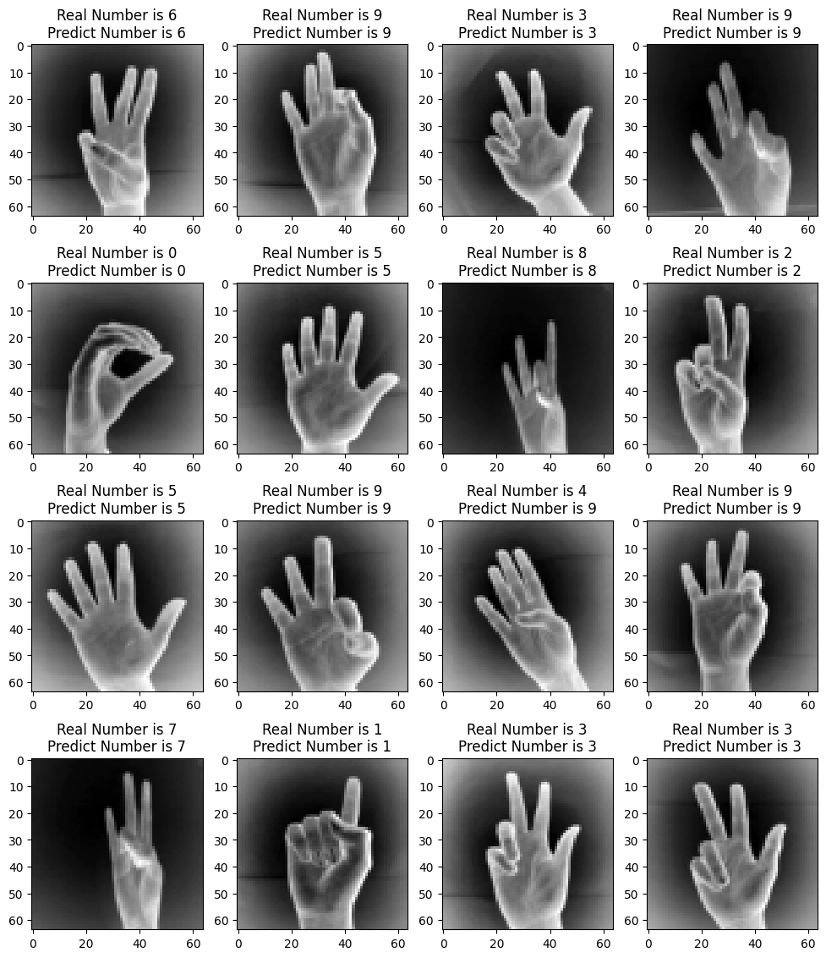
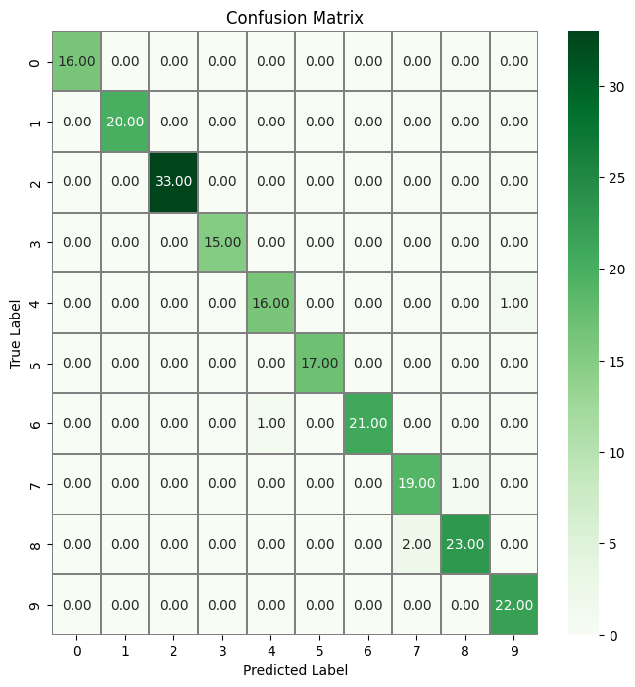
RESULTS
Demo Link
3/21/2024 Annual Review

