Slide 1
Procedure for Adding Psuedo-Components to CHEMCAD
Pseudo-components are hypothetical, representative compounds used in chemical engineering and process simulation – Google AI
Requirements:
Boiling curve
Light-ends analysis
API gravity or specific gravity of fluid
All found in “Crude Assay”

Slide 2
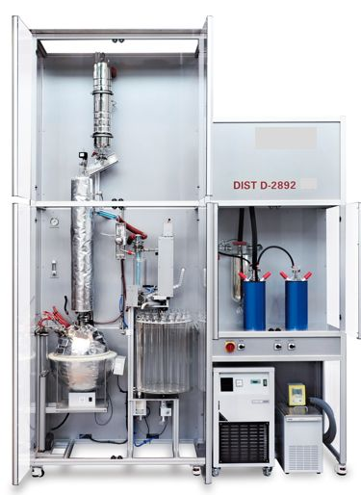


Background - Measurement of Boiling Point Curves
Data reported along with other key measurements in “Crude Assay”
Collection tubes are positioned on a rotating pallet are synchronized with the boiling vessel temperature.
Condensate is collected in the tubes for mass and volume measurements.
A known mass and volume of crude oil is placed in this vessel and boiled.
Since this is a batch distillation, the temperature goes up as oil is evaporated.
Chillers for low-T (below ambient T)

Slide 3
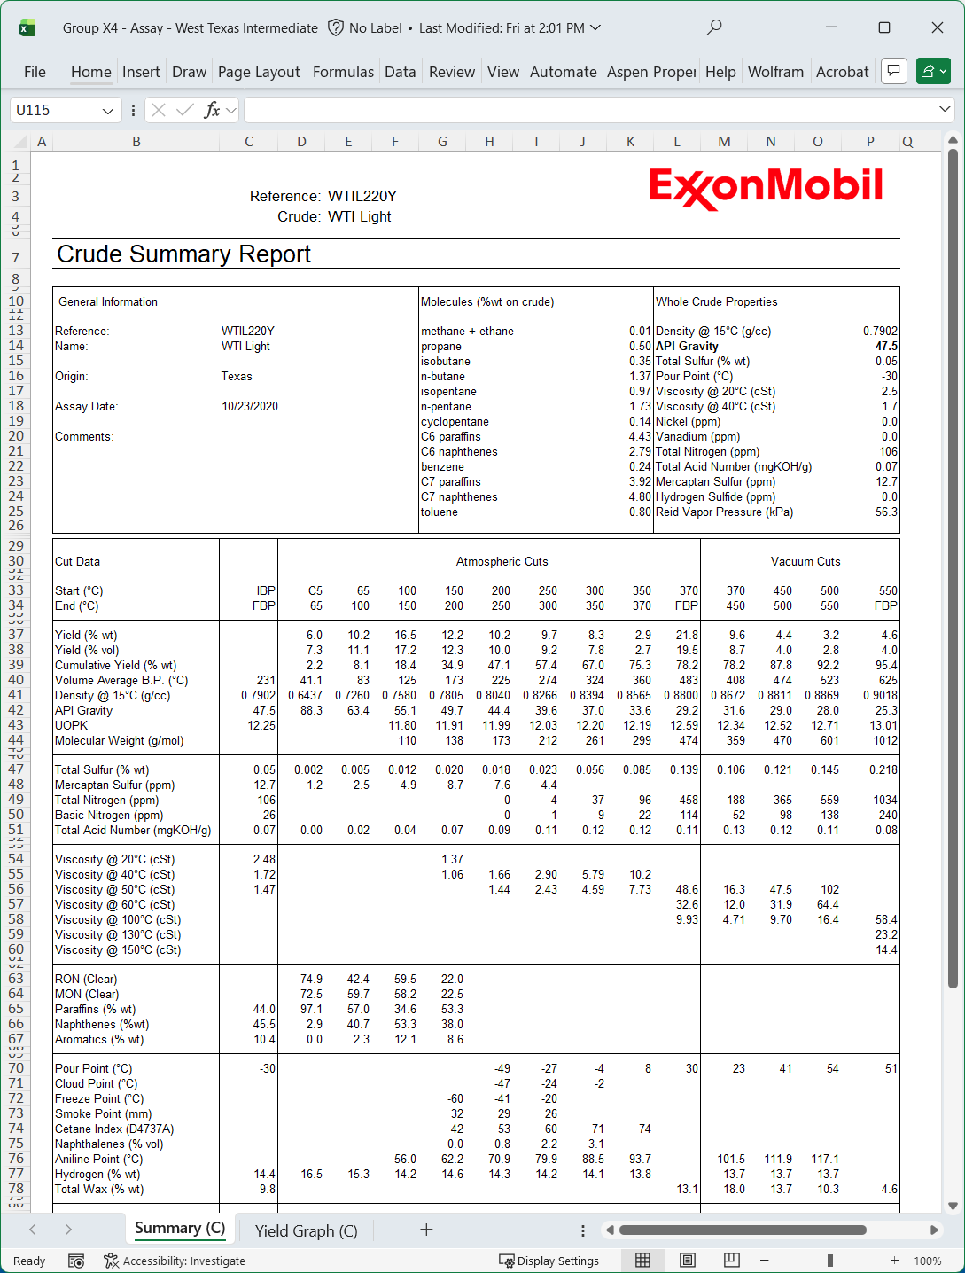
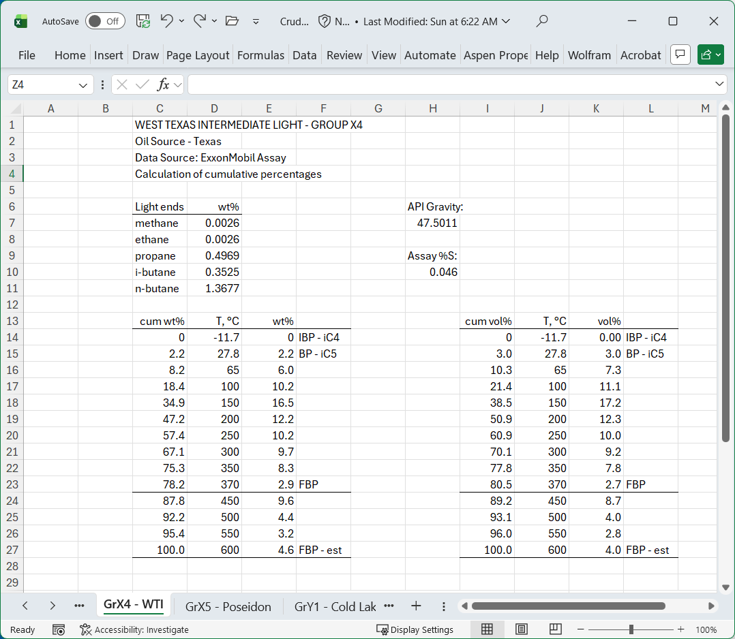
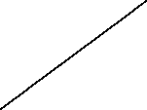



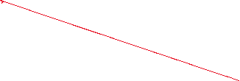




Prep your Assay Data for CHEMCAD
Build a scratch worksheet by following the color-coded instructions below.
For this project, light ends are methane, ethane, propane, i-butane, and n-butane.
Note: copy and past data
cum wt% in cell C15 is “=C14+E15”
then copy down.
Arrange the columns this way so you can copy and paste the data into CHEMCAD.
Do the same procedure for vol%

Slide 4
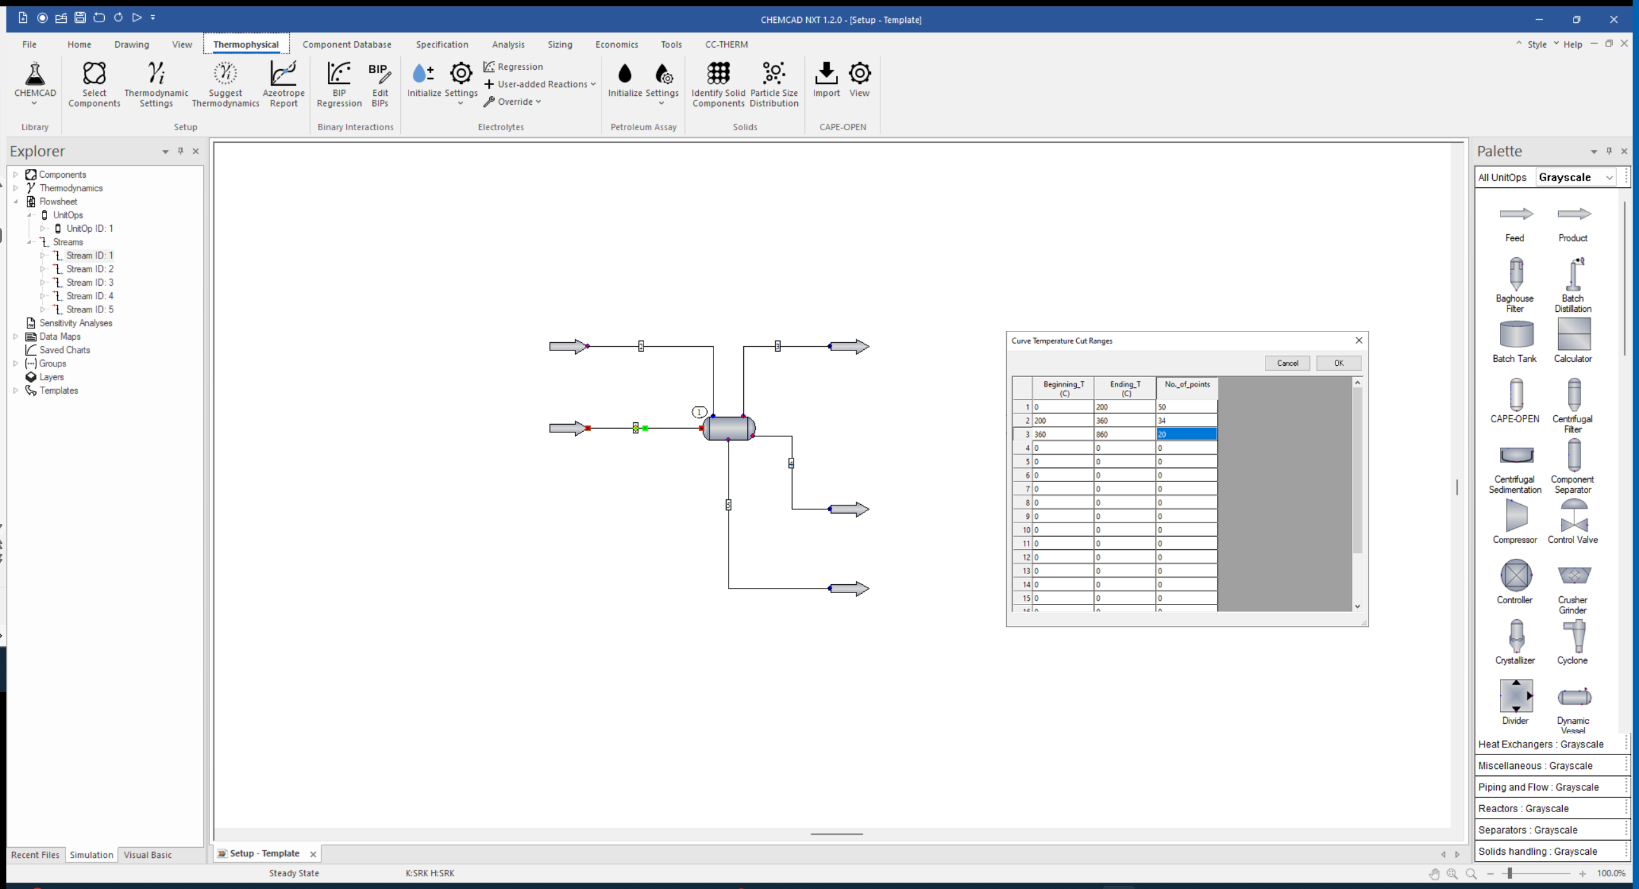



Open the CHEMCAD Template

Slide 5
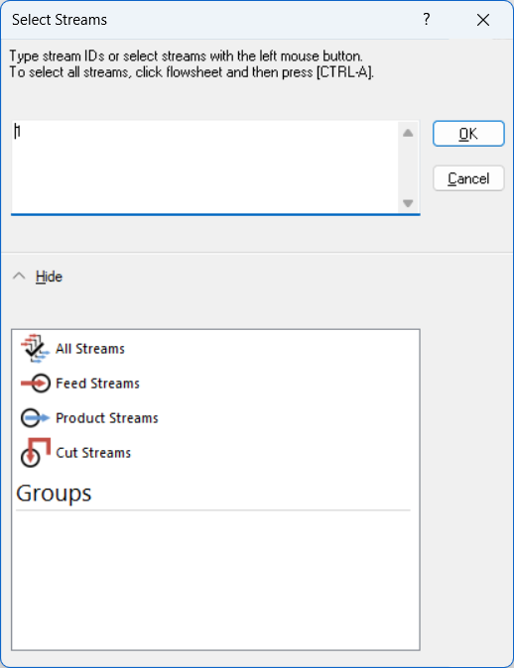
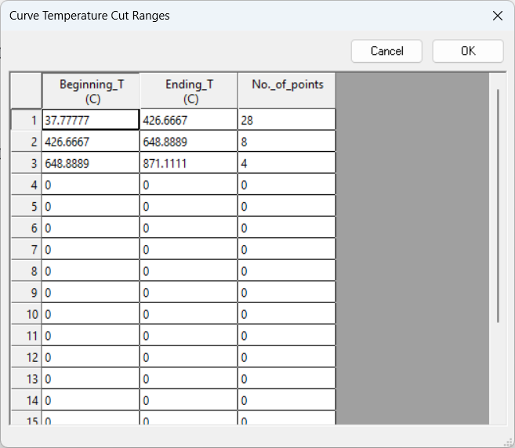
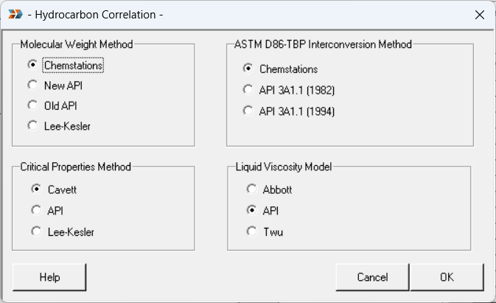



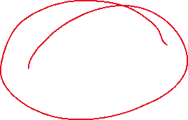
Step Through the Windows…

Slide 6
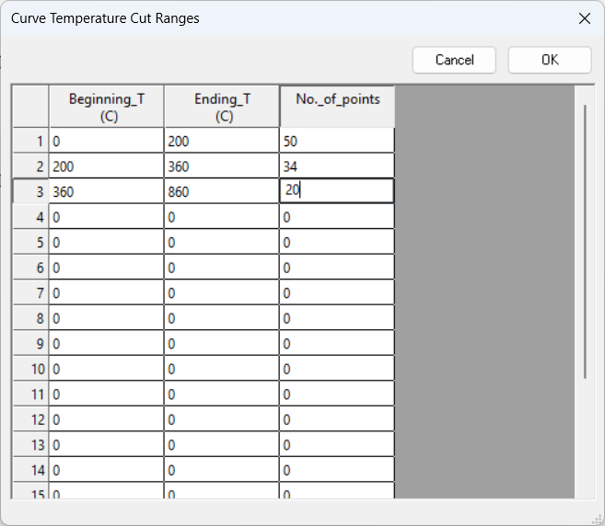
Set Cut Ranges for the Pseudo-Components

Slide 7
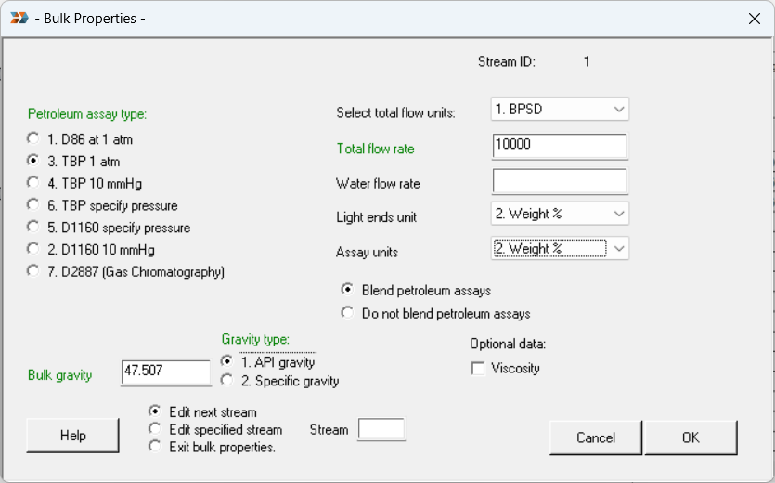






Add Bulk Properties

Slide 8
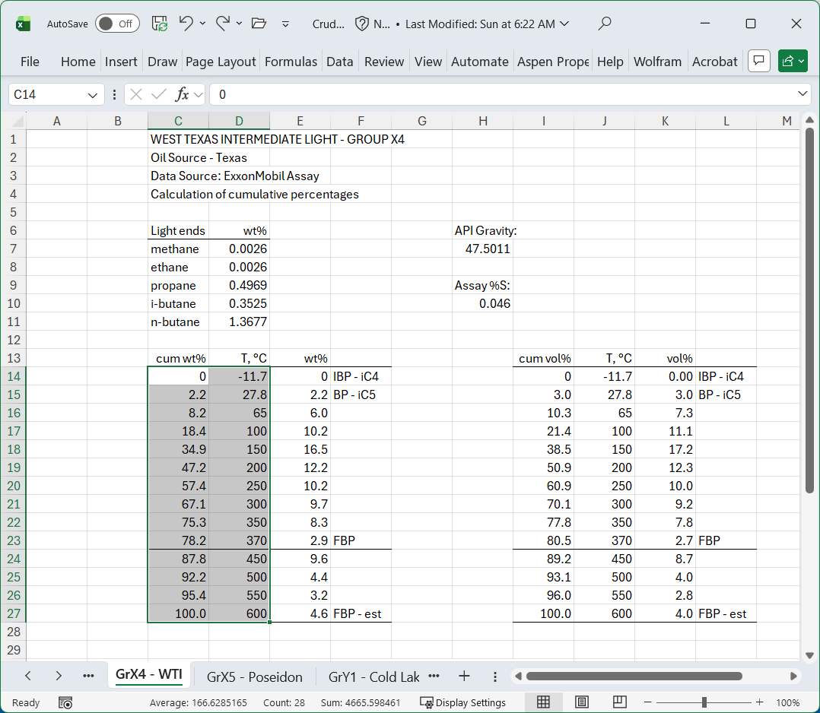
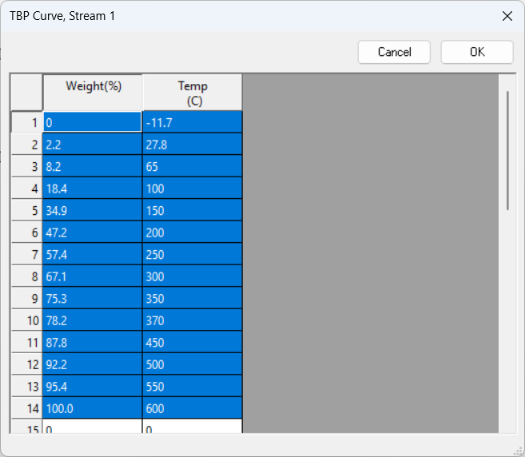




Copy and Paste the wt% Assay Data

Slide 9
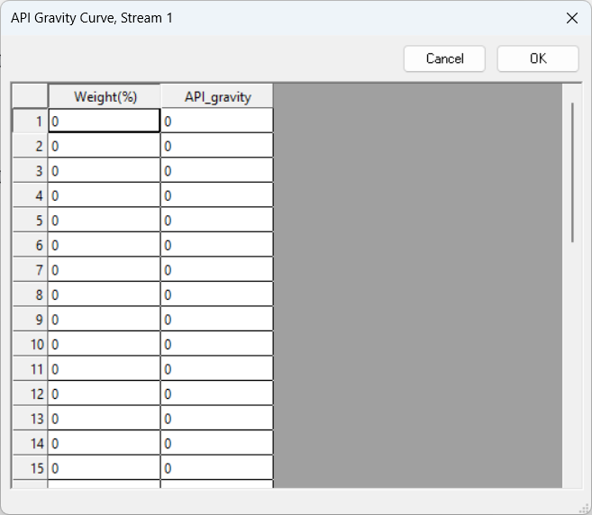

The API Gravity Curve is Optional.

Slide 10
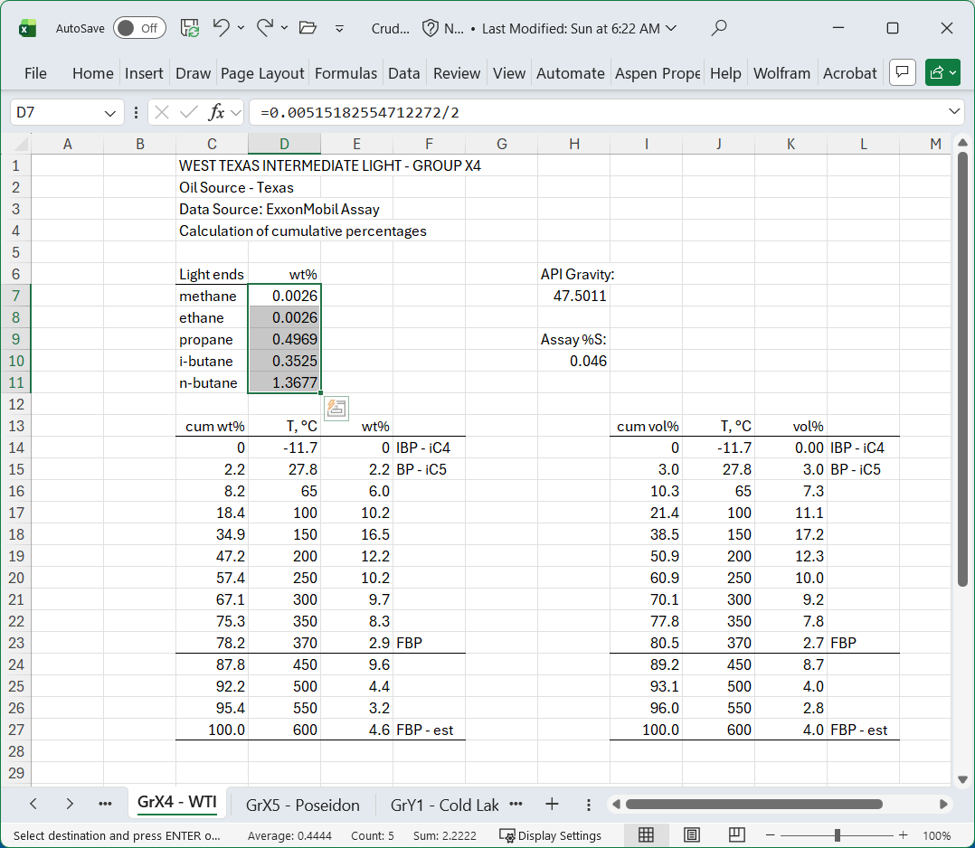
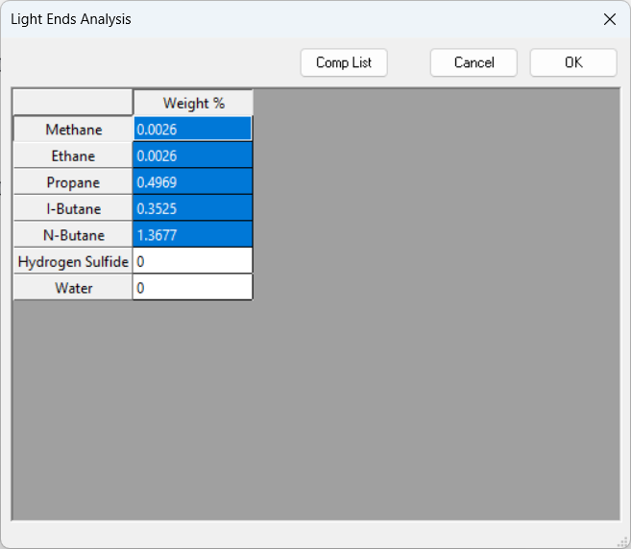
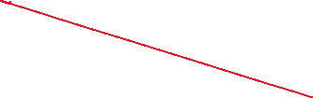

Add the Light Ends

Slide 11
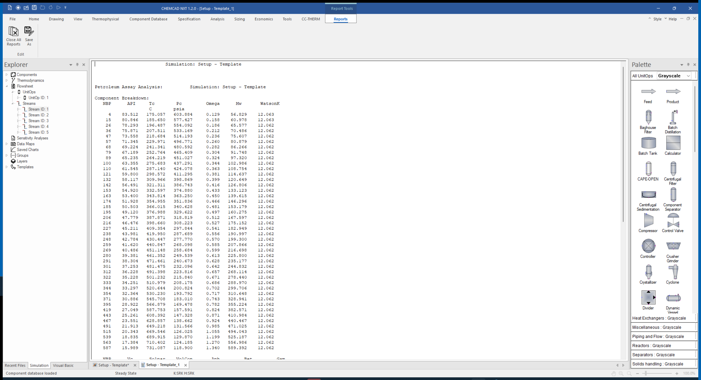
Detailed Component Report

Slide 12
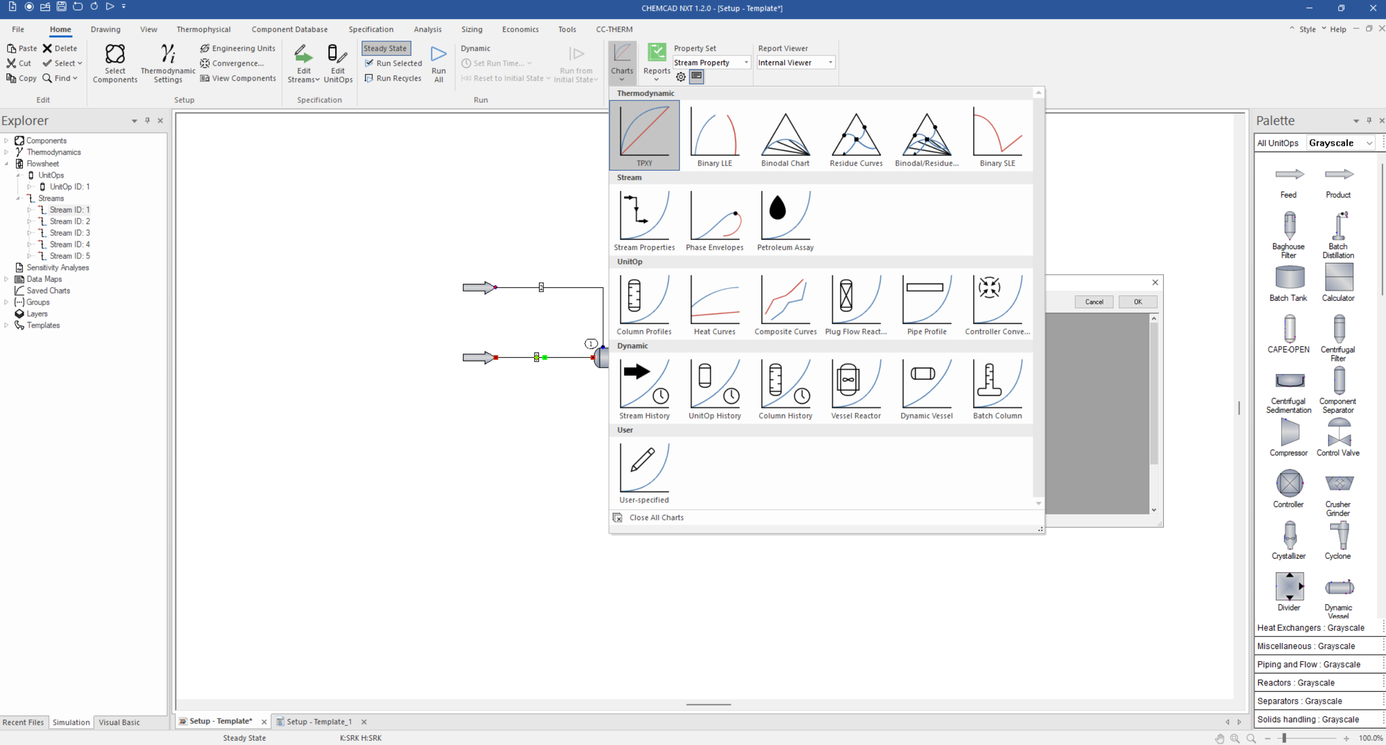
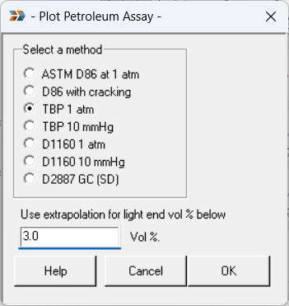




Prepare your Assay Data
Home Tab
Charts

Slide 13
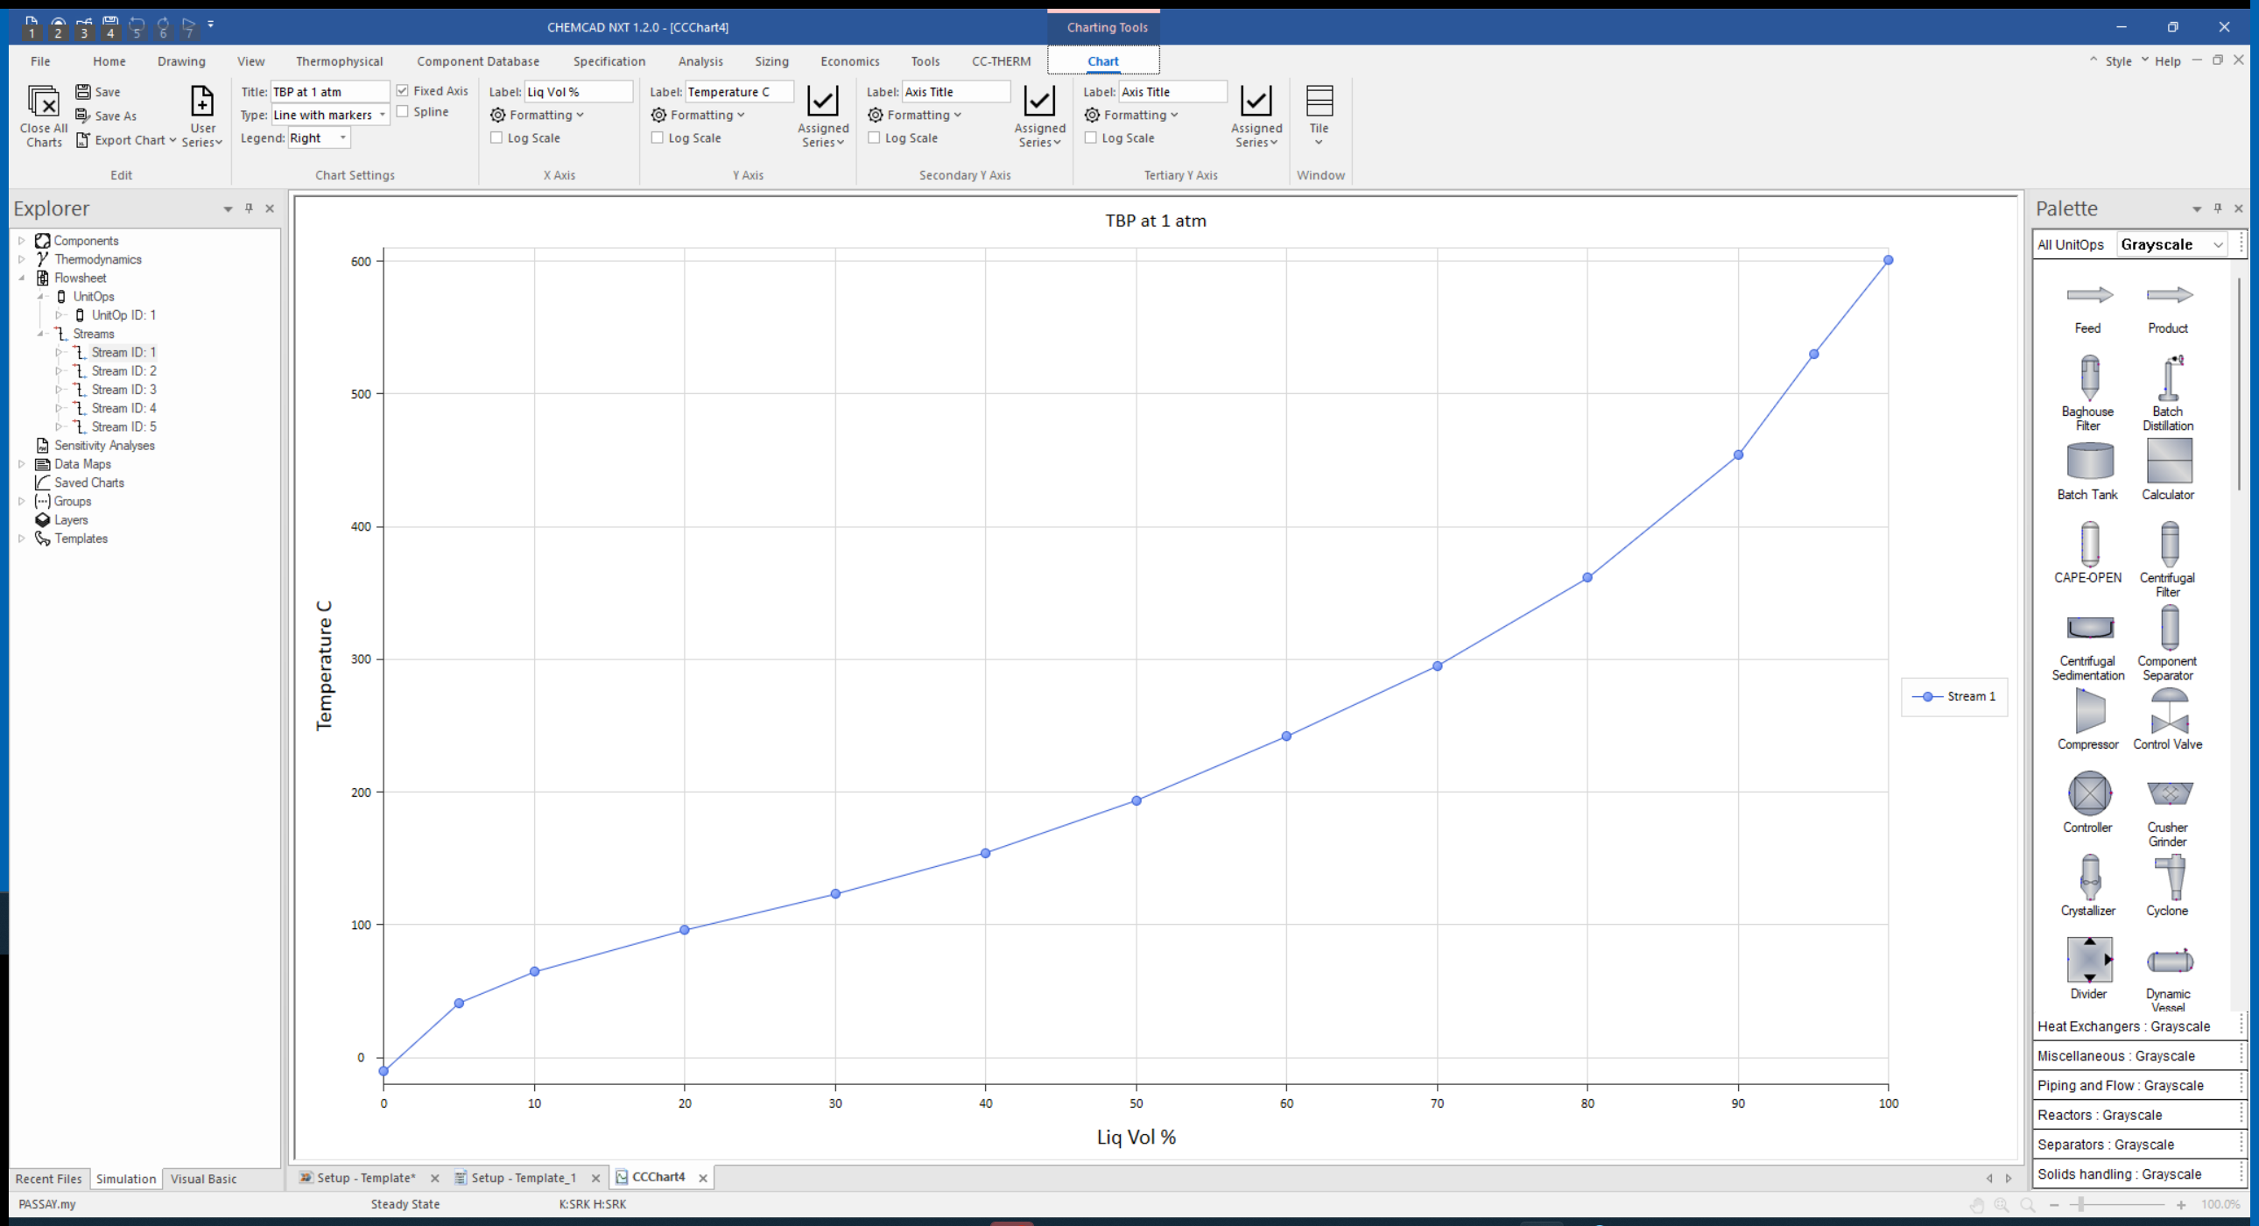
Your TBP True Boiling Point (TBP) Curve

Slide 14
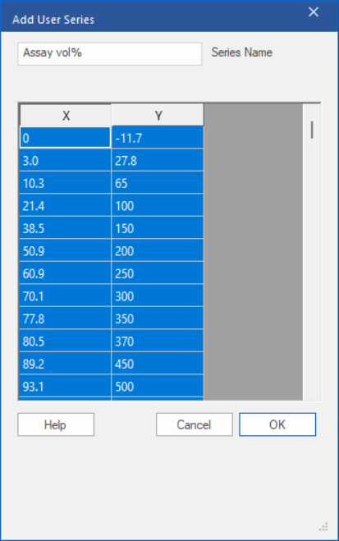
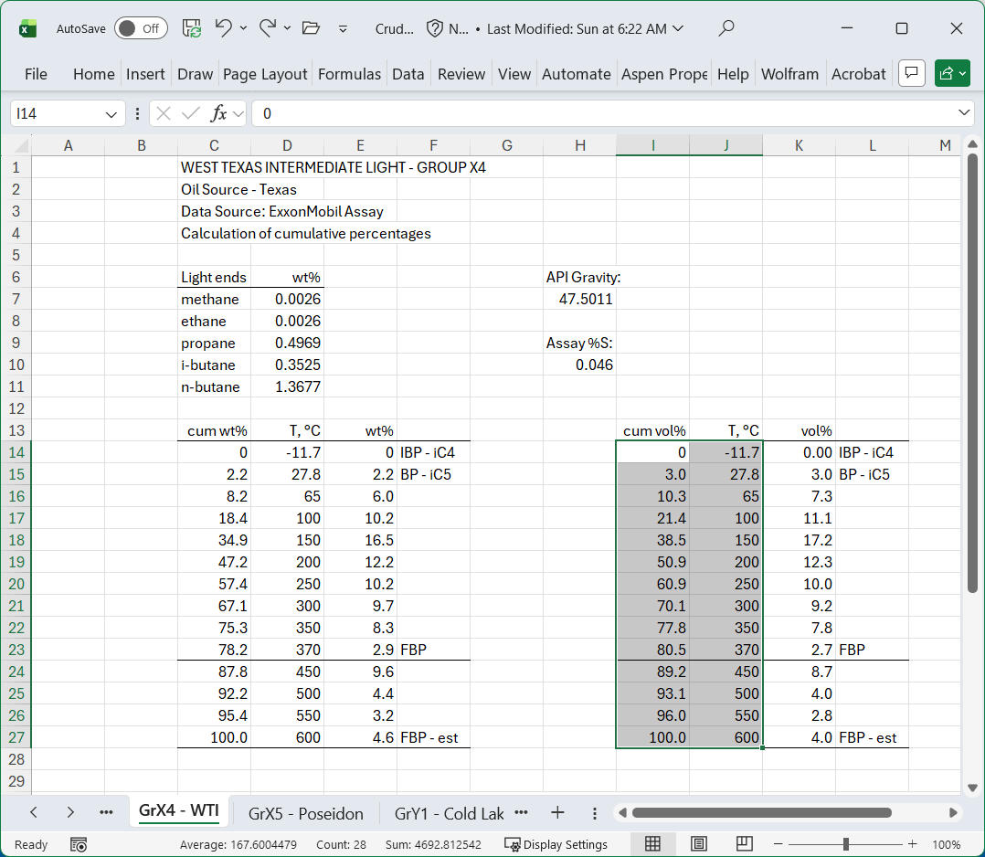





Add the Assay Data (vol%)

Slide 15
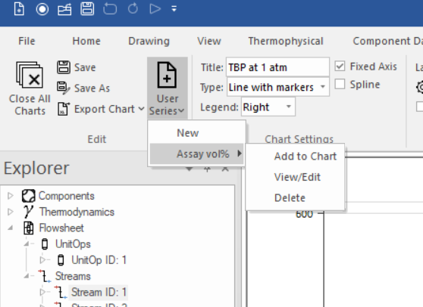





Add the Assay Data (vol%)

Slide 16
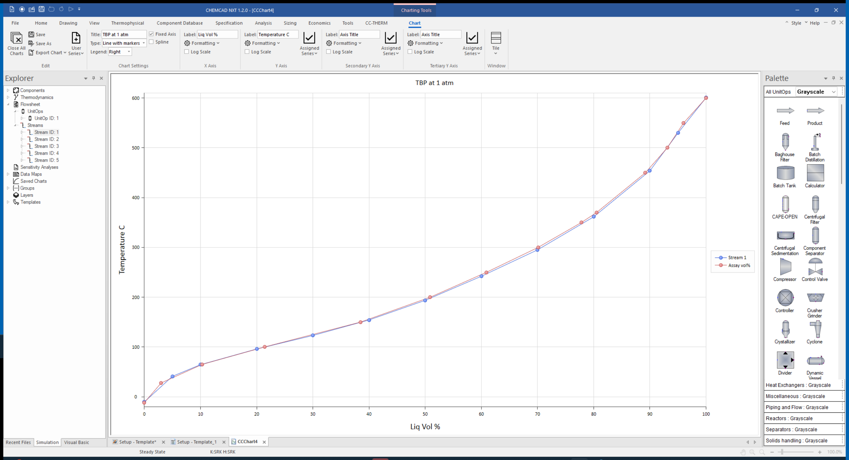
Simulated Plot with Experimental Data
You may now begin work on the write-up for this section.
Give your draft to the instructor early for critique.
NOTE CAREFULLY: For your final report, you will need to add TBP curves for each of your final products to this plot.

Slide 17
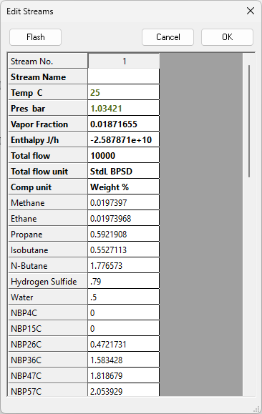
Add Water and H₂S to Stream 1 as Specified
This does not change the TBP curves.

Slide 18
Questions?

