Slide 1
Procedure for Adding Psuedo-components to CHEMCAD
Requirements:
Boiling curve
Light-ends analysis
API gravity or specific gravity of fluid
All found in “Crude Assay”

Slide 2
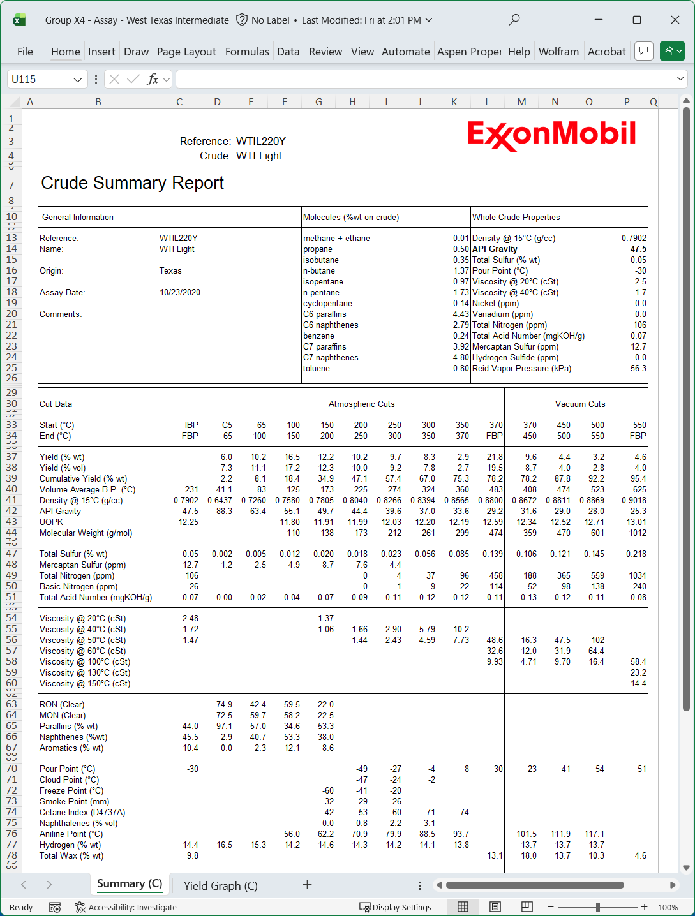
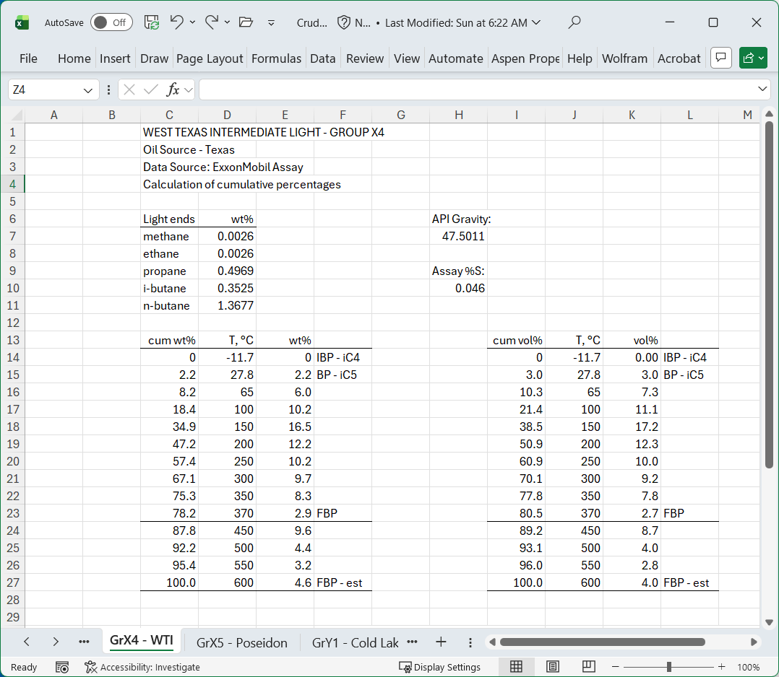




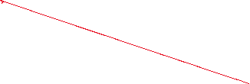




Prep your Assay Data for CHEMCAD
Build a scratch worksheet by following the color-coded instructions below.
For this project, light ends are methane, ethane, propane, i-butane, and n-butane.
Note: copy and past data
cum wt% in cell C15 is “=C14+E15”
then copy down.
Arrange the columns this way so you can copy and paste the data into CHEMCAD.
Do the same procedure for vol%

Slide 3
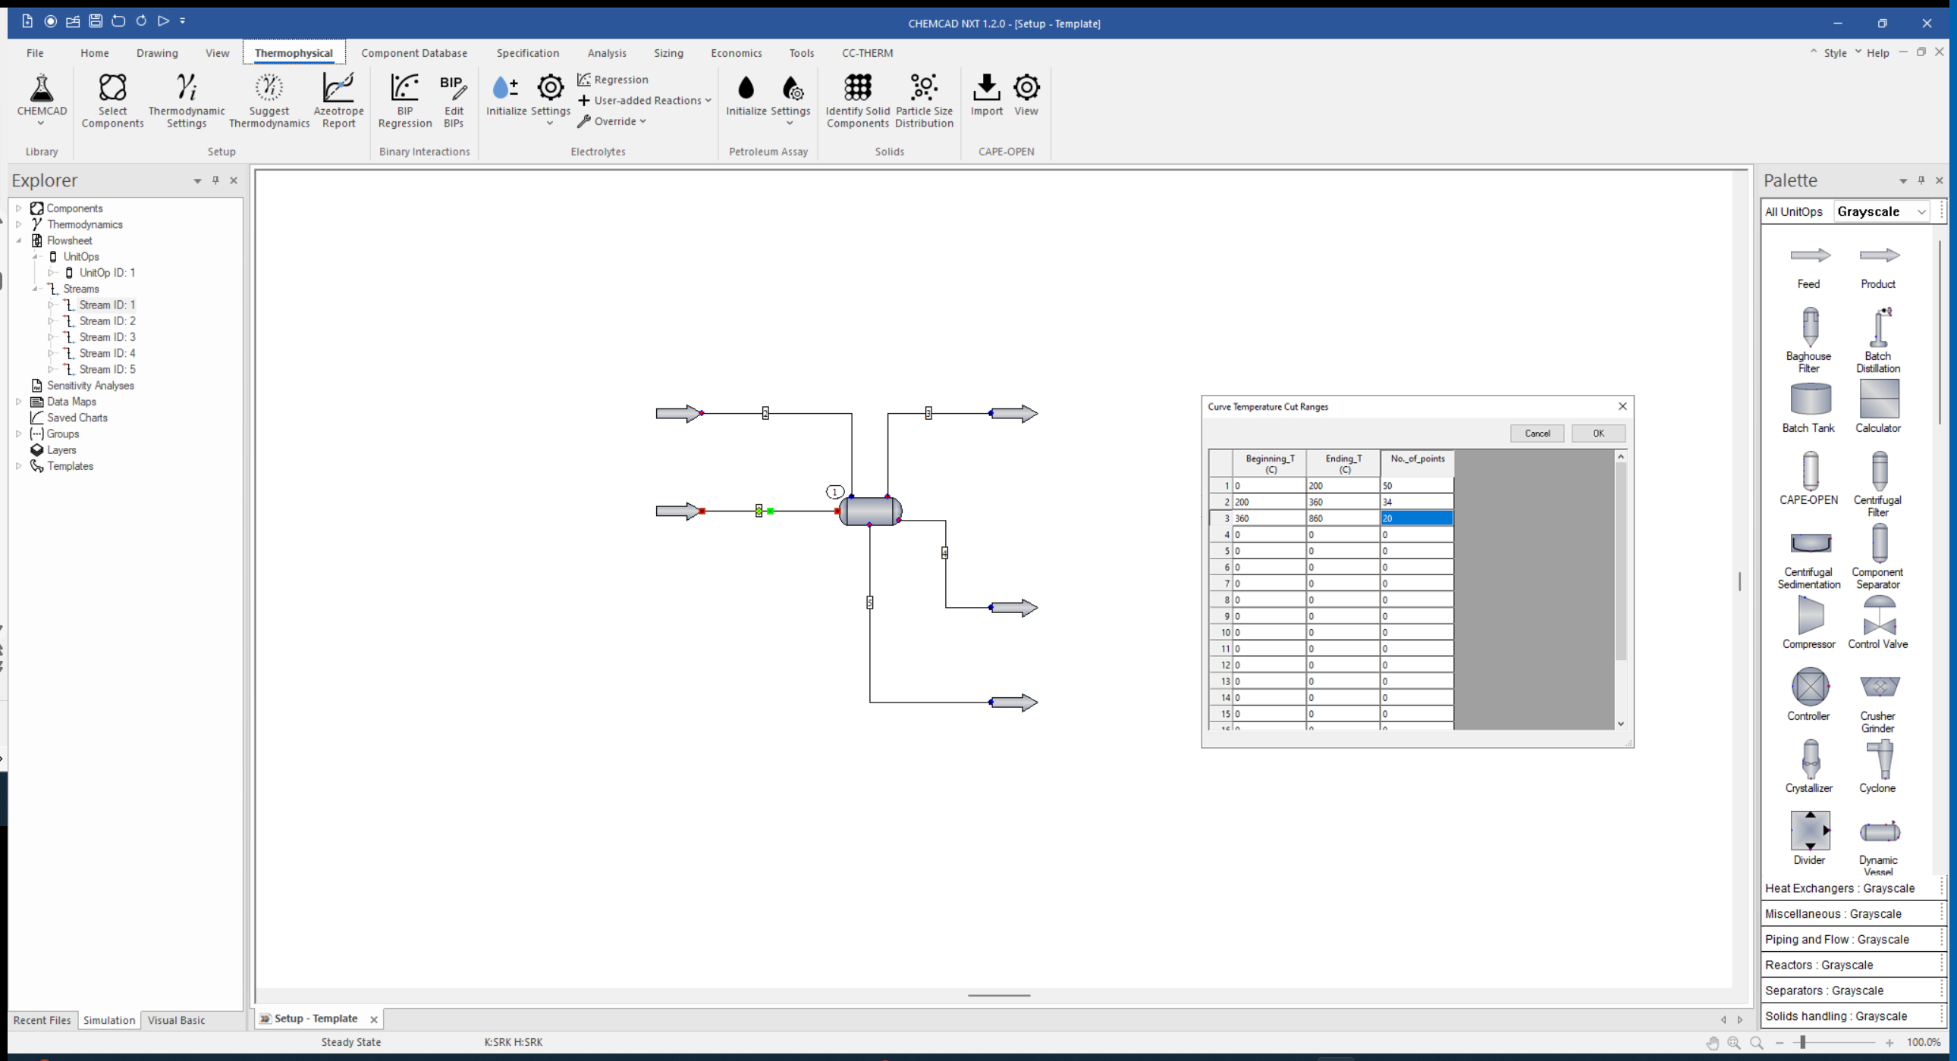



Open the CHEMCAD Template

Slide 4
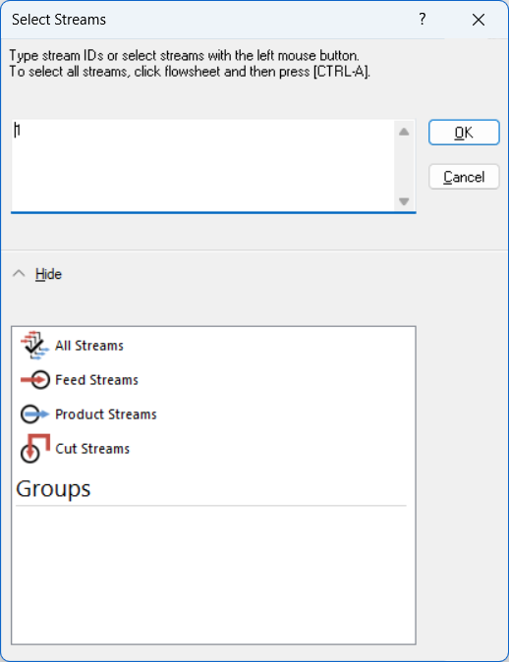
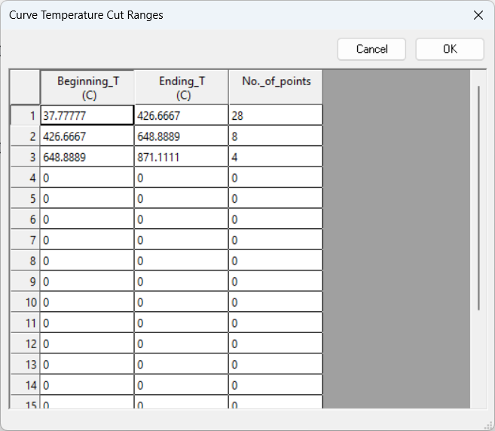
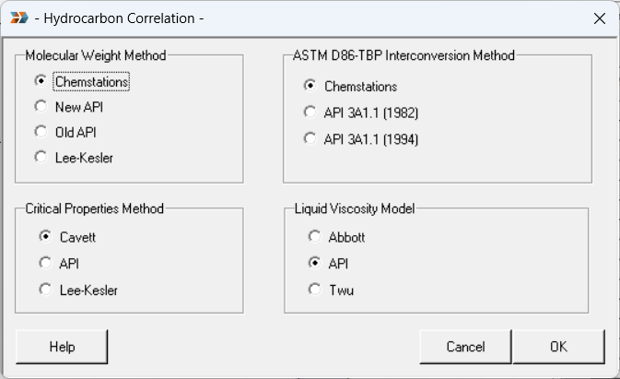



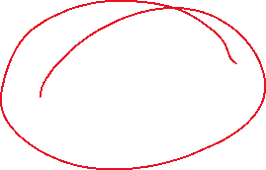
Step Through the Windows…

Slide 5
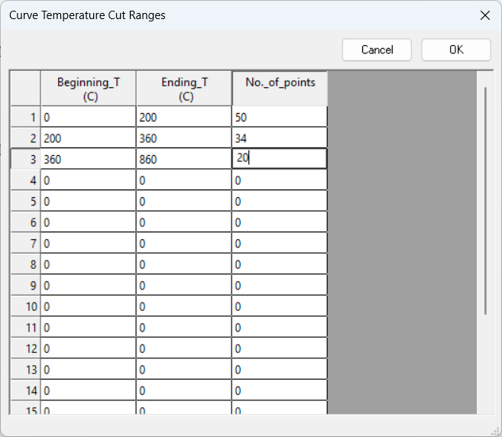
Set Cut Ranges for the Pseudo-Components

Slide 6
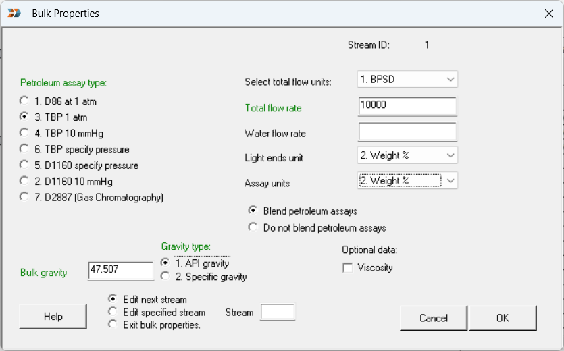






Add Bulk Properties

Slide 7
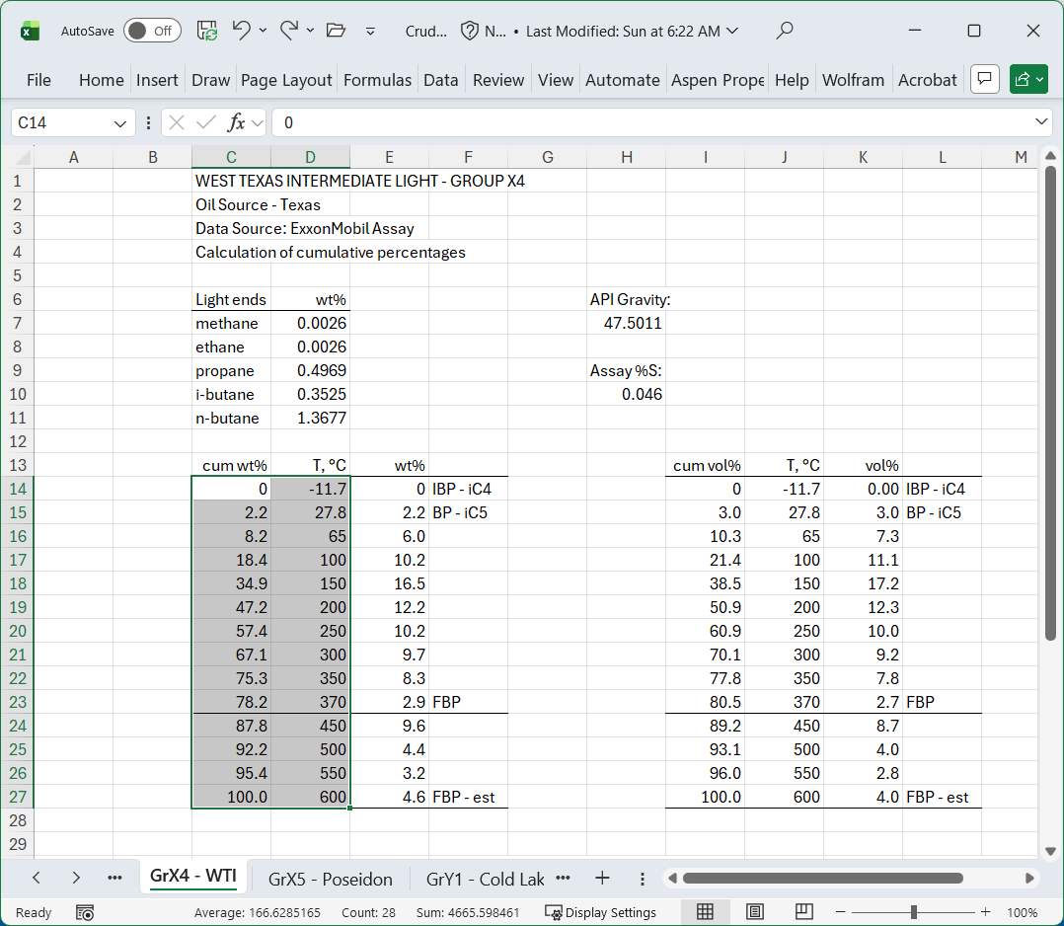
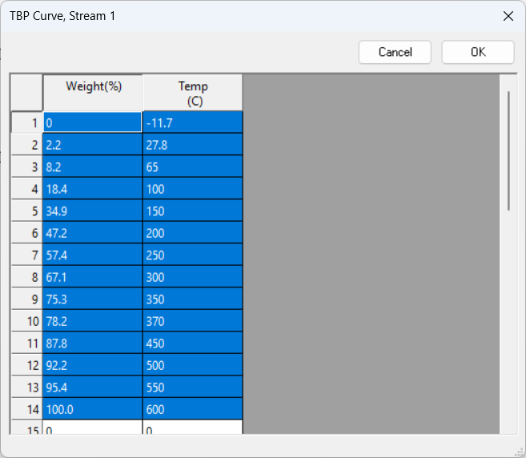




Copy and Paste the wt% Assay Data

Slide 8
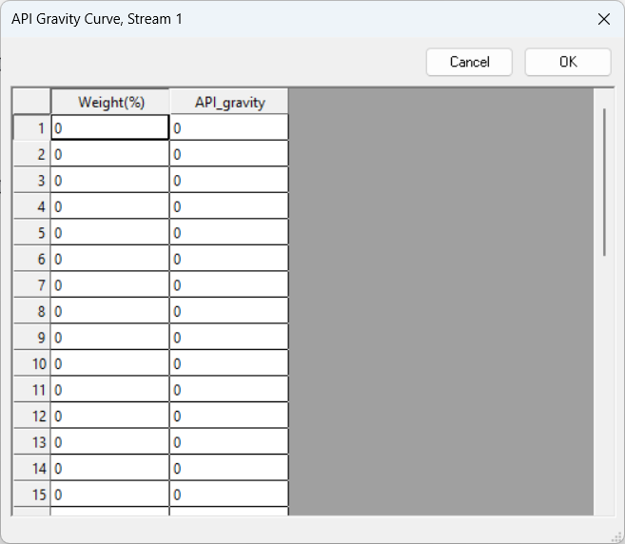

The API Gravity Curve is Optional.

Slide 9
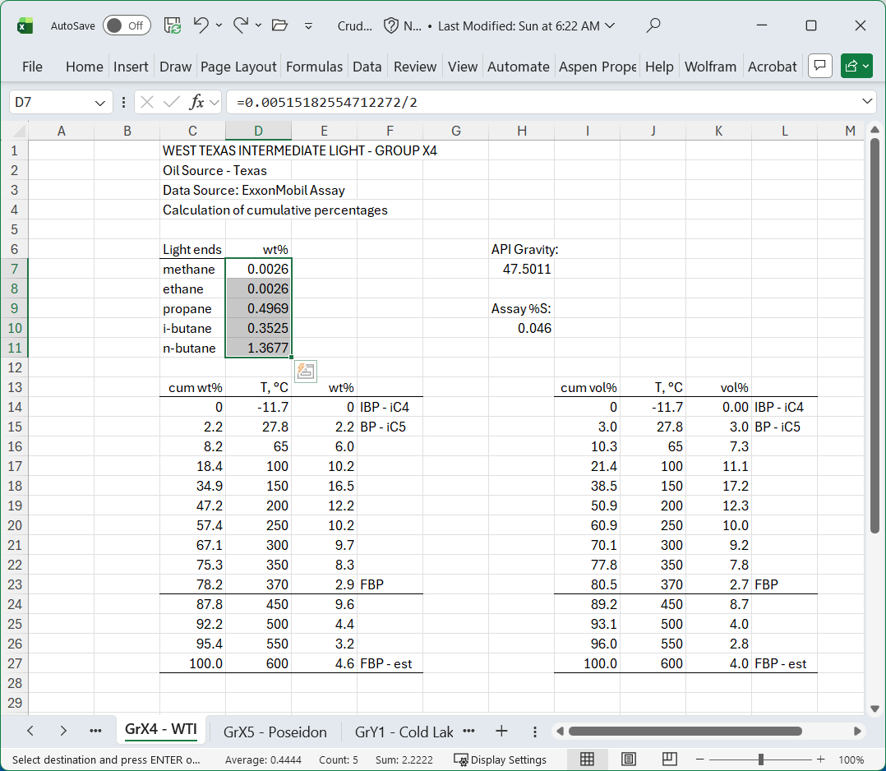
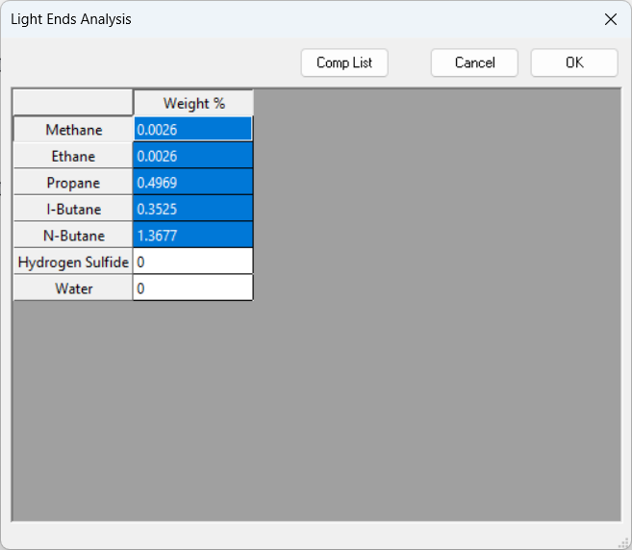
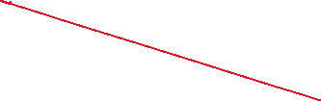

Add the Light Ends

Slide 10
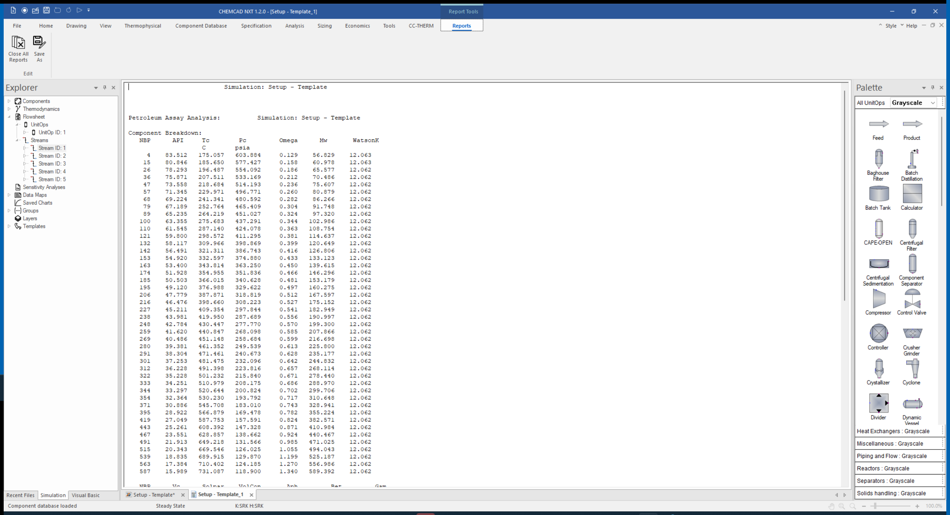
Detailed Component Report

Slide 11
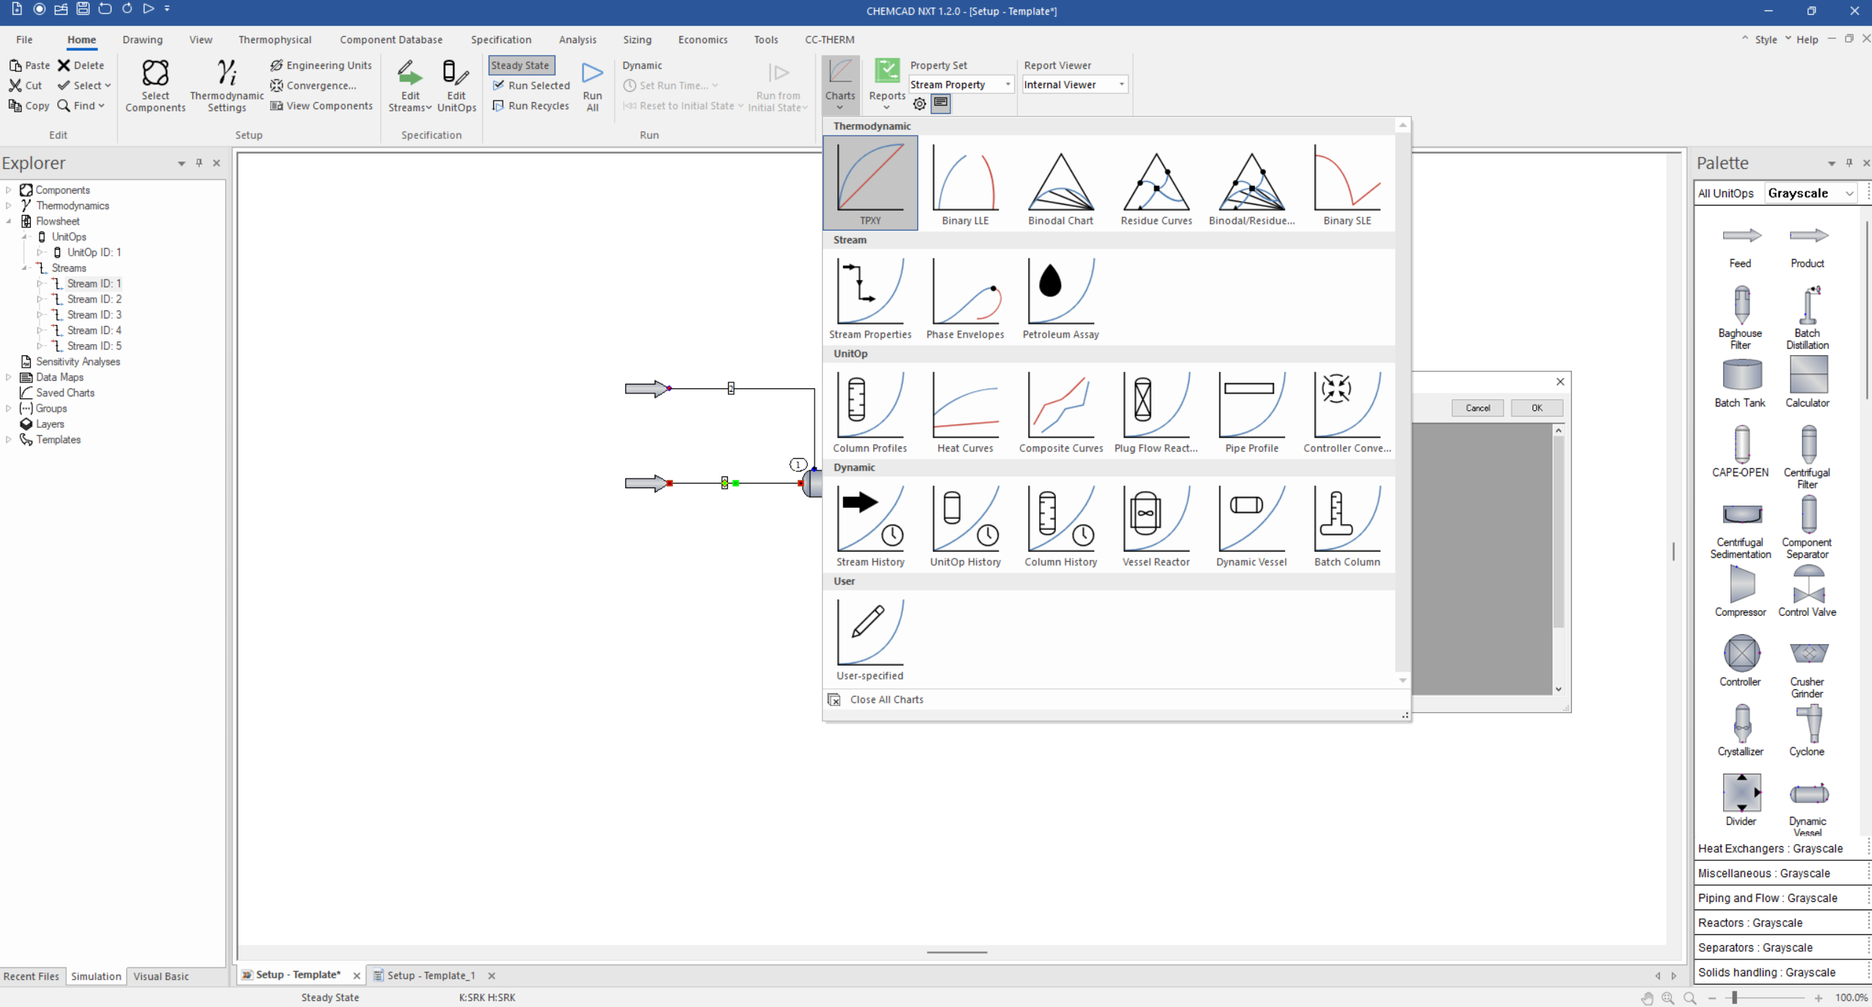
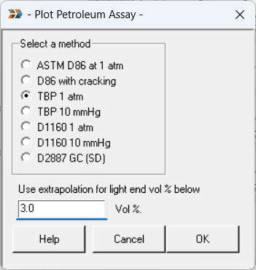




Prepare your Assay Data
Home Tab
Charts

Slide 12
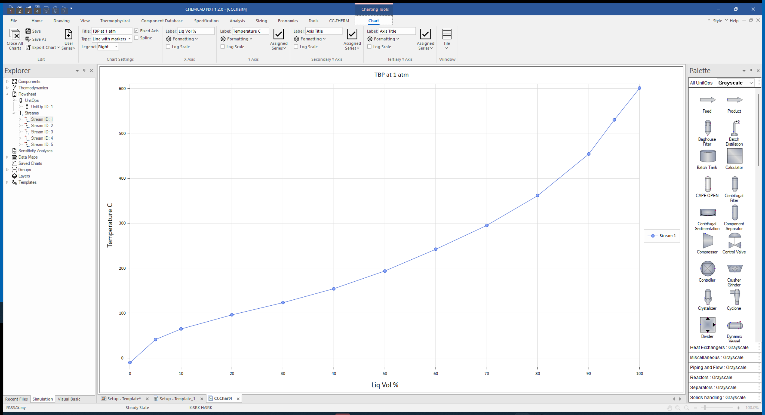
Your TBP True Boiling Point (TBP) Curve

Slide 13
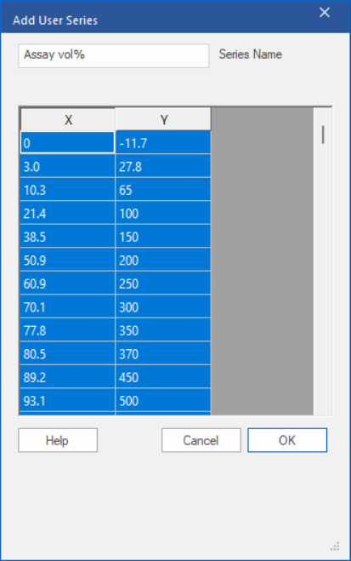
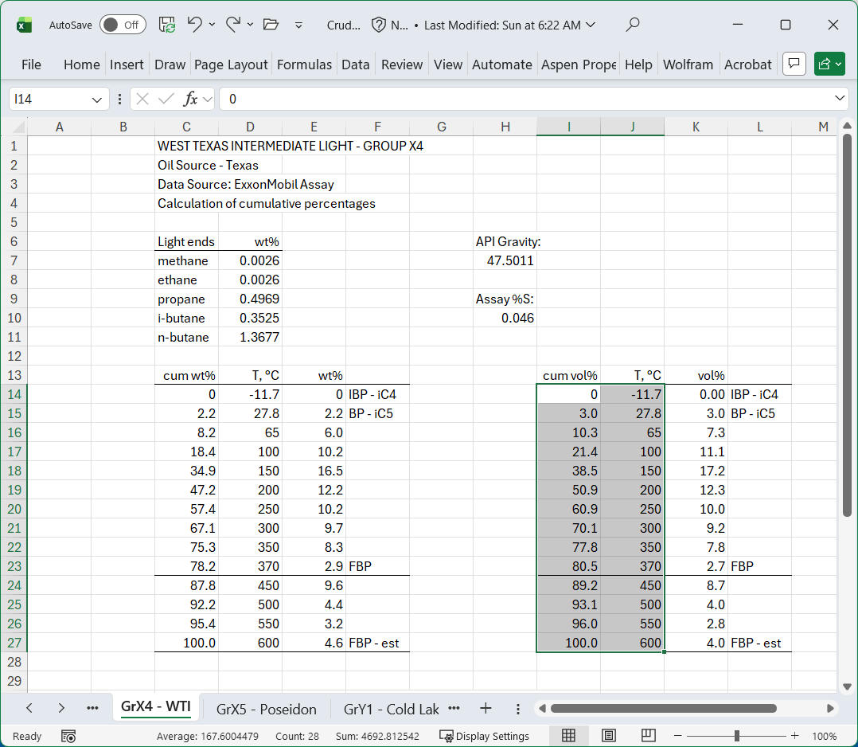





Add the Assay Data (vol%)

Slide 14
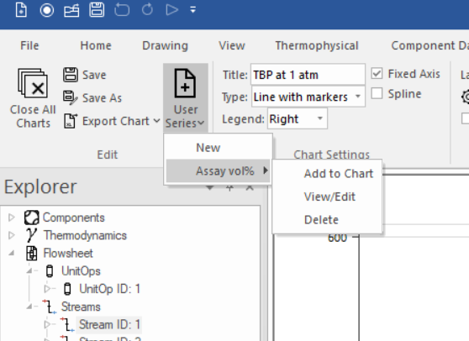





Add the Assay Data (vol%)

Slide 15
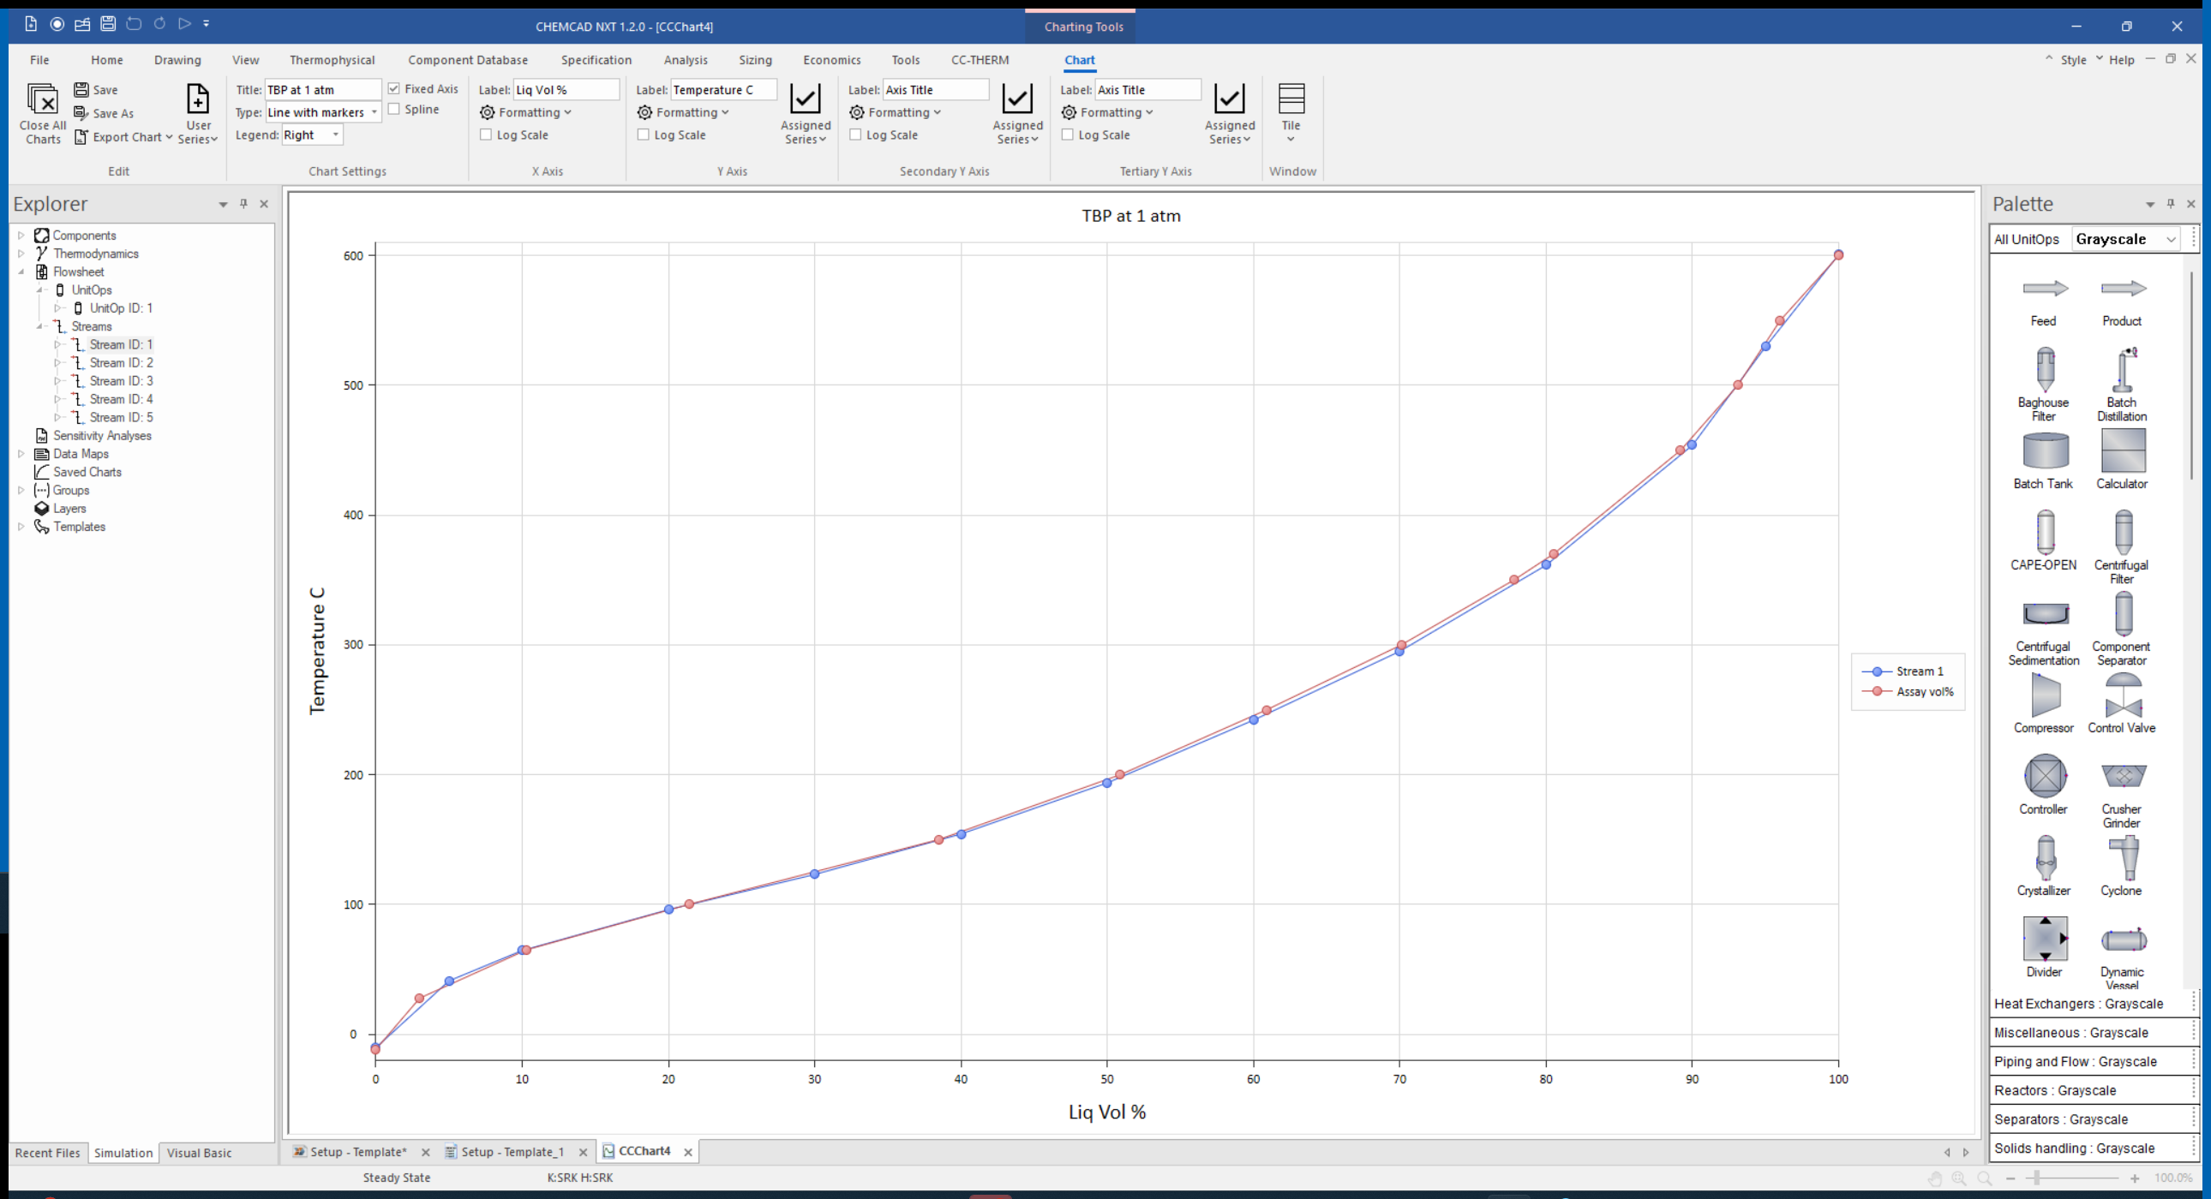
Simulated Plot with Experimental Data
You may now begin work on the write-up for this section.
Give your draft to the instructor early for critique.
NOTE CAREFULLY: For your final report, you will need to add TBP curves for each of your final products to this plot.

Slide 16
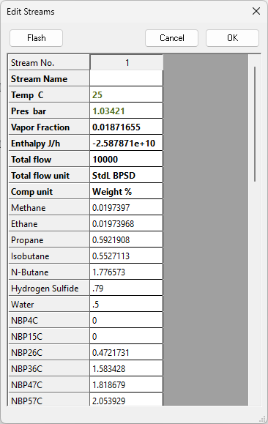
Add Water and H₂S to Stream 1 as Specified
This does not change the TBP curves.

Slide 17
Questions?

