Slide 1
CSC664 INFORMATION VISUALIZATION
Exploratory Data Analysis and Hypothesis
Validation on FBI Homicide Data
Lab assignment: five hypotheses, fifteen charts, eight libraries
Abid Hasan Talukder
October 18, 2026

Slide 2
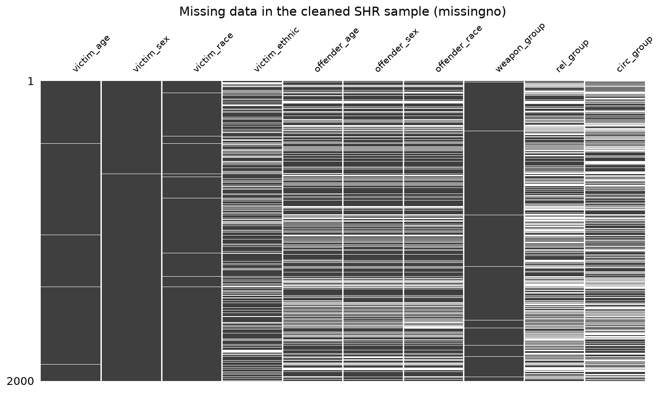
SETUP
Environment and data setup
python -m venv csc_lab_env
csc_lab_env\Scripts\Activate.ps1
python -m pip install --upgrade pip
pip install -r requirements.txt
Source. FBI Crime Data Explorer, Supplementary Homicide Report master files, 2015-2024 (10 fixed-width files).
After cleaning. 161,889 murder and non-negligent manslaughter incidents in 50 states and DC.
Variables. Year, state, region; victim and offender age, sex, race; weapon; relationship; circumstance.
Missing data. Unknown codes were set to NaN and dropped per analysis: relationship 48%, circumstance 42%, offender age 32%, victim age 1%.
Missing-value matrix (white = missing) missingno
Notes:
Data: FBI Crime Data Explorer, SHR master files 2015-2024. Everything ran inside the csc_lab_env virtual environment.

Slide 3
OVERVIEW
Five hypotheses, each tested with three charts
H1
The 2020 surge was a firearm surge
matplotlib | seaborn | plotly
H2
Who kills depends on the victim's sex
seaborn | altair | plotnine
H3
Weapon depends on closeness and age
seaborn | plotly | bokeh
H4
Geography shapes the weapon
plotly | folium | seaborn
H5
The age gap depends on the circumstance
matplotlib | seaborn | altair

Slide 4
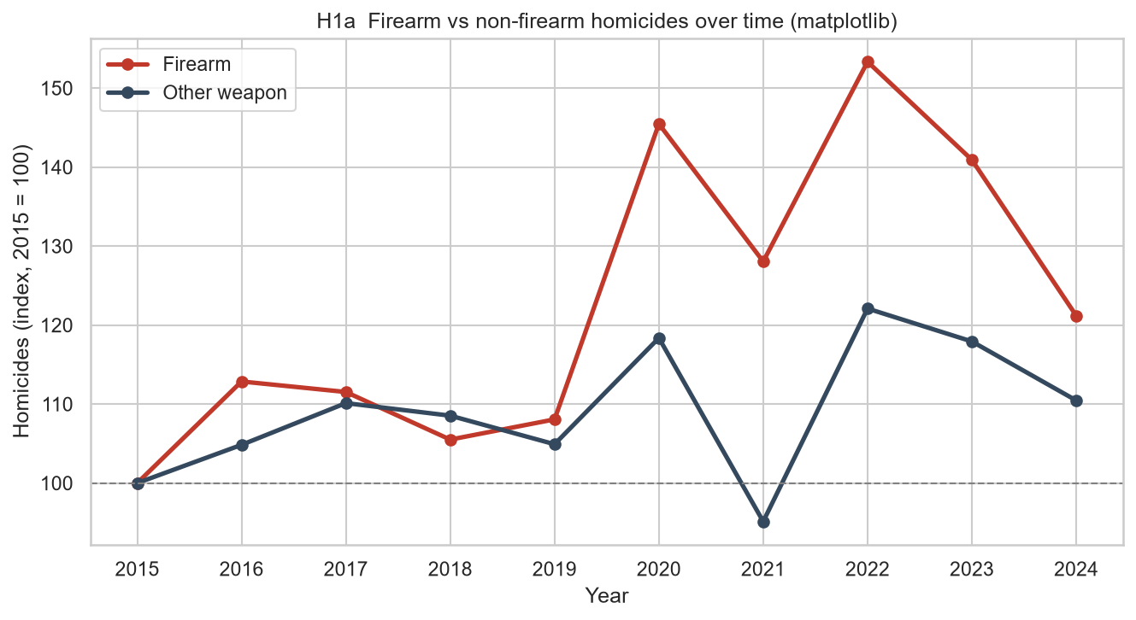
HYPOTHESIS 1 | STATEMENT AND RATIONALE
The 2020 surge was a firearm surge
The rise in homicides around 2020 was driven by firearms: gun homicides grew much faster than non-gun homicides, and the firearm share rose in every region.
WHY IT IS NOT TRIVIAL
If the surge were a general rise in violence, all weapon types would grow together. Splitting by weapon and by region tests whether it was specific and nationwide.
Chart 1a: Indexed line chart library: matplotlib
Notes:
The rise in homicides around 2020 was driven by firearms: gun homicides grew much faster than non-gun homicides, and the firearm share rose in every region.

Slide 5
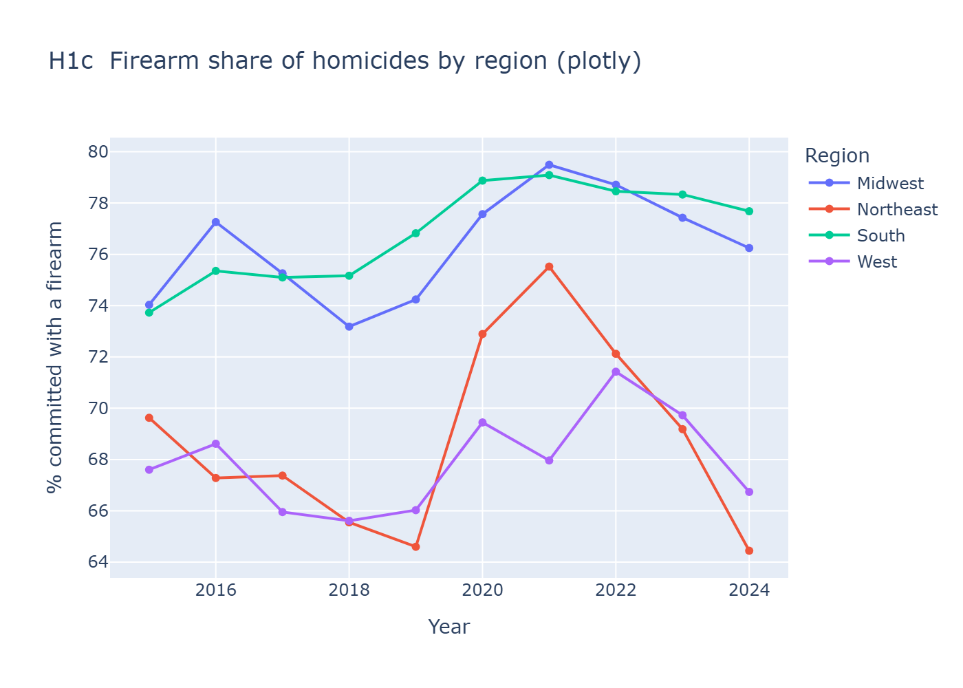
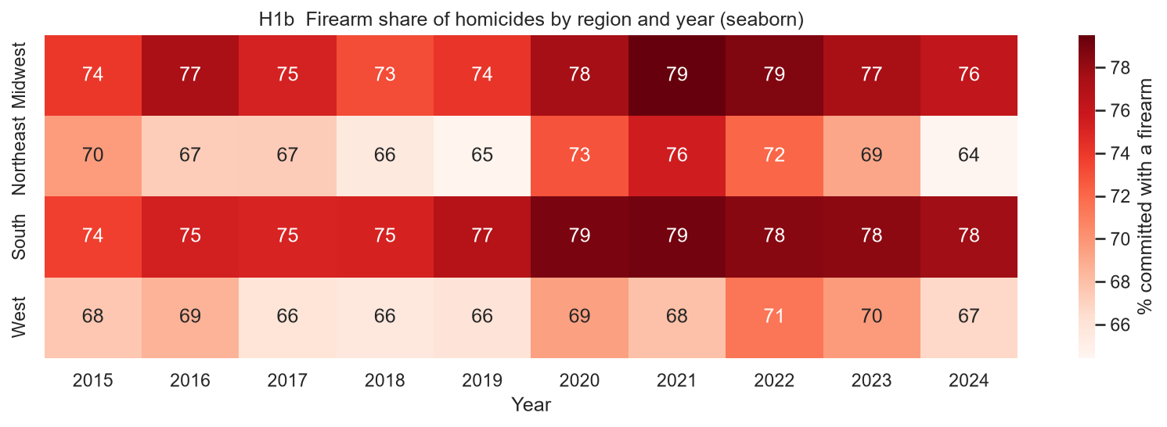
HYPOTHESIS 1 | SUPPORTING CHARTS
The 2020 surge was a firearm surge: more evidence
Chart 1b: Heatmap library: seaborn
Chart 1c: Interactive multi-line chart library: plotly

Slide 6
HYPOTHESIS 1 | CODE AND NARRATIVE
The 2020 surge was a firearm surge: code and findings
SUPPORTED
heat = df.pivot_table(index="region", columns="year",
values="firearm", aggfunc="mean") * 100
plt.figure(figsize=(11, 3.8))
sns.heatmap(heat, annot=True, fmt=".0f", cmap="Reds",
cbar_kws={"label": "% committed with a firearm"})
plt.title("Firearm share of homicides by region and year")
long = heat.reset_index().melt(id_vars="region",
var_name="year", value_name="firearm_pct")
fig = px.line(long, x="year", y="firearm_pct",
color="region", markers=True)
fig.write_html("figures/h1c_plotly_region_lines.html")
Guns drove the jump. From 2019 to 2020 firearm homicides rose about 35% (index 108 to 146) while all other weapons rose about 13% (105 to 118).
Every region moved. The firearm share rose in all four regions in 2020, most sharply in the Northeast (65% to 73%).
It partly reversed. By 2024 the Northeast and West were back near their 2019 shares; the South and Midwest stayed at 76-78%.
Caveat. The 2021 dip is a reporting gap, not a real fall: many agencies in CA and NY did not submit that year.
Excerpt from 02_hypotheses.py; the full script is in the submission zip

Slide 7
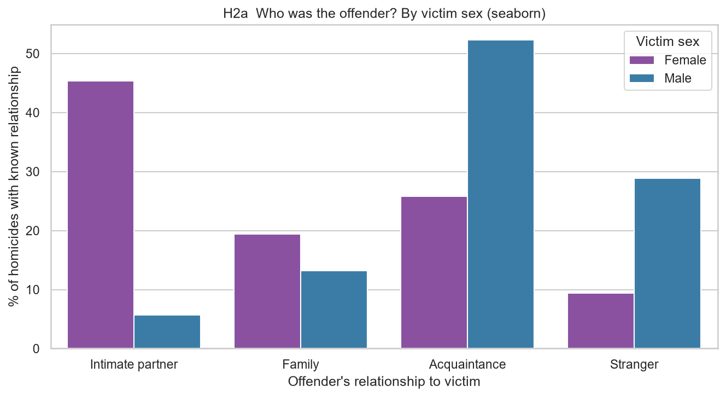
HYPOTHESIS 2 | STATEMENT AND RATIONALE
Who kills depends on the victim's sex
Women are killed mainly by intimate partners and family, men by acquaintances and strangers, and this gap has not narrowed over the decade.
WHY IT IS NOT TRIVIAL
A single overall relationship breakdown hides two very different patterns. Adding time tests whether the difference is stable or changing.
Chart 2a: Grouped bar chart library: seaborn
Notes:
Women are killed mainly by intimate partners and family, men by acquaintances and strangers, and this gap has not narrowed over the decade.

Slide 8
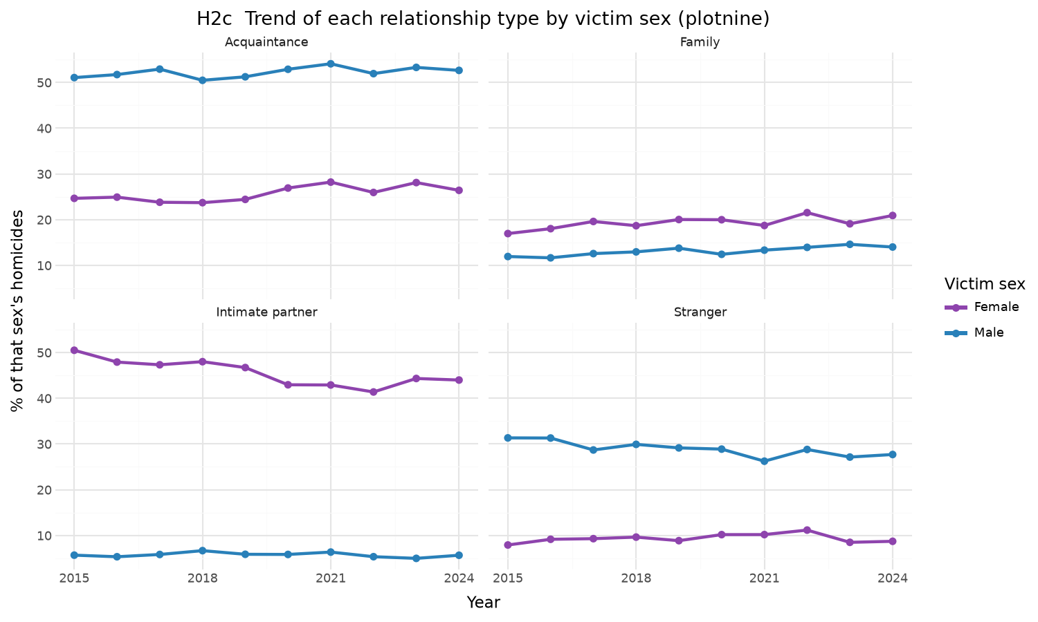
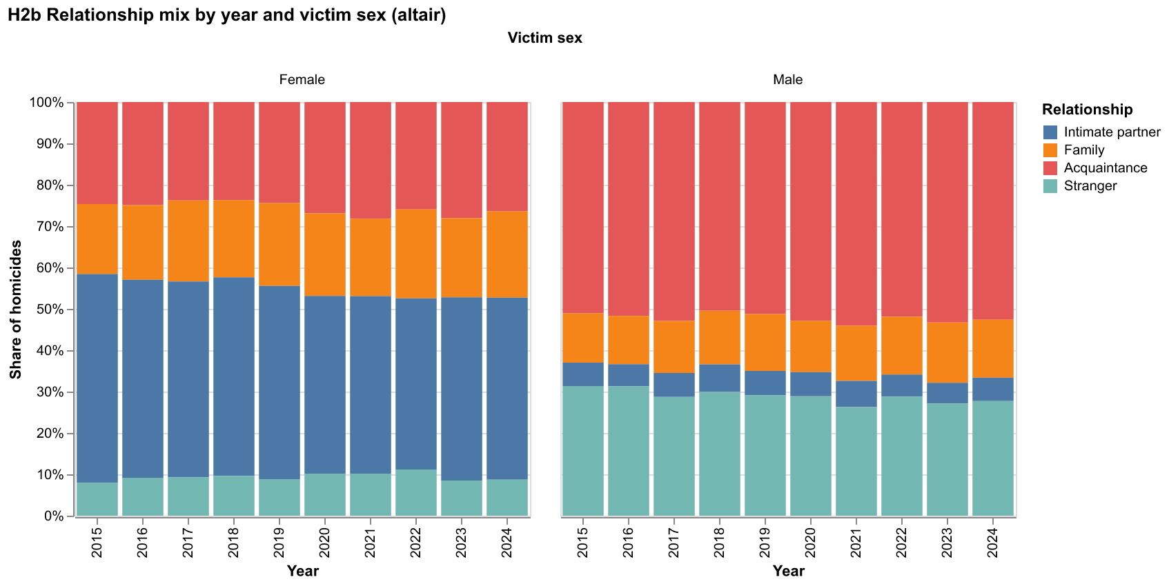
HYPOTHESIS 2 | SUPPORTING CHARTS
Who kills depends on the victim's sex: more evidence
Chart 2b: Faceted 100% stacked bars library: altair
Chart 2c: Small-multiple line charts library: plotnine

Slide 9
HYPOTHESIS 2 | CODE AND NARRATIVE
Who kills depends on the victim's sex: code and findings
PARTLY SUPPORTED
known = df.dropna(subset=["victim_sex", "rel_group"])
counts = (known.groupby(["year", "victim_sex", "rel_group"])
.size().reset_index(name="n"))
chart = alt.Chart(counts).mark_bar().encode(
x=alt.X("year:O", title="Year"),
y=alt.Y("n:Q", stack="normalize",
axis=alt.Axis(format="%"),
title="Share of homicides"),
color=alt.Color("rel_group:N", title="Relationship"),
column=alt.Column("victim_sex:N", title="Victim sex"),
).properties(width=330, height=300)
chart.save("figures/h2b_altair_stacked_facets.html")
The split is real. 45% of female victims were killed by an intimate partner and 19% by family; for male victims it is 6% and 13%.
Men face outsiders. 52% of male victims were killed by an acquaintance and 29% by a stranger (women: 26% and 9%).
But the gap narrowed. The intimate-partner share for women fell from 50.5% in 2015 to 44.0% in 2024, while the male share stayed near 6%.
Caveat. Relationship is unknown in 48% of incidents, so these are shares of cases where police identified the offender.
Excerpt from 02_hypotheses.py; the full script is in the submission zip

Slide 10
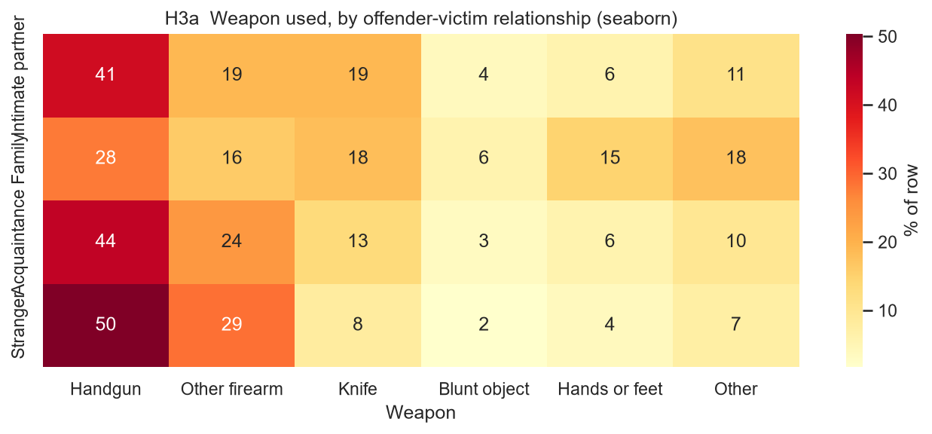
HYPOTHESIS 3 | STATEMENT AND RATIONALE
Weapon depends on closeness and age
Strangers and acquaintances kill with guns, while family homicides and child victims involve far more hands or feet, knives and blunt objects.
WHY IT IS NOT TRIVIAL
Weapon choice reflects planning and access. Close-range domestic violence and violence against children should look different from street violence.
Chart 3a: Row-normalised heatmap library: seaborn
Notes:
Strangers and acquaintances kill with guns, while family homicides and child victims involve far more hands or feet, knives and blunt objects.

Slide 11
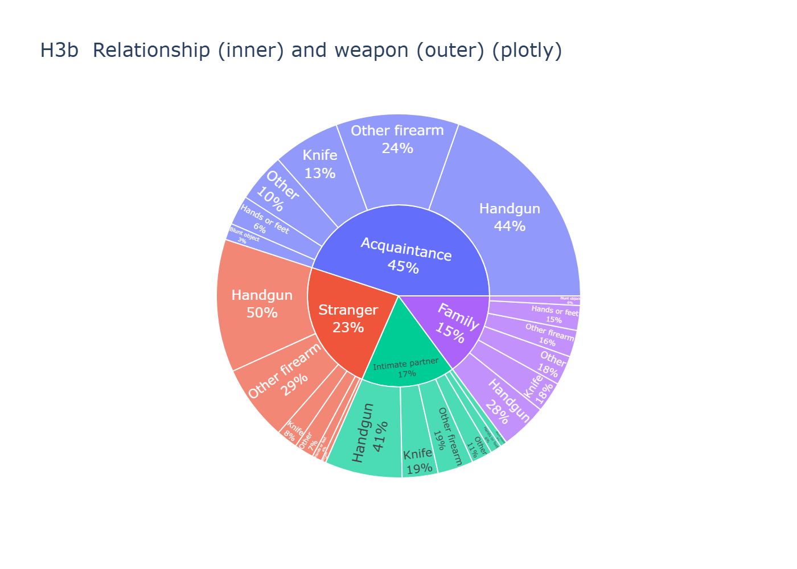
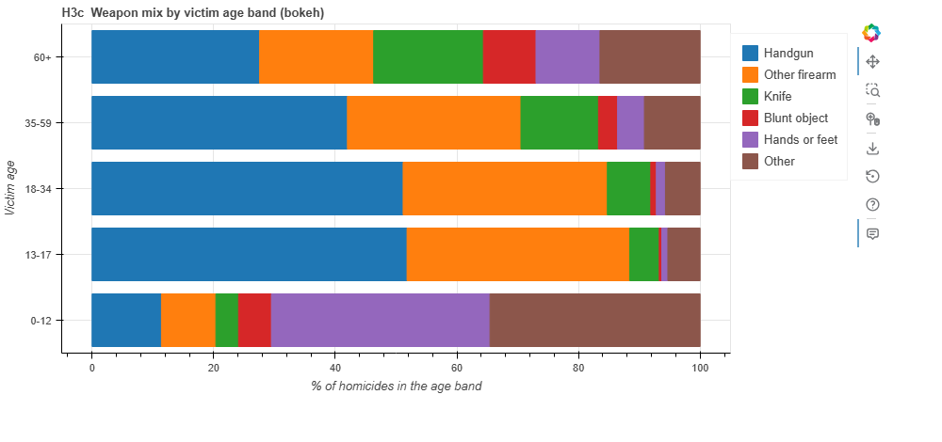
HYPOTHESIS 3 | SUPPORTING CHARTS
Weapon depends on closeness and age: more evidence
Chart 3b: Sunburst (two-level hierarchy) library: plotly
Chart 3c: 100% stacked horizontal bars library: bokeh

Slide 12
HYPOTHESIS 3 | CODE AND NARRATIVE
Weapon depends on closeness and age: code and findings
SUPPORTED
aged["age_band"] = pd.cut(aged["victim_age"],
bins=[-1, 12, 17, 34, 59, 120],
labels=["0-12", "13-17", "18-34", "35-59", "60+"]).astype(str)
tab = pd.crosstab(aged["age_band"], aged["weapon_group"],
normalize="index") * 100
source = ColumnDataSource({"age_band": list(tab.index),
**{w: tab[w].tolist() for w in WEAPON_ORDER}})
p = figure(y_range=list(tab.index), width=950, height=420,
x_axis_label="% of homicides in the age band")
p.hbar_stack(WEAPON_ORDER, y="age_band", height=0.8,
source=source, color=Category10[6],
legend_label=WEAPON_ORDER)
save(p)
Guns fall with closeness. Firearms were used in 79% of stranger homicides, 68% of acquaintance, 60% of intimate-partner and 44% of family.
Family violence is hands-on. Hands or feet account for 15% of family homicides against 4% for strangers; knives 18% against 8%.
Children are the extreme. For victims aged 0-12 only 20% involve a firearm and 36% hands or feet; for ages 13-17 firearms reach 88%.
Nuance. Intimate-partner homicides are still mostly gun deaths; the difference from strangers is one of degree.
Excerpt from 02_hypotheses.py; the full script is in the submission zip

Slide 13
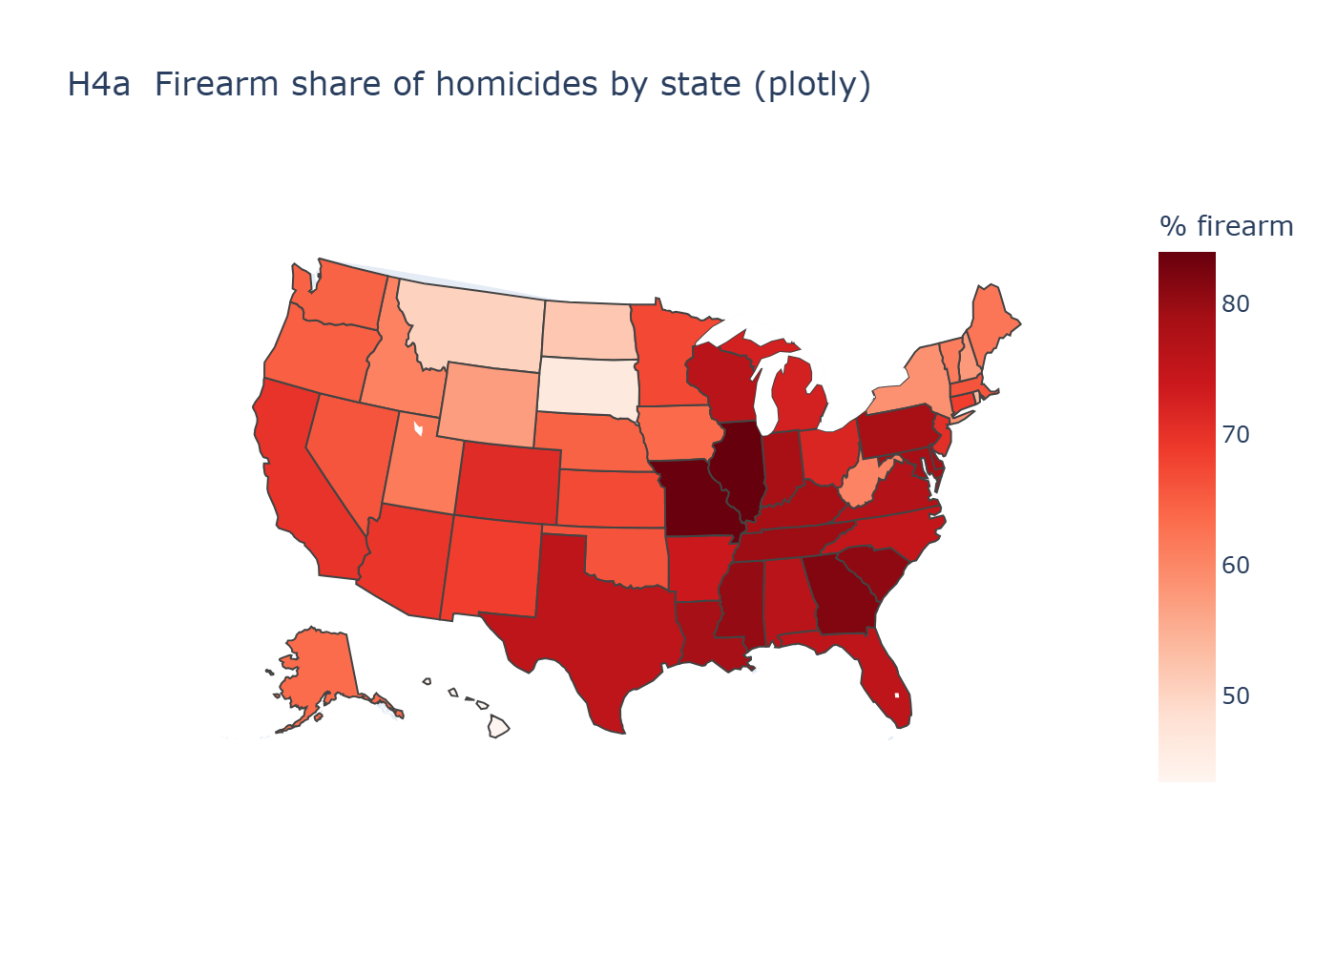
HYPOTHESIS 4 | STATEMENT AND RATIONALE
Geography shapes the weapon
The firearm share of homicides differs widely between states and is highest in the South and lowest in the Northeast.
WHY IT IS NOT TRIVIAL
Shares, not counts, are compared, so large and small states are on the same scale and uneven reporting matters less. States under 100 incidents are excluded.
Chart 4a: Interactive choropleth map library: plotly
Notes:
The firearm share of homicides differs widely between states and is highest in the South and lowest in the Northeast.

Slide 14
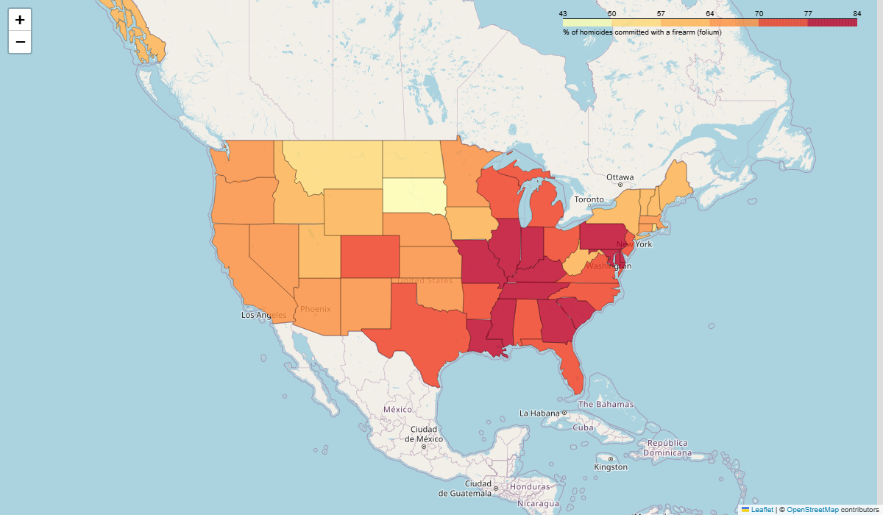
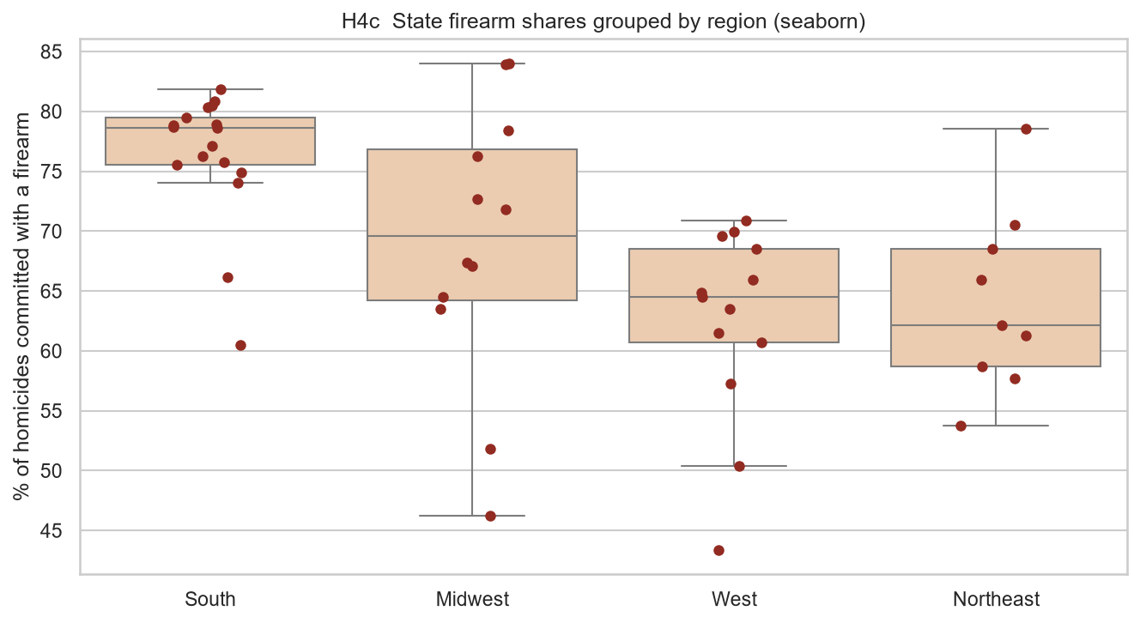
HYPOTHESIS 4 | SUPPORTING CHARTS
Geography shapes the weapon: more evidence
Chart 4b: Leaflet web map library: folium
Chart 4c: Box plot with one dot per state library: seaborn

Slide 15
HYPOTHESIS 4 | CODE AND NARRATIVE
Geography shapes the weapon: code and findings
PARTLY SUPPORTED
by_state = df.groupby(["state", "region"]).agg(
homicides=("firearm", "size"),
firearm_pct=("firearm", "mean")).reset_index()
by_state["firearm_pct"] *= 100
by_state = by_state[by_state["homicides"] >= 100]
m = folium.Map(location=[39, -97], zoom_start=4)
folium.Choropleth(
geo_data=borders, data=by_state,
columns=["state", "firearm_pct"],
key_on="feature.id", fill_color="YlOrRd",
legend_name="% of homicides with a firearm",
).add_to(m)
m.save("figures/h4b_folium_map.html")
The South leads as a block. Southern states average a 76% firearm share, and most sit between 74% and 82%.
The top states are Midwestern. Illinois (84.0%) and Missouri (83.9%) rank first; the Midwest spans 46% (South Dakota) to 84%.
The West is lowest. Western states average 62%, below the Northeast at 64%; Hawaii is the national minimum at 43%.
Takeaway. Region explains part of the variance, but the spread inside regions points to state- and city-level factors.
Excerpt from 02_hypotheses.py; the full script is in the submission zip

Slide 16
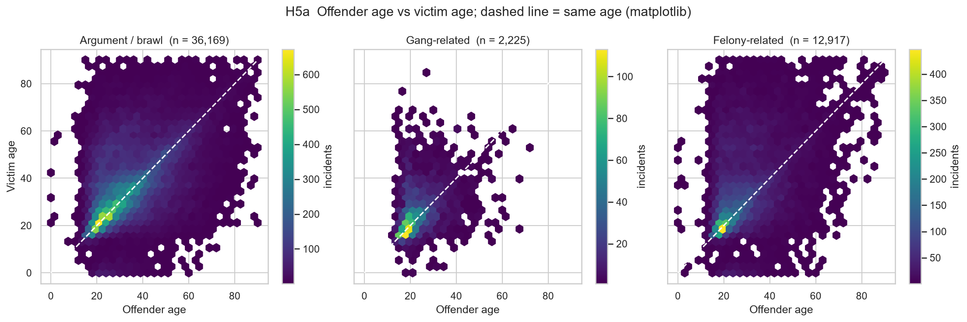
HYPOTHESIS 5 | STATEMENT AND RATIONALE
The age gap depends on the circumstance
In arguments and gang killings offender and victim are age peers, but in felony-related killings such as robbery the offender is clearly younger.
WHY IT IS NOT TRIVIAL
Arguments happen inside social circles of similar age. Felony homicides pair a young offender with whoever is targeted, so the ages should decouple.
Chart 5a: Hexbin density panels library: matplotlib
Notes:
In arguments and gang killings offender and victim are age peers, but in felony-related killings such as robbery the offender is clearly younger.

Slide 17
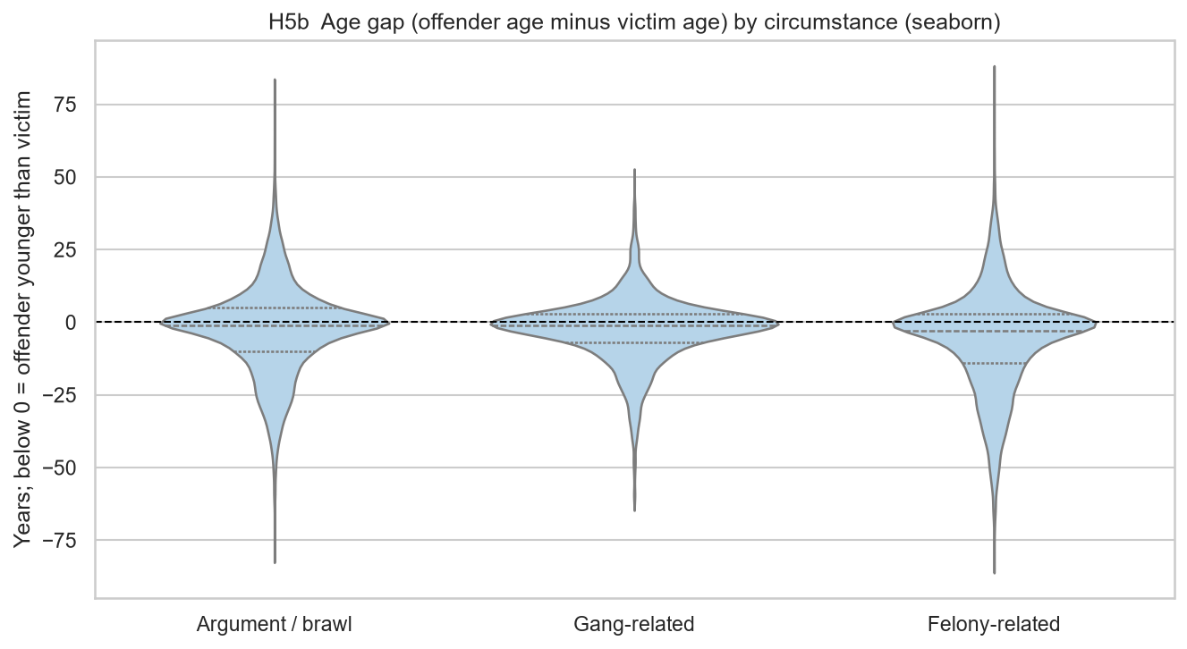
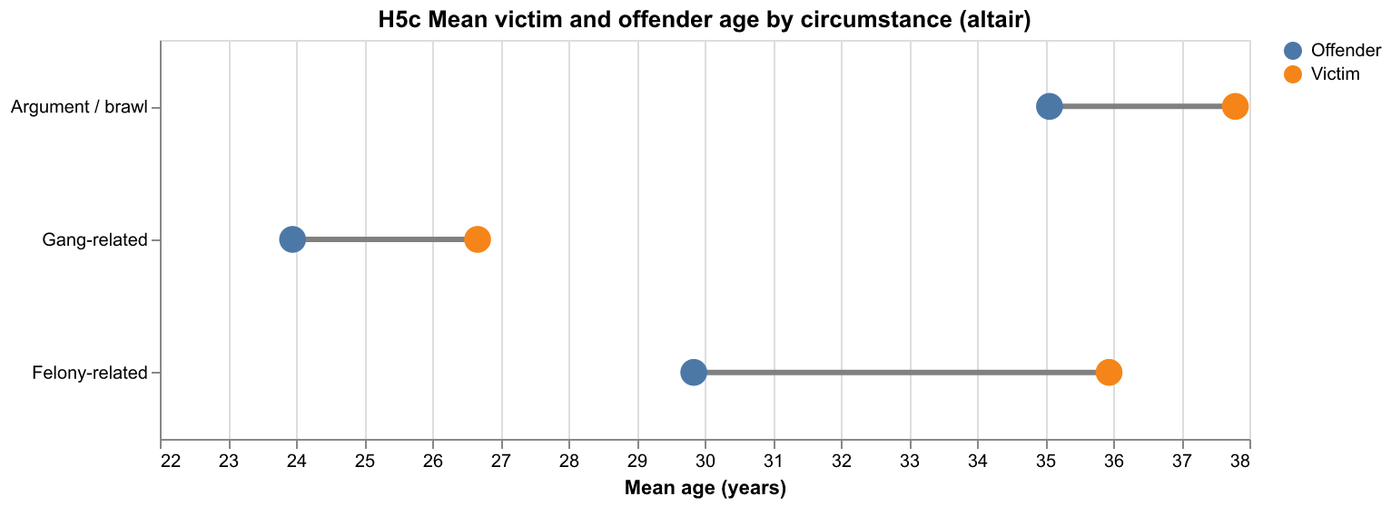
HYPOTHESIS 5 | SUPPORTING CHARTS
The age gap depends on the circumstance: more evidence
Chart 5b: Violin plot library: seaborn
Chart 5c: Dumbbell chart library: altair

Slide 18
HYPOTHESIS 5 | CODE AND NARRATIVE
The age gap depends on the circumstance: code and findings
SUPPORTED
fig, axes = plt.subplots(1, 3, figsize=(15, 5),
sharex=True, sharey=True)
for ax, group in zip(axes, CIRC_ORDER):
part = ages[ages["circ_group"] == group]
hb = ax.hexbin(part["offender_age"], part["victim_age"],
gridsize=30, cmap="viridis", mincnt=1,
extent=(0, 90, 0, 90))
ax.plot([0, 90], [0, 90], color="white", ls="--")
ax.set_title(f"{group} (n = {len(part):,})")
ax.set_xlabel("Offender age")
fig.colorbar(hb, ax=ax, label="incidents")
axes[0].set_ylabel("Victim age")
plt.savefig("figures/h5a_matplotlib_hexbin.png", dpi=150)
Felony killings decouple ages. Offenders average 29.8 years against 35.9 for victims: a 6.1-year gap (median 3).
Arguments and gangs are peers. Both show a mean gap of only 2.7 years and a median of 1; the hexbins hug the same-age line.
Gang killings are youngest. Mean offender age is 24 and victim age 27, about a decade below arguments.
Caveat. Offender age is known for only 68% of incidents, so unsolved cases are excluded; the effect is real but moderate.
Excerpt from 02_hypotheses.py; the full script is in the submission zip

Slide 19
CONCLUSION
What the data showed, and how far to trust it
Findings
Limitations
Future work
3 hypotheses supported, 2 partly supported.
The 2020 surge was a firearm surge in every region.
Victim sex, relationship and victim age strongly shape who kills and with what.
Region matters for weapon choice, but states vary widely inside regions.
Reporting is voluntary: Florida is nearly absent before 2021, and 2021 has gaps.
Relationship is unknown in 48% and offender age in 32% of incidents.
Only the first victim and first offender of each incident were analysed.
Counts are not per-capita rates.
Add population data to compute homicide rates.
Use NIBRS incident data for location and time of day.
Test differences formally (chi-square, regression).
Analyse multi-victim and multi-offender incidents.

