Slide 1


A Holistic Healthcare Software
CS-UY 4523 BK01
Design Project
Professor Fred Strauss
Spring 2020
Team B34
Abid Siam | as10476 | Bachelor of Science in Computer Science
Noor Md Fahim Faisal | nmf315 | Bachelor of Science in Computer Engineering
Mike Singh | ms9744 | Bachelor of Science in Computer Science

Slide 2
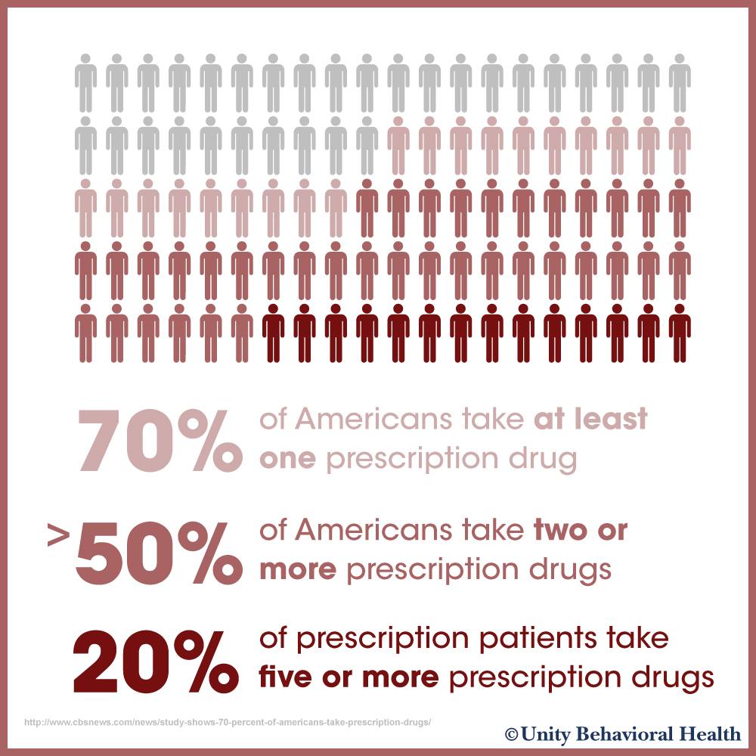
The Drug Industry in America continues to dominate the Health Care System

Slide 3

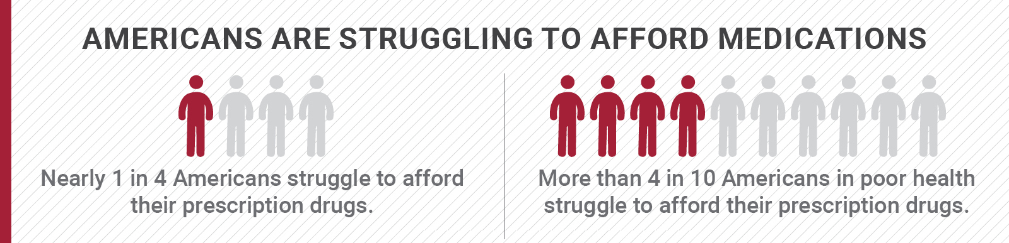
The Drug Industry in America continues to dominate the Health Care System
Without proper insurance, many Americans cannot afford these prescription drugs

Slide 4
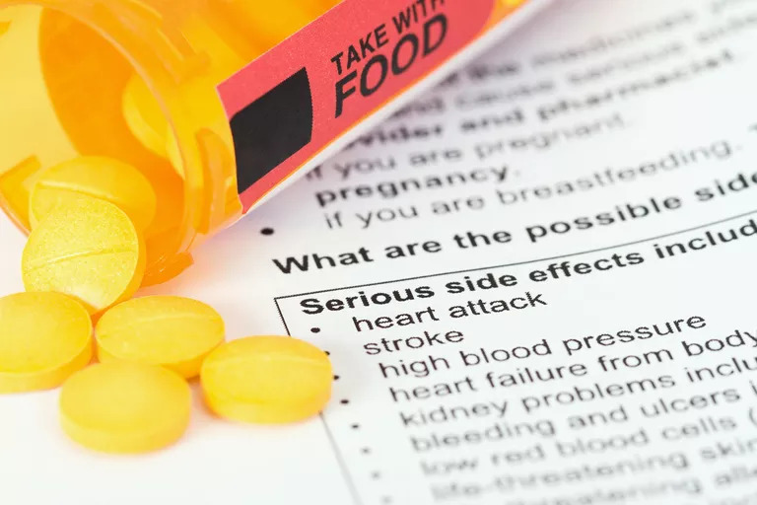
The Drug Industry in America continues to dominate the Health Care System
Without proper insurance, many Americans cannot afford these prescription drugs
Most prescription drugs come with many potential side effects
Drug misuse can also lead to terrible consequences

Slide 5
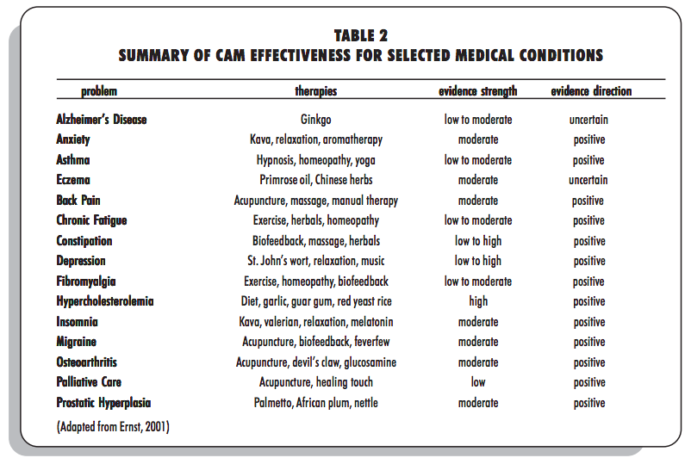
Complementary and Alternative Medicine (CAM) is a way of treating health issues without relying solely on prescription drugs.
CAM has found success in treating various health issues ranging from back pain to Osteoarthritis.

Slide 6
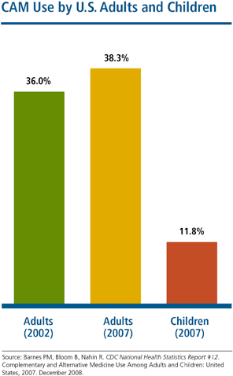
Around 40% of Americans are using some form of CAM to satisfy a health problem
According to the World Health Organization, the percentages of those in other countries who have used Alternative medicine at least once range from 40%-90%.
There are of course benefits with current medications, and some are even life-saving like insulin for diabetic patients. However, what is needed is a more holistic approach.

Slide 7


When health issues arise, depending on the severity, one may prefer to look for successful holistic methods before taking a trip to the doctor's office.
Develop an application that will take users' symptoms or problems, and respond with holistic treatment that has been shown to be effective.
Provides easy, clear-cut access to information on CAM methods.
Herbal Medicine
Therapeutic Treatment
Fitness Activities
Weight-loss Programs
Nutrition Plan & Affordable Organic Food Locations
Mental Health Programs
Lifestyle Tips
Social Prescribing
Natural Cure

Slide 8

Let’s say Alice has been dealing with anxiety, and recently it has become increasingly noticeable
Alice has a history of sensitivity to antidepressants, so she wants to explore other options
By using Natural Cure, Alice will be able to find treatment she can try at home, such as aromatherapy.

Slide 9

Natural Cure System Objectives:
Robustness
Use latest technologies to give users accurate data and results
Accessibility
Make the application accessible and easy to use
Security
Protect user data and medical information

Slide 10
Requirements

Slide 11
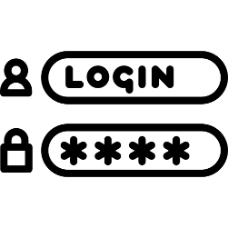

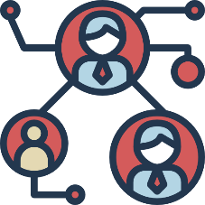


Functional Requirements (Definitions)
A user should be able to access the system by creating an account and logging in
The system must classify symptoms identified by a user and provide a diagnosis based on such symptoms
The system shall provide resources and recommendations for a user to treat identified symptoms or to prevent worse symptoms
The system must provide security measures and maintain the confidentiality of all user medical records and financial information
The system must give the user the option to obtain reports generated by the application in a desired format

Slide 12
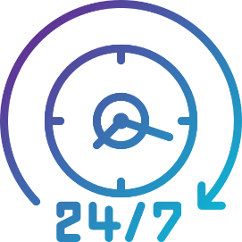


Non-Functional Descriptive Requirements
Natural Cure shall be available at all hours of the day, every day (24/7), unless it specifies in advance that a scheduled downtime will occur to allow for improvements and patches to be implemented into the product as part of the project maintainability process.
Natural Cure shall be able to retrieve recommendations to the user based on useful and accurate input with a maximum processing time of 10 seconds.
The system relies on the concept of an ‘online medical consultant’, or equivalent, being legal in every state in which it operates.

Slide 13
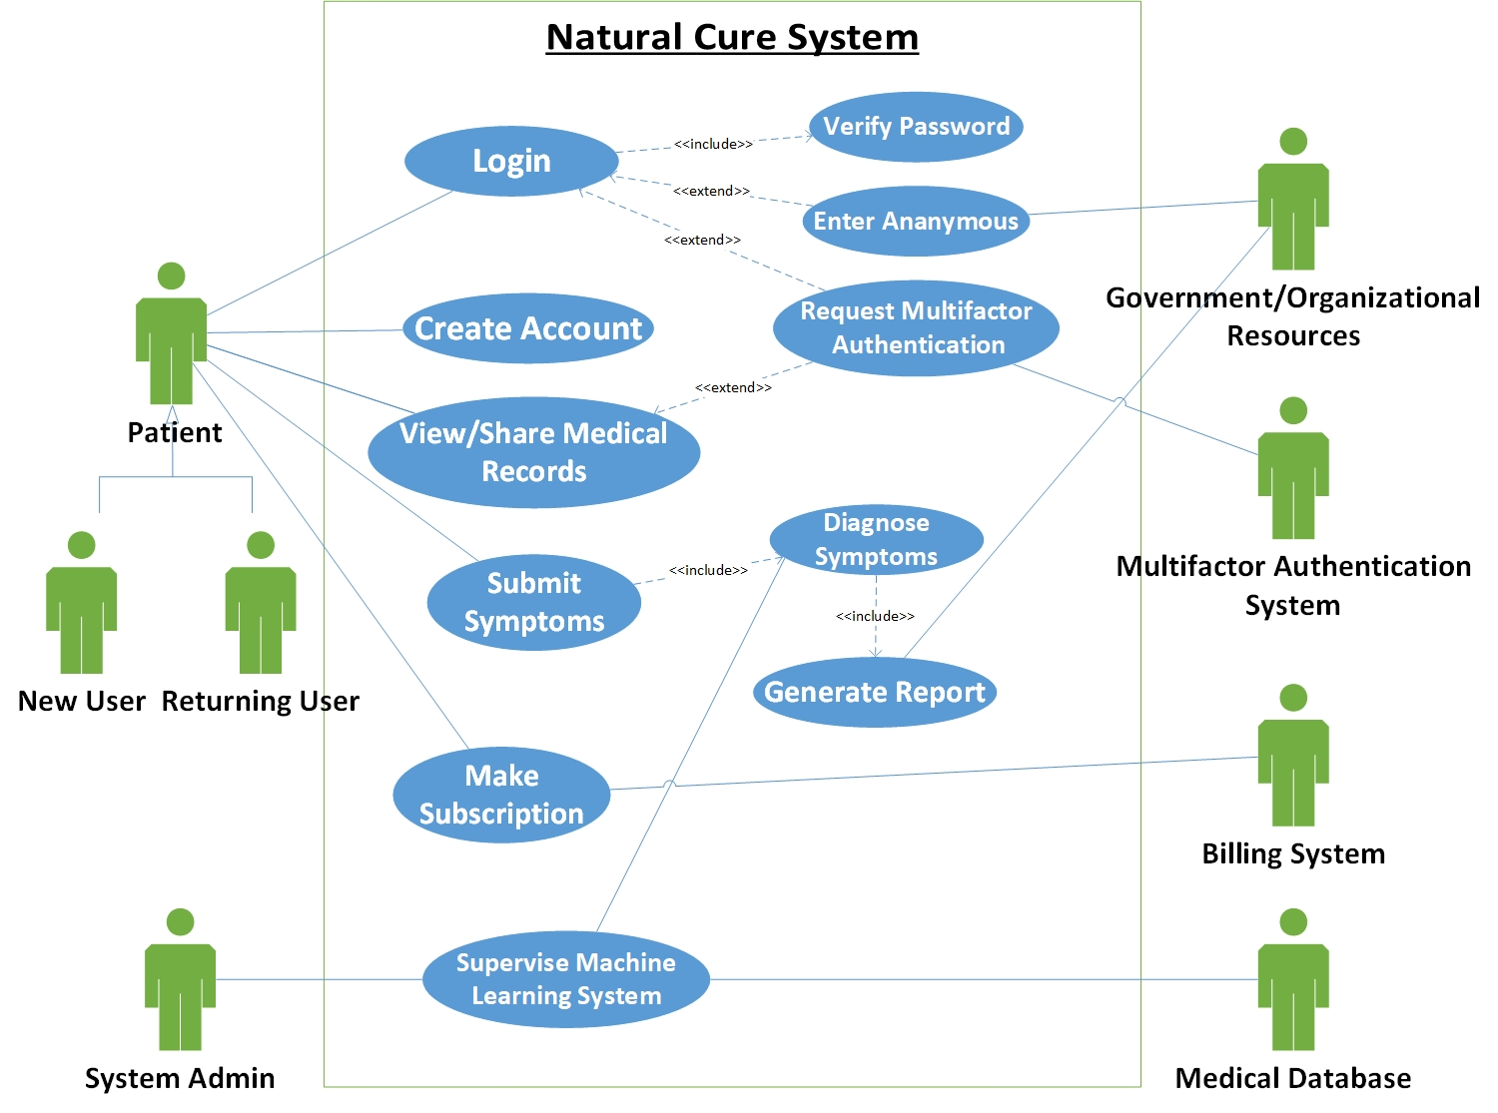
Use Case Diagram

Slide 14
Create User Account
Description | User inputs username, password, and email on website, which are verified with existing usernames in the database and stored in the database upon success.
Pre- Conditions | The user has navigated to the correct website for Natural Cure.
Flows | Basic or Normal Flows | 1. User requests to create an account, and inputs username, password (twice for verification), email, and allergies. 2. The system acknowledges the user input is valid, records information into the database, and notifies users that their information is updated. 3. The user proceeds to use the software.
 | Alternative Flows | 1. Password entered does not match requirements (a minimum of 8 characters and a mixture of numbers and letters). Prompt user to enter password again. 2. The two passwords entered do not match. Prompt user to enter password again. 3. The email address entered is not valid. Prompt user to enter email address again. 4. The username entered is already taken. Prompt user to enter a different username notifying them that the username entered is already taken.
Post Conditions | The user creates an account and the database is updated with the user information.
Special Requirements | The username for the user must not be the same as the other usernames already in the database. In essence, all usernames must be different.
Extension Points | None
Use Case Descriptions (selected)

Slide 15
Submit Symptoms
Description | The returning user enters his/her symptoms into our software, and our software returns possible treatments.
Pre- Conditions | User has logged into their account, with a list of symptoms they prepared beforehand.
Flows | Basic or Normal Flows | 1.User inputs symptoms into software, and requests diagnosis 2.The system checks the symptoms into the database and returns a list of recommended solutions.
 | Alternative Flows | 1.User inputs symptoms into software and requests diagnosis. 2.System checks for symptoms in the database but asks for more information or specifications on unclear symptoms. 3.The user clarifies their symptoms or adds more symptoms they have been experiencing into the system. 4.The system checks the symptoms into the database and returns a list of recommended solutions.
Post Conditions | User receives a list of recommended treatments.
Special Requirements | None
Extension Points | None
Use Case Descriptions (selected)

Slide 16
Static Behavior

Slide 17
Candidate Classes

Slide 18
Class Interaction
Diagram

Slide 19
Dynamic Behavior

Slide 20
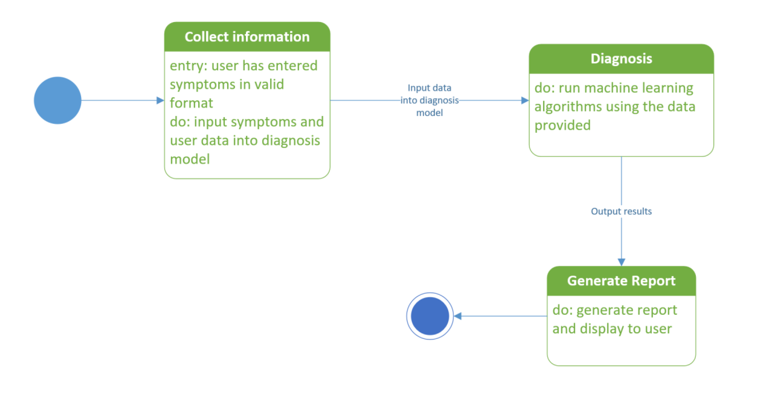
State Diagram (selected)
- Diagnosis

Slide 21
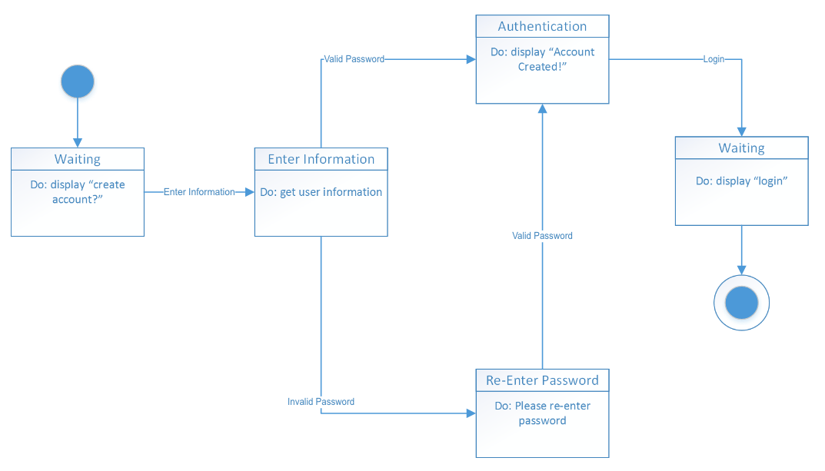
Event Diagram (selected)
- Create Account

Slide 22
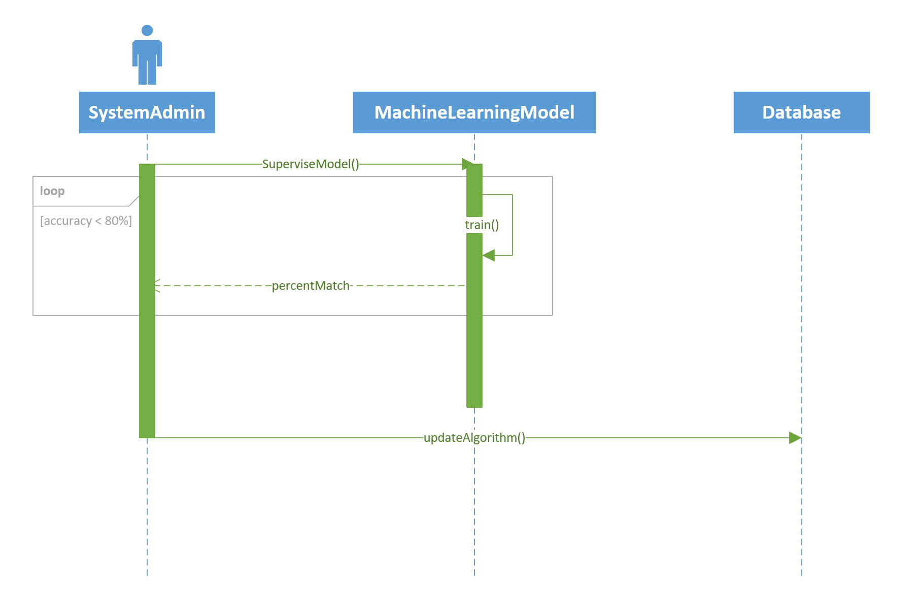
Sequence Diagram (selected)
- Supervise Machine Learning Model

Slide 23
Collaboration Diagram

Slide 24
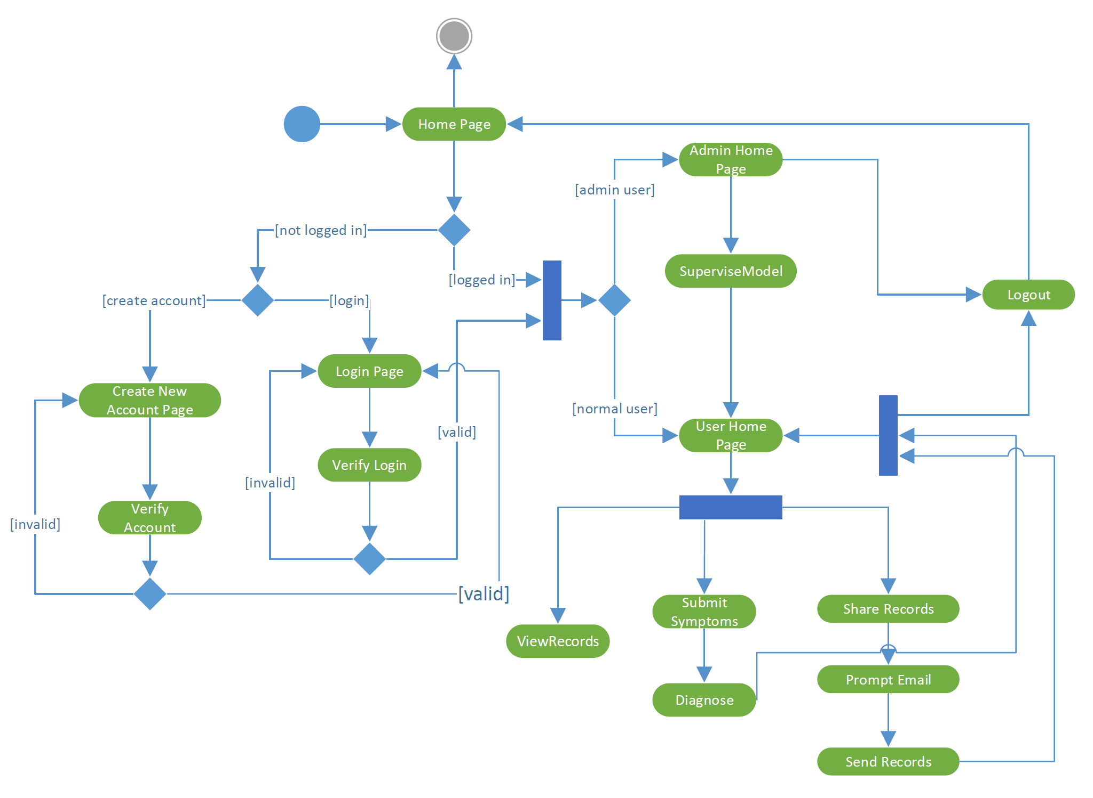
Activity Diagram

Slide 25
Every disease that exists on this planet has a cure for it hidden in nature or natural activities
We just have to do our part to find the right natural cure
We need to demonstrate to the global population the benefits of natural medicine so that they may dedicate more resources to research in this field
Rare herbs, plants, and other natural substances with healing properties may be only found in remote parts of the world
Need to reach out to the entire global population through the internet to seek out those hidden elements of natural cure
This is a global effort -> cannot be accomplished sitting in front of a computer
Ethos

Slide 26
Post Implementation Review

Slide 27
Requirements and Design Changes/Updates
Removed the Multi-factor authentication feature (passwords get encrypted)
Removed Subscription feature (all users get access to all our features free of cost)
Utilized the Infermedica API for the machine learning algorithms used for diagnosis
Required the user to accept a Terms of Service agreement
Provided users the option to upload Medical Records and then view or share those records via email (HIPAA compliant)

Slide 28
What we did right:
Pushed high-quality code and verified work done by others
Produced high-quality documents
Created thorough tests to eliminate most bugs
Updated specific documents to account for new changes
Kept active communication
What we did wrong:
X Lack of face-to-face team meetings due to schedule changes
X Started work close to deadlines
What we would change:
Include automated tests to verify our work
Increase accuracy of diagnosis by asking user more questions
Do more research on natural medicine and regulatory/legal requirements
Fill the database with more natural treatments

Slide 29
References
Slide 2: https://www.unityrehab.com/blog/prescription-drugs-more-deaths-than-illicit-drugs/
Slide 3: https://www.consumerreports.org/drug-prices/the-shocking-rise-of-prescription-drug-prices/
Slide 3: https://isaacnewtonfarris.com/insulin-a-prime-example-of-the-good-and-the-bad-of-american-healthcare/
Slide 4: https://www.verywellmind.com/the-benzodiazepines-378909
Slide 5: https://nccih.nih.gov/research/statistics/2007/camsurvey_fs1. htm
Slide 6: https://www.med.unc.edu/phyrehab/pim/files/2018/03/Effectiveness.pdf

Slide 30
References
Faisal, Maldonado, Siam, and Singh (2019). "Team_A34_Project_SRS_Complete". New York University, Tandon School of Engineering. 22 Nov. 2019.
Faisal, Maldonado, Siam, and Singh (2019). "Team_A34_Project_Presentation". New York University, Tandon School of Engineering. 5 Dec. 2019.
Faisal, Siam, and Singh (2020). "TeamB34_Project_SRS". New York University, Tandon School of Engineering. 19 Feb. 2020.
Faisal, Siam, and Singh (2020). "TeamB34_Project_SDD-initial". New York University, Tandon School of Engineering. 17 Mar. 2020.
Faisal, Siam, and Singh (2020). "TeamB34_Project_SPMP". New York University, Tandon School of Engineering. 17 Mar. 2020.

Slide 31
A Holistic Healthcare Software
CS-UY 4523 BK01
Design Project
Professor Fred Strauss
Spring 2020
Team B34
Abid Siam | as10476 | Bachelor of Science in Computer Science
Noor Md Fahim Faisal | nmf315 | Bachelor of Science in Computer Engineering
Mike Singh | ms9744 | Bachelor of Science in Computer Science

