Slide 1

Building Material Inventory Management System
International Islamic University Chittagong, Bangladesh
Md. Abed Afnan, ID: C211051
Yakub Ali, ID: C211079
Department of Computer Science and Engineering
Supervised By:
Engr. Sudipta Vaskar Rakshit
Assistant Professor
Adjunct Faculty (CSE )
Dept. Of Computer Science and Engineering, IIUC

Slide 2
Problem Statement
Here We Build a Building Material Inventory Management System. The basic Agenda for this Project is to provide tools to user to maintain/monitor Inventory system from online.
Basic Goal is to provide user :
Real-Time Visibility
Accurate Stock Tracking
Efficient Sales Management
Customer Management
Product Management

Slide 3
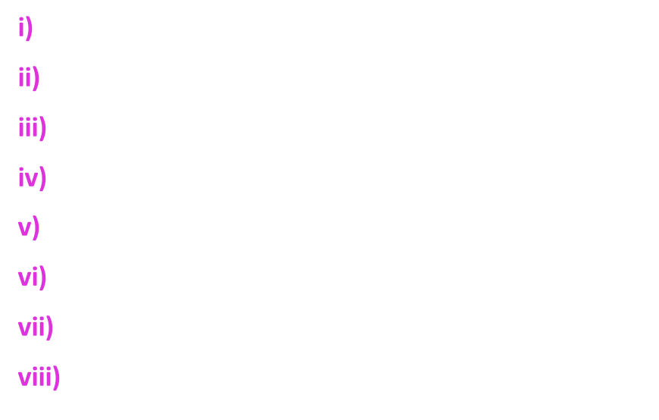
Target User

Slide 4





Tools Used
ASP.NET Web API
Microsoft SQL Server
ReactJS
VS Code
Visual Studio

Slide 5
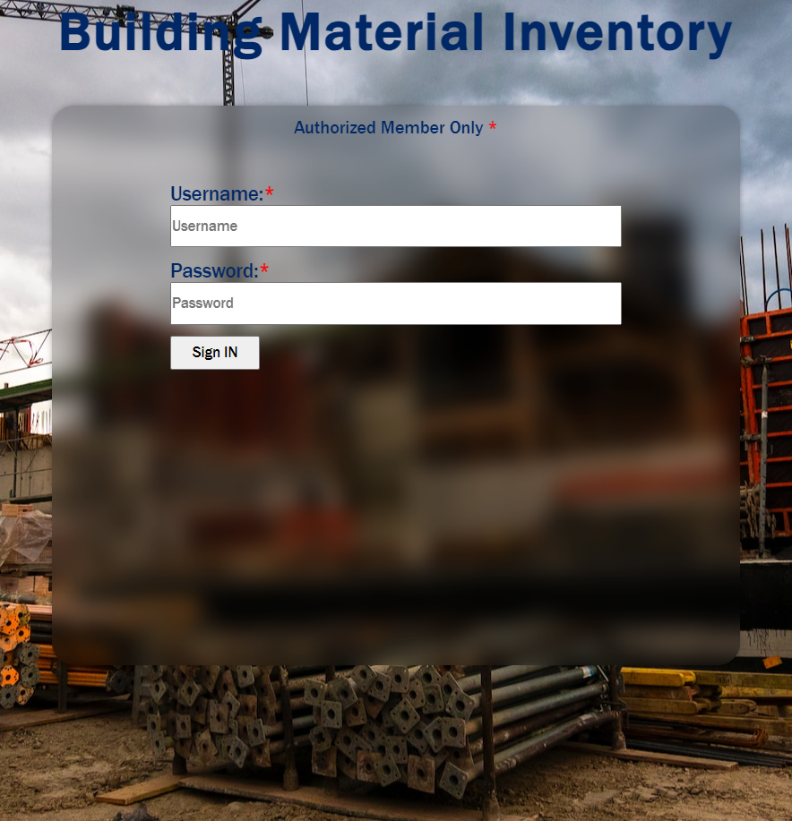
Login Page
Authorized User Can login through this login page
Note: We added user manually in DB through SQL

Slide 6
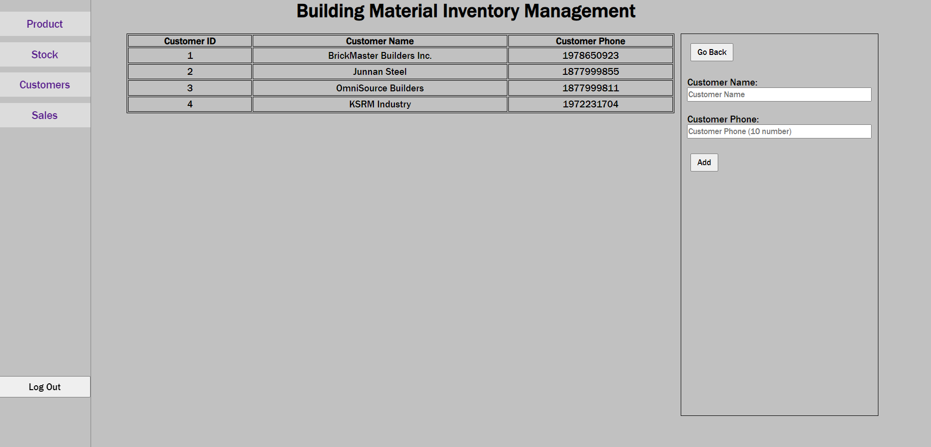
Customer Mangement page
Admin Can
Add,
Edit,
Remove
Customer through this page

Slide 7
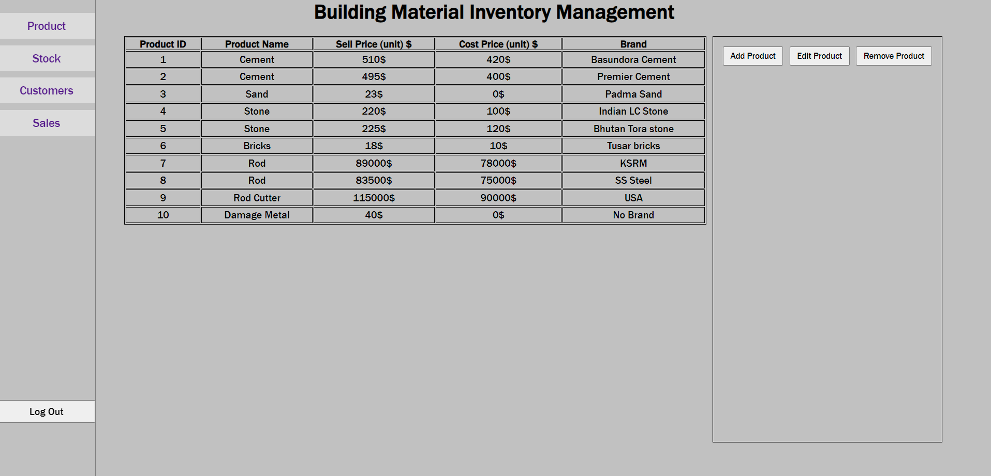
Product Mangement page
Admin Can
Add,
Edit,
Remove
Product through this page

Slide 8
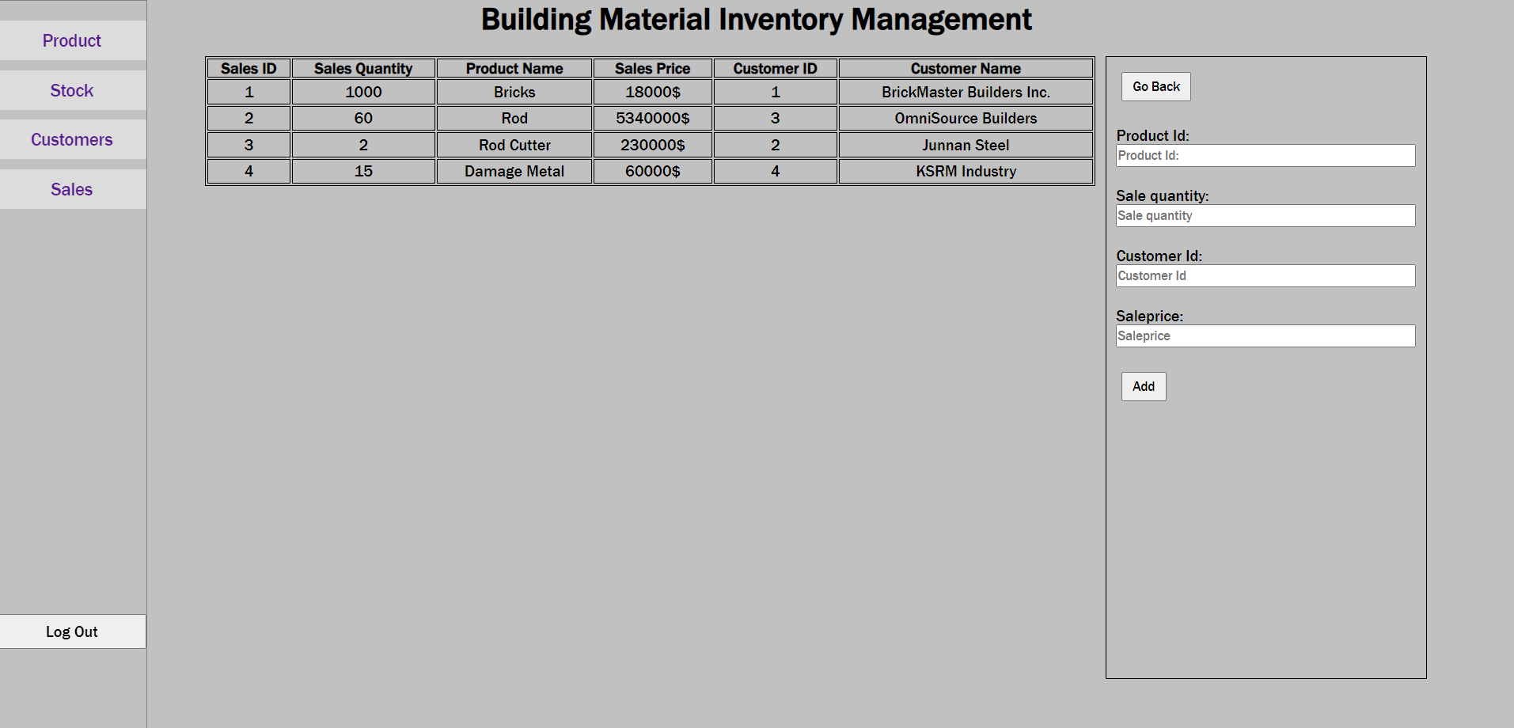
Sales Mangement page
Admin Can
Add,
New Sales info through this page

Slide 9
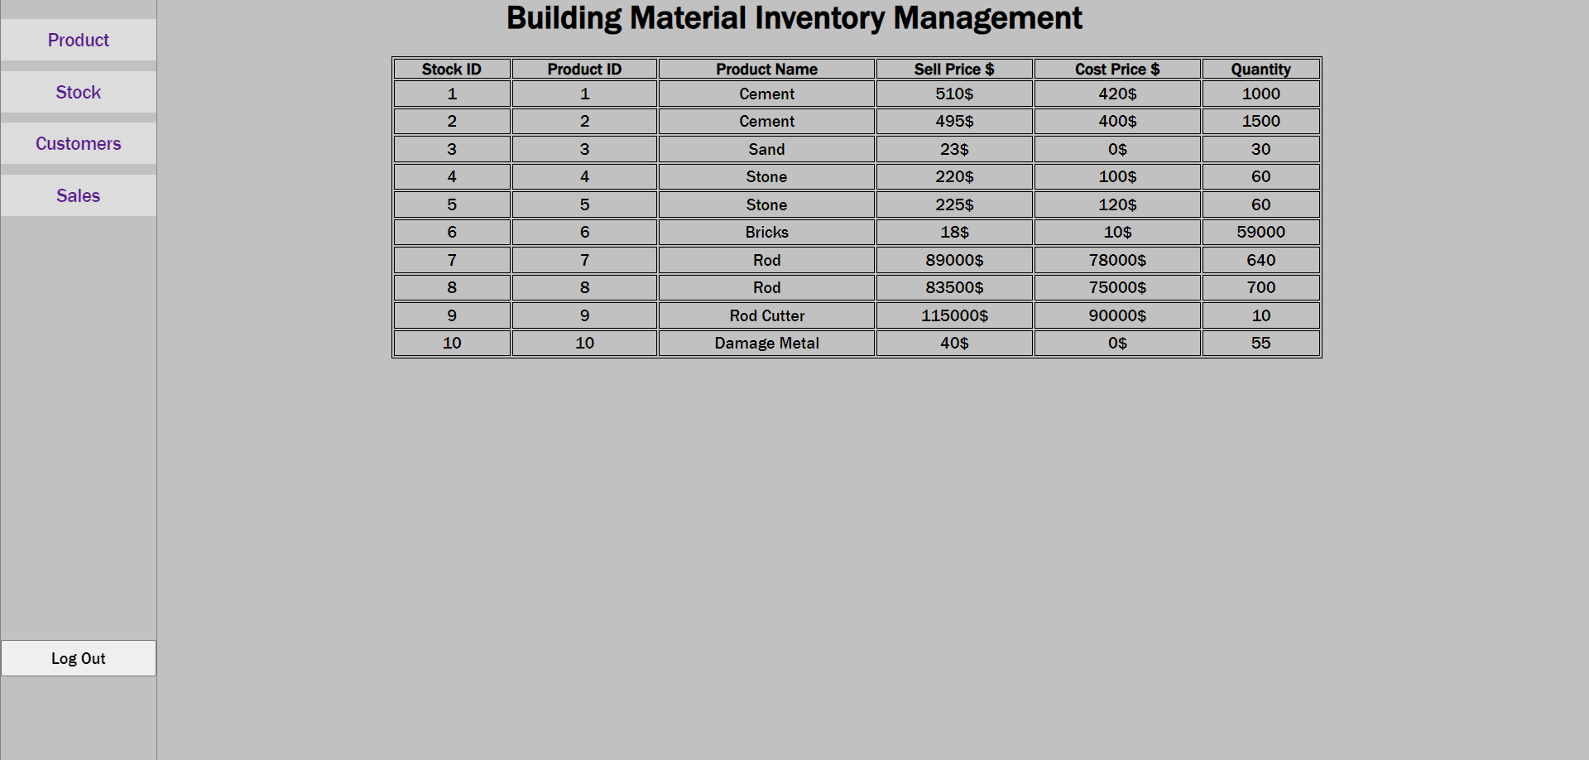
Stock Tracking page
This is View only page.
This page will help to track the product quantity, price, etc.

Slide 10
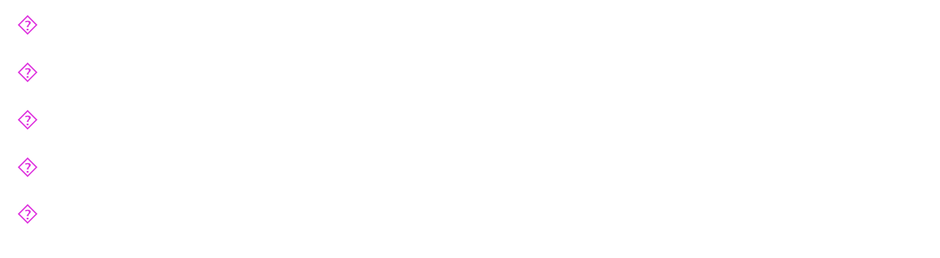
Future Work

Slide 11
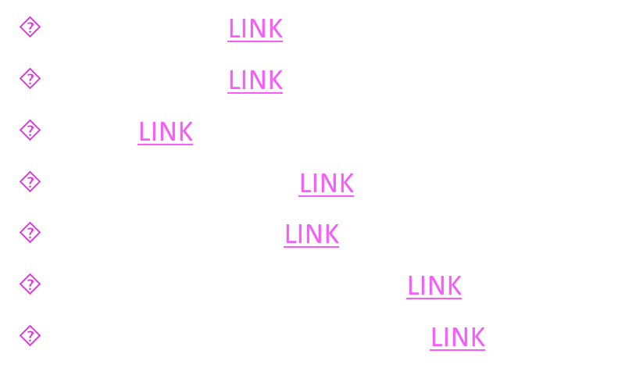
Reference

Slide 12

Acknowledgement

Slide 13


