Slide 1

THE SNAKE GAME The software development Project
INTERNATIONAL ISLAMIC UNIVERSITY, CHITTAGONG
A Proper Presentation and Demonstration on our Project
Created by:
Supervised by:
Abdullah Al Mamun (C201004)
Md. Abed Afnan (C211051)
Alauddin Mollah (C211055)
Mohammad Mohiuddin
Assistant Professor
Dept. of CSE, IIUC

Slide 2
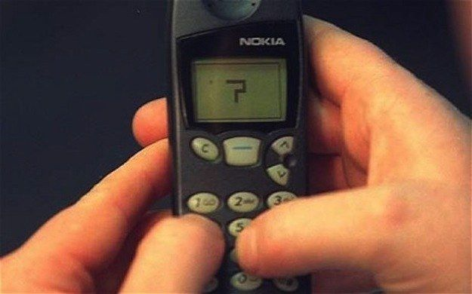
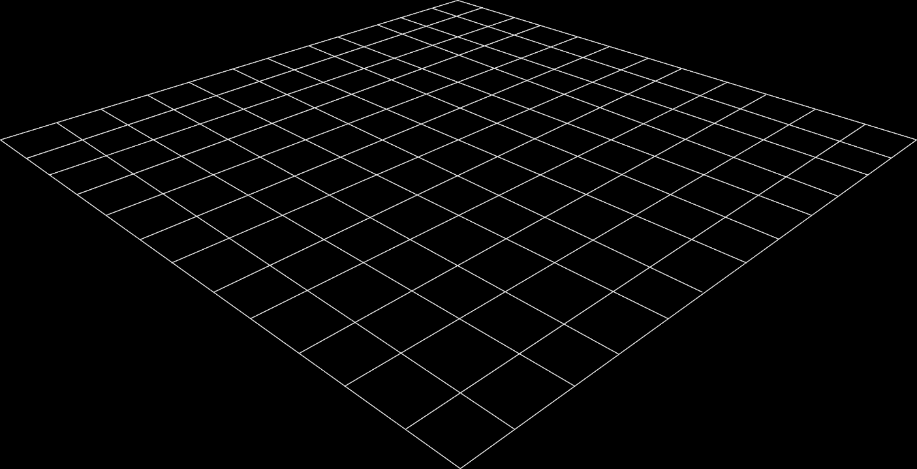
Why We choose Snake game?
Our objective is to make something interesting and something that will make us relax.
This game can make us nostalgic and take us to our old times
This project is something which will make any kid or even any youth happy. Everyone would at least try this game for fun

Slide 3
Introduction
Snake game is a well know game for everyone. Now we tried to rebuild this game. And just by some step and by a powerful language we succeed to build this game. In this presentation we will present our whole work on it.

Slide 4

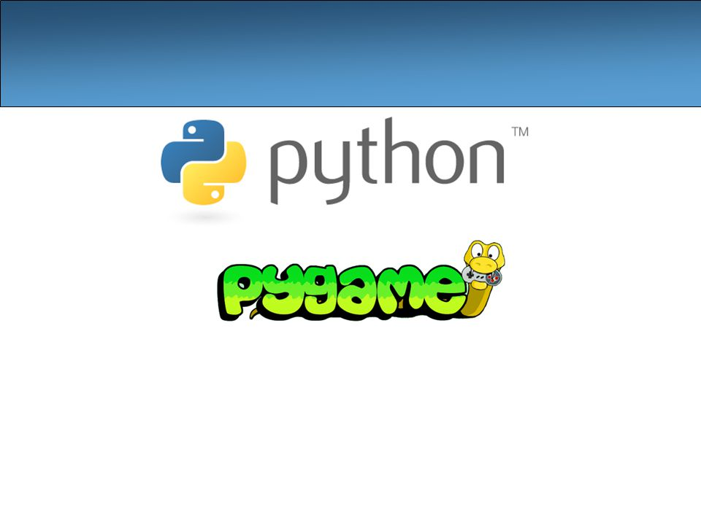
Concept we used :
PYTHON
PYGAME
Fig-1: Interface

Slide 5
Covered Topics :
Canvas
Starting UI
Start
Exit
Instruction
High score save
Collision detection
Different types of food
Regular one
Special one
In game music
Sound for crash and food collision
Extra speed
Show score in different window
Key press control

Slide 6
Diagram on functionality:
Game loop
Start_game
Start_inst
Game_over
Snake
Game_paused
Fig-3: Game Over window

Slide 7
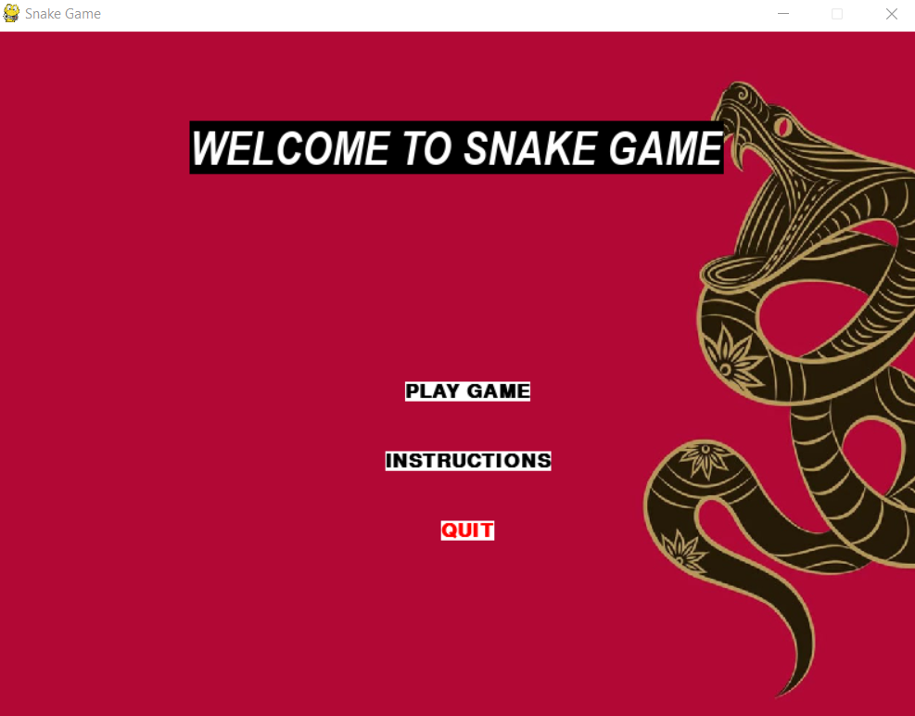
Main menu
Play game
Instruction
Quit
VID-1: Snake eating and increasing speed

Slide 8

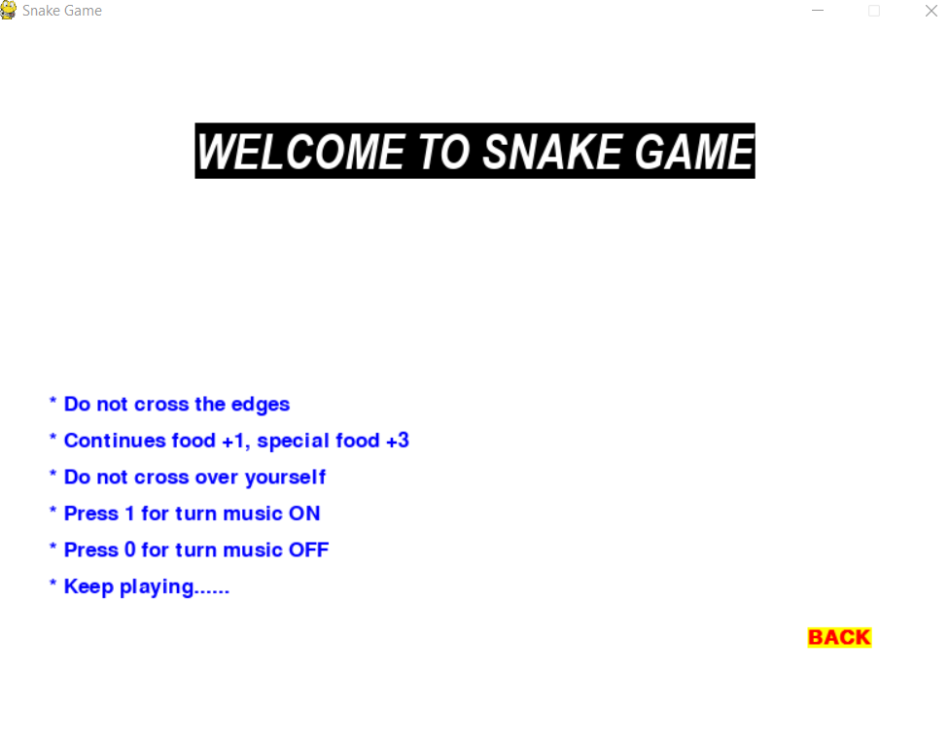
Instruction Window
Back button for go back.

Slide 9
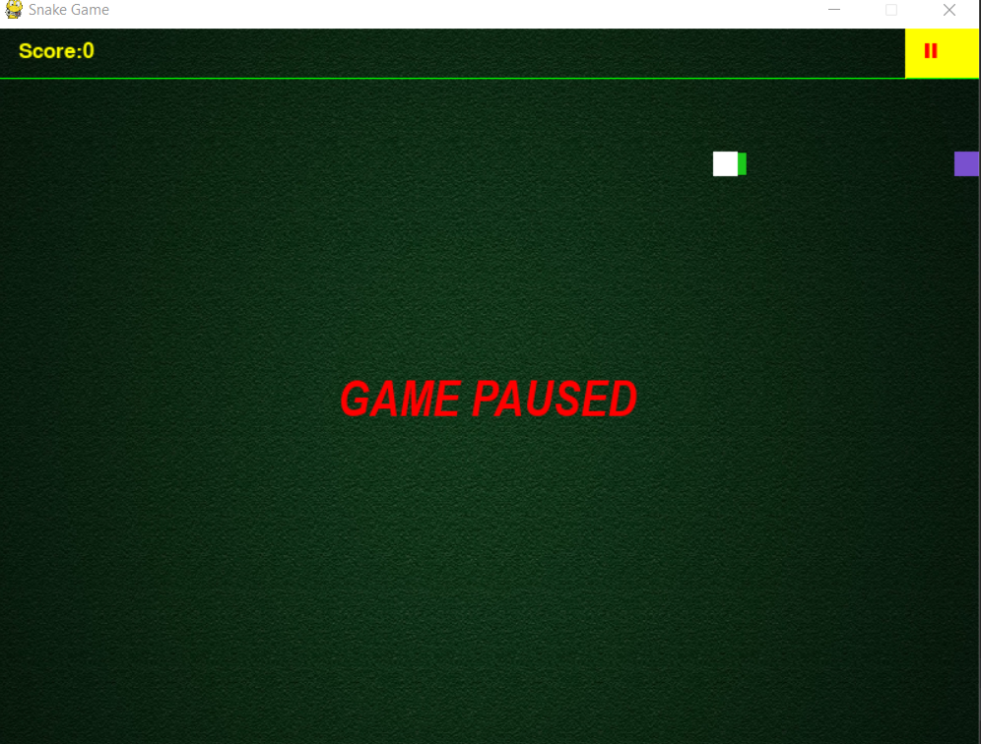
Paused Window
Use mouse to click On II bar for pause.

Slide 10
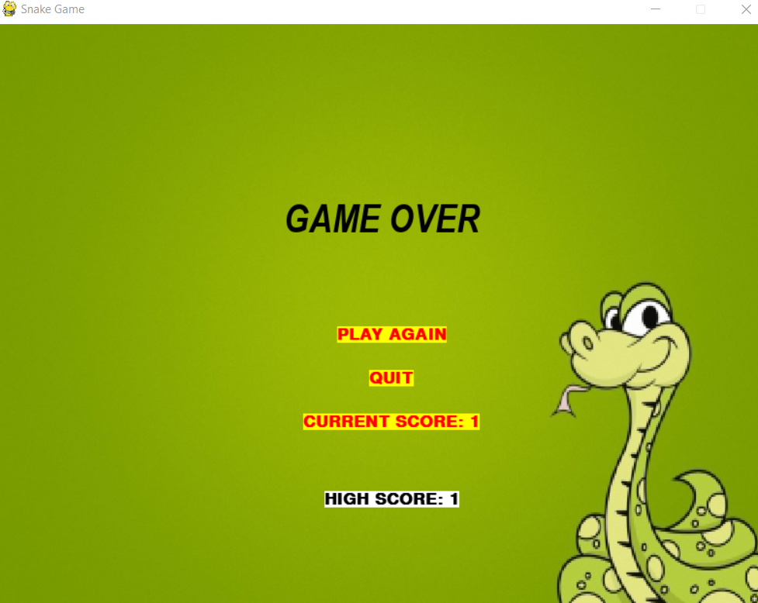
Game Over Window
Play Again
Quit

Slide 11

High score and Current score
High score will update if current score cross previous save score

Slide 12
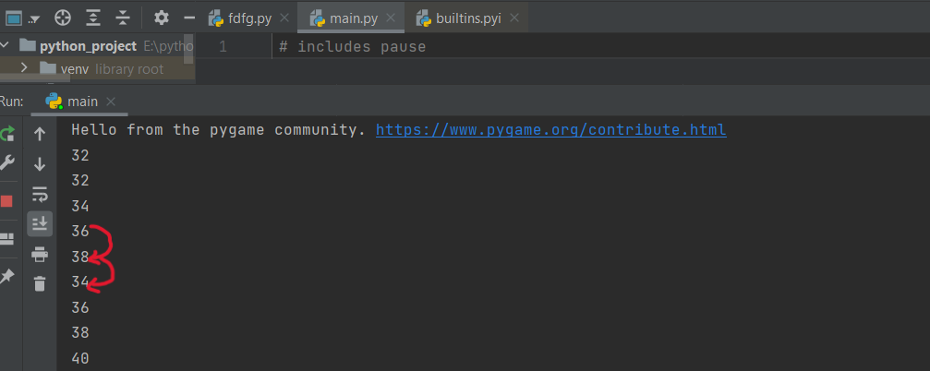
Counting speed increase and decrease
Here for regular food speed increase by 2, but for special food it will decrease by 4.

Slide 13
Final Conclusion
I hope our honorable sir will appreciate our project and will have fun by this project.
THANK YOU SIR FOR HAVING US

