Slide 1
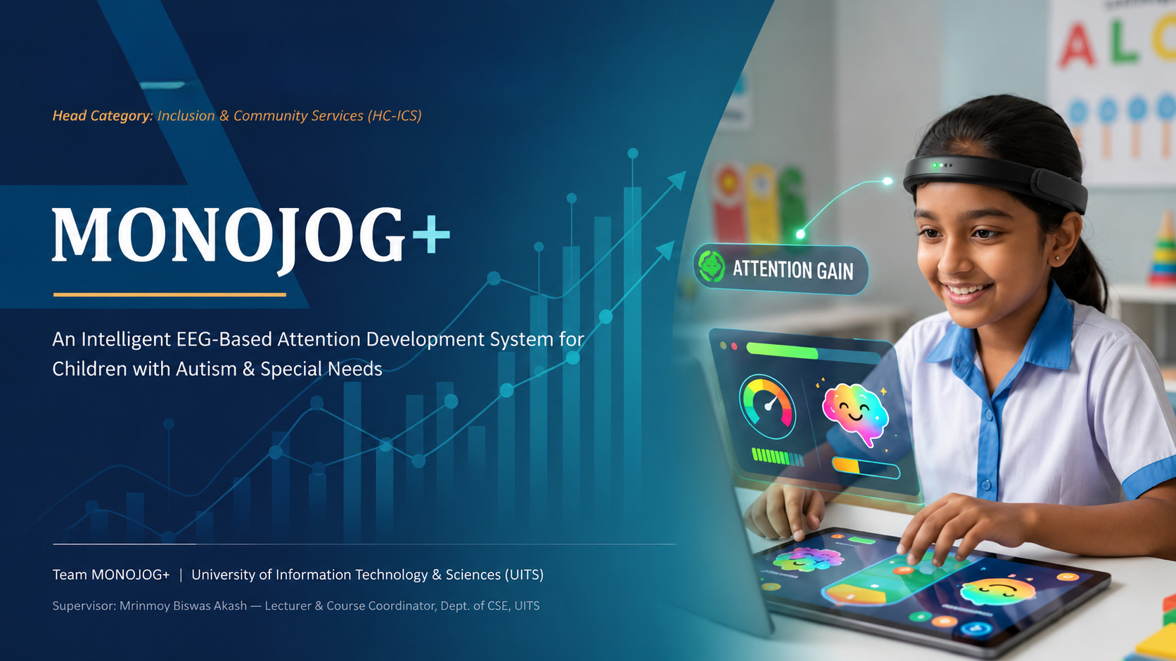

Notes:
0:00–0:30 | Greet the judges. Introduce MONOJOG+ as an EEG-based attention development platform for children with autism and special needs, entered under Inclusion & Community Services. Set up the 8-minute flow: problem, solution, technology, live demo, impact.
1

Slide 2





Attention Is Hard to See, Even Harder to Measure
THE PROBLEM
Children with Autism Spectrum Disorder (ASD), ADHD, and other neurodevelopmental conditions often struggle to sustain attention during learning and therapy. Today, most assessment still depends on a therapist's subjective observation. There is no everyday, objective way to see what is actually happening inside a child's brain during an activity.
Invisible struggle
Attention & focus difficulties in ASD/ADHD are common but hard to quantify objectively.
Subjective assessment
Progress is judged mostly by observation — inconsistent across therapists and sessions.
Costly clinical EEG
The gap: engagement tools that both monitor attention AND actively help a child build it , affordably and outside the clinic, are largely unavailable to families and special-needs schools in Bangladesh.
Lab-grade EEG/BCI systems are expensive, complex, and unsuited to daily therapy use.
Limited home access
Families & special schools lack affordable tools to track engagement outside the clinic.
MONOJOG+
02
Notes:
0:30–1:30 | Frame the human problem first, then the systemic gap. Keep this conversational — this is the emotional hook of the pitch.
2

Slide 3



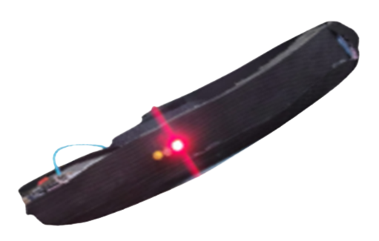
OUR SOLUTION
MONOJOG+: Wearable EEG Meets Adaptive Therapy Games
MONOJOG+ is a neurotechnology platform that pairs a non-invasive wearable EEG headset with AI-assisted signal analysis and interactive cognitive-training games. As a child plays, the device reads real-time brainwave activity, estimates attention and engagement, and lets the game adapt accordingly. This turns brain data into an active part of the therapy session rather than just a passive readout.
Sense
Engage
Understand
Wearable EEG headset captures real-time attention & focus signals.
Adaptive games respond live to the child's cognitive engagement.
Dashboards turn sessions into progress therapists & parents can track.
Positioning: MONOJOG+ supports attention development and assists cognitive training, it does not diagnose or claim to treat autism.
MONOJOG+ wearable EEG headband prototype
MONOJOG+
03
Notes:
1:30–2:30 | Introduce the Sense–Engage–Understand loop. Explicitly state the careful, evidence-based positioning line — judges will appreciate the ethical framing.
3

Slide 4





INNOVATION
What Makes MONOJOG+ Different
Real-time EEG monitoring
AI-assisted analysis
Adaptive neurofeedback games
Objective progress tracking
Attention is measured live, during the activity itself.
Signal-processing & AI models interpret cognitive engagement.
Gameplay difficulty responds to the child's focus level.
Replaces guesswork with measurable therapy outcomes.
Longitudinal analytics
Child-friendly hardware
One connected platform
Affordable by design
Attention trends over weeks & months, not just one session.
Non-invasive, lightweight, wearable headband design.
Therapists, educators & parents see the same insights.
Built to cost a fraction of laboratory EEG systems.
MONOJOG+
04
Notes:
2:30–3:15 | Move quickly through this grid — pick 3 of the 8 to say out loud (real-time EEG, adaptive games, affordability) and let the slide carry the rest visually.
4

Slide 5
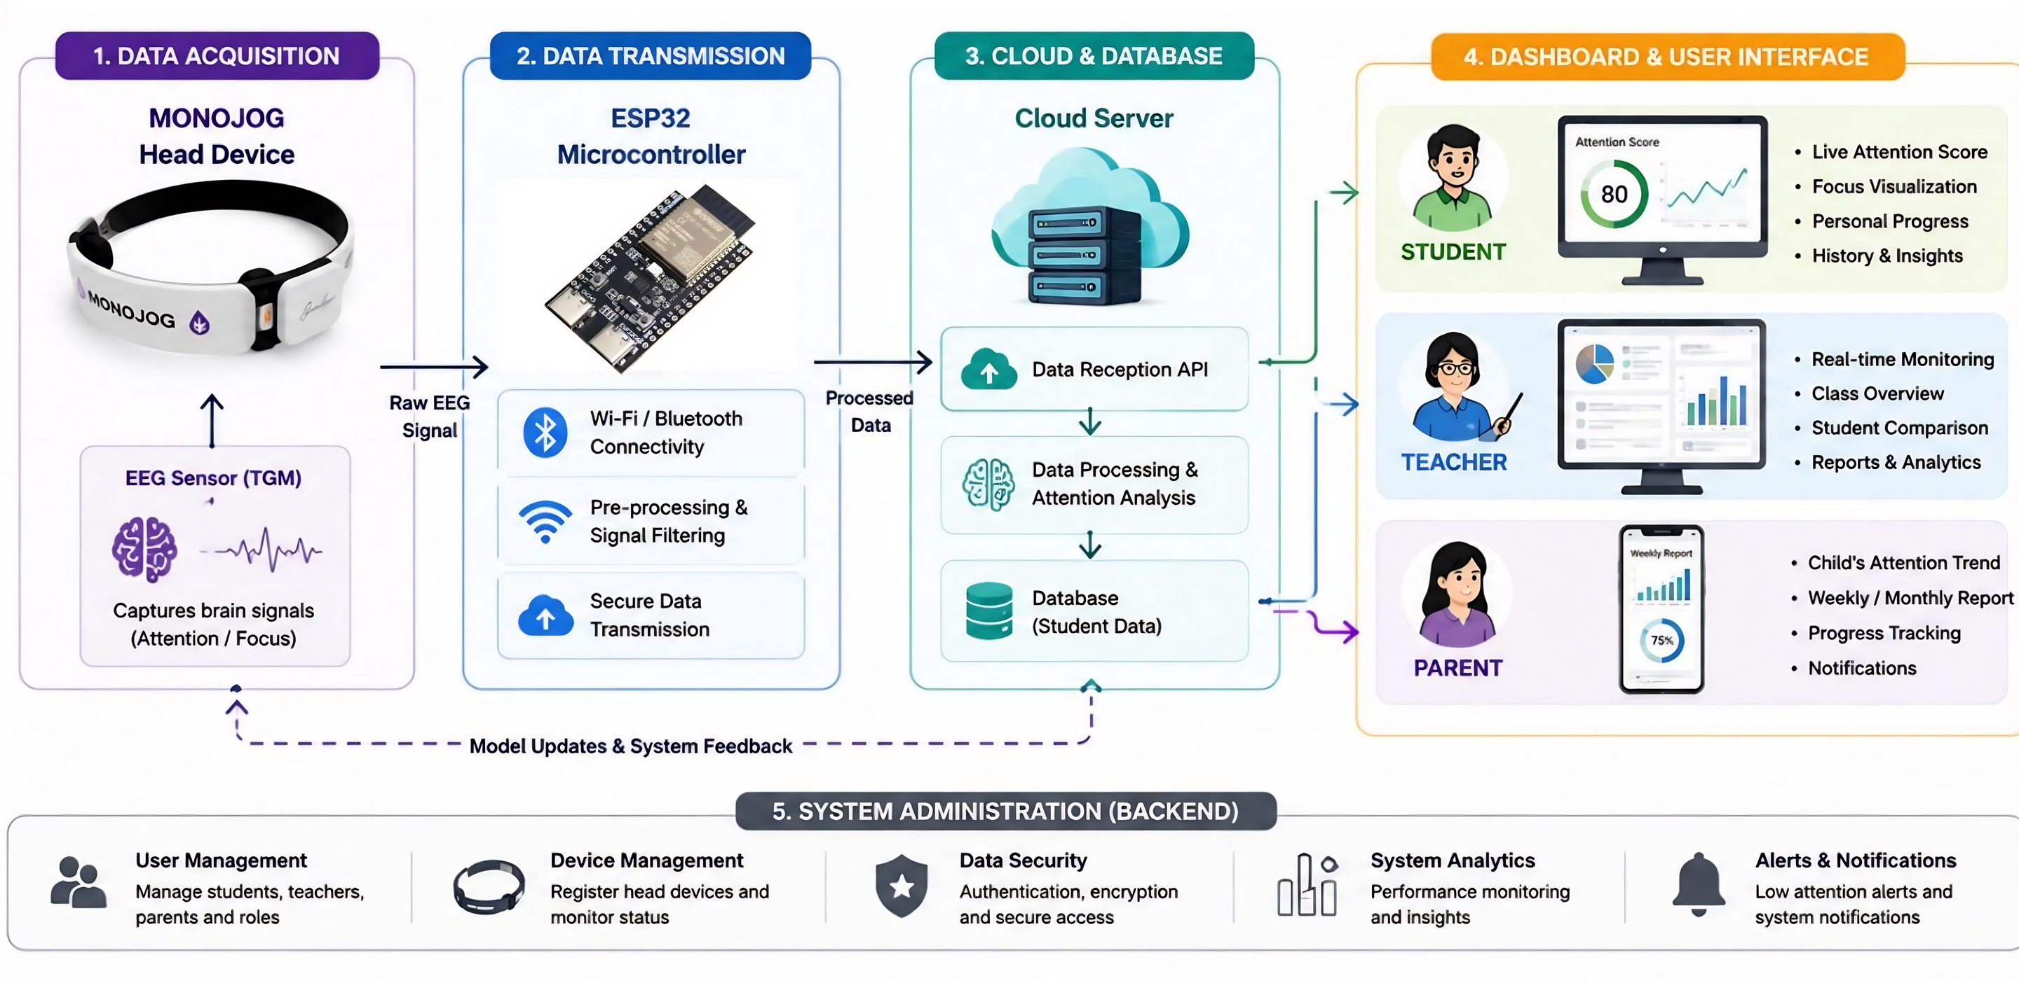
HOW IT WORKS
From Brainwave to Insight: System Architecture
MONOJOG+
05
Notes:
3:15–4:00 | Walk left to right: headset acquires signal, ESP32 processes & transmits, cloud stores & analyzes, then three tailored dashboards — student, teacher, parent.
5

Slide 6
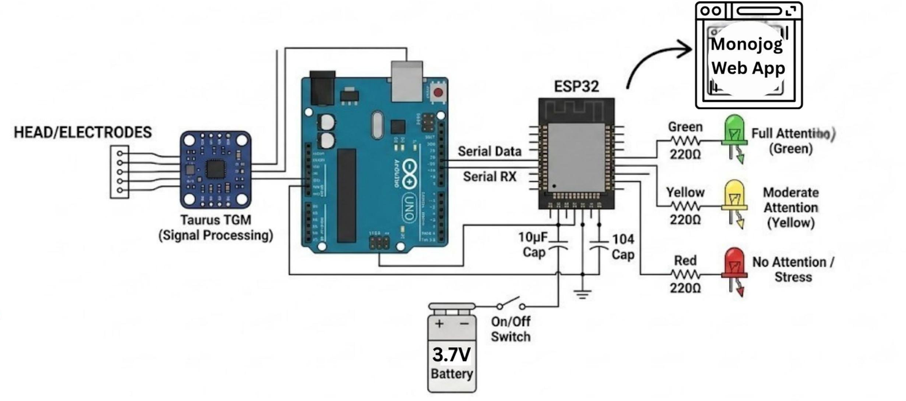




TECHNOLOGY
Core Technology Stack
EEG (Electroencephalography)
Embedded Systems (ESP32 IoT)
Brain–Computer Interface (BCI)
Gamification Engine
Digital Signal Processing
Secure Cloud Computing
Artificial Intelligence & ML
Protected Health Data Management
Prototype hardware: Taurus TGM EEG sensor · Arduino UNO signal parsing · ESP32-C6 Wi-Fi processing · rechargeable Li-ion power with a compact, child-safe headband enclosure.
MONOJOG+
06
Notes:
4:00–4:40 | Show the stack quickly; use the circuit diagram to prove this is real embedded hardware, not a concept mockup.
6

Slide 7
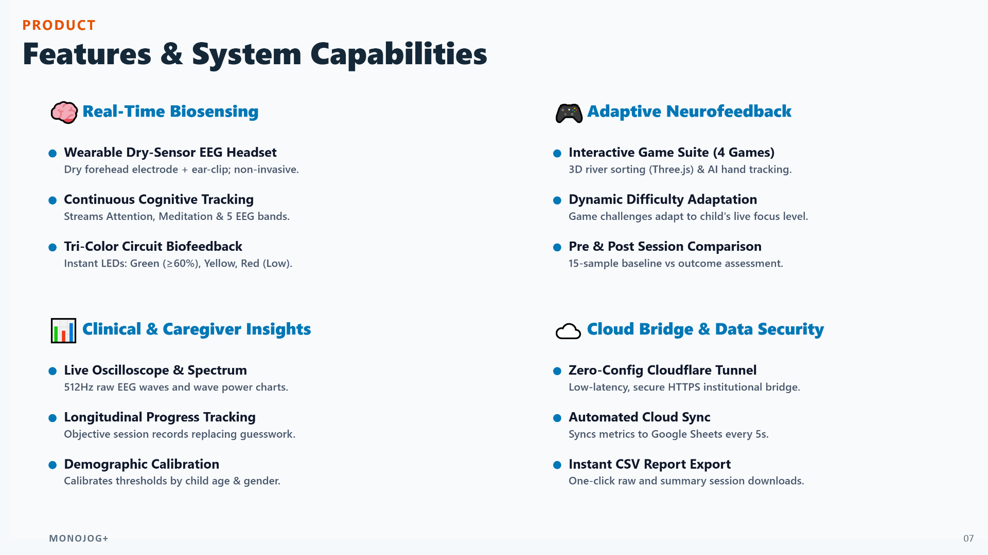

Slide 8

WHO IT SERVES
Target Beneficiaries & Social Impact
Who benefits
Social impact
Children with Autism Spectrum Disorder (ASD)
MONOJOG+ makes objective attention monitoring more accessible for children with autism and special needs. By pairing real-time brain data with engaging therapeutic games, it encourages active participation while providing therapists with measurable indicators of attention development rather than relying on observation alone.
Children with ADHD & developmental delays
Special education schools
Autism therapy & rehabilitation centers
Occupational therapists & clinical psychologists
Helps therapists personalize interventions using data
Parents and caregivers
Lets parents monitor progress beyond the clinic
Researchers studying neurodevelopment
Supports inclusive education & daily-life attention skills
Portable design widens access in underserved communities
MONOJOG+
08
Notes:
5:10–5:45 | Emphasize careful language: 'supports', 'assists', 'measures' — never 'treats' or 'cures'.
8

Slide 9

COMPARATIVE ADVANTAGE
Why MONOJOG+, and Why Now
Observation-Only Therapy
Clinical EEG Systems
MONOJOG+
Traditional approach
e.g. lab BCI rigs
Our approach
Subjective, therapist-dependent
Objective brain data
Objective, real-time attention data
No continuous data trail
Expensive & complex setup
Engaging, game-based sessions
Hard to compare across sessions
Not designed for daily/home use
Affordable, wearable, portable
Low-cost but low objectivity
Rarely available locally
Built for schools, clinics & home
MONOJOG+
09
Notes:
5:45–6:15 | Land on the middle column of MONOJOG+ — 'we combine the objectivity of clinical EEG with the accessibility special-needs families actually need.'
9

Slide 10
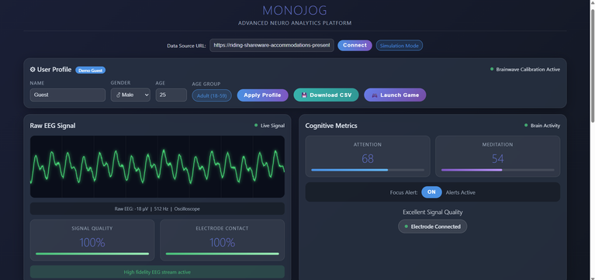
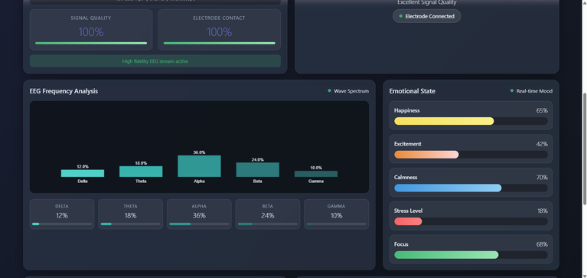
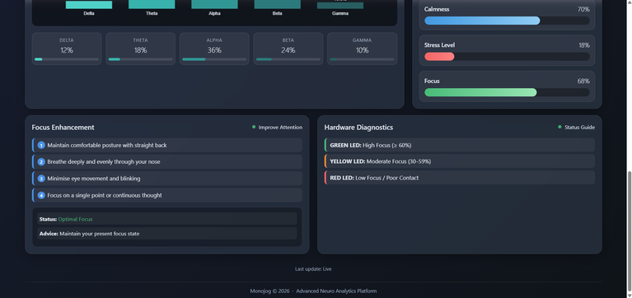
RESULTS
From Signal to Insight: The Live Dashboard
Signal & electrode quality
99%
Real-time signal integrity shown to the user at all times.
Attention / Meditation
Live
Continuous cognitive metrics computed every session.
EEG frequency analysis
5 bands
Delta, theta, alpha, beta & gamma power breakdown.
Emotional state tracking
5 states
Happiness, excitement, calmness, stress & focus.
MONOJOG+
10
Notes:
7:00–7:20 | Point to the dashboard screenshot: 'this is the same interface running live in the demo.' Keep brief — the live demo already made this point.
11

Slide 11
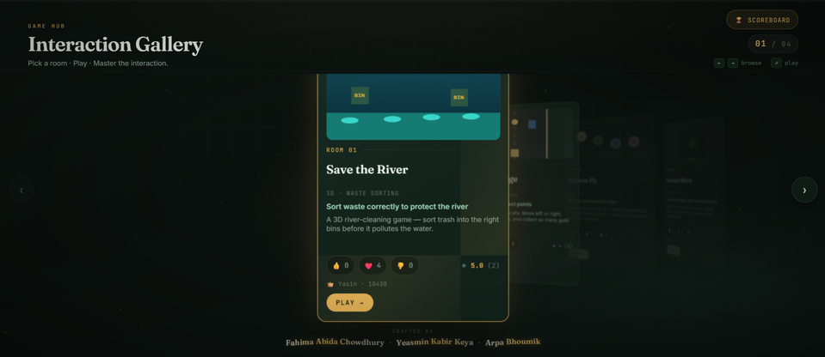
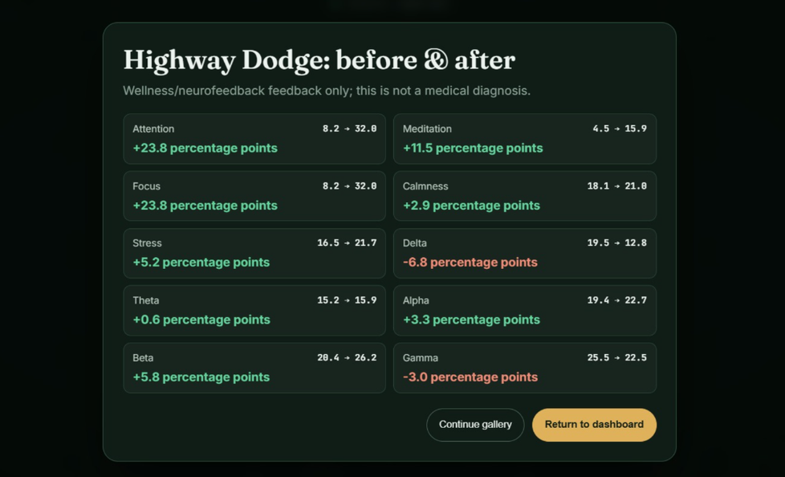
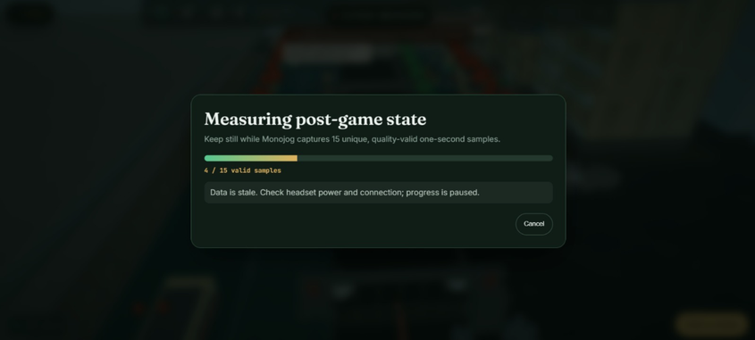
COMPARATIVE ADVANTAGE
Turning Play Into Better Attention
Interactive games help users improve attention
and concentration while staying calm, focused, and engaged.
Comparing pre- and post-game attention, focus, stress, and calmness levels.
Post-game EEG captures changes in attention and mental state.
11

Slide 12
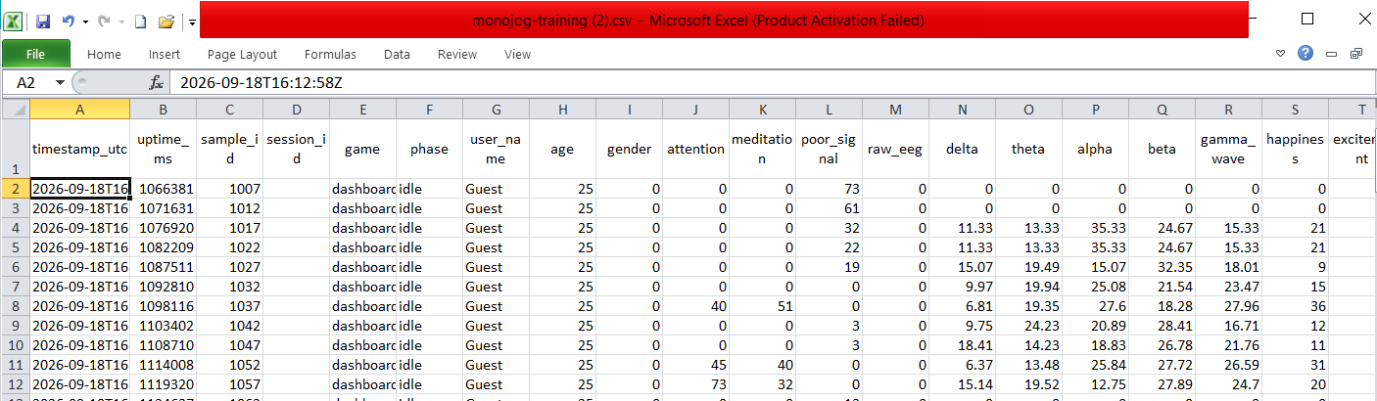
STORAGE & EXPORT
Data Storage & Export
Collected EEG and Attention Data Stored in CSV/Excel Format
12

Slide 13
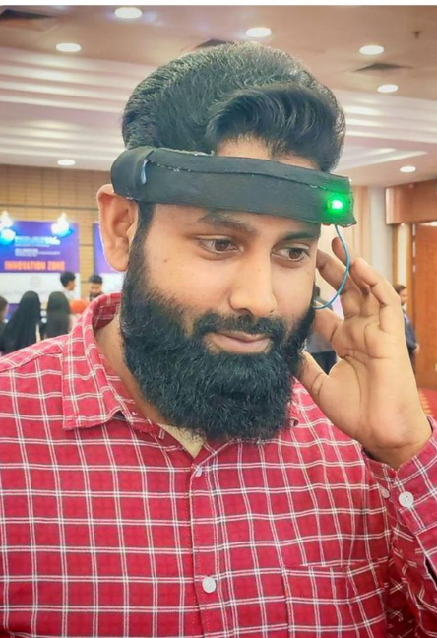
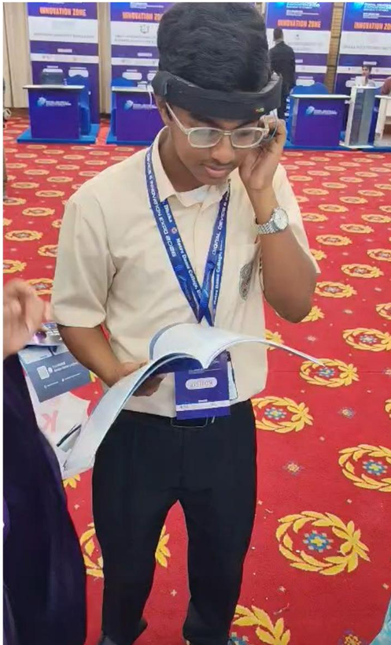
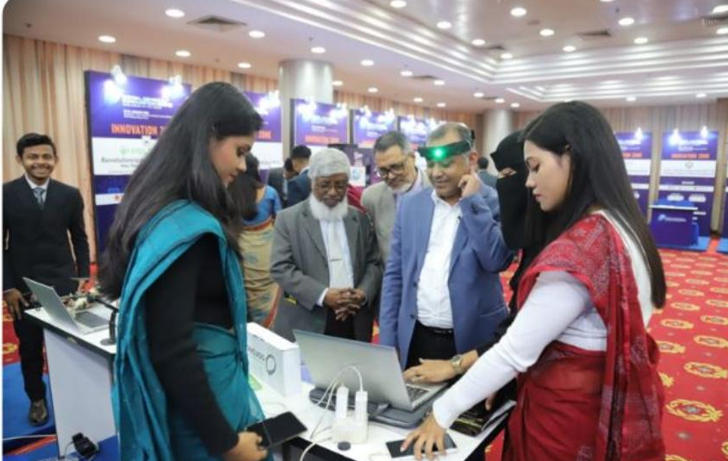
LIVE DEMONSTRATION
Tested & Demonstrated on the Ground
MONOJOG+ is a working prototype that has already been worn and tested by real users at national innovation exhibitions. Today’s live demo follows the same flow: fit the headband, calibrate signal quality, play an attention-adaptive game, and monitor the results on the live dashboard.
Fit & calibrate the headband
Wear it comfortably during activity
Live dashboard walkthrough for visitors & judges
MONOJOG+
13
Notes:
6:15–7:00 | This is the live demo cue. If presenting a physical unit, hand it around or invite a judge to try it now while narrating the three photos as 'proof this already works in the field'.
10

Slide 14

ROADMAP
What's Next for MONOJOG+
NEAR-TERM
MID-TERM
LONG-TERM
Guided Clinical Pilot
Personalized AI Models
National Accessibility
Structured pilot with therapy centers & special schools; consent-based data collection to validate attention metrics.
Child-specific engagement models, a caregiver mobile app, and expanded cloud analytics.
Multi-language platform, NGO & Ministry partnerships, and affordable rollout across special-needs schools in Bangladesh.
MONOJOG+
14
Notes:
7:20–7:40 | Show maturity: acknowledge this needs a proper pilot before making outcome claims. Judges reward honesty about the evidence stage.
12

Slide 15






OUR TEAM
Team MONOJOG+
Department of Computer Science & Engineering (CSE) — University of Information Technology & Sciences (UITS)
Fahima Abida Chowdhury
Yeasmin Kabir Keya
Arpa Bhowmik
Sawda Akter
Ishraq Uddin Chowdhury
Chief Executive Officer
Chief Operating Officer
Chief Marketing Officer
Chief Product Officer
Chief Technology Officer
Hardware Integration & System Architecture
Backend, Database & Real-Time Data
Wireless Communication & Testing (ESP32)
Dashboard UI & Data Visualization
Hardware, Networking & Security
Supervisor: Mrinmoy Biswas Akash — Lecturer & Course Coordinator, Department of CSE, University of Information Technology & Sciences (UITS)
MONOJOG+
15
Notes:
7:40–7:50 | Quick, warm team introduction. Credit the supervisor by name.
13

Slide 16
Thank You
MONOJOG+ — Helping every child build the attention they need to learn, grow, and thrive.
Questions & Live Demonstration Welcome
Team MONOJOG+ : University of Information Technology & Sciences (UITS) · Bangladesh ICT & Innovation Awards 2026
Notes:
7:50–8:00 | Close warmly, invite questions and offer the physical unit for hands-on trial.
14

Slide 17
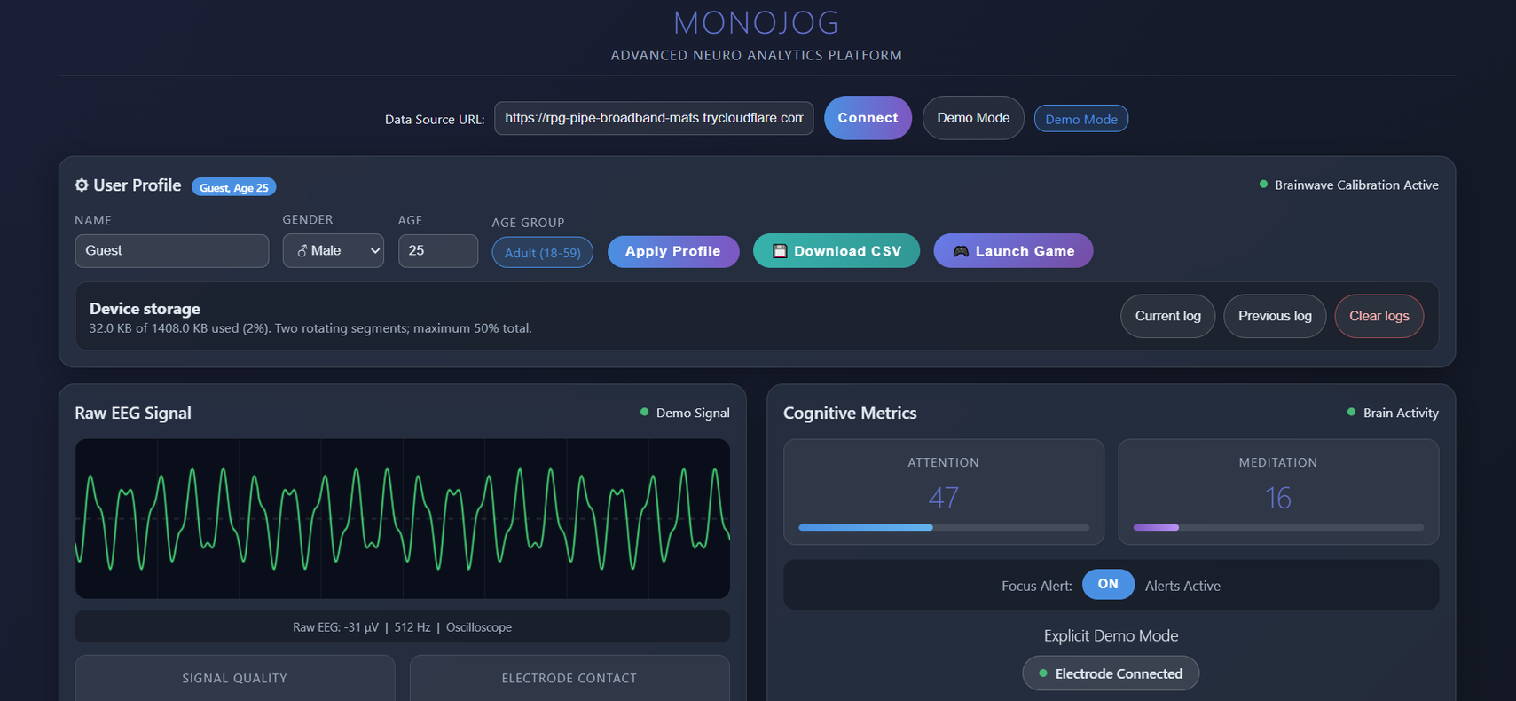
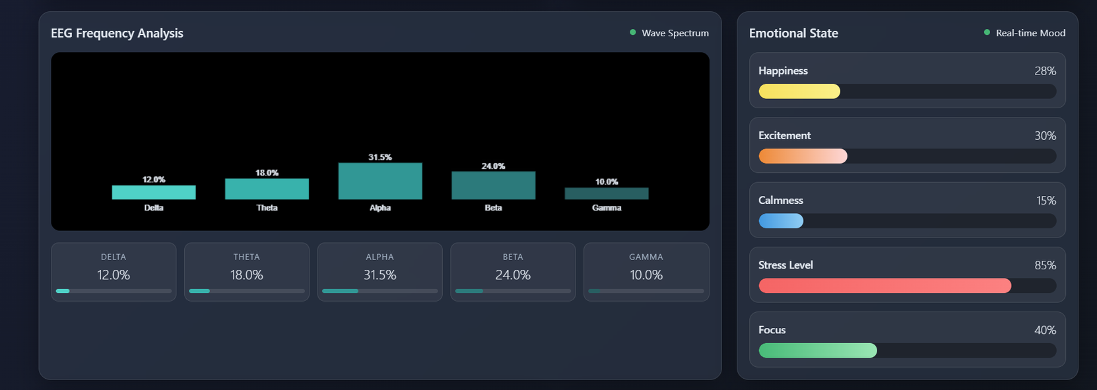
MONOJOG+DASHBOARD

Slide 18
