Slide 1
AI-Powered Test Automation Reporting
Turning Jenkins build failures into actionable insight — with GitHub Copilot
Prepared by: Abid Ali | Team: QA Automation | Demo for Management
Repository: abidaliatex/test-automation-reporting

Slide 2
Agenda
What we'll cover today
• The Problem — why triaging Jenkins failures was painful
• The Solution — a Copilot-driven reporting repository
• Architecture — Jenkins × GitHub × Copilot × MCP
• What I Built — reports, investigations, dashboards
• Live Screenshots — Jenkins, investigations, HTML dashboard, weekly email
• Benefits & Metrics — time saved, quality gained
• Future Goals — auto-fix, auto-Jira, Jira Test Management sync
• Further Enhancements & Vision
AI-Assisted Test Automation Reporting | Demo for Management
2

Slide 3
The Problem
Manual triage of automation failures does not scale
• Dozens of Jenkins builds per week across multiple jobs
• Every red/unstable build required manual log reading
• Root cause hidden in hundreds of lines of stack traces
• QA engineers spent hours repeating the same triage steps
• No central history → same issues re-investigated
• Managers lacked a clear view of trends and hot-spots
Before AI Assistance
• ~30–45 min per failed build
• Knowledge lived in engineers' heads
• Inconsistent report formats
• Reactive, not proactive
AI-Assisted Test Automation Reporting | Demo for Management
3

Slide 4
The Solution
A Copilot-assisted reporting repository
One GitHub repo that captures every failure, explains it, and tracks it over time.
Automated
Reports
AI
Investigations
Weekly
Dashboards
Every Jenkins failure creates a structured Markdown report
Copilot writes root-cause analysis with recommended fixes
Recurring patterns and hot-spots surfaced automatically
AI-Assisted Test Automation Reporting | Demo for Management
4

Slide 5
How It Works
Jenkins → GitHub → Copilot → Reports
Jenkins CI
Jenkins MCP
GitHub Copilot
This Repo
Managers &
Engineers
Runs automation
jobs & tests
Exposes build
data to Copilot
Reads failures,
writes analysis
Reports +
investigations
Consume
dashboards
Flow
• A Jenkins build fails or turns unstable
• Copilot fetches build data through the Jenkins MCP server
• A failure report is generated: reports/build-failures/{job}/build-<id>.md
• Copilot writes a root-cause analysis: investigations/copilot-findings/{job}/build-<id>-analysis.md
• Weekly job aggregates failures into a dashboard + emails a triage summary
AI-Assisted Test Automation Reporting | Demo for Management
5

Slide 6
What I Built
A clean, opinionated repository structure
test-automation-reporting/
├── README.md overview
├── AGENTS.md Copilot behaviour rules
├── prompts/
│ └── jenkins-qa-triage.md strict AI triage prompt
├── .github/
│ ├── copilot-instructions.md
│ ├── prompts/ reusable prompts
│ └── workflows/ automation workflows
├── reports/
│ └── build-failures/{job}/build-<id>.md
├── investigations/
│ └── copilot-findings/{job}/build-<id>-analysis.md
└── dashboards/
└── weekly-summary.md / .html trend report
Design Principles
• One report per build — never overwritten
• Job name is part of the folder path
• AGENTS.md enforces consistent AI behaviour
• Strict triage prompt keeps output focused
• Everything is Markdown → diff-friendly, searchable
• Workflows keep the repo tidy
AI-Assisted Test Automation Reporting | Demo for Management
6

Slide 7
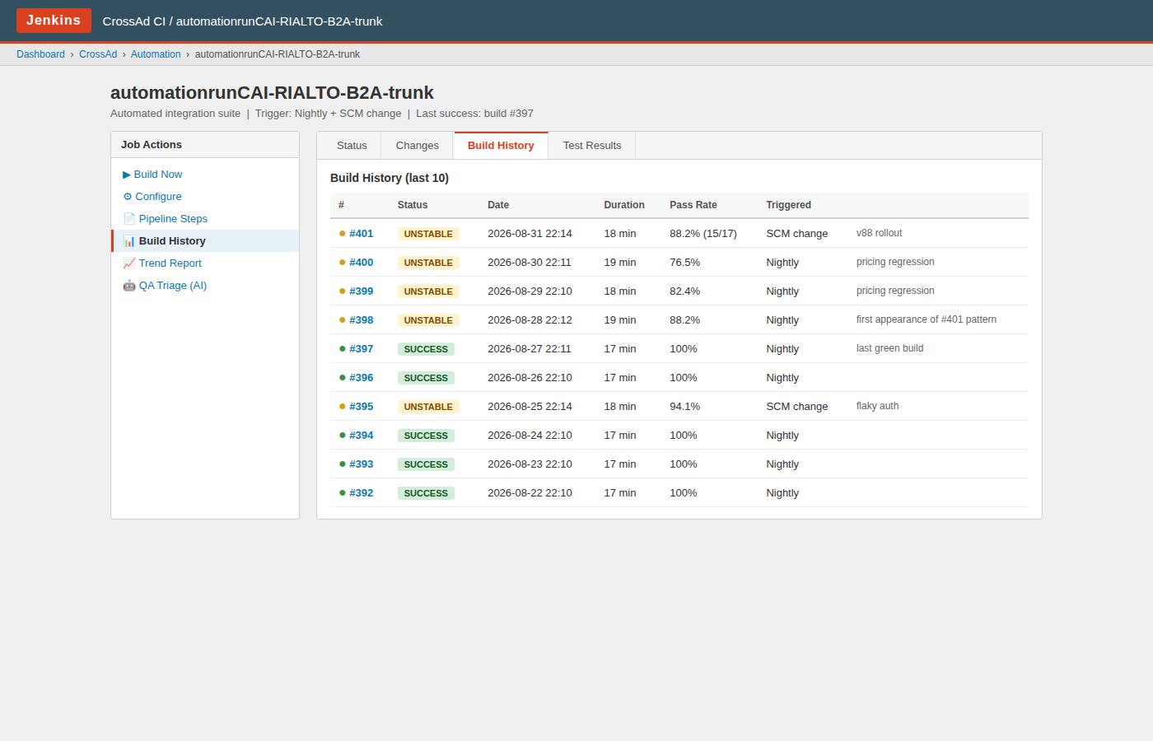
Live View — Jenkins Build History
Where it all starts: our Jenkins jobs and their build history
What you're seeing
• Nightly + SCM-triggered automation jobs
• Unstable builds since #398 — pattern begins with v88 rollout
• Last green build: #397 (2026-08-27)
• Each build number becomes an entry in this repo
• Copilot uses the Jenkins MCP server to read this data
AI-Assisted Test Automation Reporting | Demo for Management
7

Slide 8
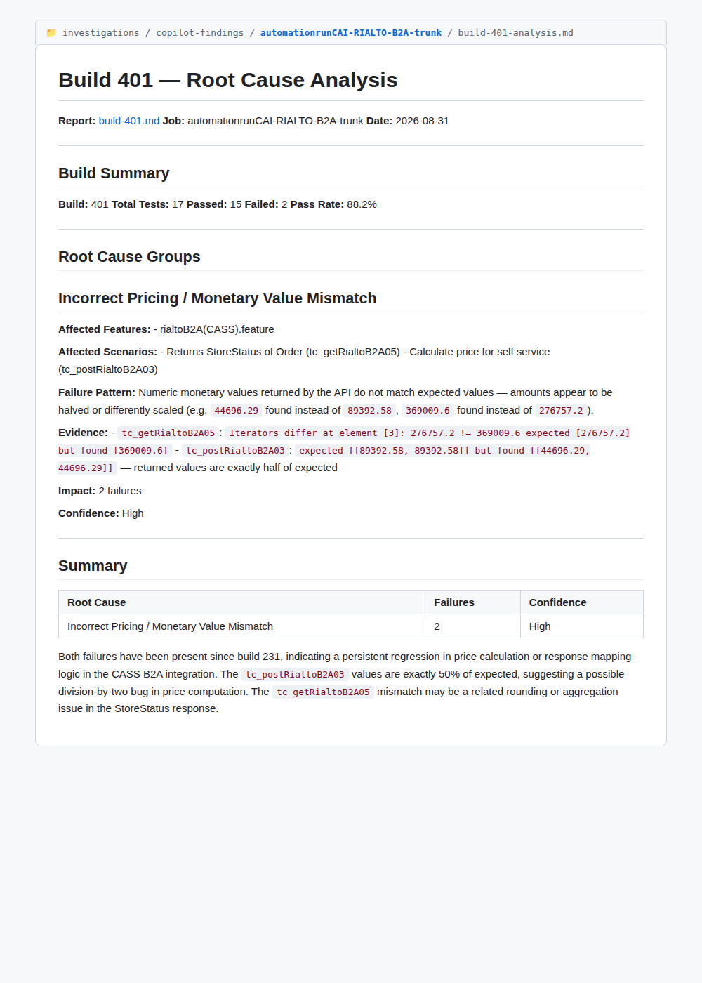
Live View — AI Root-Cause Analysis
The output of Copilot for build #401 (RIALTO-B2A trunk)
What you're seeing
• Generated automatically by Copilot
• Grouped by root cause, not by test
• Concrete evidence: expected vs. actual values
• Flags the exact bug (values halved → division-by-2)
• Tracks 'failed since' history
• Stored in Git — reviewable & searchable
AI-Assisted Test Automation Reporting | Demo for Management
8

Slide 9
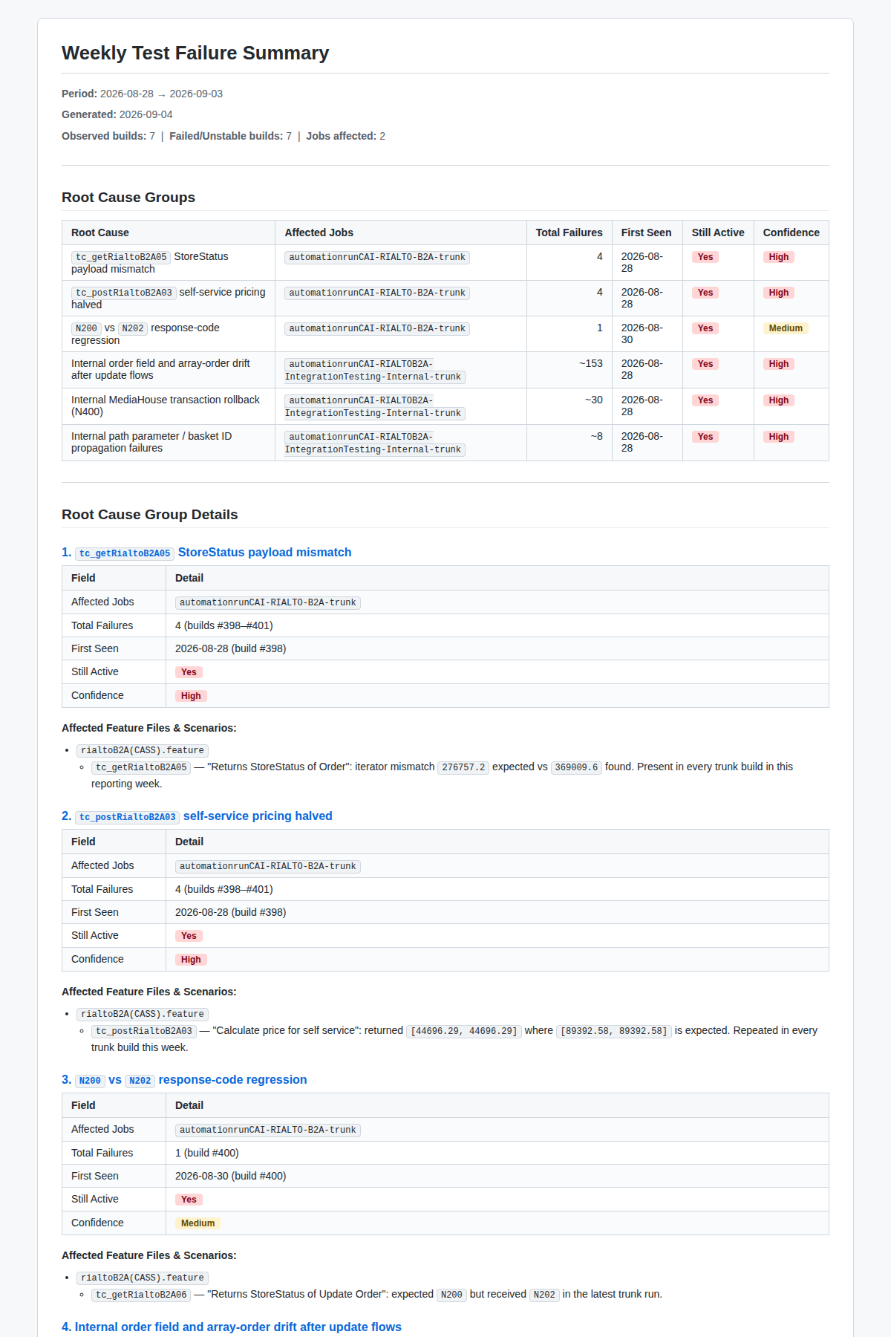
Live View — Weekly HTML Dashboard
Auto-generated trend report for management
What you're seeing
• One page, all failing jobs of the week
• Root causes ranked by impact
• Confidence + 'still active' flags
• Shareable HTML — opens in any browser
• Published every Monday morning
AI-Assisted Test Automation Reporting | Demo for Management
9

Slide 10
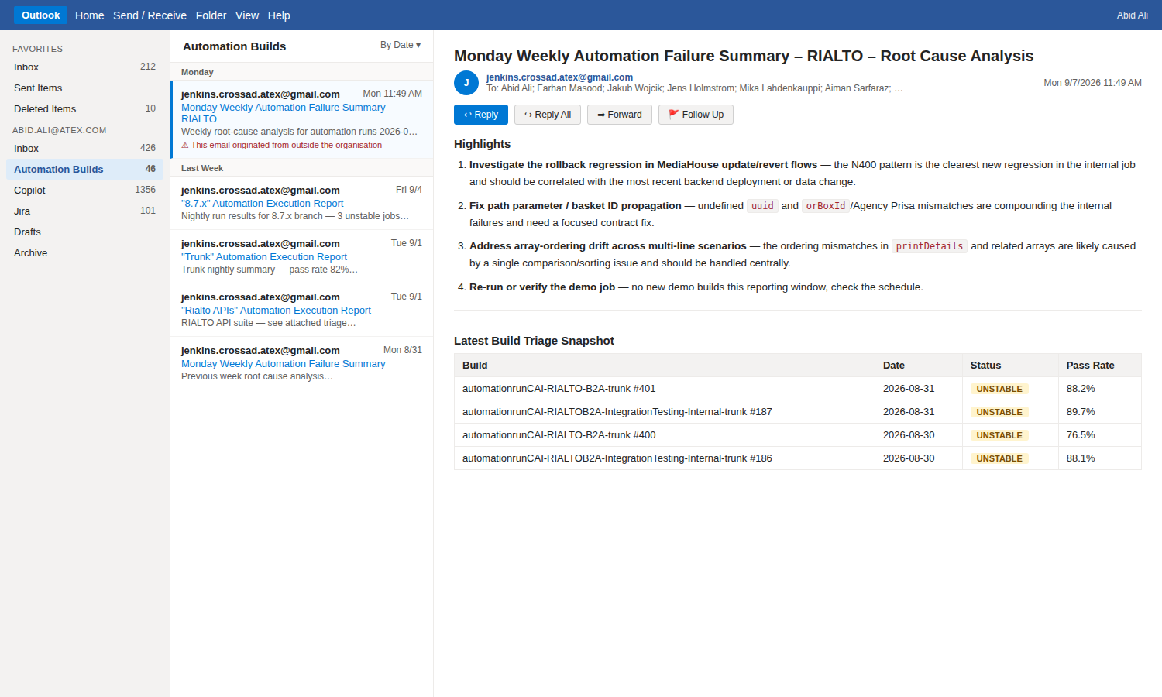
Live View — Monday Triage Email
The weekly summary delivered straight to your inbox
What you're seeing
• Sent to QA leads, devs, and management
• Top 4–5 action items at the top
• Latest build snapshot table
• Links back to full HTML dashboard & repo
• No one has to log into Jenkins to see the story
AI-Assisted Test Automation Reporting | Demo for Management
10

Slide 11
By the Numbers
What the repo already contains
150+
20+
2
1
AI-generated investigations
Failed builds documented
Jenkins jobs onboarded
Central source of truth
Time & Quality Impact
• Triage time per failure: ~40 min → ~5 min (≈ 85% faster)
• Consistent report format across every build — no more free-text emails
• Historical searchable trail — same failure never investigated twice
• Weekly dashboards make recurring root causes visible to leadership
AI-Assisted Test Automation Reporting | Demo for Management
11

Slide 12
Why AI (Copilot)?
The right tool for the right job
What Copilot does well here
What humans still own
• Reads long, noisy Jenkins logs quickly
• Groups failures by likely root cause
• Correlates errors with recent commits
• Writes clean, consistent Markdown
• Follows strict prompts (AGENTS.md + triage prompt)
• Improves as we refine the prompts
• Final validation of the fix
• Deciding priority and ownership
• Talking to dev teams and product
• Reviewing the AI output for accuracy
• Continuously improving the prompts
AI-Assisted Test Automation Reporting | Demo for Management
12

Slide 13
Business Benefits
Why this matters beyond QA
• Faster feedback loop — devs learn about regressions in minutes, not days
• Lower cost of quality — engineers spend time fixing, not searching
• Transparency — every failure has a traceable report and analysis
• Better decisions — dashboards show where to invest QA effort
• Knowledge retention — nothing is lost when team members change
• Scalable — adding a new Jenkins job means one folder, no new process
• Foundation for further automation — auto-Jira, auto-Slack, auto-fix bots
AI-Assisted Test Automation Reporting | Demo for Management
13

Slide 14
Future Goals
From reporting → to auto-remediation
🔧 Auto-Fix Automation Issues
📝 Auto-Create Jira (via Jira MCP)
When failure is a test-code or config issue, Copilot opens a PR against the automation repo with the fix — reviewed by QA, merged, re-run.
When failure is a product bug, Copilot uses the Jira MCP server to open a ticket with root cause, evidence, affected scenarios, severity & component.
🧠 Smart Classifier
♻️ Self-Healing Tests
First step in the pipeline: is this a test issue, an env issue, or a real product bug? Decides whether to auto-fix, auto-Jira, or escalate.
For known flaky patterns (timing, ordering, data), Copilot proposes locators, waits, or retries and validates the fix in a scratch build.
AI-Assisted Test Automation Reporting | Demo for Management
14

Slide 15
Future Goal — Jira Test Management
Close the loop between automation runs and the test-management tool
🧪 Sync with Jira Test Management (Xray / Zephyr)
How it fits together
• Every automated test case in Jenkins maps to a Jira Test in Xray / Zephyr
• After each build, Copilot pushes execution results into a Jira Test Cycle
• Failing tests are auto-linked to the Jira bug created from the failure
• Traceability: Requirement → Test → Execution → Defect, end-to-end
• Test-manager sees pass/fail trends inside Jira, not just Jenkins
• Manual + automated coverage visible on one dashboard
• Uses the Jira / Xray MCP server — no custom REST plumbing
Jenkins build
Runs automation suite
This repo
Structured results + AI analysis
Jira Test Management
Test cycle updated (Xray / Zephyr)
Jira bug
Auto-linked to the failed test
Requirement
Traceability chain complete
AI-Assisted Test Automation Reporting | Demo for Management
15

Slide 16
Future Flow
What happens automatically after a failure
Test / Framework Issue
PR opened
Copilot opens PR
in automation repo
Build Fails
AI Classifier
(Copilot)
Environment / Data
Env fixed
Copilot pings DevOps
+ opens infra ticket
Real Product Bug
Jira raised
Copilot creates Jira
via Jira MCP
Test Coverage Update
Xray updated
Copilot syncs results
to Jira Test Mgmt
Humans review the PR / ticket — Copilot never merges directly.
AI-Assisted Test Automation Reporting | Demo for Management
16

Slide 17
Further Enhancements
Ideas worth exploring next
🔔 Slack / Teams alerts
📱 Live dashboard site
Instant notification per failure with AI summary link
GitHub Pages site with real-time build health & MTTR
🕵️ Flaky-test detector
📊 Trend analytics
Score tests by instability, auto-quarantine noisy ones
MTTR, escape rate, top failing components
🔗 GitHub Issue integration
🧪 Xray / Zephyr sync
Auto-link investigations to related PRs & commits
Push automation results into Jira Test Management
🧠 Historical corpus
🌐 Multi-team rollout
Copilot searches past investigations before writing new
Onboard other QA teams — same repo pattern, own folder
🔒 Redaction guardrails
🗣️ Conversational triage
Automatic PII/secret scrubbing before writing reports
'Why is build 401 failing?' → chat answer
AI-Assisted Test Automation Reporting | Demo for Management
17

Slide 18
Roadmap
From today to the vision
Now
Repo live · 2 jobs onboarded · weekly dashboard · Monday email
Next (Q1)
Onboard remaining Jenkins jobs · Slack/Teams alerts · trend site
Then (Q2)
AI classifier · auto-Jira via Jira MCP · Xray / Zephyr sync
Later (Q3)
Auto-fix PRs for test-side issues · self-healing suggestions
Vision
Predictive analytics · MTTR SLAs · conversational triage
AI-Assisted Test Automation Reporting | Demo for Management
18

Slide 19
Thank You
Questions & Discussion
Abid Ali | QA Automation
github.com/abidaliatex/test-automation-reporting

