Slide 1
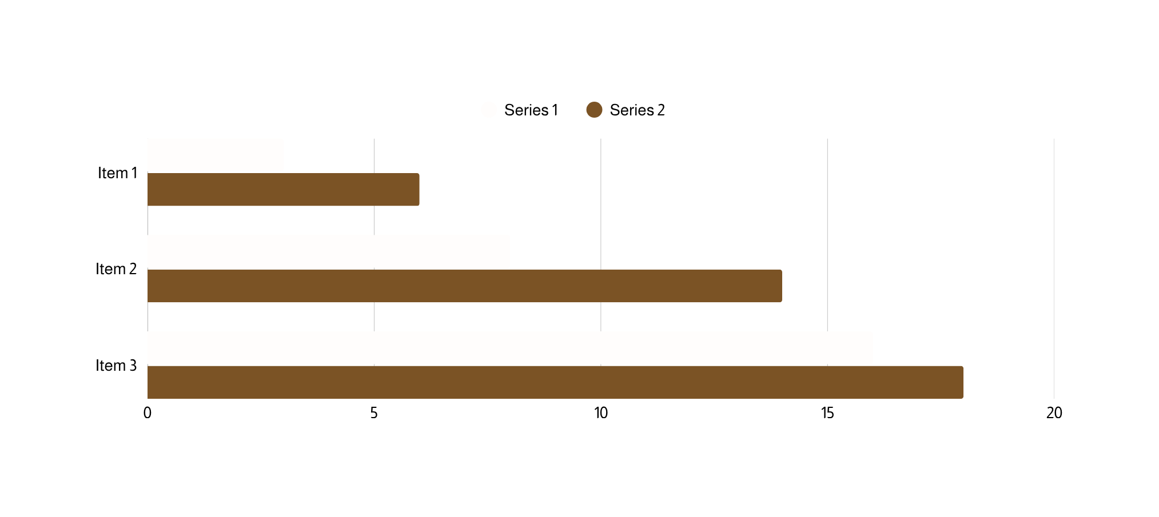
Python PPT Demo
Created using python-pptx
Name | Age | City
Alice | 25 | London
Bob | 30 | Paris
Charlie | 28 | Tokyo

