Slide 1
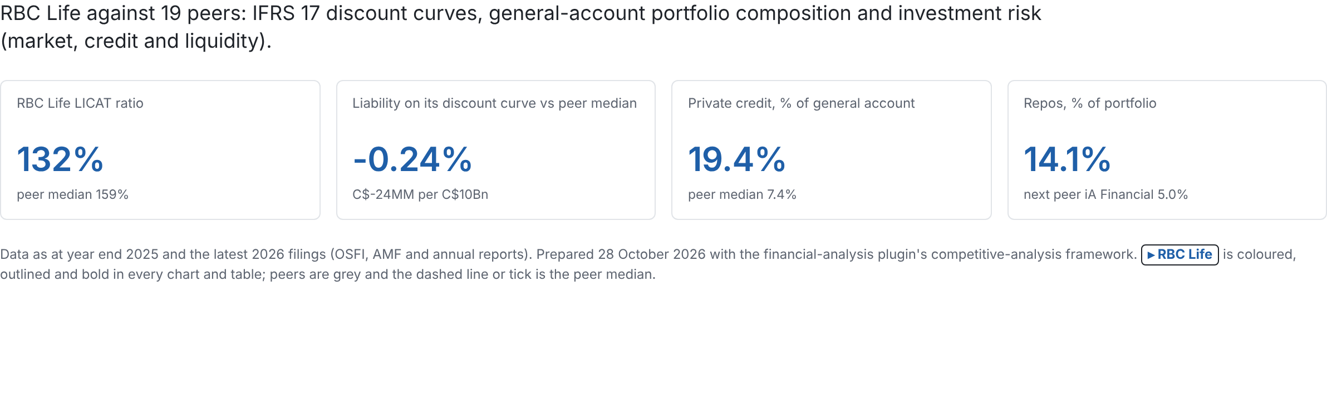
Canadian life & health insurers: peer investment landscape
Source: the three analyses in abiddobani/InsuranceCompanies (analysis/discount_curves, analysis/portfolio_composition, analysis/investment_risk), re-run 28 Oct 2026.
1 / 21

Slide 2
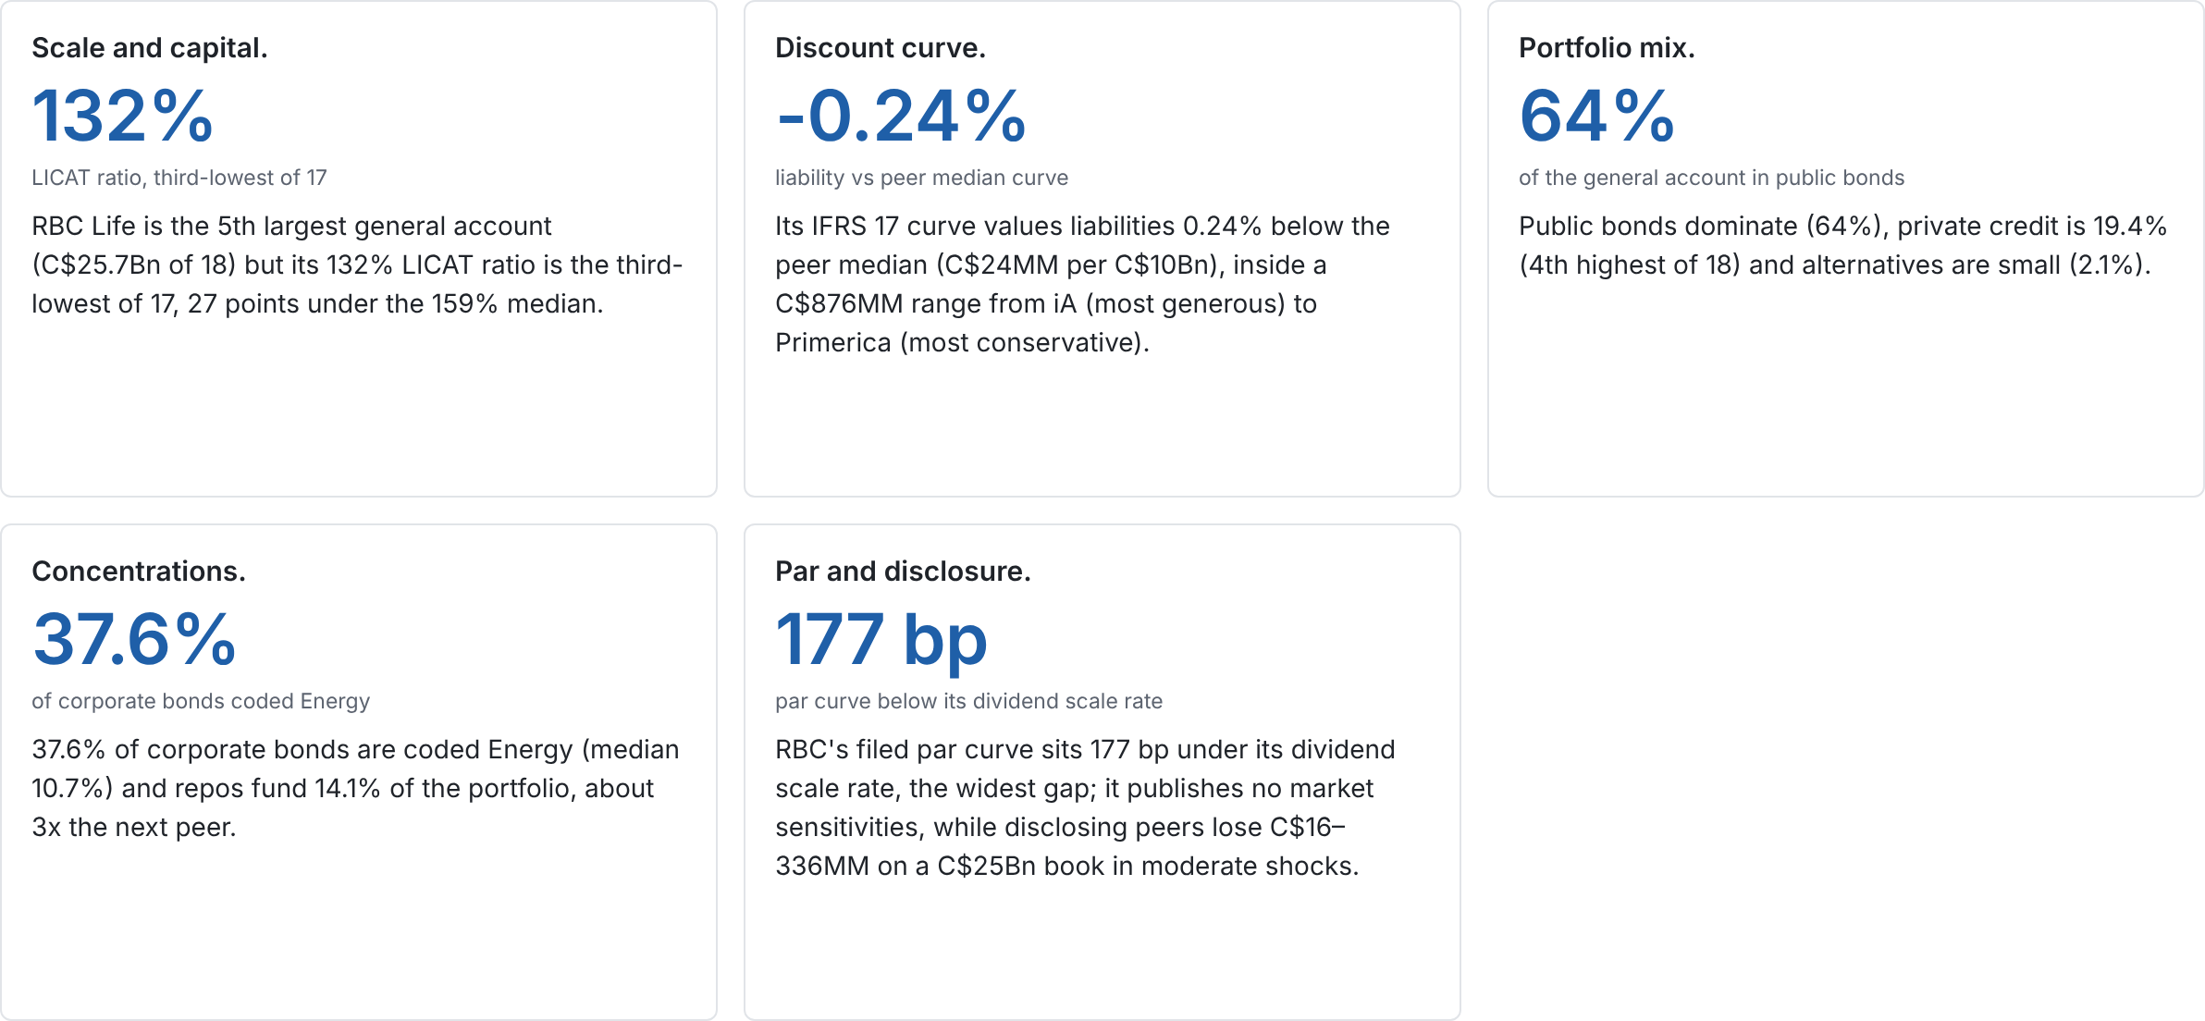
RBC Life runs a high-quality but thinly capitalised book, with two concentrations peers do not have
Source: slides 3 to 20. Peer medians are taken across every insurer with the metric; scale is C$ general-account invested assets at each insurer's latest filing.
2 / 21

Slide 3
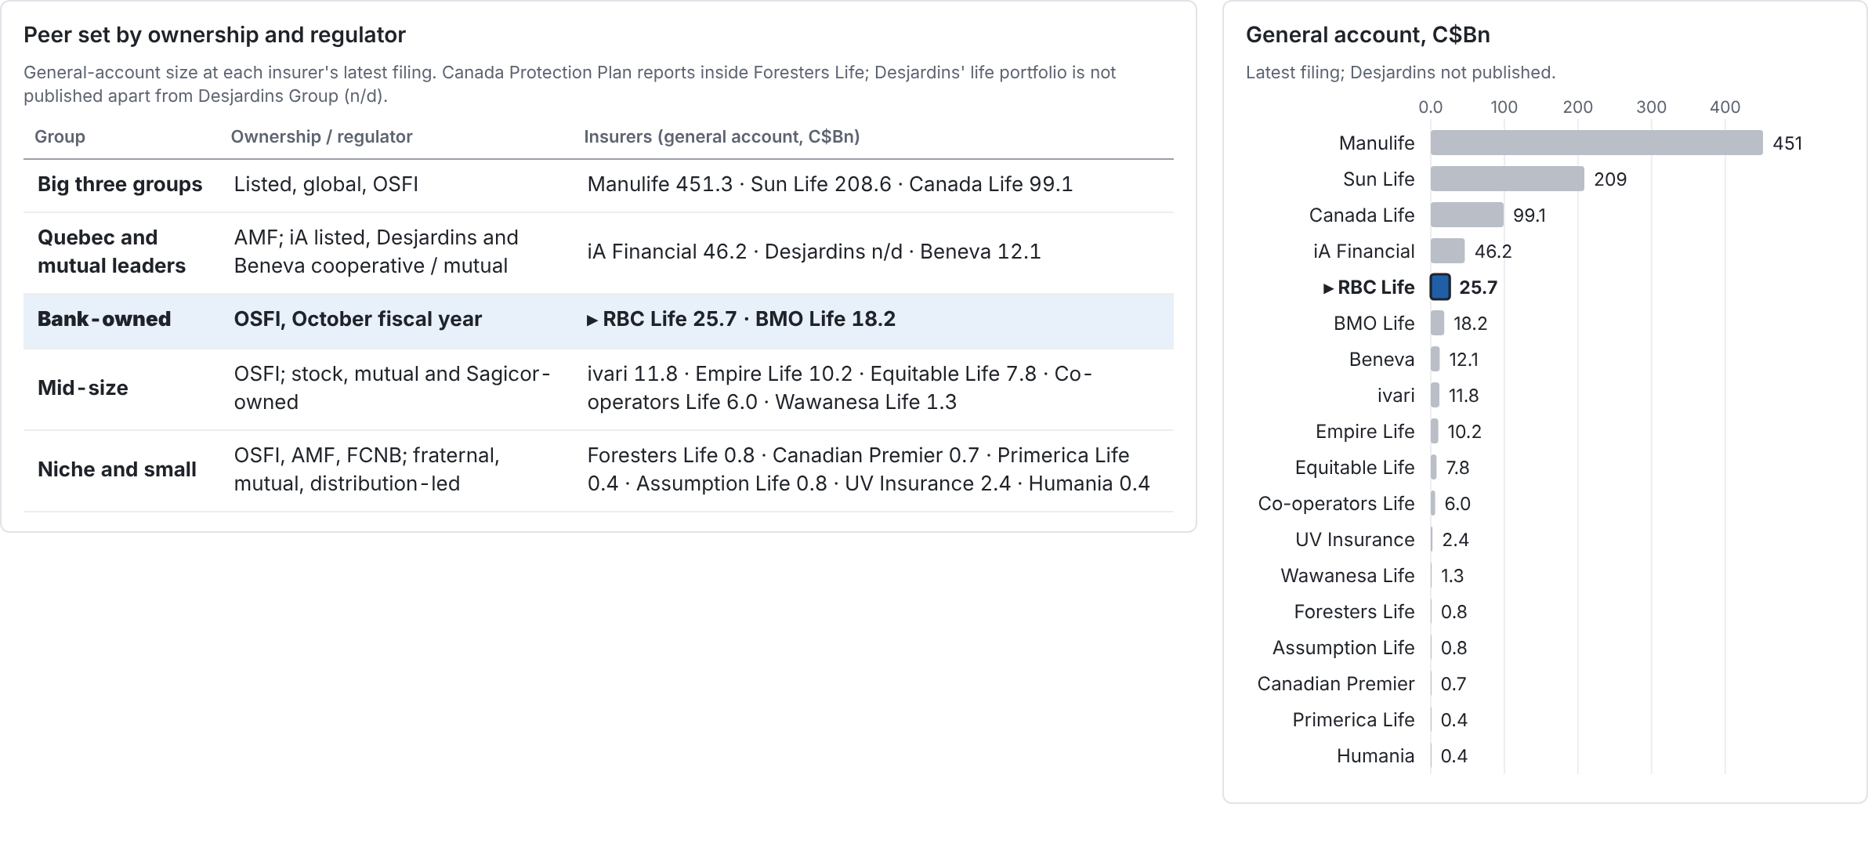
Twenty insurers in five strategic groups; RBC Life competes with BMO Life as the bank-owned pair
Source: OSFI, AMF and FCNB registers; general-account size from the portfolio composition analysis (mid-2026 for OSFI filers and listed groups, December 2025 for annual reporters).
3 / 21

Slide 4
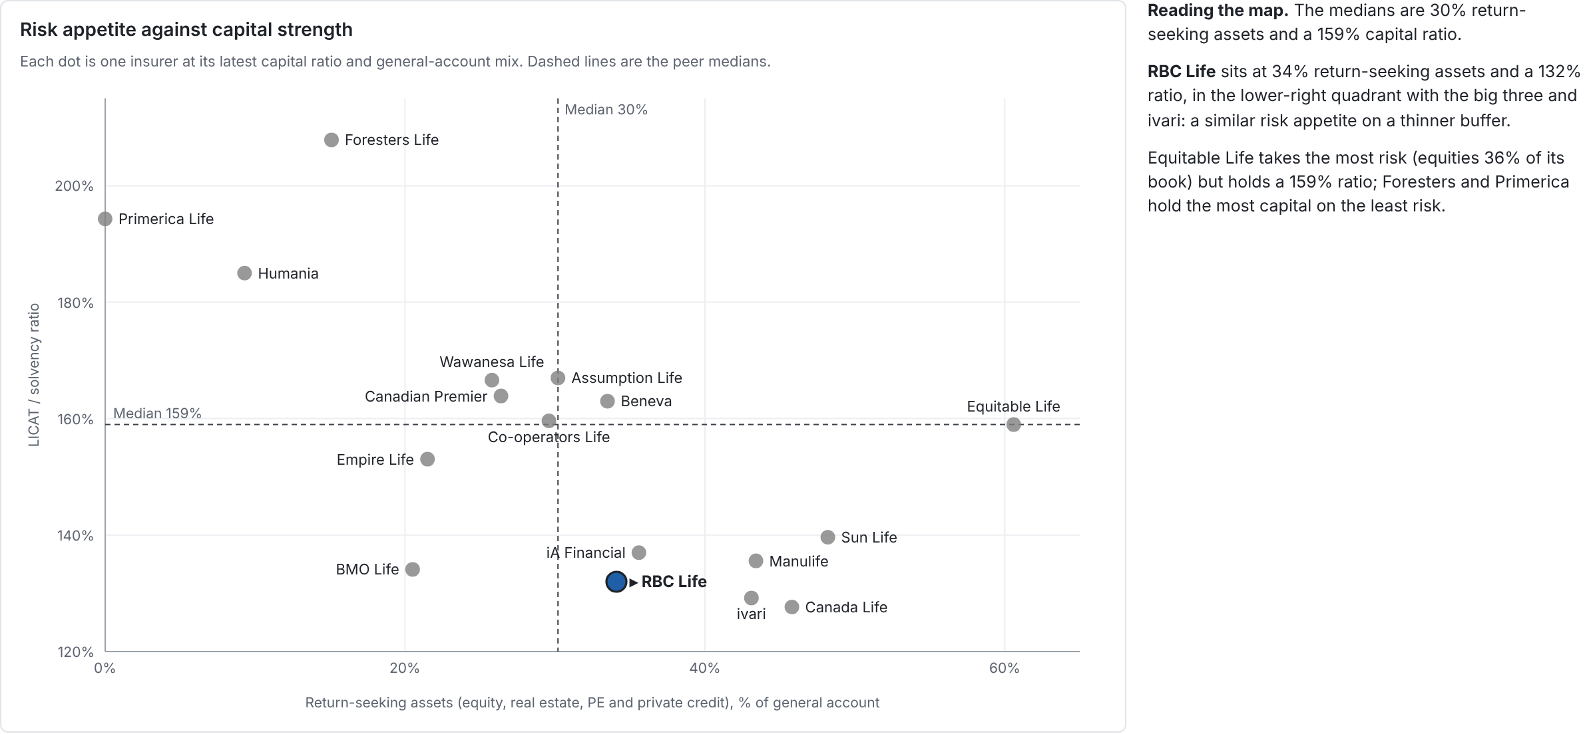
Positioning: RBC Life takes median-level investment risk on a below-median capital buffer
Source: LICAT total ratio from OSFI LCQ FY2025 Q4 (CARLI / solvency ratio for iA, Beneva, Assumption, Humania); asset mix from the portfolio composition analysis. UV Insurance and Desjardins publish no ratio.
4 / 21

Slide 5
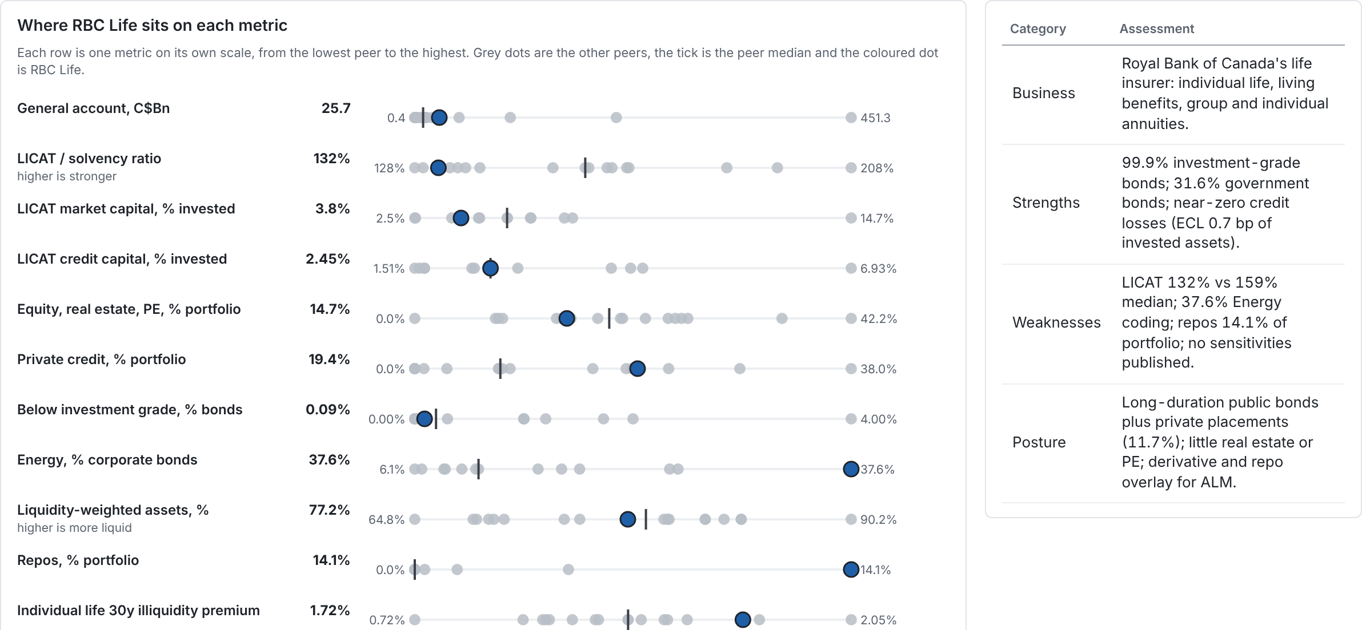
RBC Life profile: fifth-largest book, investment-grade bonds, the thinnest disclosure in the peer set
Source: OSFI LCQ, LF2, LF3 for RBC Life Insurance Company (legal entity, fiscal year to 31 Oct 2025; portfolio at 31 Jul 2026); peers as on later slides. Metrics RBC Life does not publish are marked.
5 / 21

Slide 6
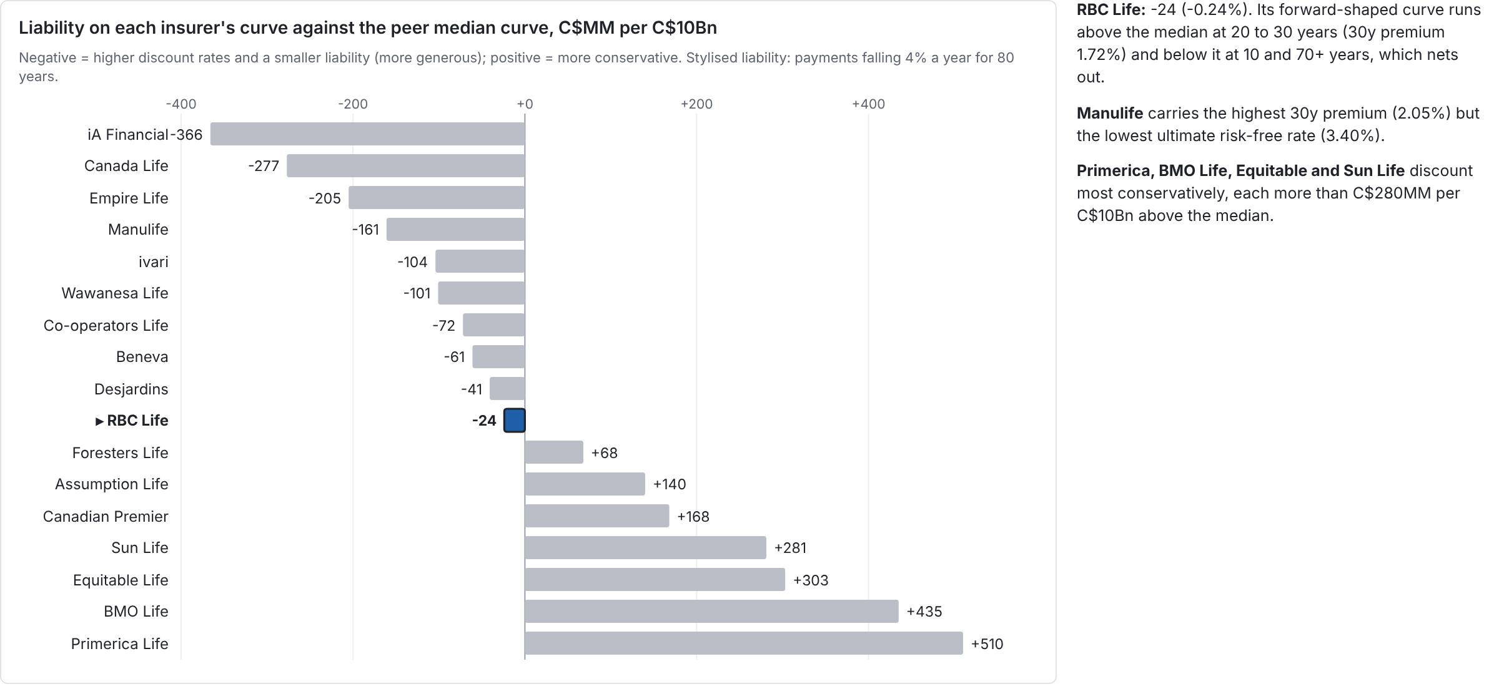
Discount curves: RBC Life is at the peer median; iA to Primerica spans C$876MM of liability per C$10Bn
Source: OSFI LF2 pages P35035 to P35065 (most illiquid curve, individual non-par), Q4 2025; iA, Desjardins, Beneva and Assumption Life 2025 annual reports. Analysis: analysis/discount_curves.
6 / 21

Slide 7
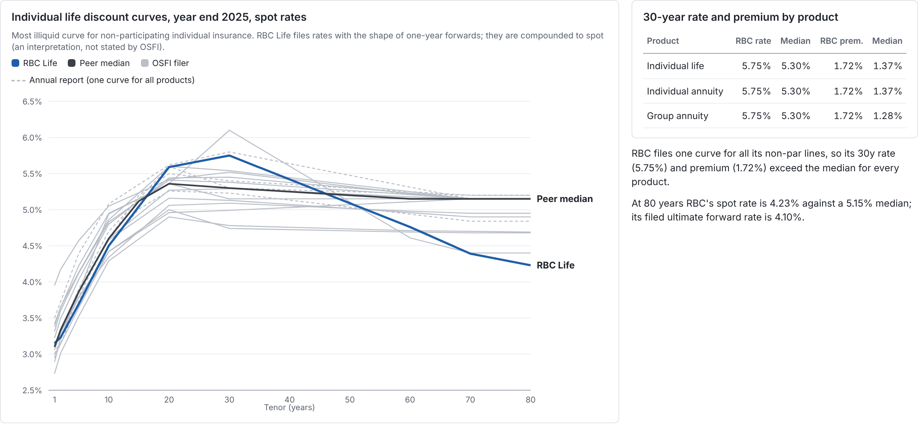
RBC Life's curve runs above the peer median at 20 to 30 years and below it at the long end
Source: OSFI LF2 by line of business, Q4 2025 (fiscal Q4 2025 for RBC Life and BMO Life); annual reports for iA, Desjardins, Beneva and Assumption Life. Premiums for insurers without their own risk-free curve are measured over the median OSFI risk-free curve.
7 / 21

Slide 8
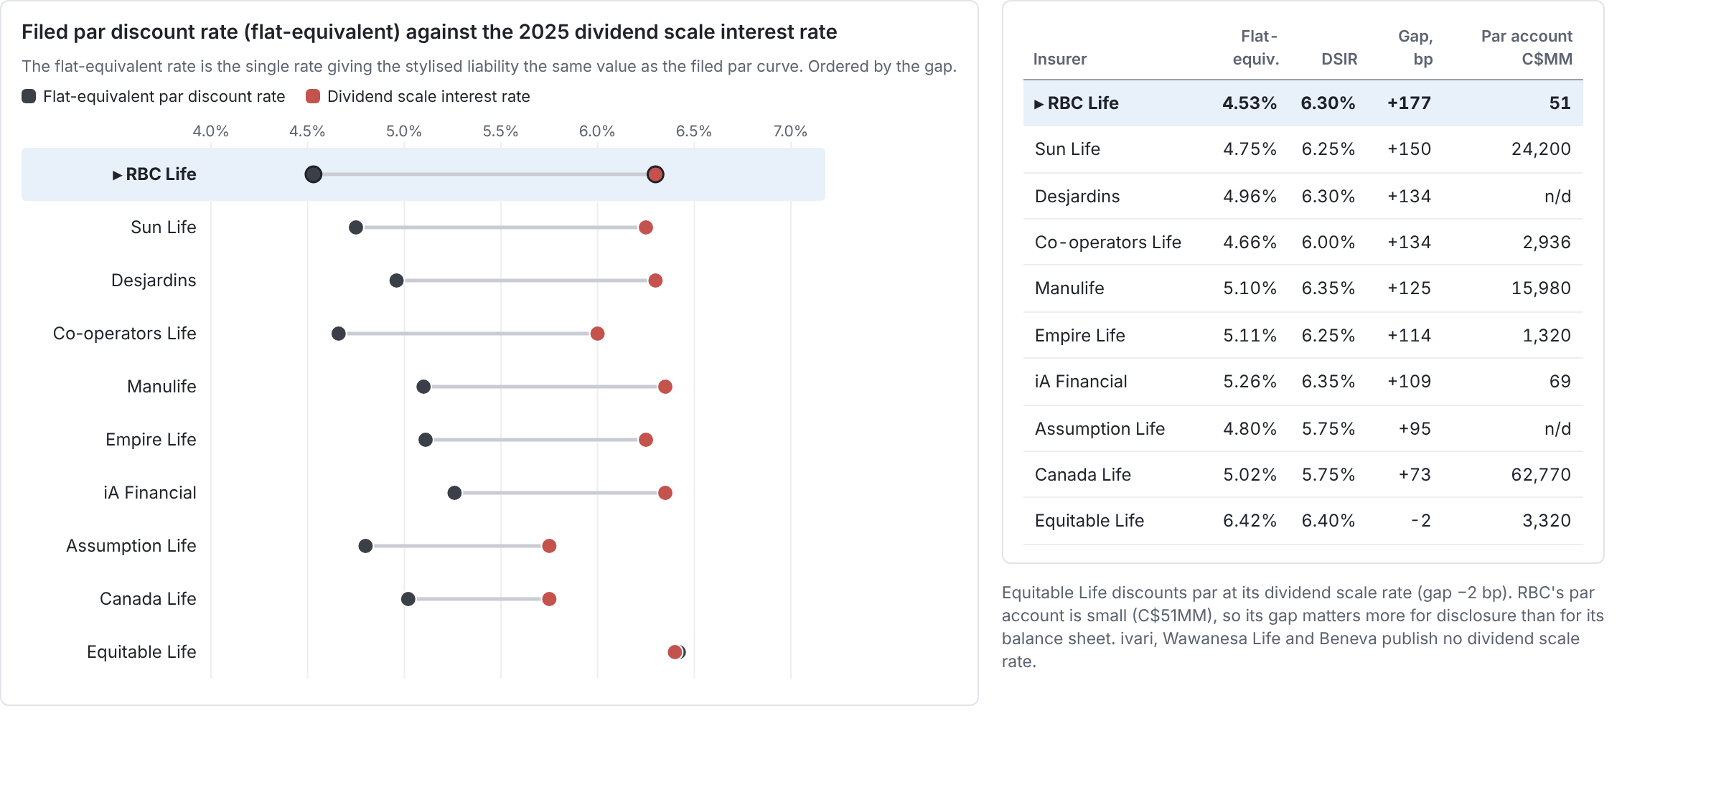
Par: dividend scale rates run 73 to 177 bp above filed par curves; RBC Life's 177 bp gap is the widest
Source: OSFI LF2 par curves, Q4 2025; annual-report curves for iA, Desjardins and Assumption Life; dividend scale interest rates 2025 from PolicyAdvisor's table, RBC Life and Equitable Life confirmed on their own sites; par account sizes from PolicyAdvisor 2026 and Co-operators' par report.
8 / 21

Slide 9
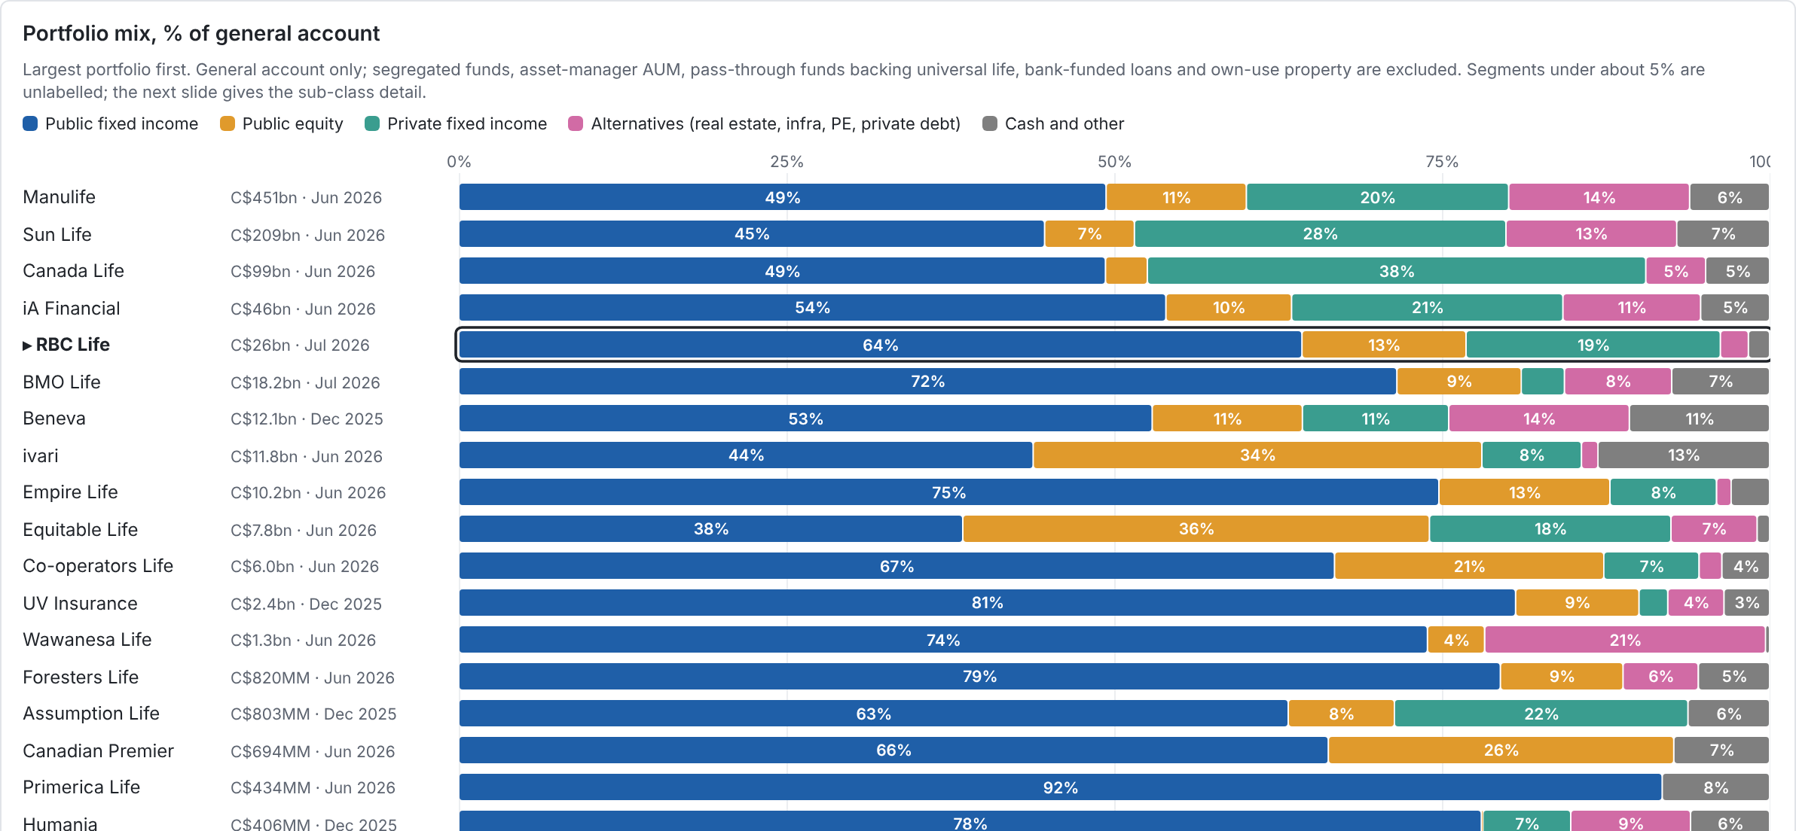
Portfolio: RBC Life is 64% public bonds with few alternatives; the big three and Equitable lean on private assets
Source: OSFI LF2 P21012 / LF1 (OSFI filers, mid-2026); Q2 2026 supplements for Manulife, Sun Life, Great-West Lifeco and iA; 2025 annual reports for Beneva, UV, Humania and Assumption Life. Desjardins' life portfolio is not published. Analysis: analysis/portfolio_composition.
9 / 21

Slide 10
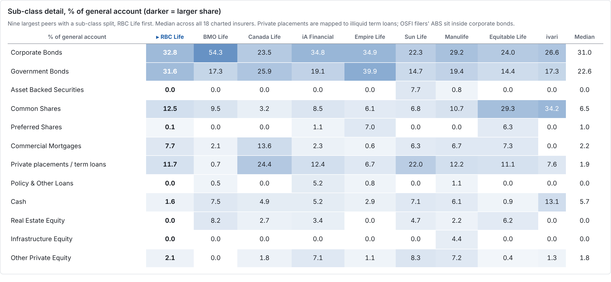
RBC Life overweights government bonds and public equity, and holds the least cash of the larger peers
Source: as previous slide. UV Insurance and Humania publish only summary statements and are not shown.
10 / 21

Slide 11
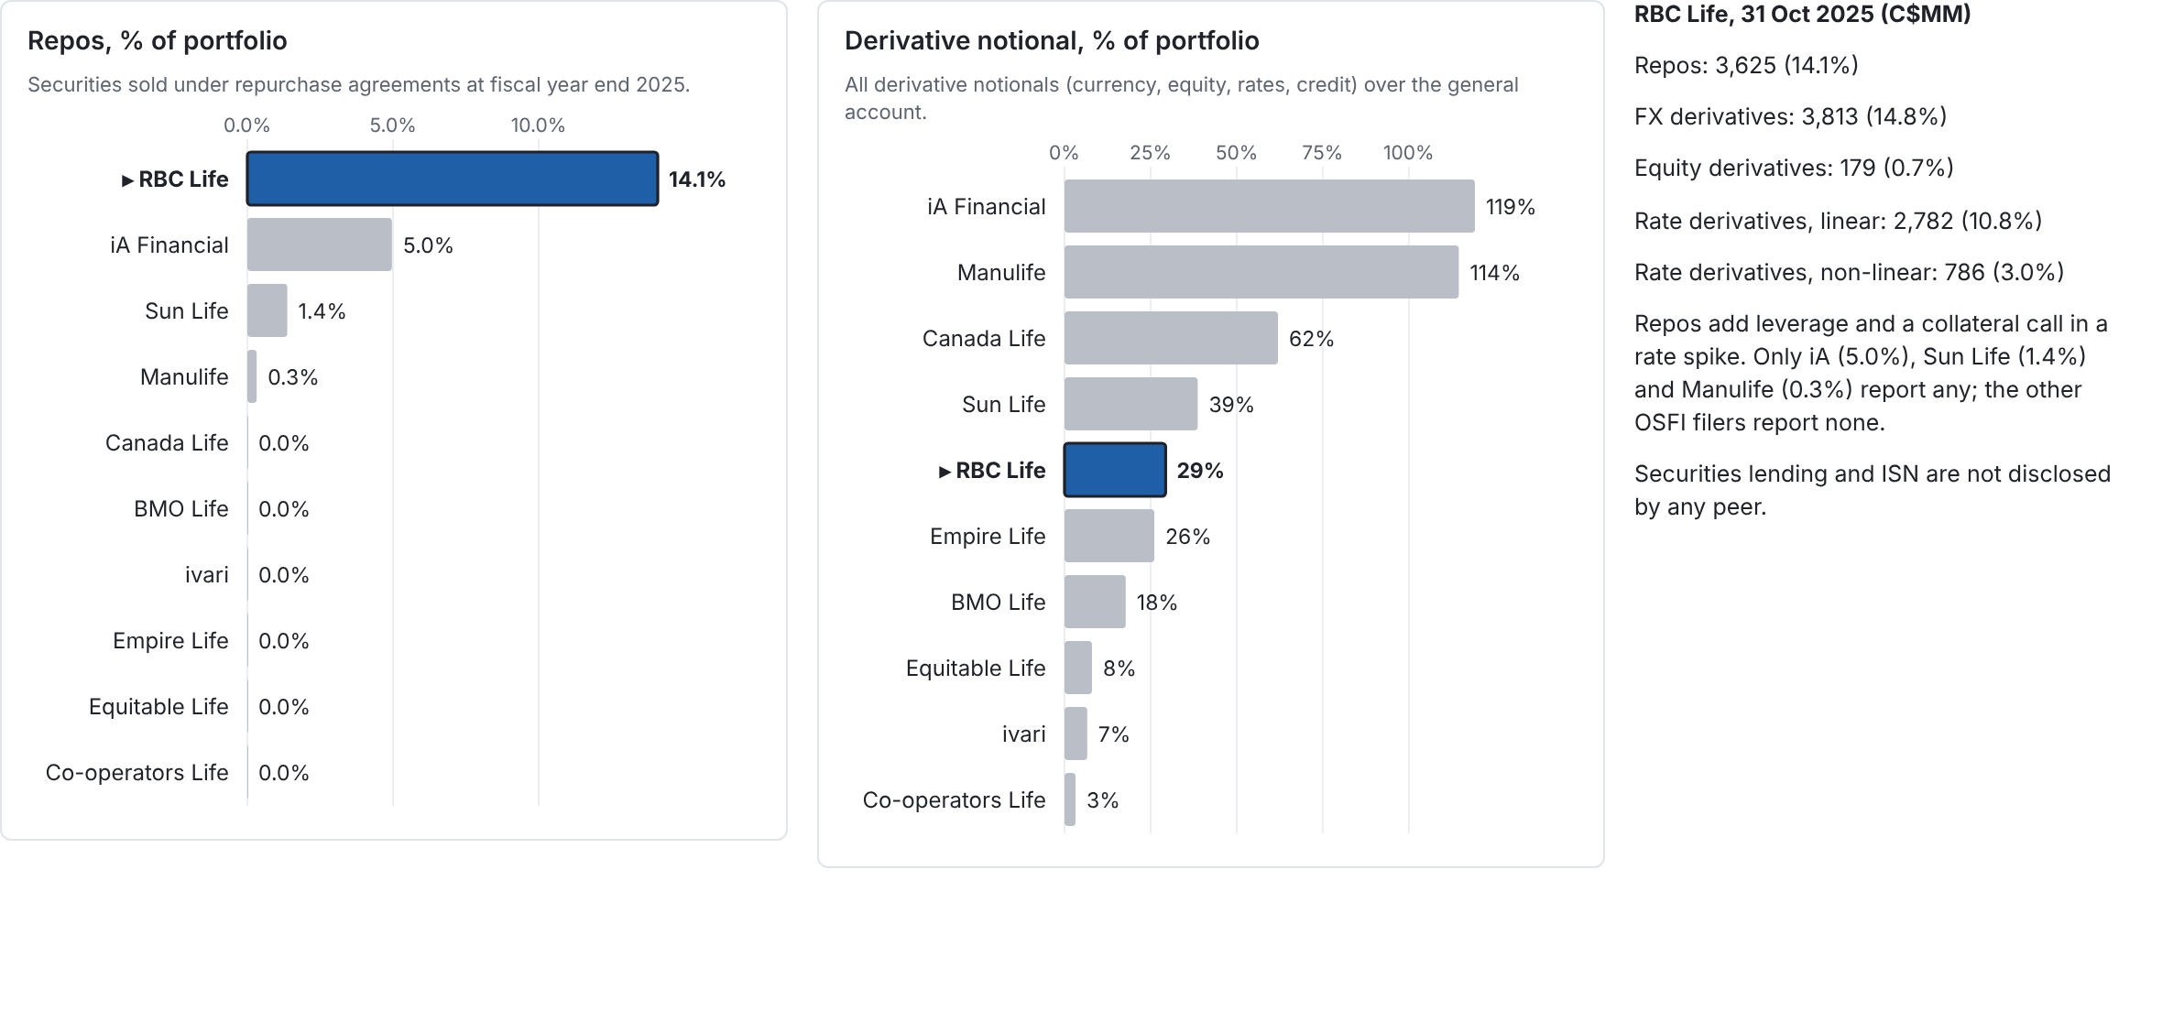
RBC Life funds 14.1% of its portfolio with repos, about 3x the next peer (iA Financial, 5.0%)
Source: OSFI LF3 P21110 derivative notionals and P22030 row 280 repos, fiscal 2025 (legal entity); iA and Manulife financial statement notes. Annual-report insurers are not covered.
11 / 21

Slide 12
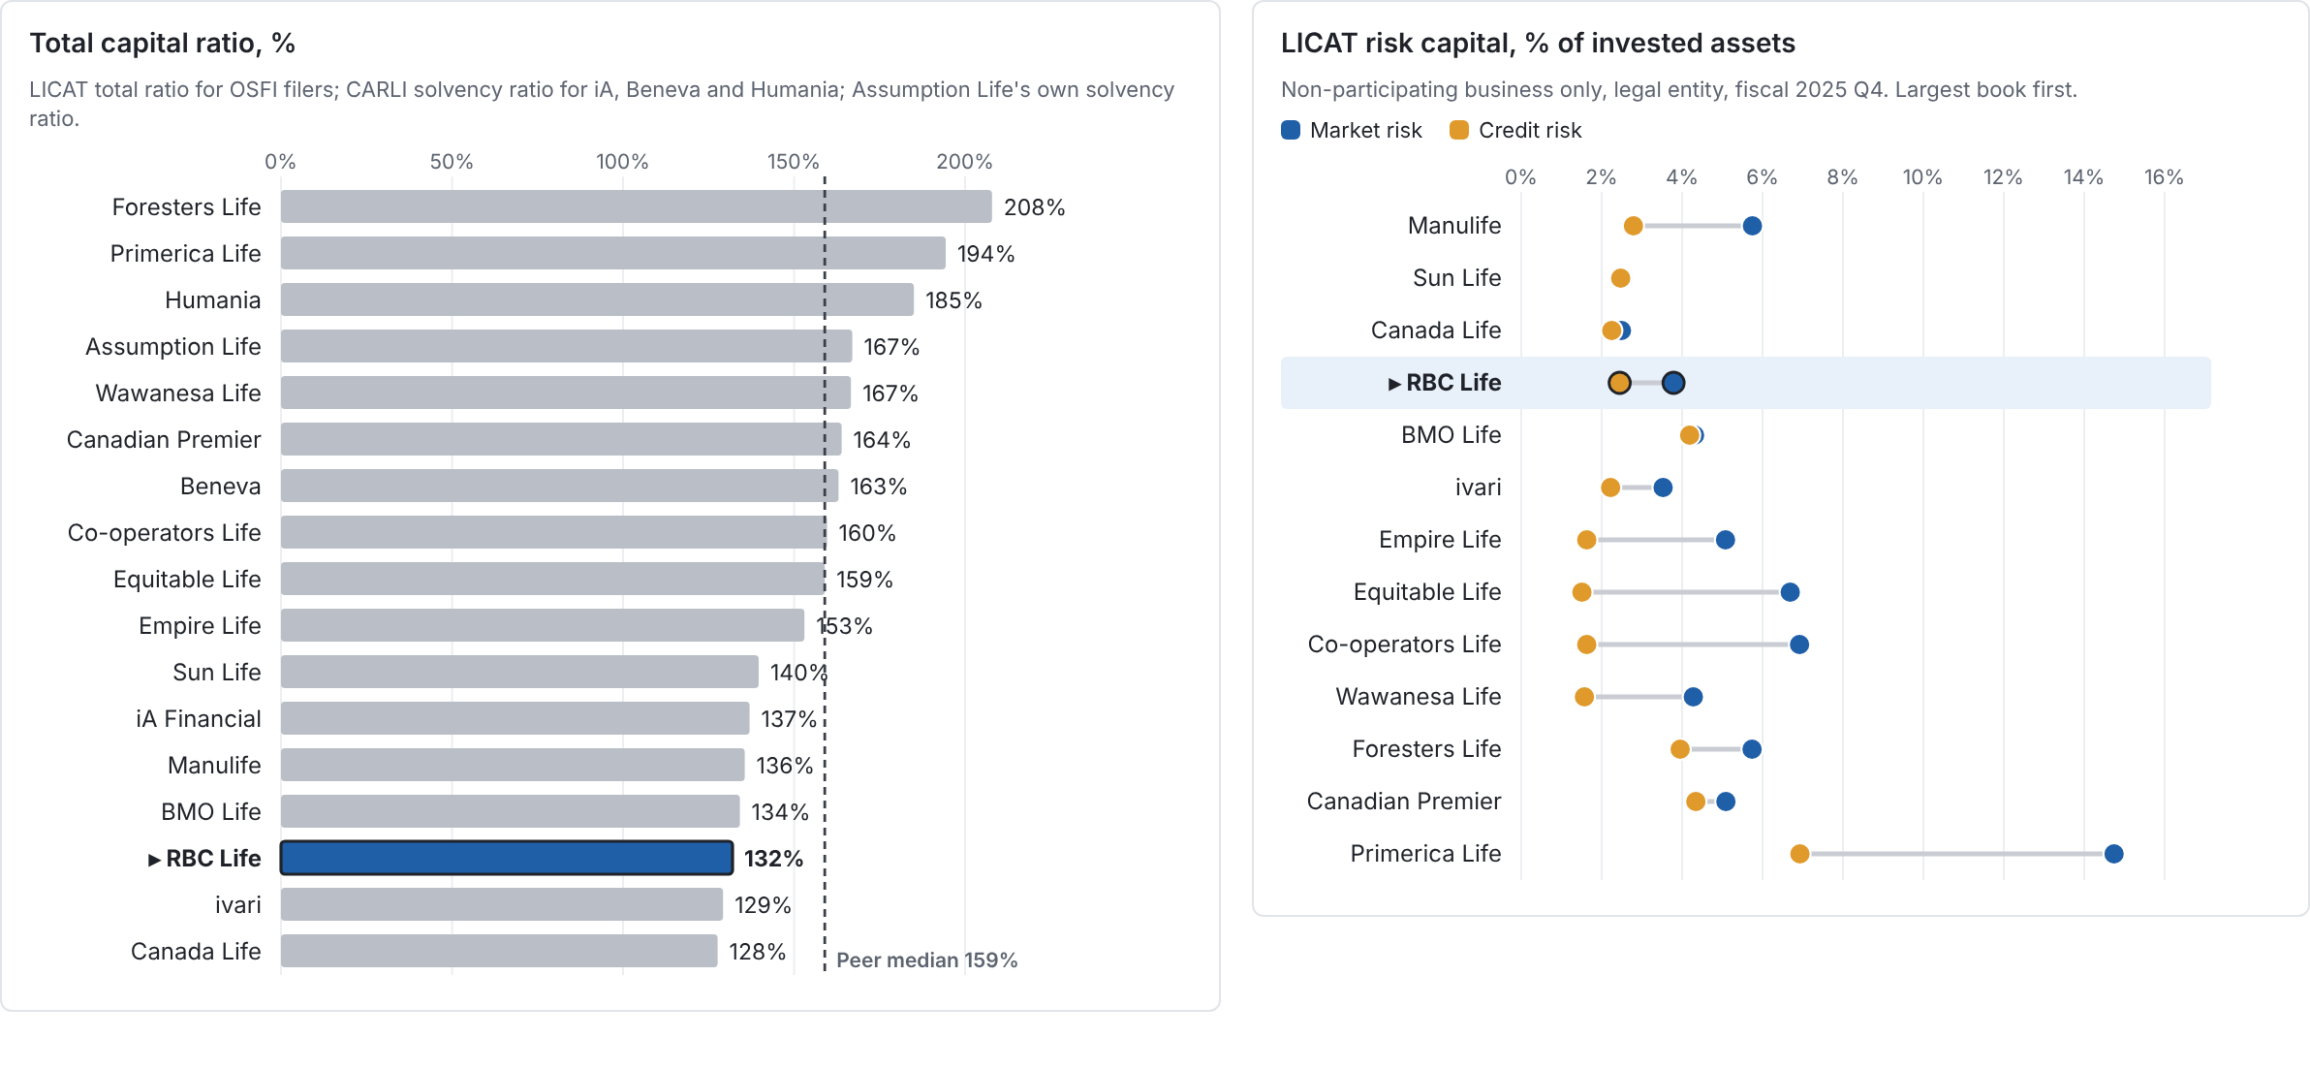
Capital: RBC Life's 132% LICAT ratio is the third-lowest of 17, 27 points below the 159% median
Source: OSFI LCQ (LICAT summary and components D3000010077 / D5000010057), FY2025 Q4 (RBC Life, BMO Life: Oct 2025); AMF and annual reports for iA, Beneva, Assumption and Humania. Analysis: analysis/investment_risk.
12 / 21

Slide 13
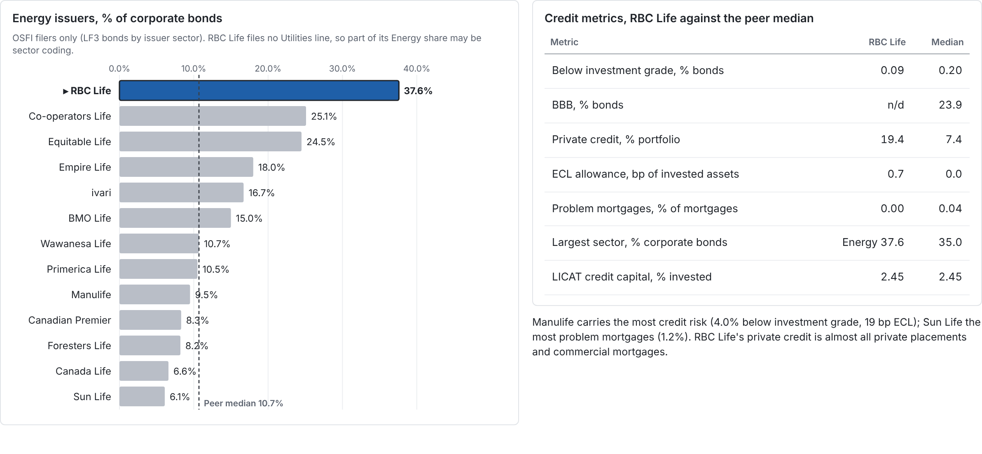
Credit: RBC Life's bonds are 99.9% investment grade, but 37.6% of its corporates are coded Energy, 3.5x the median
Source: OSFI LF3 P21030 bonds by issuer sector and P21050 problem mortgages, LF2 P21020 expected credit losses (FY2025 Q4); rating splits from year-end 2025 annual reports (RBC Life publishes none).
13 / 21

Slide 14
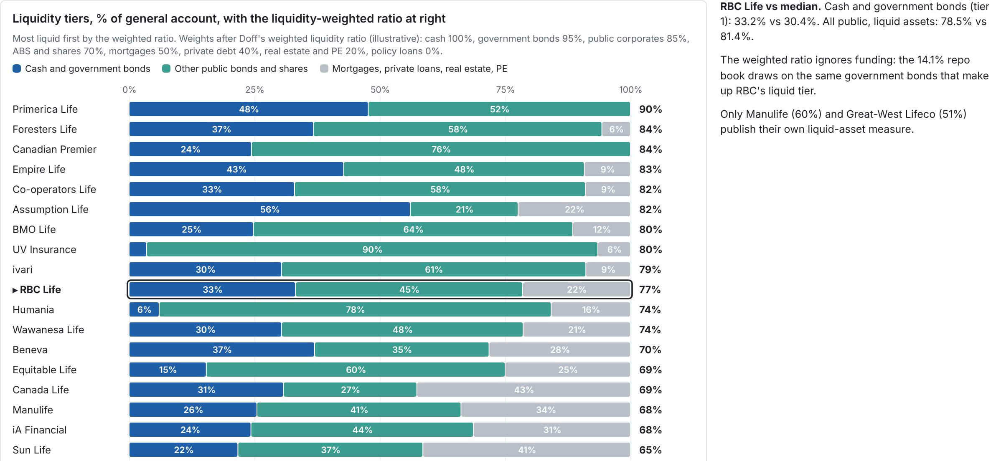
Liquidity: RBC Life's liquidity-weighted assets (77%) sit at the median (78%); the big three run the least liquid books
Source: latest general-account mix from the portfolio composition analysis; tier weights from R. Doff, Investment risks: market, credit and liquidity risk (Risk.net).
14 / 21

Slide 15
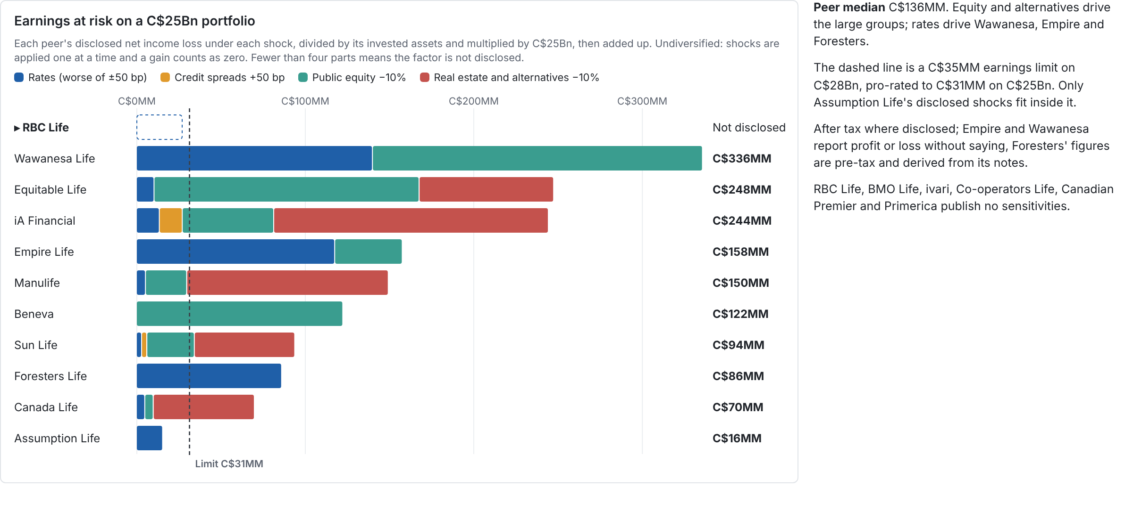
Market risk: moderate shocks cost disclosing peers C$16 to 336MM on a C$25Bn book; RBC Life publishes no sensitivities
Source: year-end 2025 MD&A and financial statement sensitivity notes, scaled to C$25Bn of invested assets; ±100 bp and −15% shocks scaled linearly. Detail: analysis/investment_risk/disclosed_sensitivities.csv.
15 / 21

Slide 16
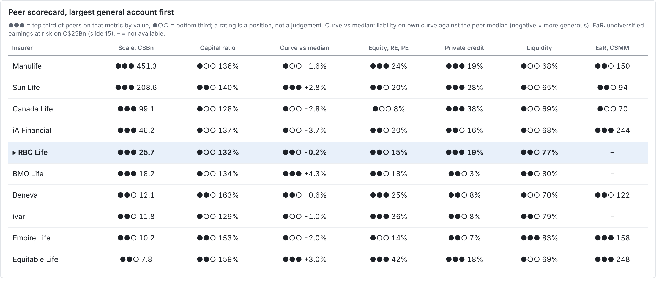
Scorecard (1/2): among the ten largest books, only Canada Life and ivari hold less capital than RBC Life
Source: slides 6, 9, 12, 14 and 15; capital ratios as on slide 12.
16 / 21

Slide 17
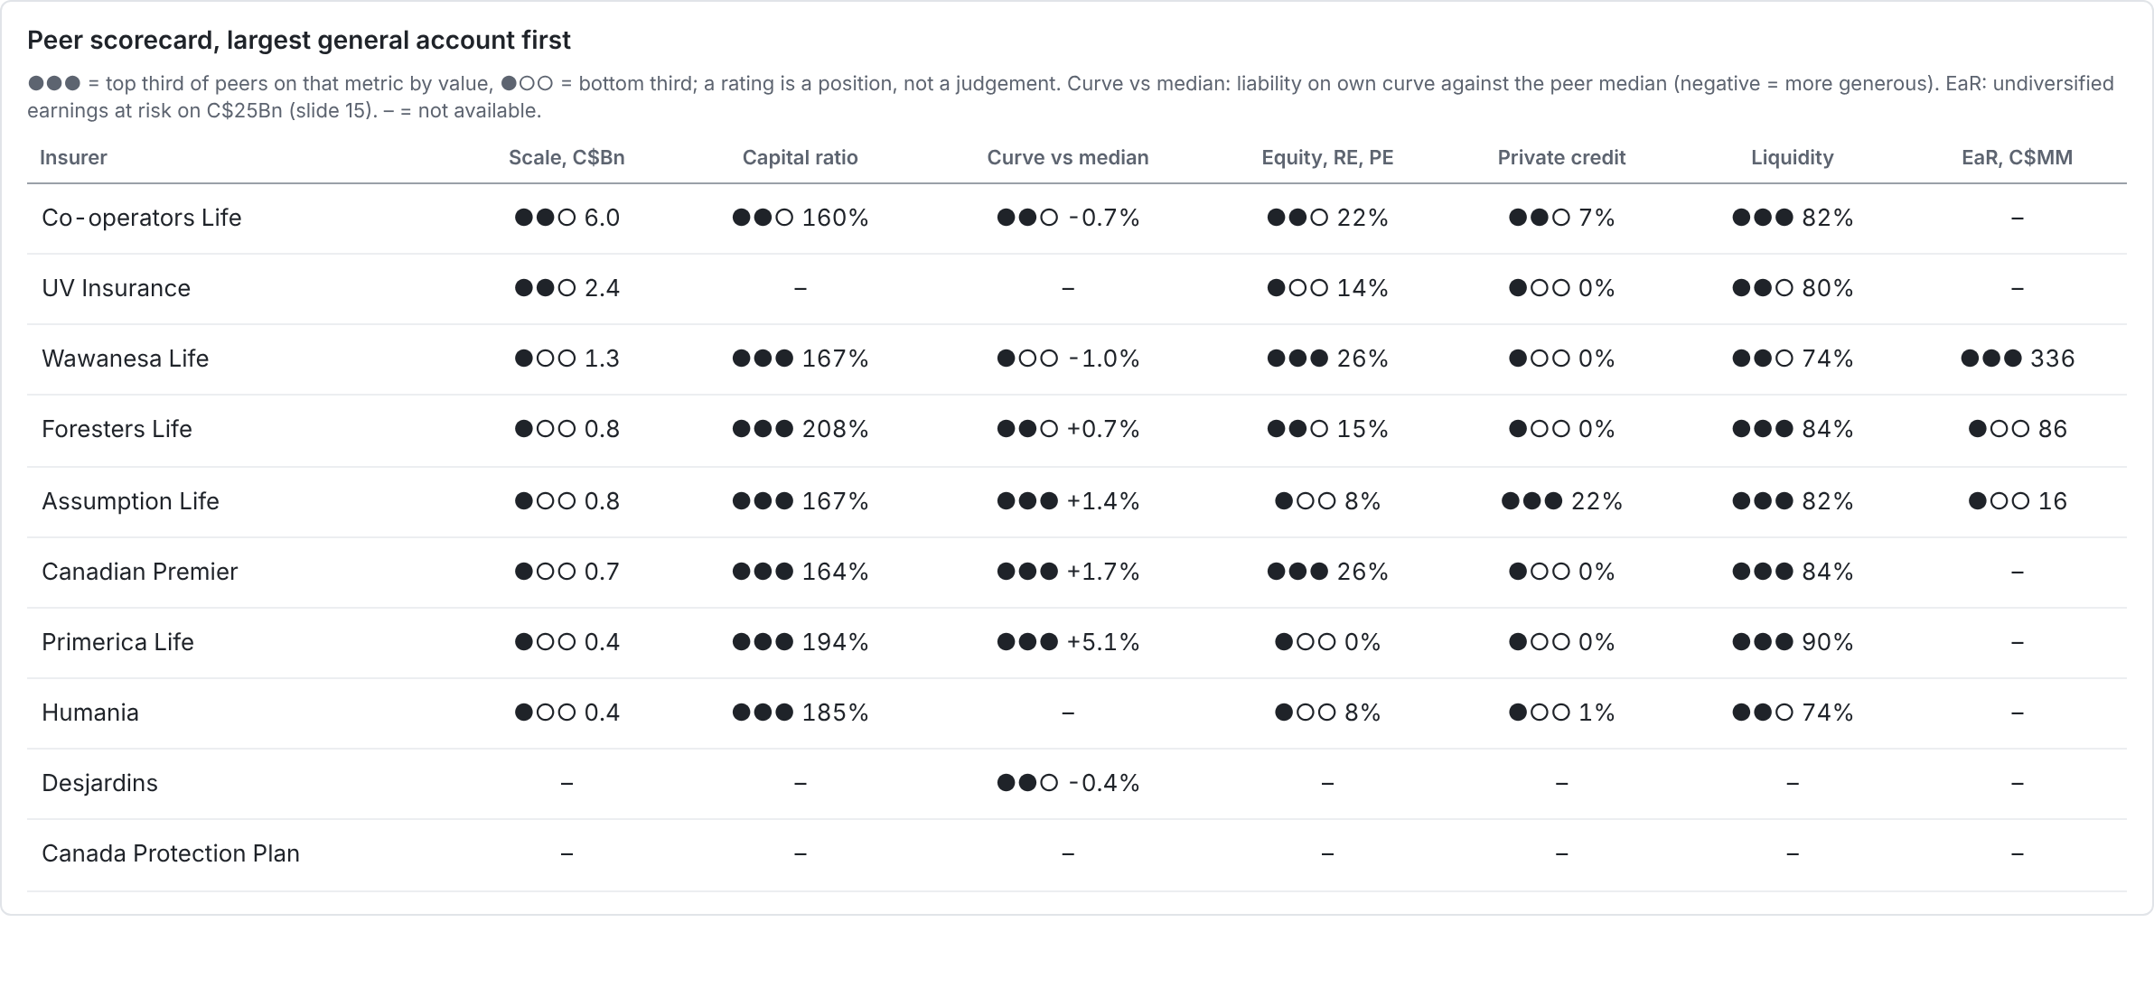
Scorecard (2/2): smaller peers hold more capital and liquidity; Wawanesa Life carries the most earnings at risk (C$336MM)
Source: slides 6, 9, 12, 14 and 15; capital ratios as on slide 12.
17 / 21

Slide 18
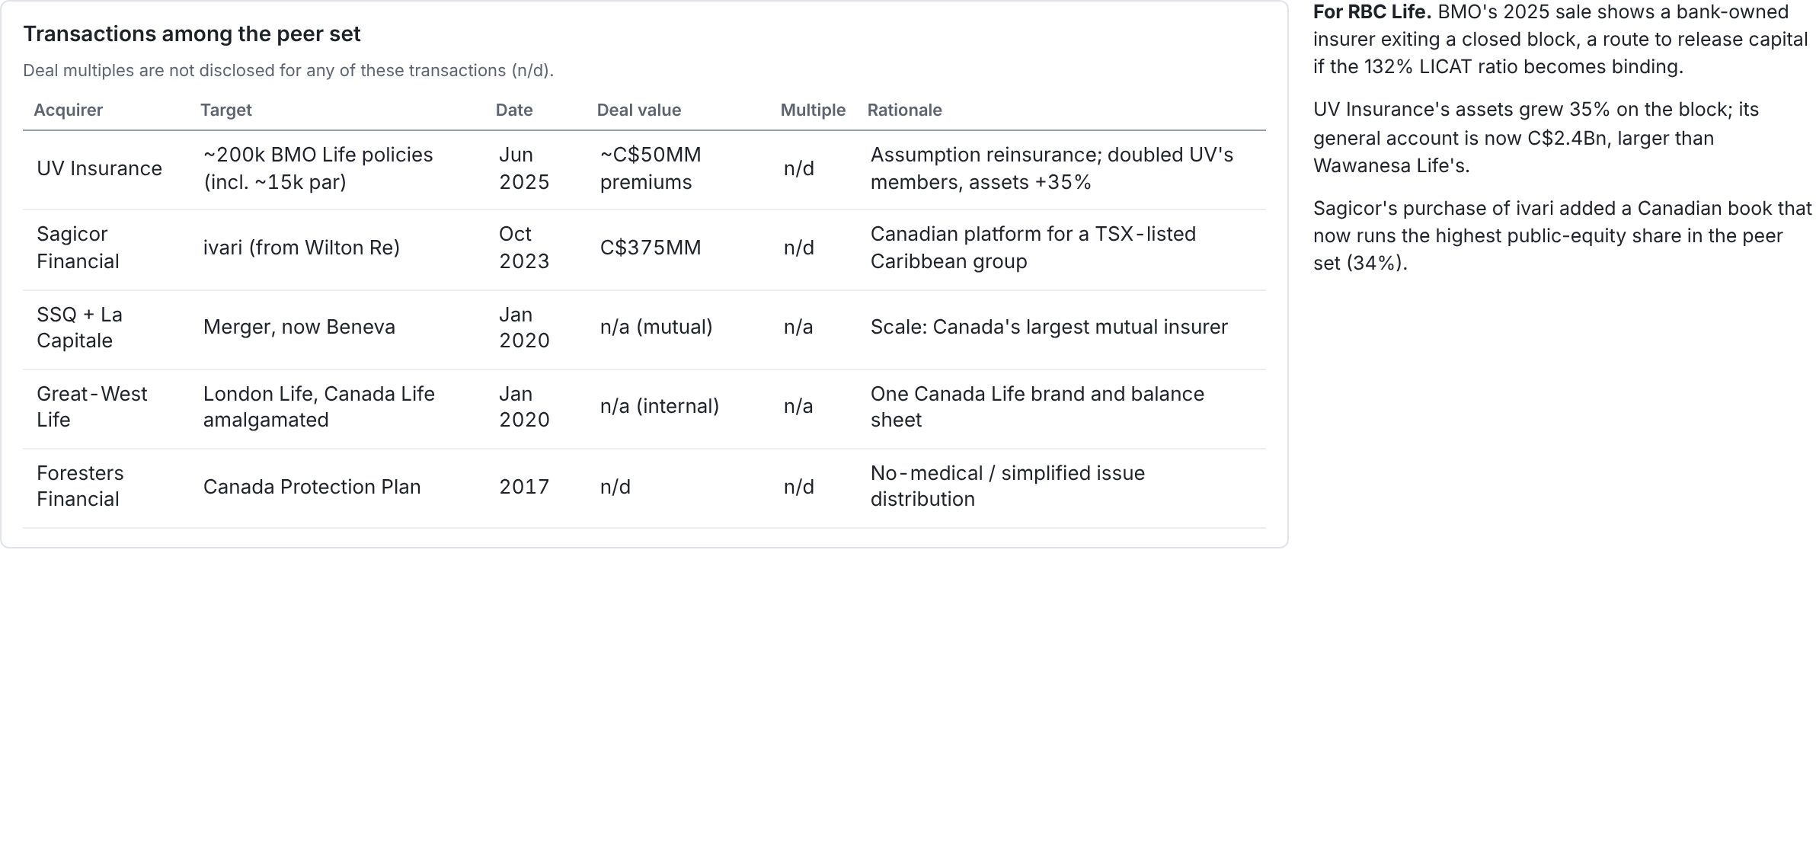
Consolidation is reshaping the tail of the peer set; bank-owned insurers are pruning non-core blocks
Source: Insurance Portal (9 Jun 2025); Sagicor press release (3 Oct 2023); Beneva and Canada Life announcements (Jan 2020); Insurance Business (Foresters and CPP).
18 / 21

Slide 19
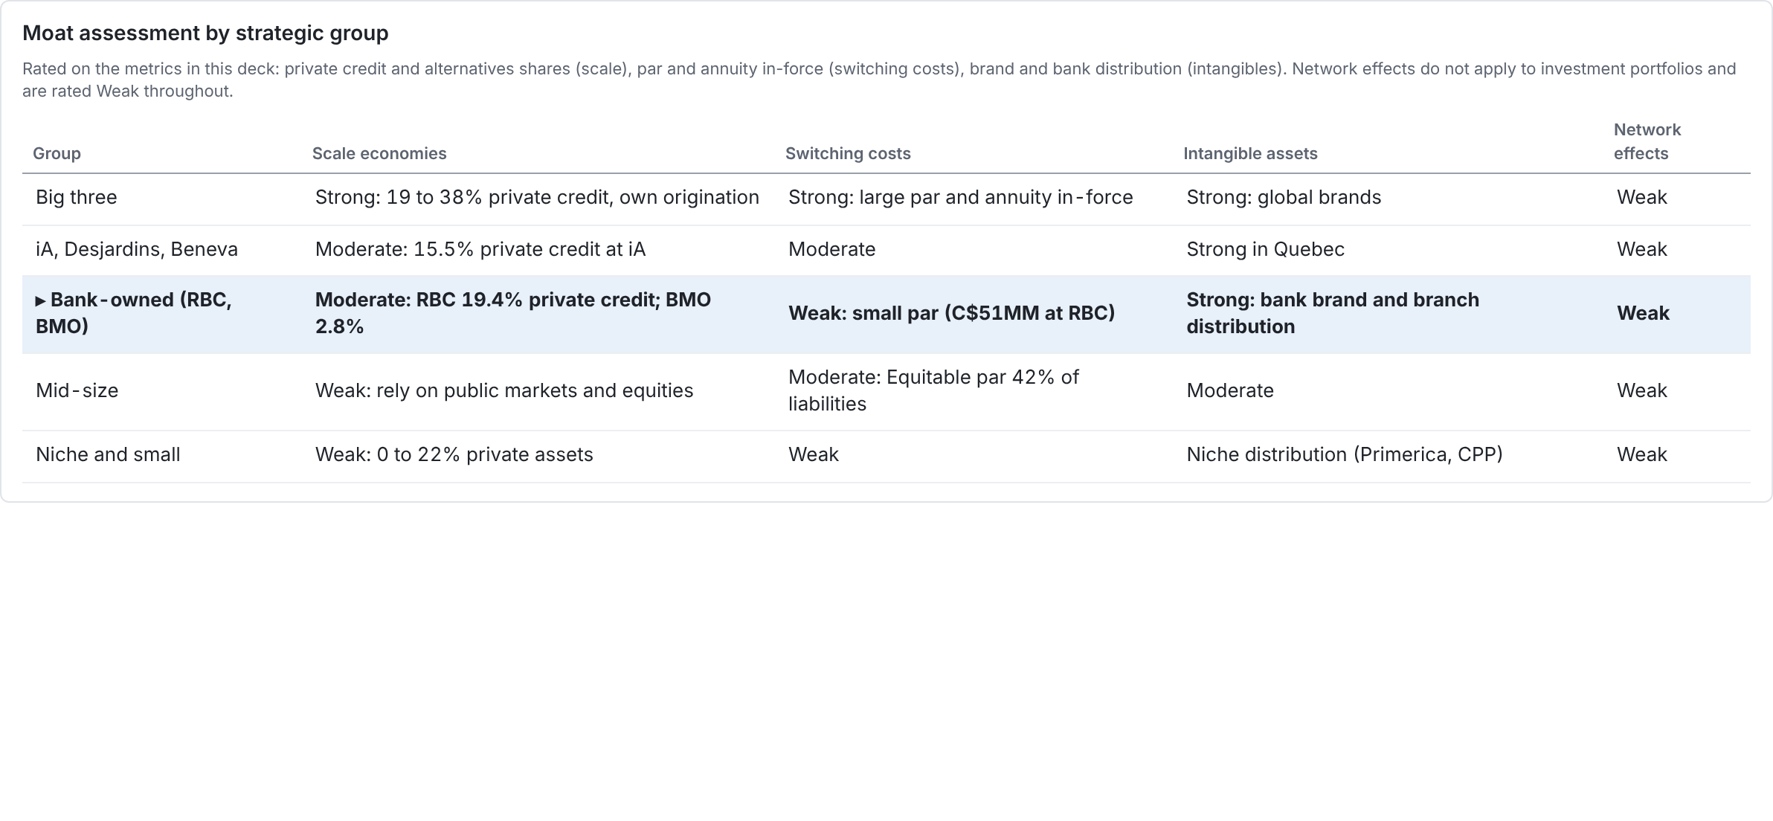
Scale is the clearest durable investment advantage: the big three originate private assets peers cannot
Source: slides 3, 8, 9 and 12. The ratings are assessments built on disclosed metrics, not disclosed figures.
19 / 21

Slide 20
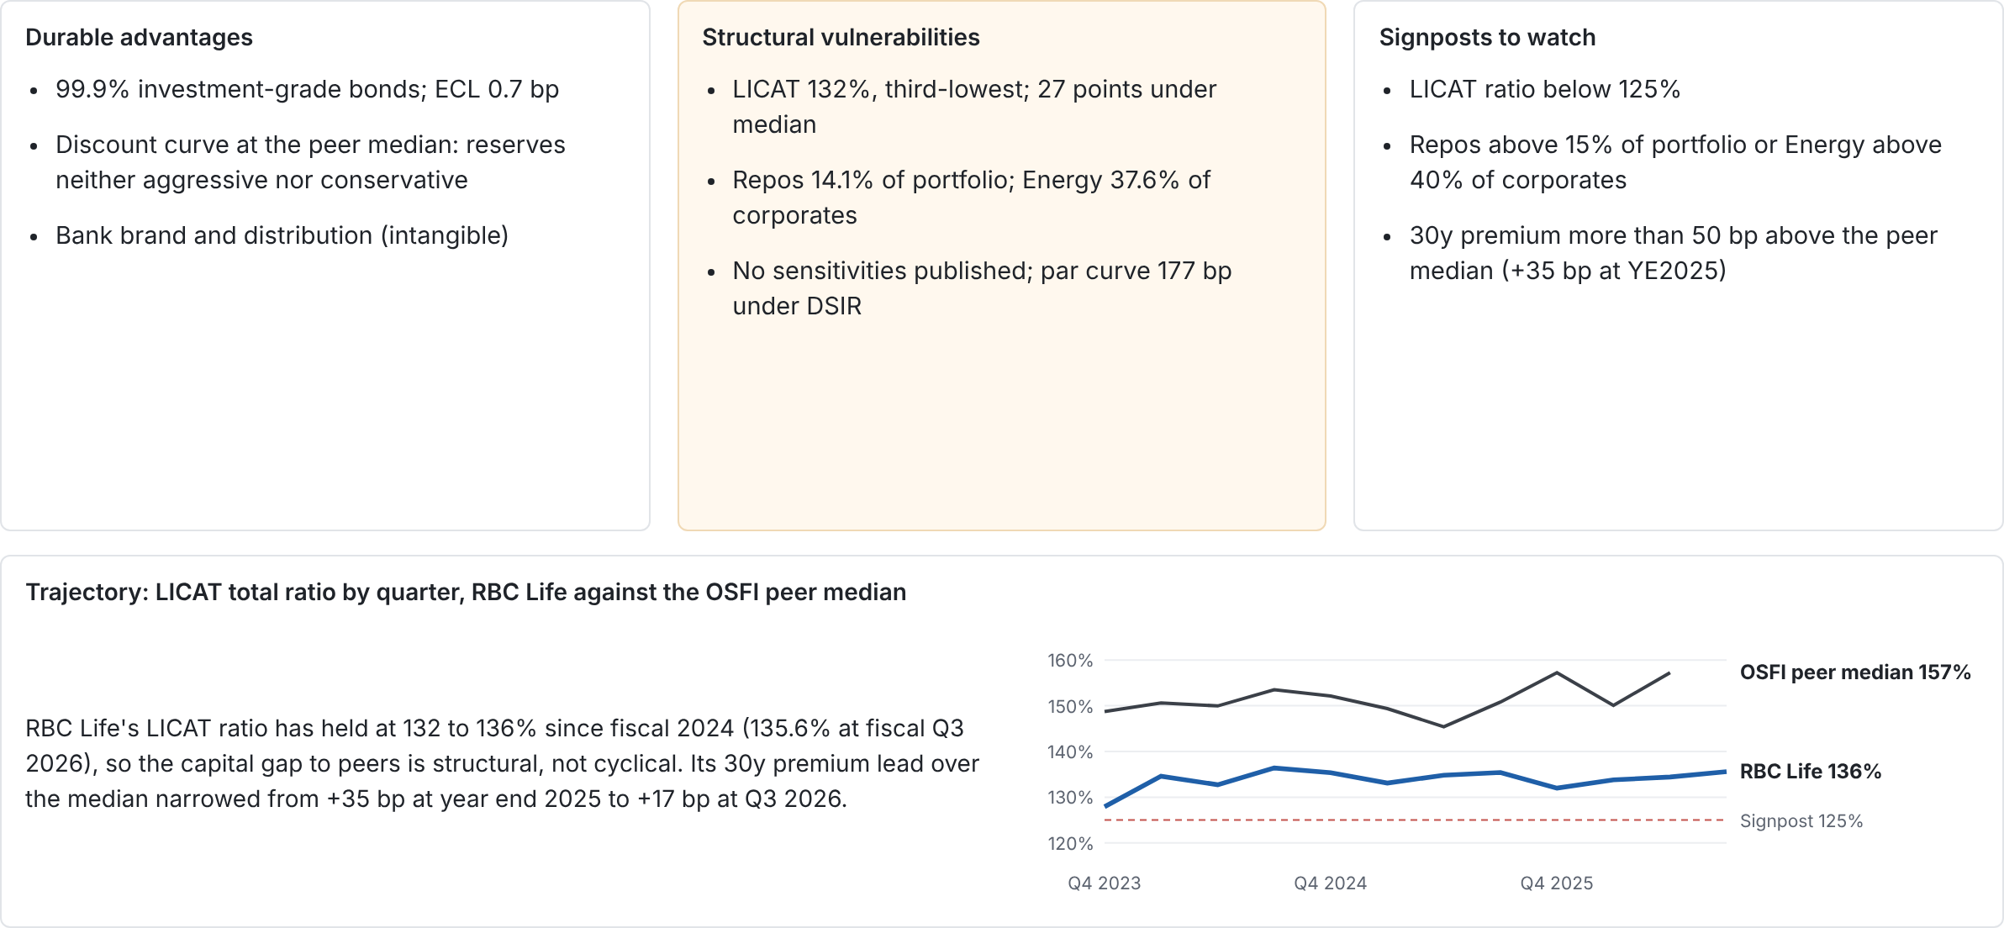
For RBC Life: defend the clean credit book, fix the capital buffer, and explain the two concentrations
Source: synthesis of slides 2 to 19; LICAT history from OSFI LCQ (one entity per insurer, fiscal quarters; RBC Life's fiscal Q3 2026 ends July 2026). Quantified signposts are proposals for monitoring, not targets set by RBC Life.
20 / 21

Slide 21
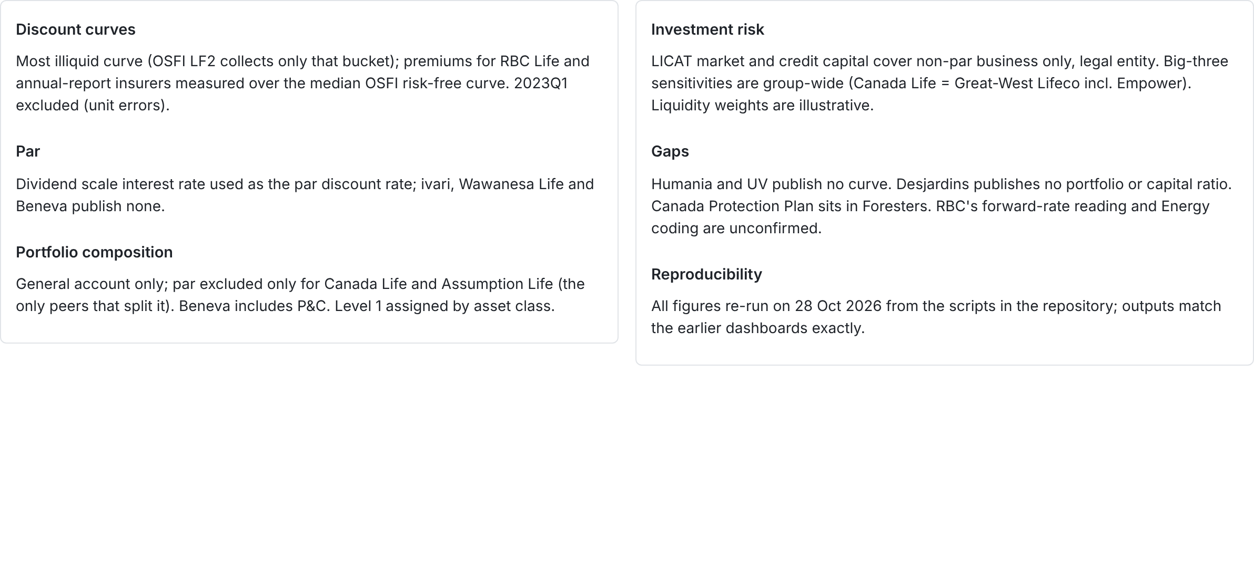
Method, coverage and caveats
Code and data: abiddobani/InsuranceCompanies, analysis/discount_curves, analysis/portfolio_composition, analysis/investment_risk, analysis/summary_deck.
21 / 21

