Slide 1
GATEKEEPER
Validate package names against PyPI & npm — before you install.
$ pip install gatekeeper-cli $ gatekeeper audit requirements.txt
typosquat detection · registry heuristics · cleaned manifests
Python 3.10+ · MIT · click + aiohttp + rich · SQLite cache

Slide 2
One keystroke from compromise
Typosquatting is a supply-chain attack: publish a package whose name is one slip away from something popular, and wait. Install hooks run code the moment a developer mistypes pip install — no exploit needed, just a typo. Gatekeeper checks every name before it is ever installed.
requests → requessts
doubled letter — 1 edit
numpy → nurnpy
'rn' renders like 'm'
lodash → l0dash
zero passes for 'o'
≤ 2 edits
150 + 150
4 folds
similarity window vs popular names
bundled top PyPI & npm packages
rn↔m · 0↔o · l↔1 · r↔rn

Slide 3
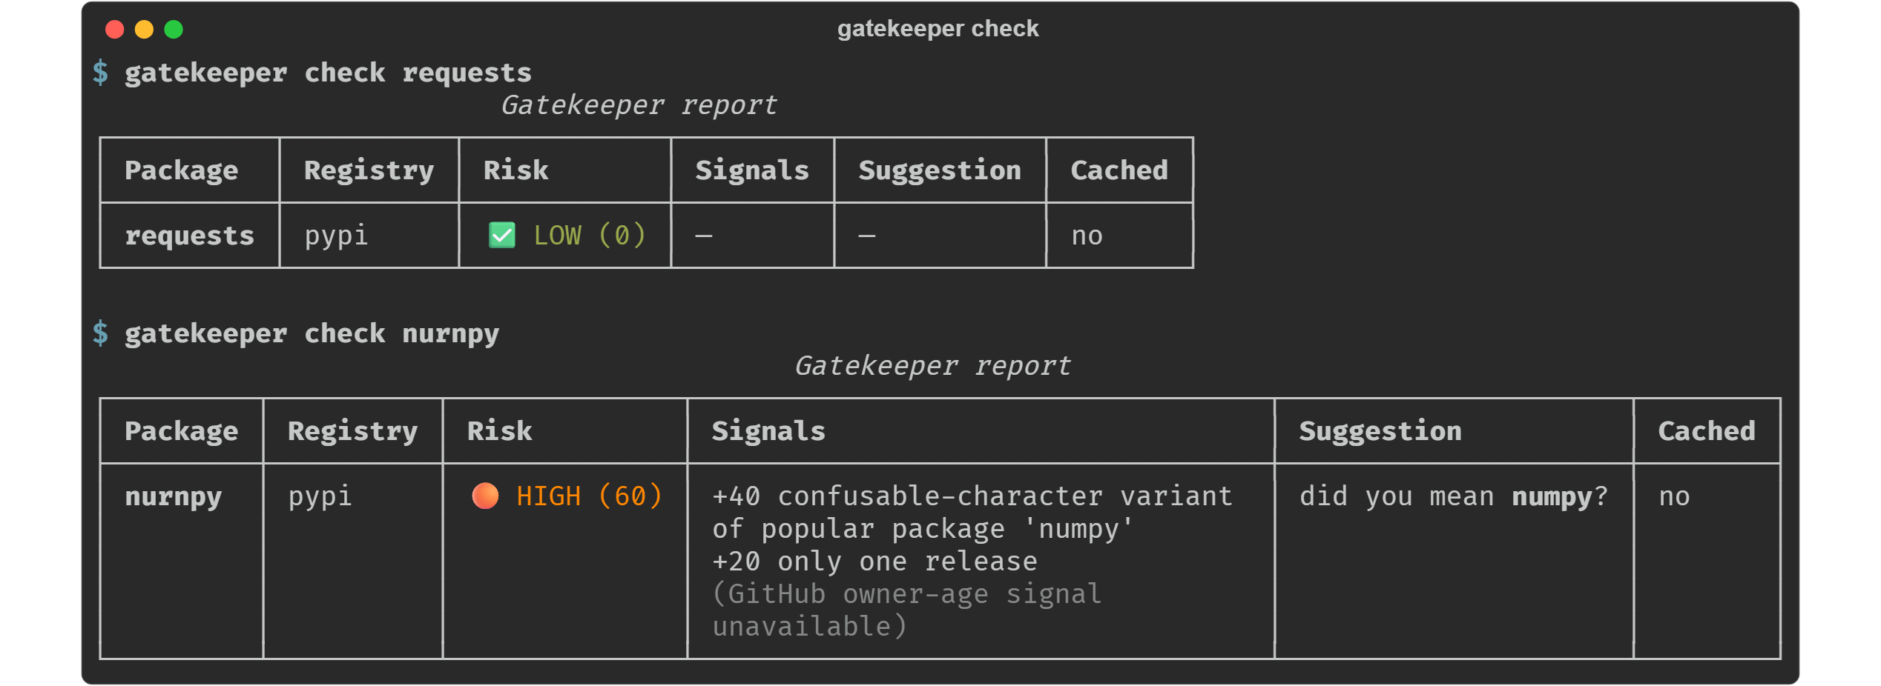
It catches real ones
Live run, unedited: nurnpy really exists on PyPI. Gatekeeper flags it HIGH (60): confusable-character variant of numpy (+40), single release (+20) — and still tells you what you probably meant.

Slide 4
Auditable scoring — fixed points, inclusive bands
Signal | Pts | Trigger
SUBSTITUTION_PATTERN | 40 | confusable collision (rn↔m, 0↔o, l↔1)
TYPOSQUAT_DISTANCE_1 | 40 | 1 edit from a popular package
TYPOSQUAT_DISTANCE_2 | 25 | 2 edits from a popular package
NEW_PACKAGE | 30 | first release < 7 days ago
SINGLE_RELEASE | 20 | exactly one release
FEW_RELEASES | 10 | 2–4 releases
YOUNG_GITHUB_OWNER | 15 | repo owner account < 90 days old
CRITICAL
80 – 100
HIGH
60 – 79
MEDIUM
40 – 59
LOW
0 – 39
Points are summed and capped at 100. At most one similarity signal applies per package.
no score for not-found / lookup-error packages — they get their own status

Slide 5
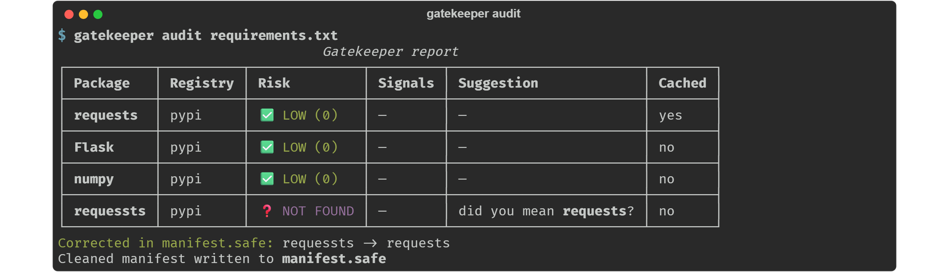
Audit a manifest, ship a clean one
requirements.txt
→
gatekeeper audit
→
manifest.safe
Correction policy: only unambiguous typos — names that do not exist on the registry but sit within 2 edits of a popular package — are rewritten. A look-alike that exists is flagged for a human, never silently renamed.

Slide 6
Engineering under the hood
[ aiohttp ]
[ sqlite ]
Resilient by default
Concurrent-safe cache
10 s timeout, 3 attempts with exponential backoff on 429/5xx, honors Retry-After. Timeouts, 4xx and malformed JSON degrade to a status in the report — never a crash.
WAL mode + busy retry at ~/.gatekeeper/cache.db. 24 h TTL; top-50 packages pinned forever; LRU eviction past 500 entries runs inside one BEGIN IMMEDIATE transaction — single-writer by construction.
[ prefetch ]
[ honesty ]
Fire-and-forget warmup
Only real signals
Checking torch quietly prefetches torchvision & torchaudio from a static co-occurrence map. Output renders first; stragglers get 2 s of grace, then cancellation. Failures are logged, never raised.
Every score maps to a real API field (releases upload times, time.created, versions…). Maintainer account age isn't exposed by PyPI/npm — so it's a GitHub-owner fallback, marked unavailable when absent.

Slide 7
Built for CI
exit codes
0 clean · 1 on HIGH/CRITICAL or not-found · --strict fails on lookup errors too
# .github/workflows/deps.yml steps: - run: pip install gatekeeper-cli - run: gatekeeper audit \ requirements.txt --json # exit 1 blocks the merge
--json
stable, versioned schema (schema_version: 1) for machine parsing
pipeline
GitHub Action runs ruff + pytest across Python 3.10 / 3.11 / 3.12
docker
slim two-stage image; mount a volume to persist the cache
108 tests · zero live network in tests · ruff clean
github.com/abidedavana/Gatekeeper

