Slide 1


ALY 6080: XN Project
CoverQuick Data Analysis
May 31, 2023
Presented by:
Abhilash Dikshit
Kush Patel
Siddharth Alashi
Submitted to:
Dr Chinthaka Pathum Dinesh, Prof Herath Gedara, Faculty Lecturer
Notes:
Abhi

Slide 2

About Sponsor
An AI-based programme called CoverQuick creates unique cover letters and resumes for job applications.
Products : Prepare Resume , CoverLetter, Track Application, Resume Grader
Number of Users : 5000 users (Ref till September 2022 )
EXPLORATORY DATA ANALYSIS (EDA)
DATASETS PROVIDED:
WITH JOB DESCRIPTION
WITHOUT JOB DESCRIPTION
Notes:
Abhi

Slide 3
Research Questions:
Planning and Execution
1. What are the three industries that the majority of CoverQuick's users have applied (No Job Description Dataset) and will apply to (With Job Description Dataset)?
2. Discover trends in demographics and find which industries yield the best and the worst resumes (CoverQuick provides metrics for defining a "Good" resume).
3. Determine the expected age and approximate experience level.
4. Determine trends in experience and skills for these target users.
EDA on no job description dataset as well as on with job description dataset.
Dataset splitting for the respective columns which were in json and nested json format.
Identification and visualization for the top 3 industries that the majority of users have applied.
Identification and visualization for the approximate age range and experience level.
Identification and visualization for the trends in experience and skills for these target users.
Identification and visualization to discover the trends in demographics for the number of candidates registering to the website across globe for resume building.
(Note: For presentation, we have shown for no job description dataset analysis only)
Notes:
Abhi

Slide 4
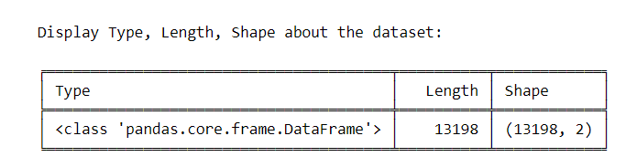
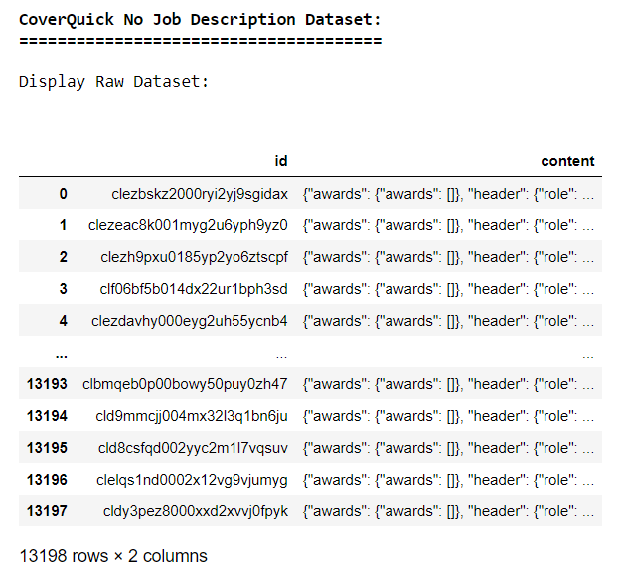
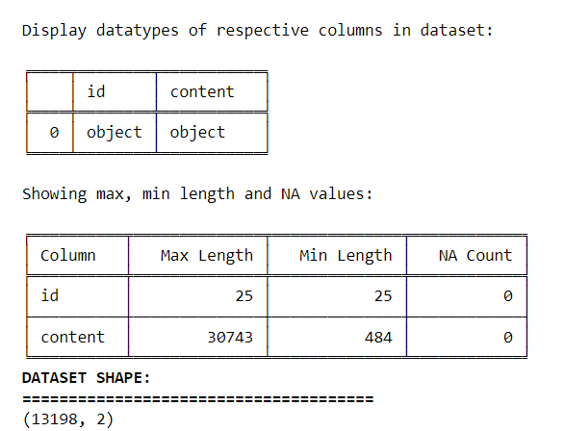
EDA : NO JOB DESCRIPTION DATASET
Fig: Display of Raw Dataset
Notes:
Abhi

Slide 5
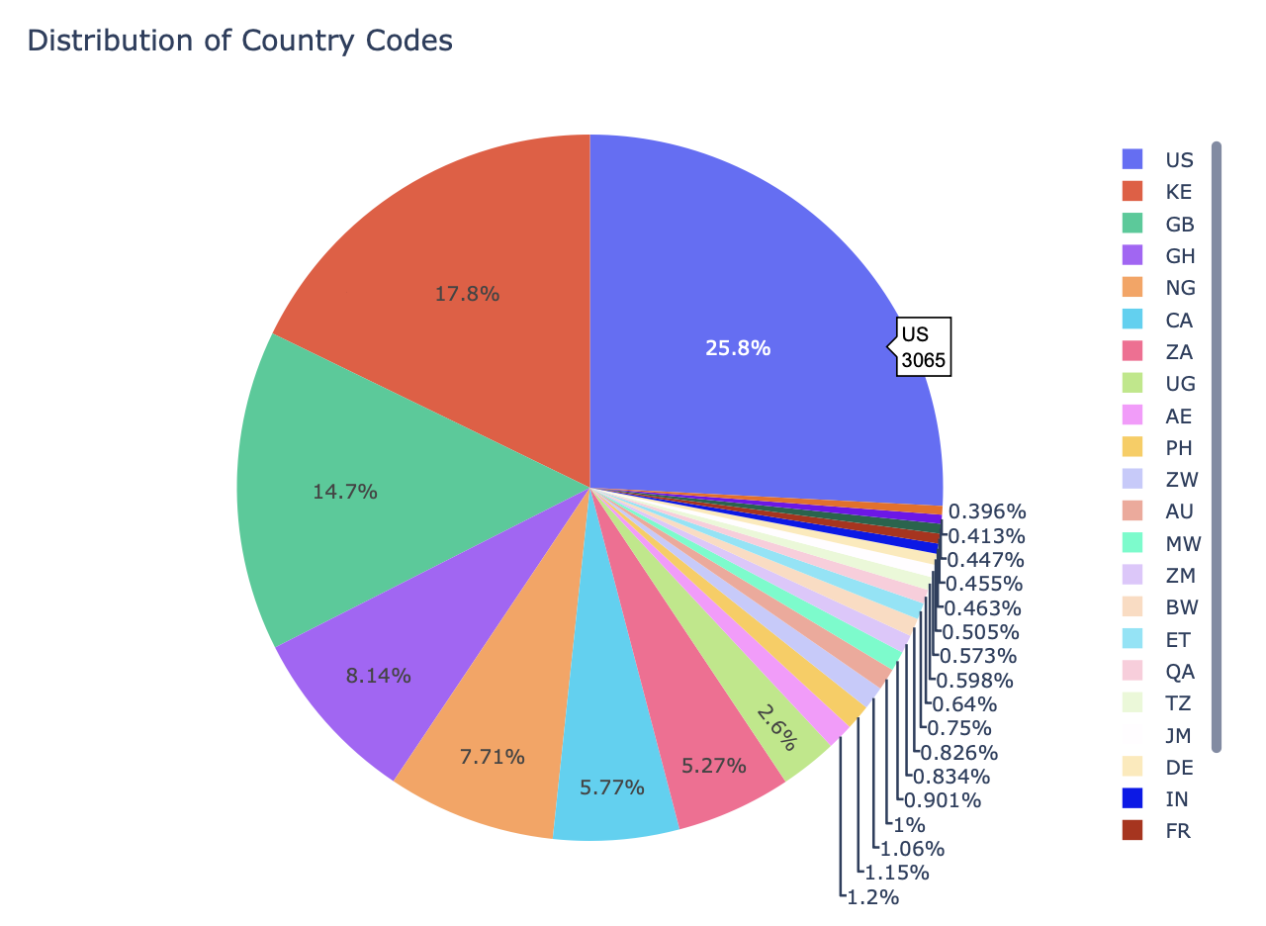
Distribution of Country Codes w.r.t ID
Demographics Explanation:
Top 3 countries as per number of users
United States has maximum user: 25.8% of total user : 3065 applicants
Kenya (KE) has 17.8% :2113 applicants
Great Britain (GB) : 14.7% : 1714 number of applicants
Least Number of users
NA : Other Country : 0.396% : 47 Applicants
SL (Sierra Leone): 0.413% : 49
Malaysia (MY): 0.447% : 53
Notes:
Abhi

Slide 6
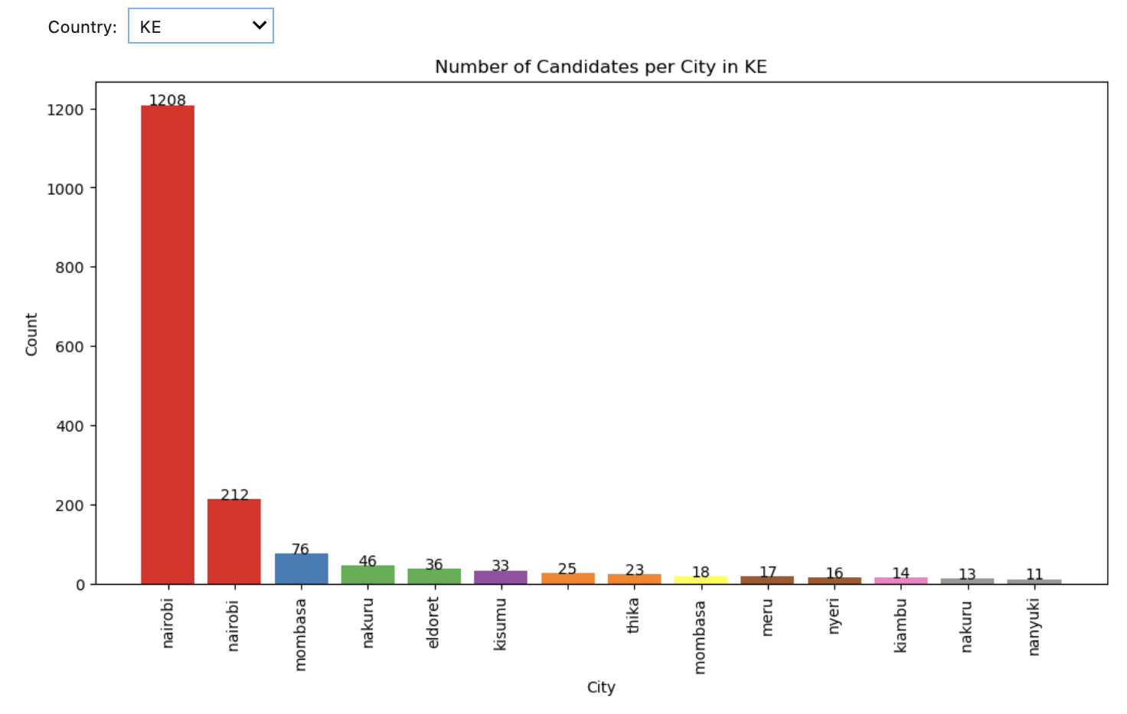
Number of Candidates per City in respective Countries
We can determine how many users have registered to CoverQuick’s website for resume building by specifying the countries from the drop down
Nairobi with 1208 users
Mombasa : 212 users
Least number of users in Kenya
Nakuru, nanyuki cities.: 13, and 11 respectively
Notes:
Abhi

Slide 7
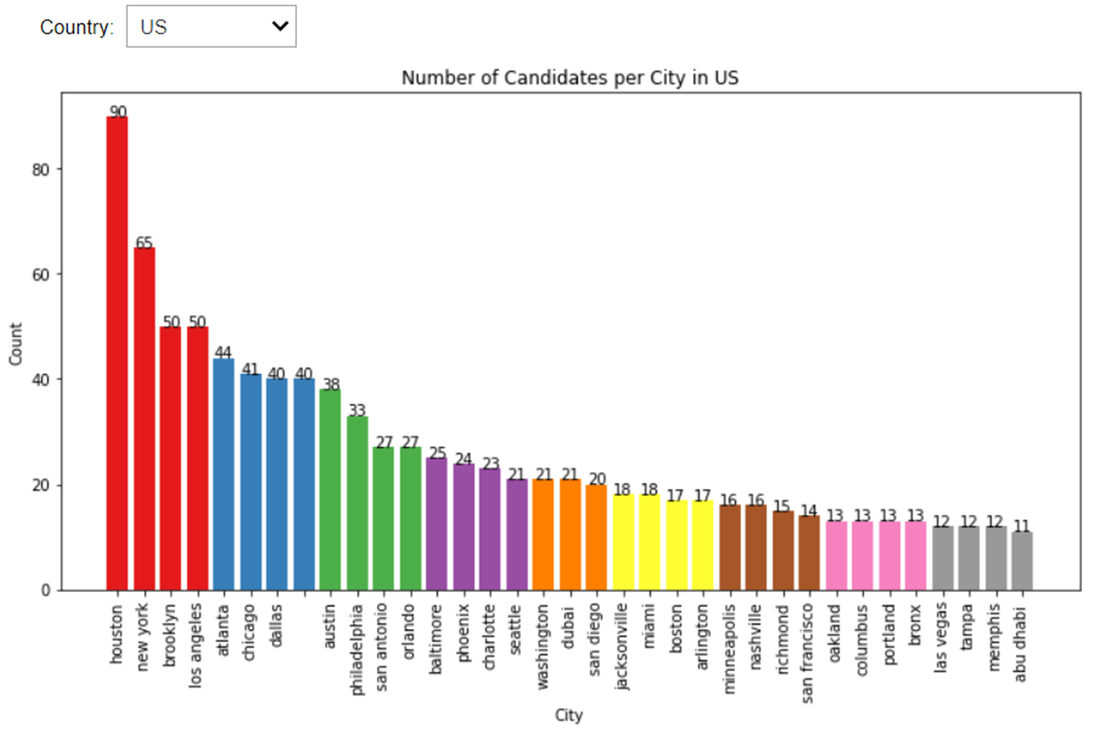
Number of Candidates per City in United States of America
Houston with 90 applicants
New york : 65 applicants
Brooklyn, Los Angeles : 50
Least users
Tampa, Las Vegas, Memphis: 12 applicants
Notes:
Abhi

Slide 8
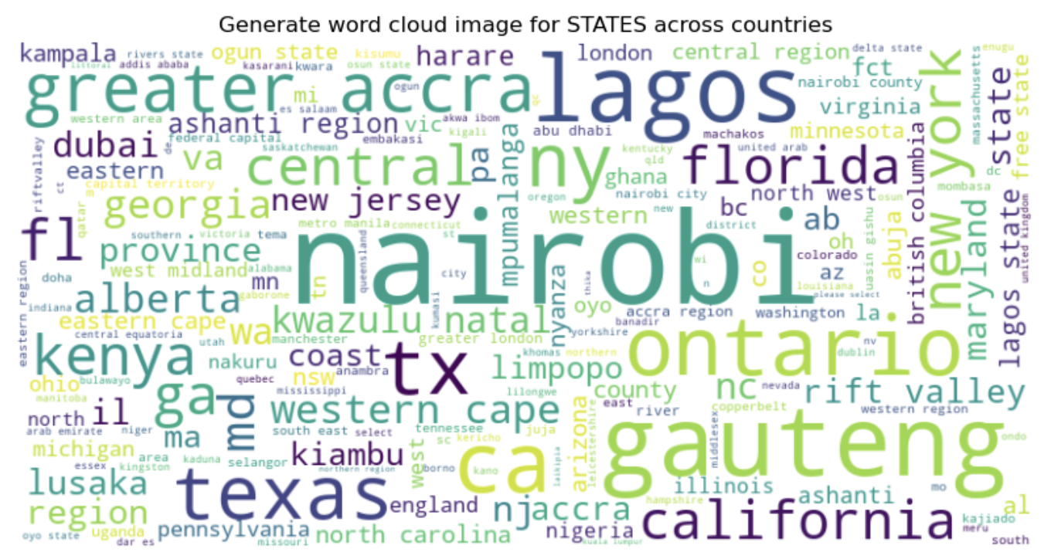
Generate word cloud image for STATES across countries
Nairobi, Lagos, Texas, Ontario, Gauteng are the Provinces, States applicants in the worldwide
Delta states, mefu south, dar es, are the provinces which has less number of applicants
Notes:
Abhi

Slide 9
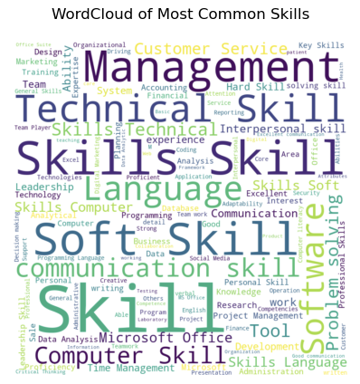
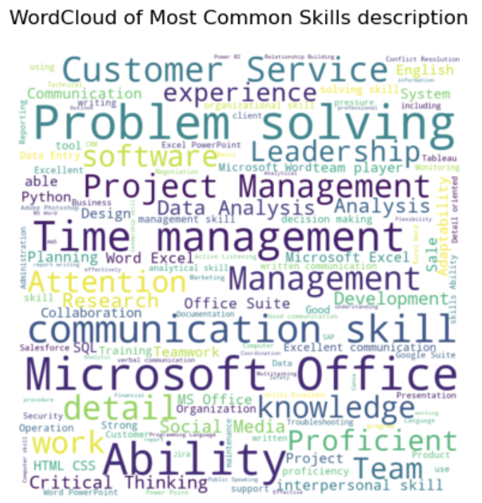
WordCloud of Most Common Skills and Skills description
Common Skills Among the users
Management
Technical skills
Soft Skill (good communication, leadership skills, interpersonal skills)
Language
Computer Skill
Software
Skills as per Description
Customer Service
Problem Solving
Time Management
Microsoft Office
Competitive Skills required : SQL, Critical thinking, Data Analysis, Analysis
Notes:
Abhi

Slide 10
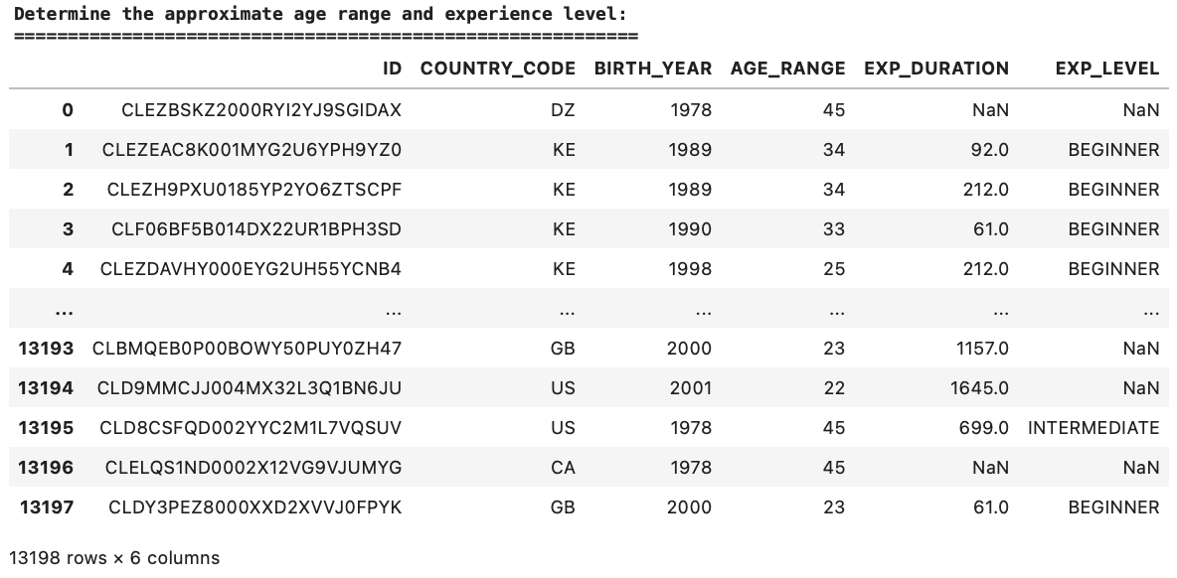
Determine the approximate age range and experience level
Predefined duration thresholds are established in order to classify experience levels. These levels are classified as 'BEGINNER' for experience durations up to 1 year (365 days), 'INTERMEDIATE' for durations ranging from 1 to 2 years (365 to 730 days), and 'ADVANCED' for durations between 2 to 3 years (730 to 1095 days).
Subsequently, the DataFrame is modified to incorporate an additional column called 'EXP_DURATION', which denotes the duration of experience calculated in days. Additionally, an 'EXP_LEVEL' column is introduced, which classifies the experience level based on predefined thresholds.
By presenting these columns, one can observe the commencement and termination dates of experience, the calculated duration in days, and the assigned level of expertise for each candidate.
Notes:
Abhi

Slide 11
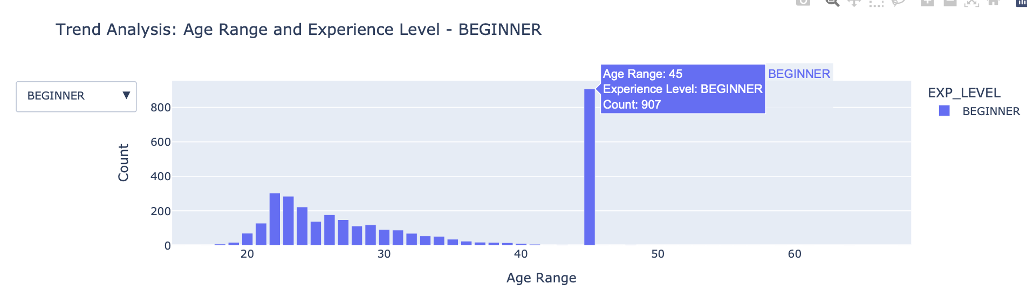
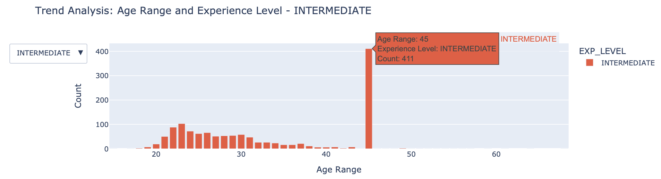
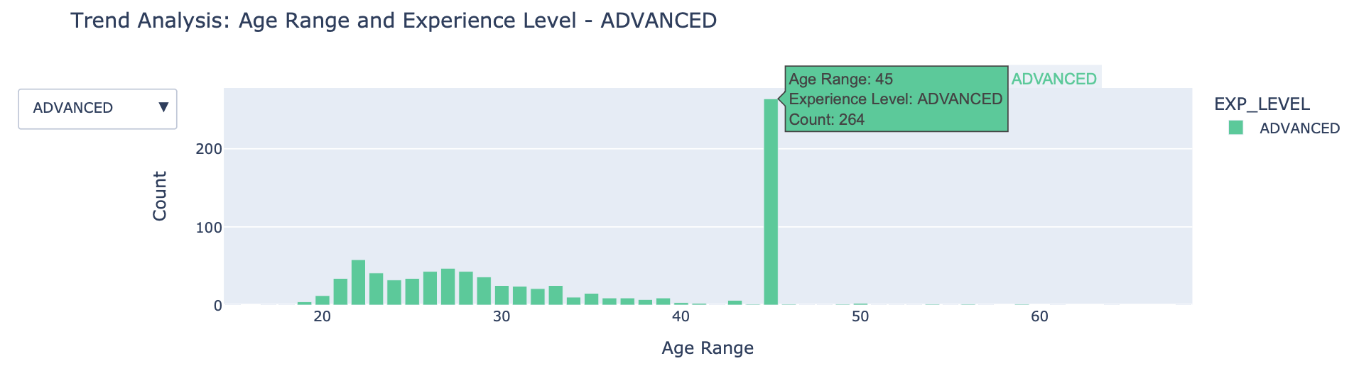
Determine the expected age and experience level
The x-axis represents the age ranges, ranging from 18-24, 25-34, 35-44, 45-54, and 55+. The y-axis represents the count of candidates. Each bar in the chart is segmented into different colors representing different experience levels.
By selecting different experience levels from the dropdown menu, the chart dynamically updates to show the trend analysis specifically for that experience level. The title of the chart also changes accordingly to provide focused insights.
Hovering over each bar provides additional information, including the specific age range, experience level, and the corresponding count of candidates.
The visualization aims to provide a clear and visually appealing representation of the distribution of candidates across different age ranges and experience levels, allowing for a quick and comprehensive understanding of the trends in your project data.
Notes:
Abhi

Slide 12
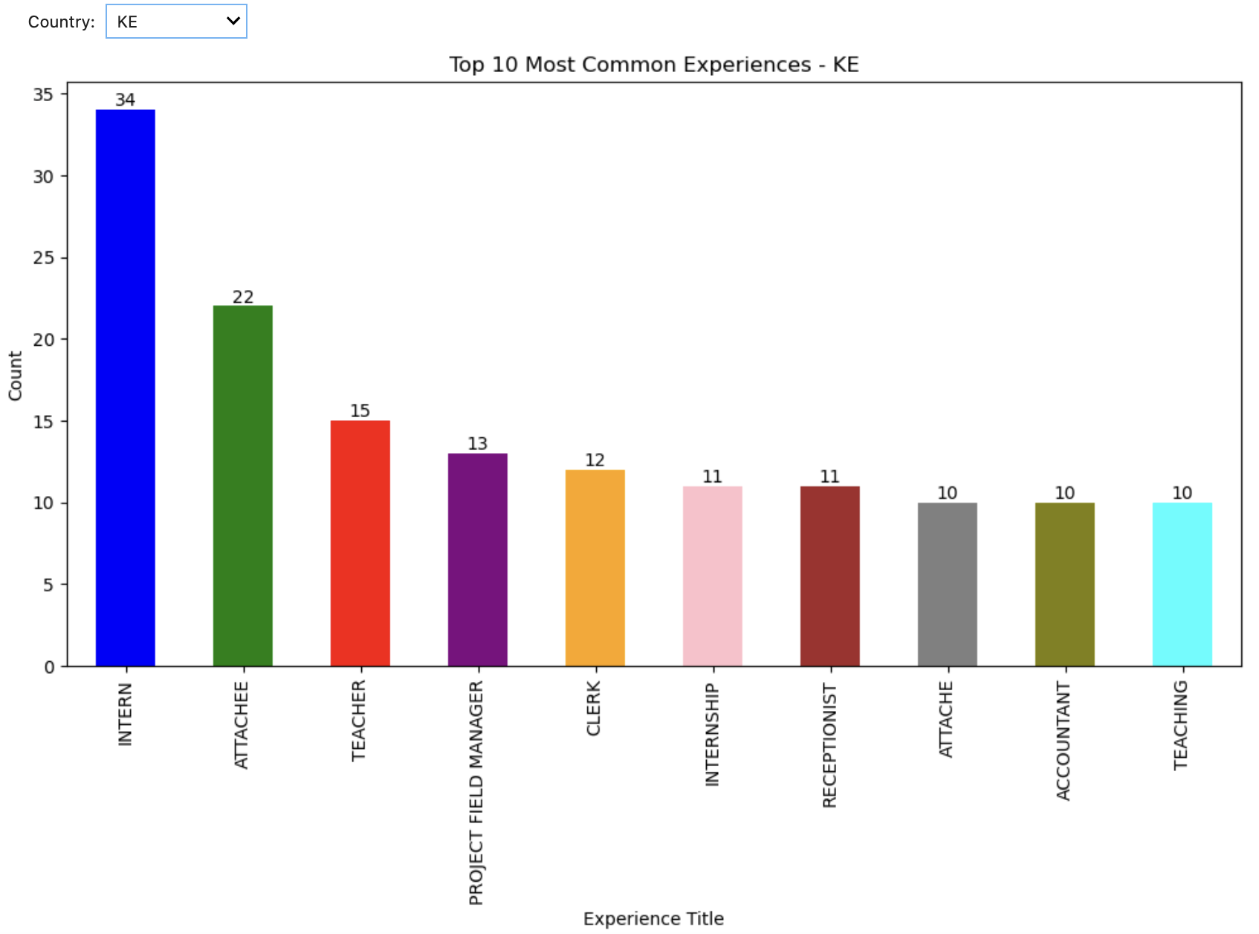
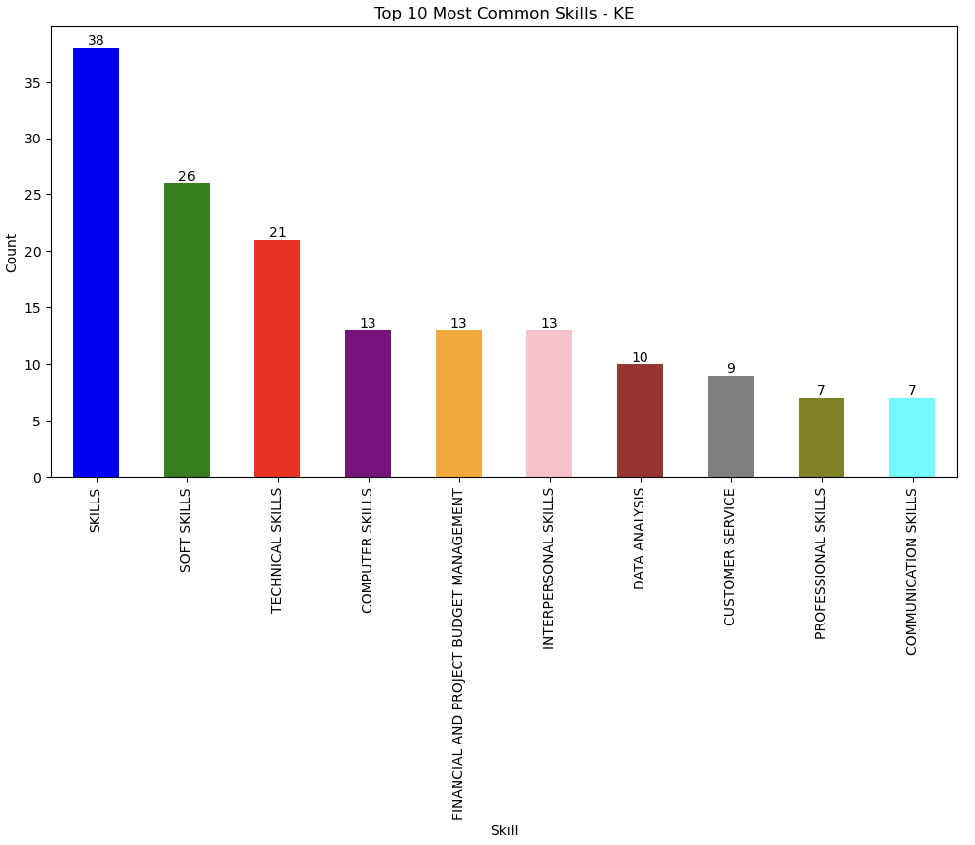
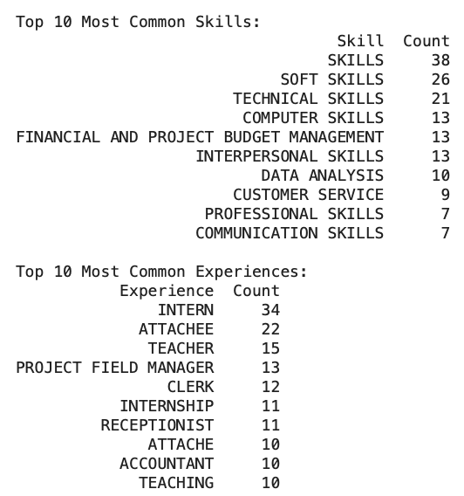
Determine trends in experience and skills for the target users.
A bar chart can be utilized to visually represent the top 10 prevalent experiences and skills. By utilizing a dropdown menu, users have the option to choose specific countries and observe the corresponding top 10 experiences and skills associated with those countries. This graphical representation allows for a clear understanding of the most common experiences and skills across different countries.
Notes:
Abhi

Slide 13
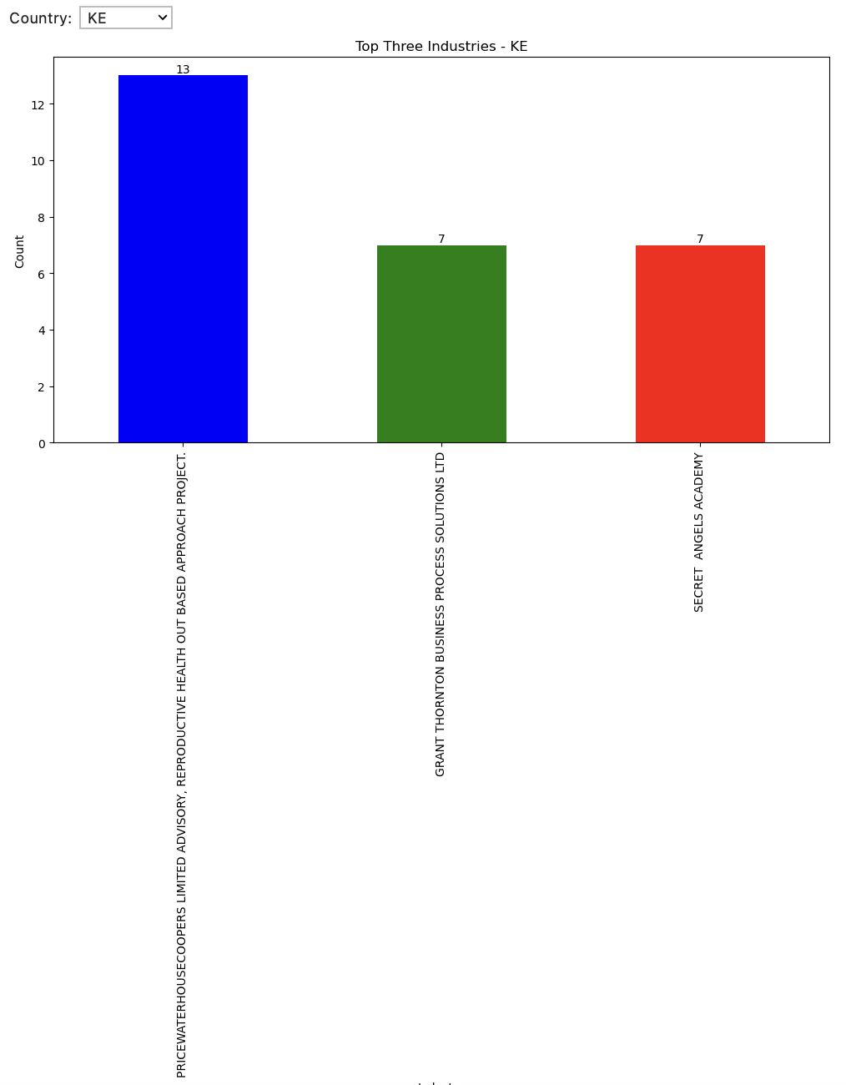
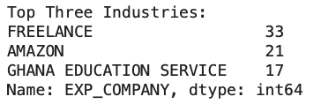
Top three industries that the majority of CoverQuick's users have applied:
As shown below, from the total dataset with no job description, we can see that the top three industries/company candidates apply to are mostly Freelancers (33), Amazon (21), and Ghana Education Service (17).
We can also select the countries from the dropdown and get the top three industries per country wise.
Notes:
Abhi

Slide 14
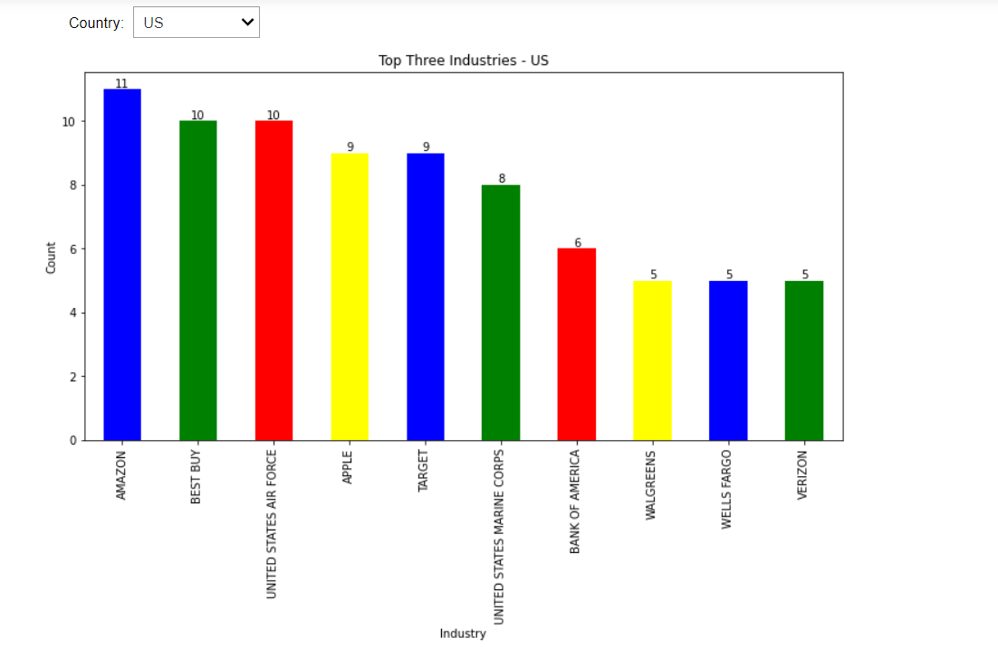
Top industries for specific countries that the majority of CoverQuick's users have applied:
As shown below, from the total dataset with no job description, we can see that the top three industries/company candidates apply to are mostly Amazon (11), Best Buy (10), and United States Air Force (10), Apple
(9), Target(9), United States Marine Corps(8), Bank of America (8), walgreens(5),Wellsfargo(5), Verizon(5).
From Raw analysis
Popular companies users apply to
Internet and Technology
Banking and Finance
Retail and Logistics
Government / Federal run businesses
Notes:
Abhi

Slide 15
Thank You!

