Slide 1
Fraud Credit Card Transactions Assignment 12-2, Week -12 Term Project : EDA – DSS 530 Syed Abidi

Slide 2
Term Project question
There were 284,807 rows and 31 columns of credit card data, which I wanted to use EDA to determine and stope the fraudulent transactions. The given data has several variables including, Time, Amount in Euro, Class (Fraud and normal transactions), and different variables.
I wanted to create a model, which can be used to predict and identify each fraudulent transaction.
This model could help to save fraud transactions, as fraud losses worldwide reached $27.85 Billion dollars in 2018.

Slide 3
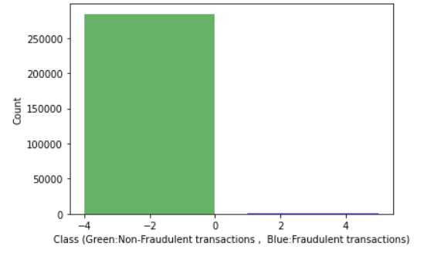
Fraud transaction of 2013 data
I have used the credit card data of European credit card holders. These transactions were made in two days of September 2013. Analysis of this data reveals 492 fraudulent transactions out of total 284,807. Analysis also shows that data is unbalanced which account of 0.17% of total transactions.
The dataset is not balanced, null classifier which predicts class = 0 would obtain over 99% accuracy. This clearly demonstrate that a simple measure of mean accuracy should not be used due to insensitivity to false negatives.

Slide 4
Five Variables of the dataset
1st Variable 'Class' is used to label fraud or normal transaction, 1 means fraud and 0 means normal transactions
2nd Variable 'Time' contains the seconds elapsed between each transaction and the first transaction in the dataset
3rd Variable 'Amount' is used in Euro for the amount of each transaction Amount
4th Variable 'V1' is used for the first principal components obtained with payment card assurance for the first transactions
5th Variable 'V2 to V28' is used for the principal components obtained with payment card assurance for other transactions

Slide 5
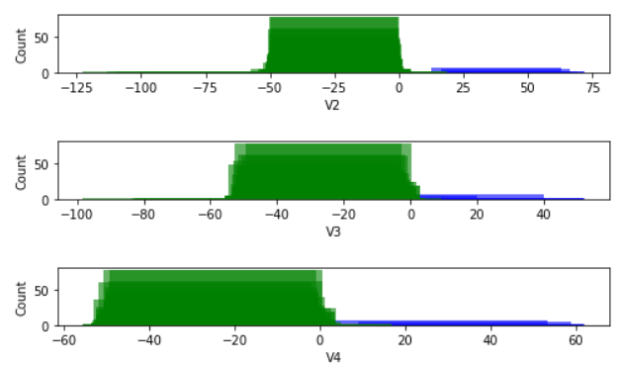
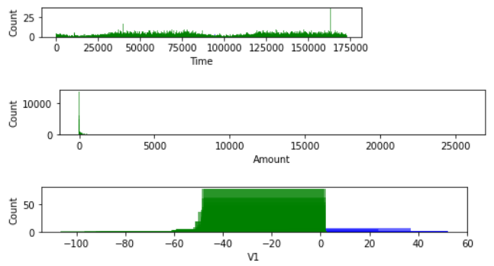
Histograms Analysis

Slide 6
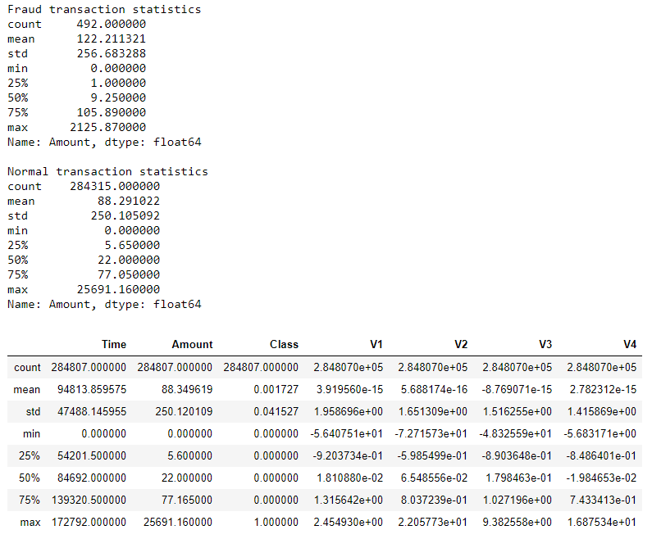
Descriptive Characteristics of Data

Slide 7
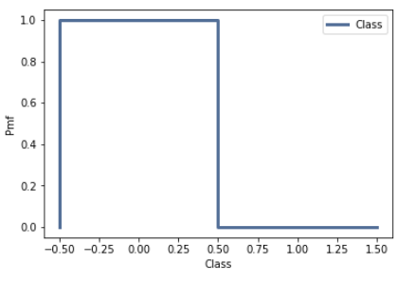
PMF Analysis

Slide 8
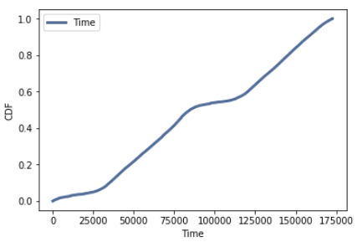
CDF Analysis

Slide 9
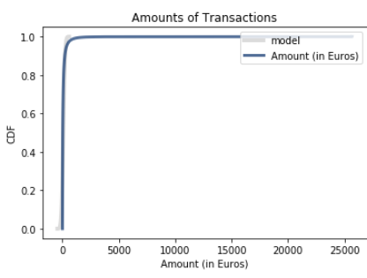
Probability Distribution Plot

Slide 10
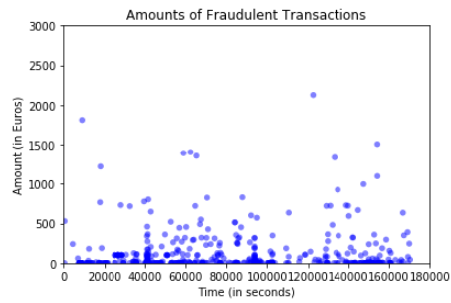
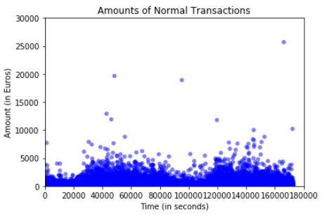
Scatterplots Analysis

Slide 11
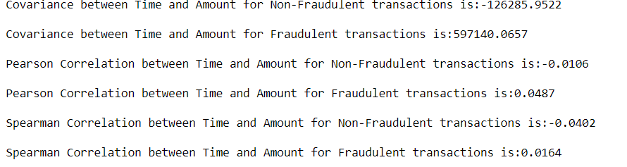
Covariance and Correlation Analysis

Slide 12
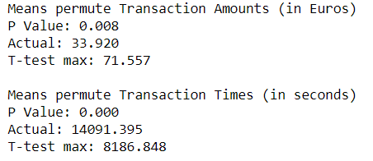
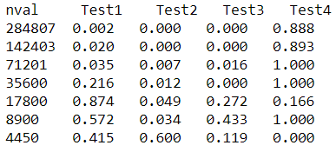
Hypothesis Testing Analysis

Slide 13
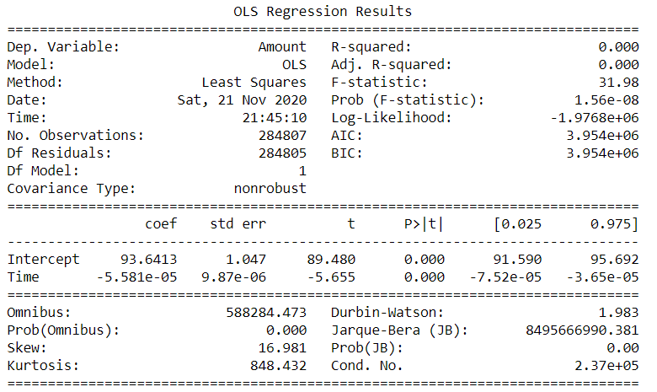
Regression Analysis

Slide 14
Key Observations
Transactions of 1825 out of total 284k transactions had zero value.
Only 27 were fraudulent and 1798 legal transactions.
The fraudulent mean of transactions was 122.21 and valid transactions mean was only 88.29.
About 50% of the fraudulent transactions were less than 10 and about 50% of the valid transactions were less than 22.
About 75% of the fraudulent transactions were less than 106 and about 75% of the valid transactions were less than 77.
The maximum amount of the fraudulent transaction was 2125.87 and maximum amount of valid transaction was 25691.16.
Most of the fraudulent transaction occurred during the first 12 hours and between 23rd and 30th hour.
It was interesting to note that if transactions recorded at 12 a.m. then there were more chances of fraud transactions during the morning hours.
There were 99% of the legal transactions are of value less than 2000.
There were 99% of the fraudulent transactions are of value less than 1250.

