Slide 1
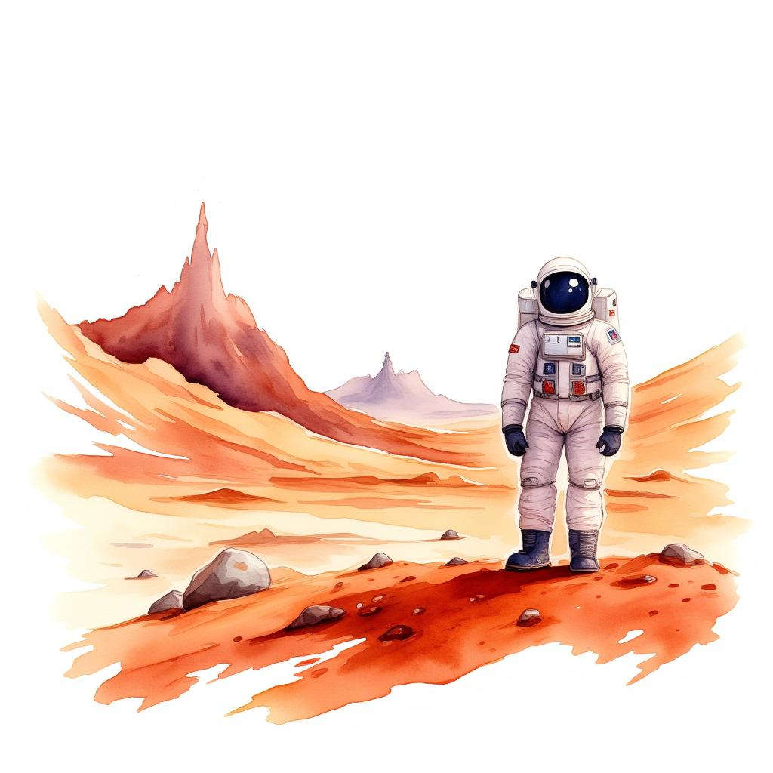
Mustafa's Trip to Mars
Written by Abubakar Abid

Slide 2

Mustafa loves playing with his red toy truck.
One day, his truck starts to glow, grow, and zoom up into the sky!
1

Slide 3

Up, up, up goes Mustafa in his special red toy truck.
He waves bye-bye to his house as it gets tiny down below.
2

Slide 4

The stars look like tiny lights all around him.
His red toy truck flies fast past the moon and the sun.
3

