Slide 1
Neural Algorithms and Computing Beyond Moore’s Law
Presented by
Abid Hasan Muin
Roll: 1507119

Slide 2
Outline
Moore’s Law
Dennard Scaling
Breakdown of Dennard Scaling
Post-Moore’s Law world
Neuromorphic Computing
Neural Algorithms
Conclusion
Reference

Slide 3
Moore’s Law
Moore's law is the observation that the number of transistors in a dense integrated circuit doubles about every two years.

Slide 4
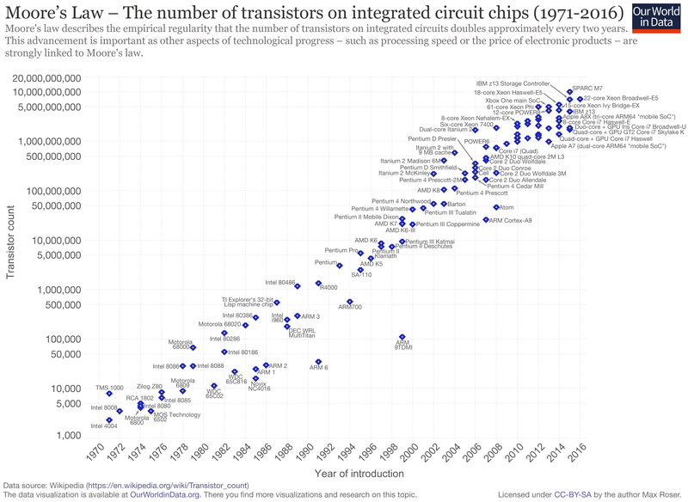
Fig-1: Moore's Law Transistor Count 1971-2016

Slide 5
Dennard Scaling
Dennard scaling aka MOSFET scaling states that as transistors get smaller, their power density stays constant.
That means, the power use stays in proportion with area; both voltage and current scale (downgrade) with length.

Slide 6
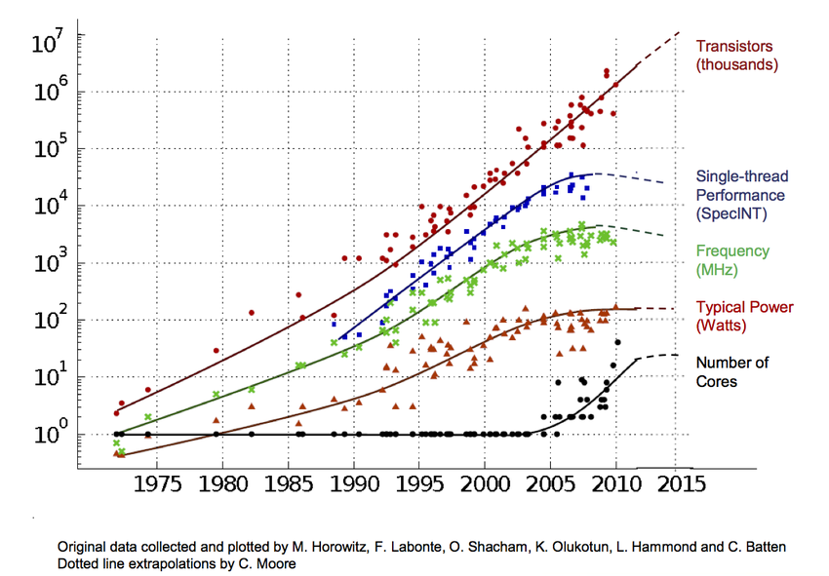
Breakdown of Dennard Scaling

Slide 7
Breakdown of Dennard Scaling
Dynamic (switching) power is computed as –
Power, P = CFV² + V_{threshold}I_{leakage}
Where,  = percent time switched
C = capacitance
F = frequency
V = voltage
V_{threshold} = threshold voltage
I_{leakage} = leakage current

Slide 8
Has Moore’s law failed?
Moore’s law translates to predictions of processing power. At the outset, transistor counts and processing power increased exponentially.
But Moore’s law apparently failed several years ago, causing power on single chip to be stagnated.

Slide 9
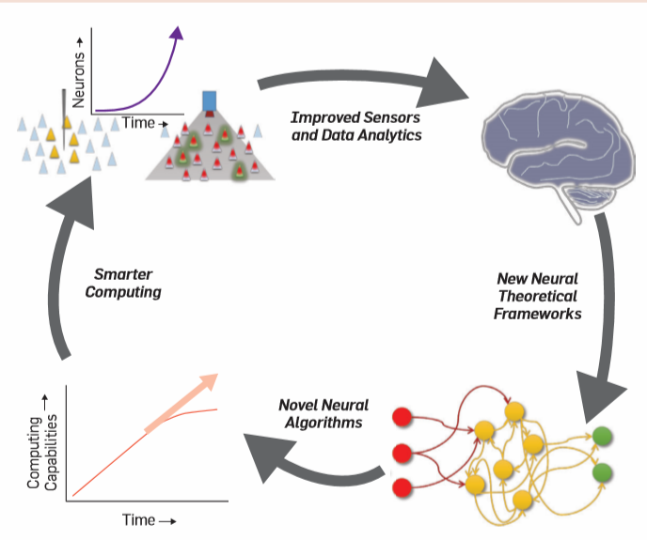
Post Moore’s law world
While Moore’s law is slowing down, it has enabled the miniaturization of sensors and improved the analytics required to improve neural data collection.

Slide 10
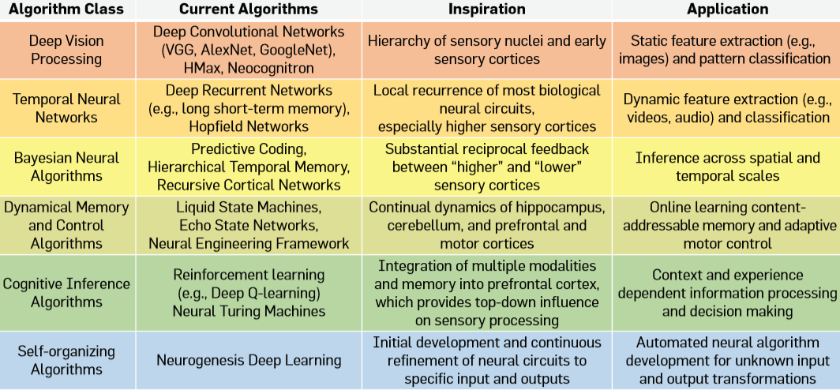
Neuromorphic computing

Slide 11
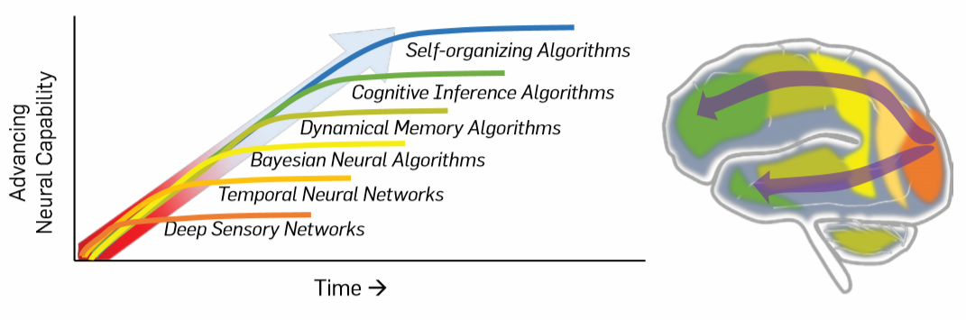
Neuromorphic computing

Slide 12
Neural Algorithms
Feed-forward sensory processing:
Temporal neural networks
Bayesian neural algorithms
Dynamical memory and control algorithms
Cognitive inference algorithms, Self-organizing algorithms and beyond

Slide 13
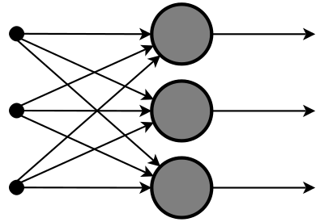
Feed-forward sensory processing
Neural network to computationally solve tasks associated with Human vision and other sensory systems.
Data or inputs travel in one direction.
The data passes through the input nodes and exit on the output nodes.
Inputs
Outputs
Fig: Feed-forward neural network

Slide 14
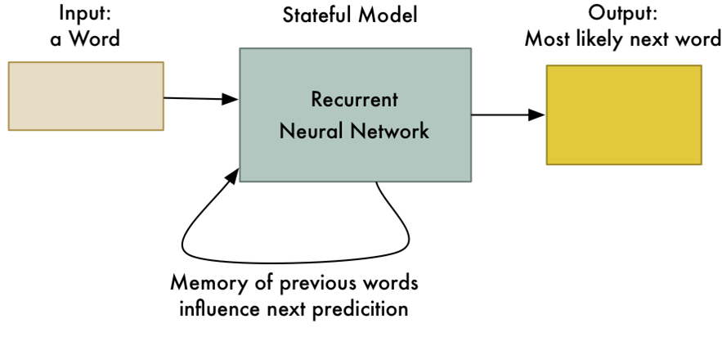
Temporal neural networks
A class of ANN where connection between nodes form a directed graph along a temporal sequence.
Can use their internal state (memory) to process sequence of inputs.

Slide 15
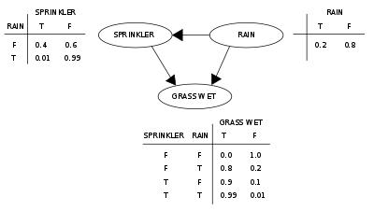
Bayesian neural algorithms
Probabilistic graphical model that represents a set of variables and their conditional dependencies via a DAG.

Slide 16
Dynamical memory and control algorithms
LSM (Liquid State Machine):
Particular kind of Spiking Neural Network (SNN)
Consists of a large collection of units (nodes or neurons).
Nodes are randomly connected to each other.
NEF (Neural Engineering Framework):
Main method for constructing Neural simulations.
Provides a rational and robust strategy for simulating and evaluating function of a wide variety.

Slide 17
Conclusion
While an argument has been made for why neural computing could provide the computing industry with a future beyond Moore’s Law, by no means is this future assured.
Arguably, the greatest urgency is to inspire the broader neuroscience community to pursue developing theories that can impact neural computing.
There is considerable reason to believe that our knowledge of the brain will continue to accelerate through improved neuro-technologies, the path by which that knowledge can be leveraged into a real impact on computing is not well established.

Slide 18
Reference
https://en.wikipedia.org/wiki/Dennard_scaling
http://compneuro.uwaterloo.ca/research/nef.html
https://en.wikipedia.org/wiki/Liquid_state_machine
https://www.quora.com/What-is-a-Bayesian-Neural-Network?share=1
https://en.wikipedia.org/wiki/Bayesian_network
https://www.analyticsindiamag.com/6-types-of-artificial-neural-networks-currently-being-used-in-todays-technology/
http://www.cleveralgorithms.com/nature-inspired/neural.html
https://cacm.acm.org/magazines/2019/4/235577-neural-algorithms-and-computing-beyond-moores-law/fulltext

