Slide 1
Capstone project presentation

Slide 2
Introduction
Toronto has been hosting its famous health congregation Seminar since 2010. It’s a Five-day event and the professionals are also accompanied by their families. The objective of the project is to create maps.
Maps that would assist them in arriving at probable logistics with regards to:
1. Hotels as Accommodation
2. Shopping malls and Event places
3. Parks,Restaurant,Cafetaria for family recreation
This Project would have the objective of looking at such data points, clean them, merge them into probable sets and visualize the same with maps.

Slide 3
Data for the project
Parameters of the Foursquare account would be defined ex: Client ID etc.
Define the geographical area, get the coordinates of the same.
Individual Search URL would have to be created specifying the search criterion as 'Hotel','Restaurant','Park' etc.. and queried to the Foursquare API to get the data.

Slide 4
Methodology
On query of the Foursquare API, JSON data file is outlined. Each of the individual JSON file is then converted into a dataframe using the Pandas library.
Cleaning and more cleaning such that:
1. All null data points are ignored
2. Un-necessary columns dropped
3. Relevant results are bundled together.
Creating two merged data frame with:
1. Point of interest of Delegates – Merged Data frame consisting of Hotel, Shopping centre and Cafeteria clusters
2. Point of interest of Families of Delegates – Merged Data frame consisting of Park, Restaurant and Cafeteria cluster
Creating two visualization of this data frame and project the venue points as being reflected in the data frame on the map of Toronto

Slide 5
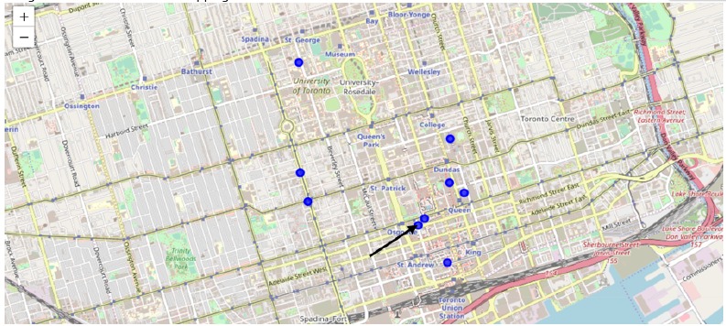
Results
Figure 1: Hotels, shopping stores and cafeterias

Slide 6
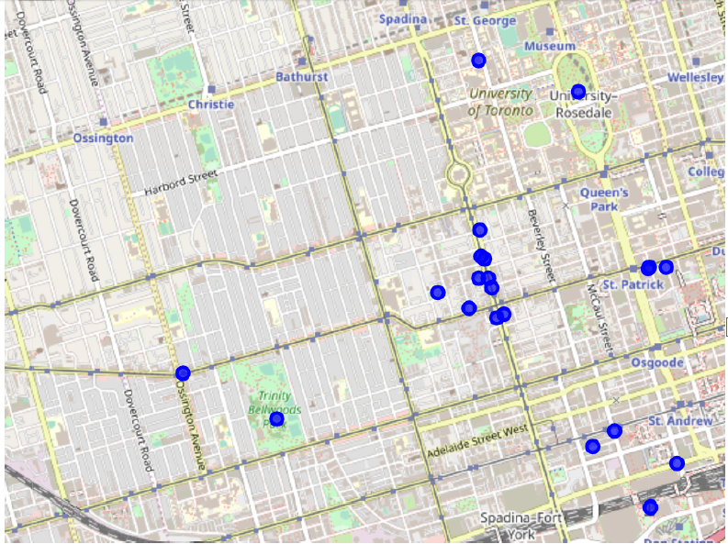
Results (Cont.)
Figure 2: Parks, restaurants and cafeterias

Slide 7
Results and discussion
Figure 1, provides the ball point markers from the logistic point of view of the Delegates which includes Accommodation, place to hold the seminar, Point of shopping for daily essentials and souvenirs.
With regard to the place of accommodation, it would be desirable if the Seminar place is around the same location. Hence one of the prime locations if looked in conjunction with the analysis done at code stage is Hotel Sheraton which is in close proximity to the Grand Ballroom. This by dint of both having the same postal code.

Slide 8
Results and discussion
Considering the Delegates stay with their family in the aforementioned location(Marked with a black arrow in Figure 1) which is in Queens street, there are lots of two or three streets away on both sides of the location as seen in Figure 2. There should therefore be ample choice for the families to select from to while away their time when the delegates are away on Seminar.

Slide 9
Conclusion
Acquired data points using foursquare API to provide logistic choices for various venues of interest.
A probable location of choice for accommodation has been suggested.

