Slide 1
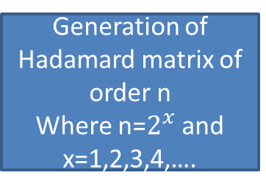
Generation of Hadamard matrix of order n
Where n=$2^{x}$ and x=1,2,3,4,….
Dot product between each row
Chip sequence generation
Find minimum correlation between two rows
Create the Spread Spectrum Sequence
Oversample the spread sequence
Sketch the BER dependency on different parameters
Transmit data through LED
Compare the recovered data with the original data sequence
Recover data by the dot product of chip sequence and spread spectrum sequence
Oversample the user chip sequences

