Slide 1
RMI – Remote Method Invocation
Introduction
What is RMI?
RMI System Architecture
How does RMI work?
Distributed Garbage Collection
RMI & the OSI Reference Model
Security
Programming with RMI

Slide 2
Introduction
Low-level sockets can be used to develop client/server distributed applications
But in that case, a protocol must be designed
Designing such a protocol is hard and error-prone (how to avoid deadlock?)
RMI is an alternative to sockets

Slide 3
What is RMI?
A core package of the JDK1.1+ that can be used to develop distributed applications
Similar to the RPC mechanism found on other systems
In RMI, methods of remote objects can be invoked from other JVMs
In doing so, the programmer has the illusion of calling a local method (but all arguments are actually sent to the remote object and results sent back to callers)

Slide 4
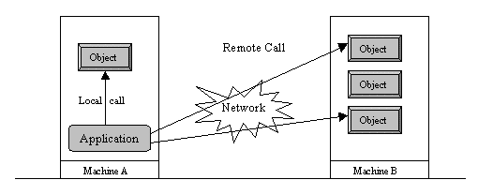
Local v. Remote method invocation

Slide 5
Goals and Features of RMI
seamless object remote invocations
callbacks from server to client
distributed garbage collection
NOTE: in RMI, all objects must be written in Java!

Slide 6
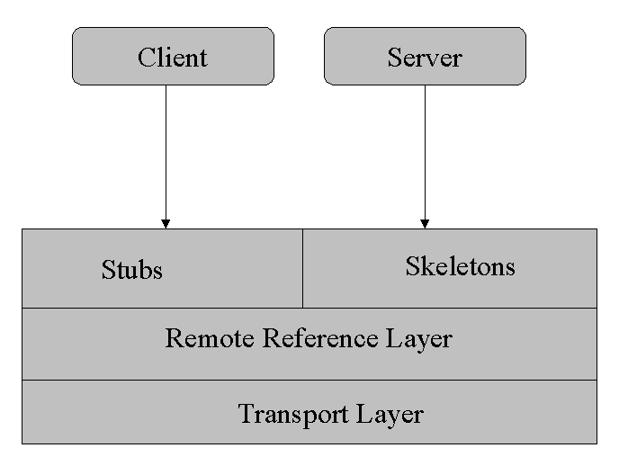
RMI System Architecture
Built in three layers (they are all independent):
  Stub/Skeleton layer
  Remote reference layer
  Transport layer

Slide 7
The Stub/Skeleton layer
The interface between the application layer and the rest of the system
Stubs and skeletons are generated using the RMIC compiler
This layer transmits data to the remote reference layer via the abstraction of marshal streams (that use object serialization)
This layer doesn’t deal with the specifics of any transport

Slide 8
The Stub/Skeleton l
Client stub responsible for:
  Initiate remote calls
  Marshal arguments to be sent
  Inform the remote reference layer to invoke the call
  Unmarshaling the return value
  Inform remote reference the call is complete
Server skeleton responsible for:
  Unmarshaling incoming arguments from client
  Calling the actual remote object implementation
  Marshaling the return value for transport back to client

Slide 9
The Remote Reference Layer
The middle layer
Provides the ability to support varying remote reference or invocation protocols independent of the client stub and server skeleton
Example: the unicast protocol provides point-to-point invocation, and multicast provides invocation to replicated groups of objects, other protocols may deal with different strategies…
Not all these features are supported….

Slide 10
The Transport Layer
A low-level layer that ships serialized objects between different address spaces
Responsible for:
  Setting up connections to remote address spaces
  Managing the connections
  Listening to incoming calls
  Maintaining a table of remote objects that reside in the same address space
  Setting up connections for an incoming call
  Locating the dispatcher for the target of the remote call

Slide 11
How does RMI work?
An invocation will pass through the stub/skeleton layer, which will transfer data to the remote reference layer
The semantics of the invocation are carried to the transport layer
The transport layer is responsible for setting up the connection

Slide 12
The Naming Registry
The remote object must register itself with the RMI naming registry
A reference to the remote object is obtained by the client by looking up the registry

Slide 13
Distributed Garbage Collection
RMI provides a distributed garbage collector that deletes remote objects no longer referenced by a client
Uses a reference-counting algorithm to keep track of live references in each Virtual Machine
RMI keeps track of VM identifiers, so objects are collected when no local or remote references to them

Slide 14
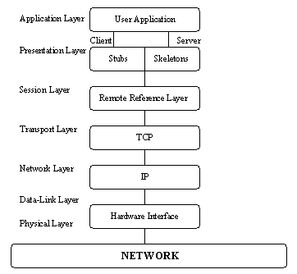
RMI and the OSI reference model
How can RMI be described by this model?

Slide 15
Security
While RMI is a straightforward method for creating distributed applications, some security issues you should be aware of:
  Objects are serialized and transmitted over the network in plain text
  No authentication: a client requests an object, all subsequent communication is assumed to be from the same client
  No Security checks on the register
  No version control

Slide 16
Programming with RMI
Anatomy of an RMI-based application
  Define a remote interface
  Provide an implementation of the remote interface
  Develop a client
  Generate stubs and skeletons
  Start the RMI registry
  Run the client and server

Slide 17
Define a remote interface
It specifies the characteristics of the methods provided by a server and visible to clients
  Method signatures (method names and the type of their parameters)
By looking at the interface, programmers know what methods are supported and how to invoke them
Remote method invocations must be able to handle error messages (e.g. can’t connect to server or server is down)

Slide 18
Characteristics of remote interface
Must be declared public
To make an object a remote one, the interface must extend the java.rmi.Remote interface
Each method declared in the interface must declare java.rmi.RemoteException in its throws clause.
see DateServer example

Slide 19
Implement the remote interface
The implementation needs to:
  Specify the remote interface being implemented
  Define the constructor of the remote object
  Implement the methods that can be invoked remotely
  Create an instance of a remote object
  Register it with the RMI registry
see DateServerImpl example

Slide 20
Develop a client
Example:
  DateClient.java

Slide 21
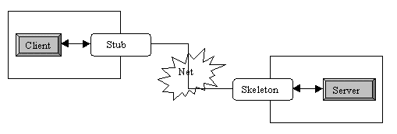
Generate stubs and skeletons
Use the rmic compiler
Place the remote interface and the stub class on the client side, and both the stub and skeleton on the server side.
  alternately, some of these files could be dynamically loaded (will see this later)

Slide 22
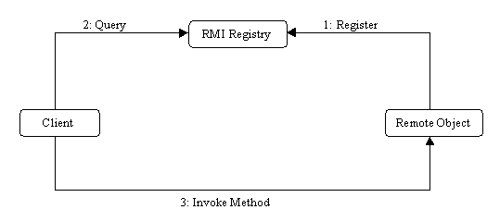
Start the RMI registry
It is a naming service that allows clients to obtains references to remote objects

Slide 23
Run the server and client
Run the rmi registery (default port: 1099)
Run the server
Run the client

Slide 24
The server class
The class that defines the server object should extend UnicastRemoteObject
  This makes a connection with exactly one other computer
  If you must extend some other class, you can use exportObject() instead
  Sun does not provide a MulticastRemoteObject class
The server class needs to register its server object:
  String url = "rmi://" + host + ":" + port + "/" + objectName;
    The default port is 1099
  Naming.rebind(url, object);
Every remotely available method must throw a RemoteException (because connections can fail)
Every remotely available method should be synchronized

Slide 25
Hello world server: interface
import java.rmi.*;
public interface HelloInterface extends Remote {
public String say() throws RemoteException;
}

Slide 26
Hello world server: class
import java.rmi.*;
import java.rmi.server.*;
public class Hello extends UnicastRemoteObject
implements HelloInterface {
private String message; // Strings are serializable
public Hello (String msg) throws RemoteException {
message = msg;
}
public String say() throws RemoteException {
return message;
}
}

Slide 27
Registering the hello world server
class HelloServer {
public static void main (String[] argv) {
try {
Naming.rebind("rmi://localhost/HelloServer",
new Hello("Hello, world!"));
System.out.println("Hello Server is ready.");
}
catch (Exception e) {
System.out.println("Hello Server failed: " + e);
}
}
}

Slide 28
The hello world client program
class HelloClient {
public static void main (String[] args) {
HelloInterface hello;
String name = "rmi://localhost/HelloServer";
try {
hello = (HelloInterface)Naming.lookup(name);
System.out.println(hello.say());
}
catch (Exception e) {
System.out.println("HelloClient exception: " + e);
}
}
}

Slide 29
rmic
The class that implements the remote object should be compiled as usual
Then, it should be compiled with rmic:
  rmic Hello
This will generate files Hello_Stub.class and Hello_Skel.class
These classes do the actual communication
  The “Stub” class must be copied to the client area
  The “Skel” was needed in SDK 1.1 but is no longer necessary

Slide 30
Trying RMI
In three different terminal windows:
  Run the registry program:
    rmiregistry
  Run the server program:
    java HelloServer
  Run the client program:
    java HelloClient
If all goes well, you should get the “Hello, World!” message

Slide 31
Summary
Start the registry server, rmiregistry
Start the object server
  The object server registers an object, with a name, with the registry server
Start the client
  The client looks up the object in the registry server
The client makes a request
  The request actually goes to the Stub class
  The Stub classes on client and server talk to each other
  The client’s Stub class returns the result

Slide 32
References
Trail: RMI
by Ann Wollrath and Jim Waldo
  http://java.sun.com/docs/books/tutorial/rmi/index.html
Fundamentals of RMI Short Course
by jGuru
  http://developer.java.sun.com/developer/onlineTraining/
  rmi/RMI.html
Java RMI Tutorial
by Ken Baclawski
  http://www.ccs.neu.edu/home/kenb/com3337/rmi_tut.html

Slide 33
What else?
Dynamically loading stubs and skeletons
Implementing callbacks
Implementing factories
How to sign objects over RMI
How to create custom RMI socket factories
SSL sockets
Remote object activation

