Slide 1

Payment Gateways

Slide 2
What is Payment Gateway?
A payment gateway is an e-commerce application service provider service that authorizes payments for e-businesses(ex: online shopping carts)
Before going to the payment gateways first we need to know the following terms.

Slide 3
Terms which are related to payment gateway
E-commerce
Web services
Payment Process

Slide 4
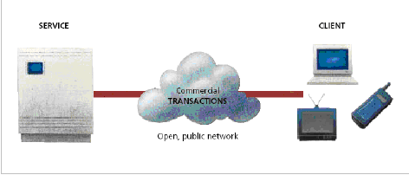

E-commerce
Electronic Commerce, commonly known as (electronic marketing) e-commerce or eCommerce, consists of the buying and selling of products or services over electronic systems such as the Internet and other computer networks.

Slide 5
Web services
A Web service is defined by the W3C (World Wide Web Consortium)as "a software system designed to support interoperable machine-to-machine interaction over a network”.
For accessing every web service we need an API(Application Program Interface) key.
Web service is a platform independent.

Slide 6
Payment Process
A payment process is nothing but an transaction of money between the users and merchant (owner of the product).
In payment process we need there are 2 types of accounts.
Business Account (user)
Merchant Account (owner)
Notes:
In this slide, you can just quickly say that these are the reasons why we started for the setup of Intranet.

Slide 7

Online Shopping Example
The Payment Gateway Workflow should be inserted before the checkout.
After the confirm order page will the payment gateway workflow be activated

Slide 8
Working of Payment Gateway
Visitor places the order on the website and it is sent to the merchant's web server in encrypted format. This is usually done via SSL (Secure Socket Layer) encryption. Content organization
The transactions details are then forwarded to the concerned Payment Gateway.
The transaction information is then passed on to the merchants acquiring bank by the Payment Gateway.
Merchants acquiring bank then forwards the transaction information to the issuing bank (one that issued the credit card to the customer).

Slide 9
Then the card issuing bank sends a response back to the Payment Gateway. The response includes information that whether the payment has been approved or declined. In case of declination the reason is also sent in the response.
The response is then forwarded by the Payment Gateway to the merchant’s server.
At merchants server the response is encrypted again and is relayed back to the customer. This allows the customer to know that whether the order has been placed successfully or not.
The entire process typically takes less than 5 seconds.
Notes:
Should we include this? Or just leave it out?

Slide 10
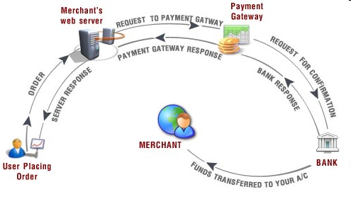
Flow of payment process
Notes:
May be you just mentioned here that these are the software you have looked at.

Slide 11
Types of Payment Gateways
PayPal (Global)
Authorize. Net (US)
VeriSign (Global)
Link point (US)
2Checkout (Global)
World Pay (Global)
Cyber Source (US)
Protx (UK)
EWay (AU)
Moneris (CA)
QuickBooks Merchant Services (US Only)

Slide 12
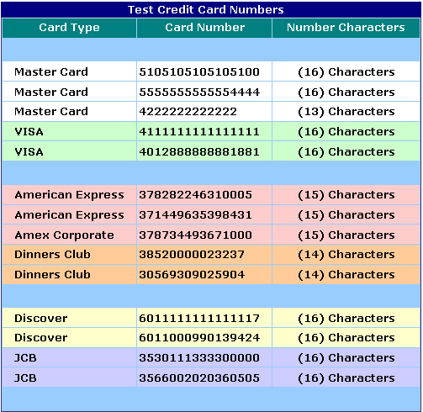
Types of credit cards

Slide 13
Gateway advantages
Gateways can provide many benefits, with its main benefit being security. We recommend to all our customers that they use a payment gateway to handle all credit card payments. While VP-ASP does provide credit card number encryption and can ensure that the software is secure, it is still stored in a location that a hacker may be able to access. Whereas, when using a payment gateway, the credit card information is sent directly to the bank for verification and therefore no credit card details are stored.
In addition to security, payment gateways also provide the following benefits:
Credit card validation and processing in real time
Less fraud (but there are many stolen credit card numbers floating around)
Money is normally deposited into your bank account automatically
Reports and refunds normally allowed via browser by gateway company (not VP-ASP)

Slide 14
Gateway Disadvantages
Every gateway company charges fees. Fees can include some or all of the following:
Fixed fee per month
Percentage fee per amount spent
A fixed fee per transaction
In addition your own bank or the gateway's bank will charge a merchant fee for the privilege of allowing credit card purchases. This can range from 1-5% or more.

Slide 15

Getting API certificate and credentials from Paypal
To create an API certificate, you must have a PayPal Business or Premier Account. Login into your existing Business or Premier PayPal Account, or create a new PayPal Business or Premier Account.
Click the Profile tab in the My Account sub-menu.

Slide 16
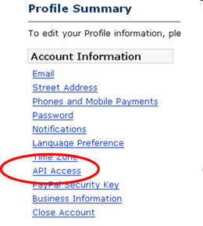
From the Profile Summary page, click API Access under the Account Information header.

Slide 17
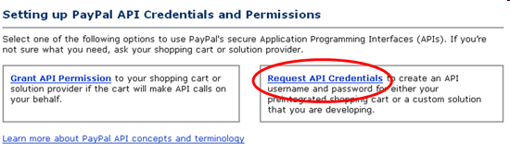
From the API Set-up page, click Request API Credentials in the right-hand box.

Slide 18
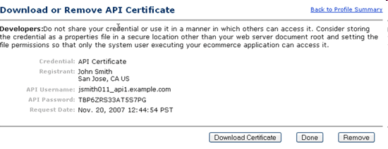
The Download or Remove API Certificate page displays your API credentials and allows you to download your API certificate.

Slide 19
Save the values for API Username and Password.
Click the Download Certificate button. You are prompted to download a file called cert_key_pem.txt. This file is your live API Certificate.
Rename this file to something more familiar, such as paypal_live_cert.pem. It is not necessary to keep the .txt file extension. Be sure to remember where you save the file.

Slide 20
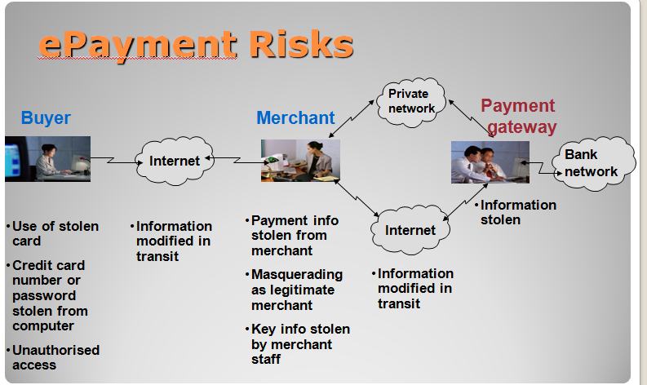
Epayment risks

