Slide 1

Pakalo
Artificially Intelligent Cooking Assistant
FYP-I Mid Evaluation
Abid Waqar i16-0229
Mashood Ur Rehman i16-0063 Supervisor
Nauraiz Mushtaq i16-0106 Dr. Omer Beg

Slide 2
Our Poster
1.
At a Glance

Slide 3
Design
Made On Photoshop
Green Colour Scheme
Minimalist Approach
Content
High Level Architecture
Example Scenario
Timeline
Overview of Tools

Slide 4
Competitive Analysis
2.
What’s out there?

Slide 5


The Current Market
Recipe Catalogs and Meal Planners
Restaurant Recommenders
Recipe Sharing Platforms

Slide 6
Chatbots
Betty Crocker (Cooking QnAs)
Make it Soy (Vegan Substitutes)
Seamless (Food Ordering)

Slide 7
No Chatbot that Guides User through a Recipe

Slide 8
Use Cases
3.

Slide 9
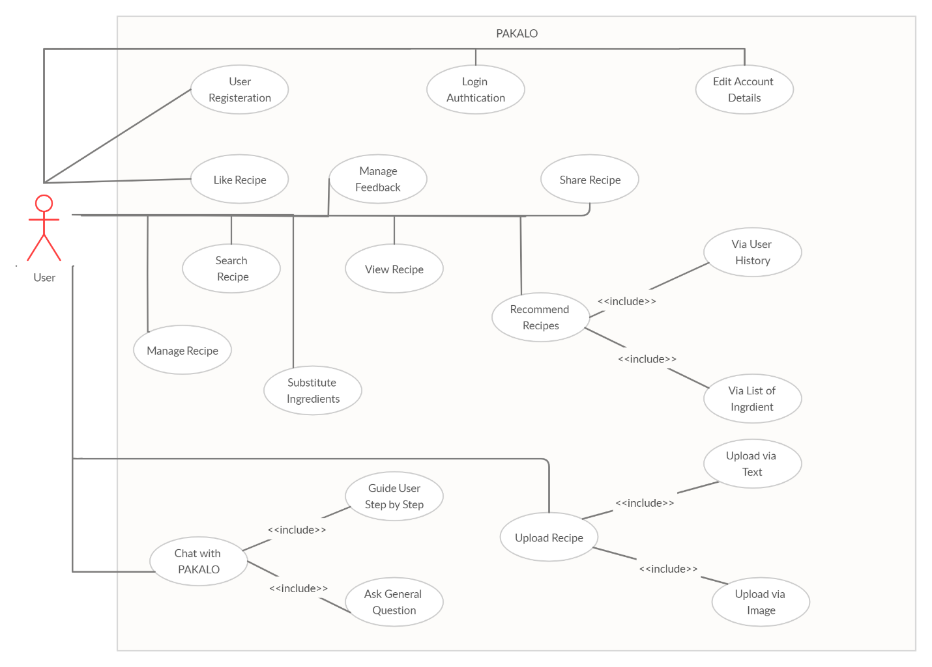
Use Case Diagram

Slide 10
Implemented Use Cases
UC-01: General QnA
User Level
Primary Actor: User
Ask General Questions
Questions about Cooking
Conversational Aspect
UC-02: Search Recipe
User Level
Primary Actor: User
Search For Recipe in App
Access Recipe of Choice

Slide 11
Iteration One Implementation Details
4.

Slide 12
Data Gathering And Scraping
Gathered recipe data from several Kaggle competitions
Recipe data was also scrapped from several websites.
The total amount of recipe data gathered is close to 1.1 million

Slide 13
Preprocessing
Gathered recipe data was then processed to extract title, ingredients and instruction.
The text in ingredients and instructions were further normalized and processed according to database hierarchy.

Slide 14
Data Storage
Processed data was then uploaded to Firebase’s firestore database.
Some limitations were faced because of free account on database, like 20,000 writes per day.

Slide 15
Categorization
A food group categorization structure was found from the internet.
This categorization data was scraped.

Slide 16
Searching Recipe
Connected firebase firestore database to PAKALO app.
Implemented searching recipe.

Slide 17
General Conversational Chatbot
Question and Answer Encoding
Model LSTM Layers and Embedding Layers
Training and Decoding
Sample QnA datasets like WikiQACorpus

Slide 18
Demo
5.

Slide 19
Next Steps
6.
Work we have ahead

Slide 20
Iteration Two
Making the Chatbot into a Guide
Proper Conversational Chatbot Model Formation
Context Understanding
Response Formation

Slide 21

Iteration Two End Goal
Crush two garlic cloves using the back of the knife
Chop the garlic into fine pieces and place in the pan.
What should I do next
Pakalo?
Alright I have done that. What should I do now?

Slide 22
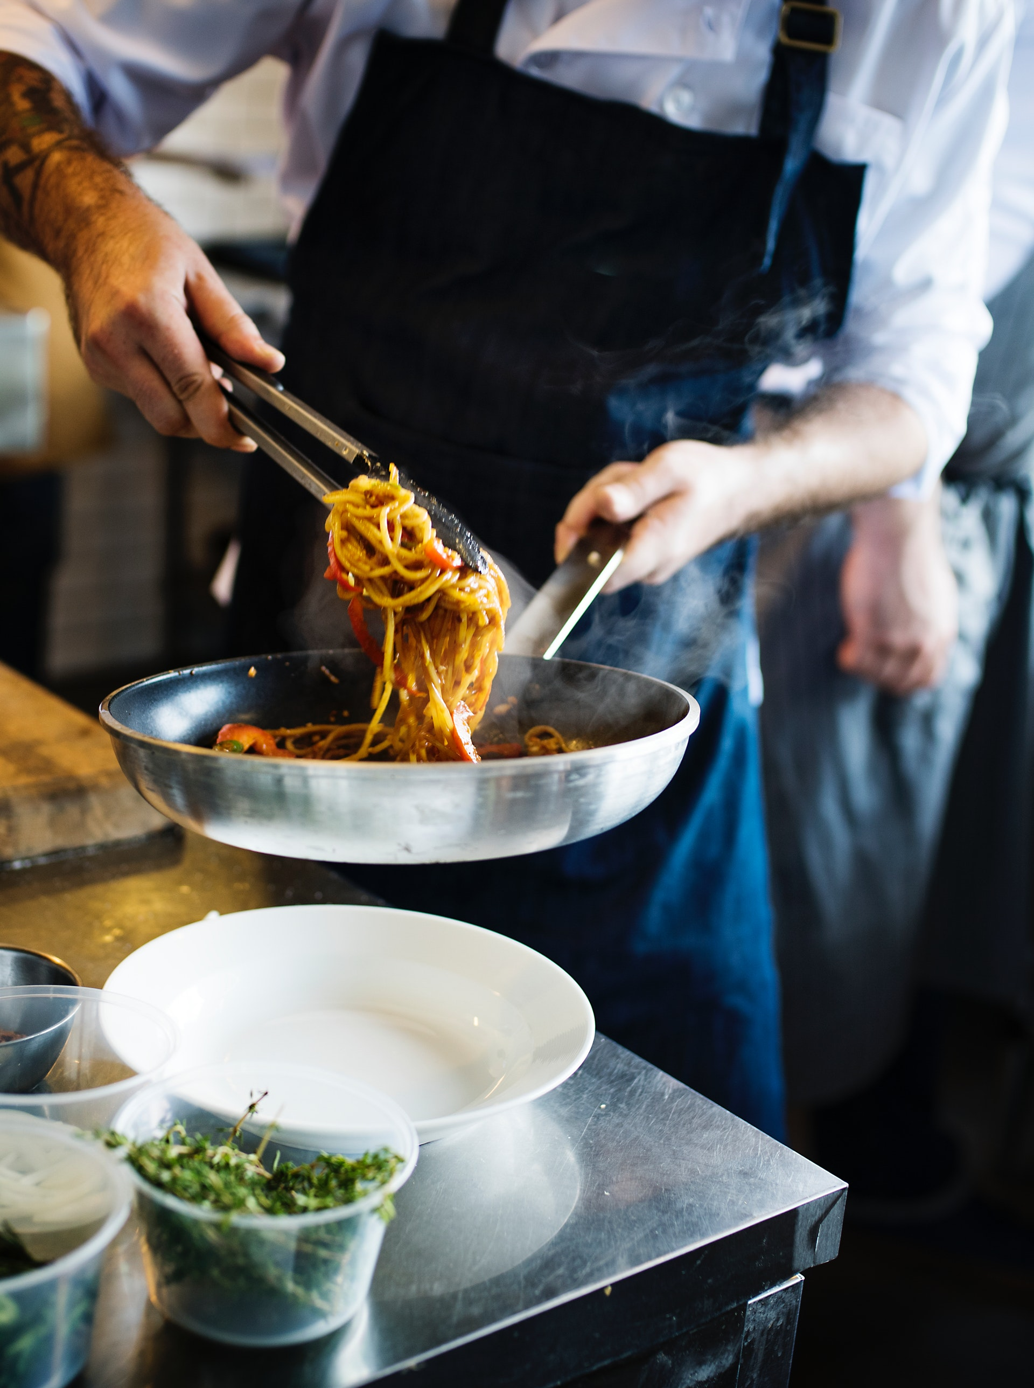
Thank you!
We would love to take any questions now.

Slide 23
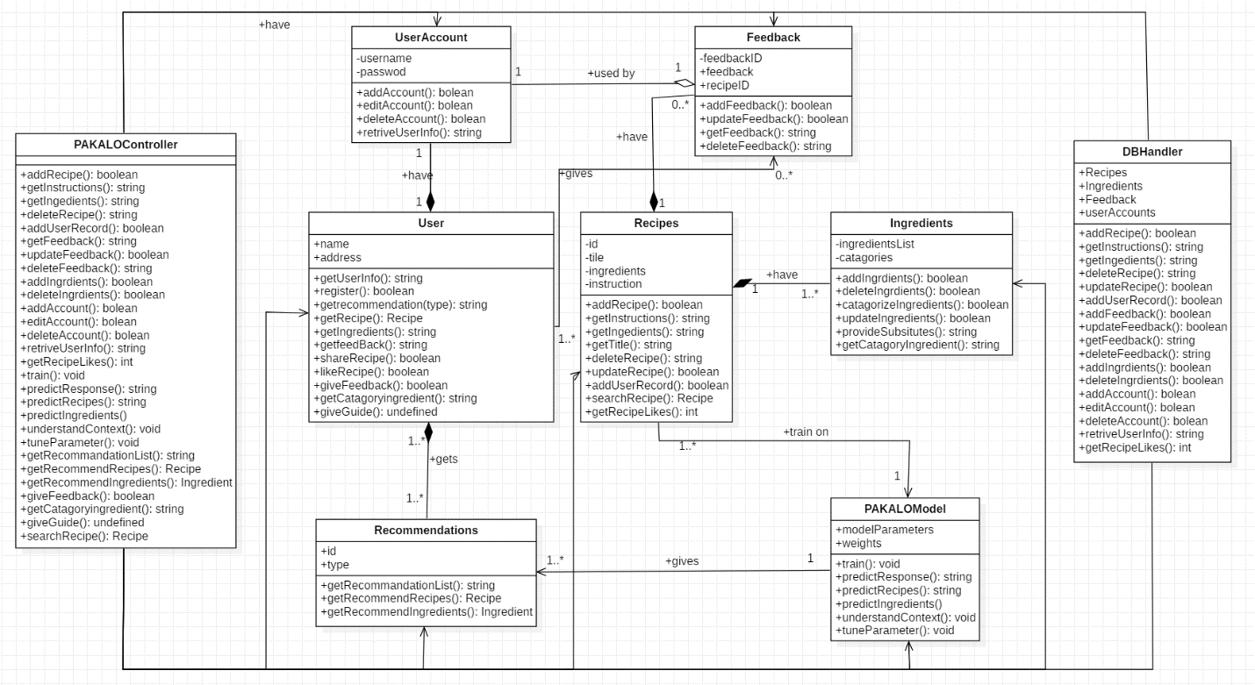

Slide 24
