Slide 1
COVID19 and airline Travel
An analysis of United States COVID case number trends
compared with numbers of airline travelers.
Notes:
Key takeaways: 1. demo organizing a large project, 2. group feedback on visualizations

Slide 2

Project Summary
This project set out to explore COVID19 case data compared to airline traveler data in the United States.

Slide 3
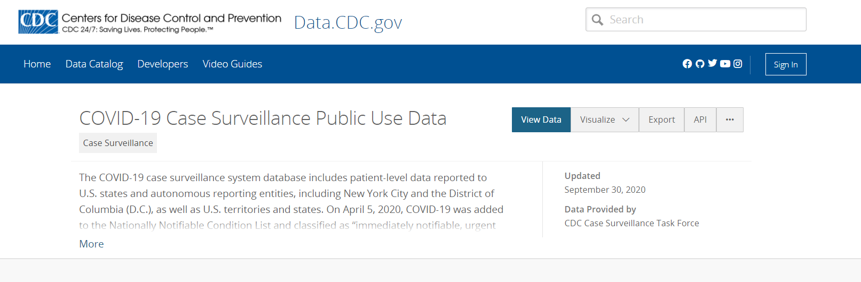
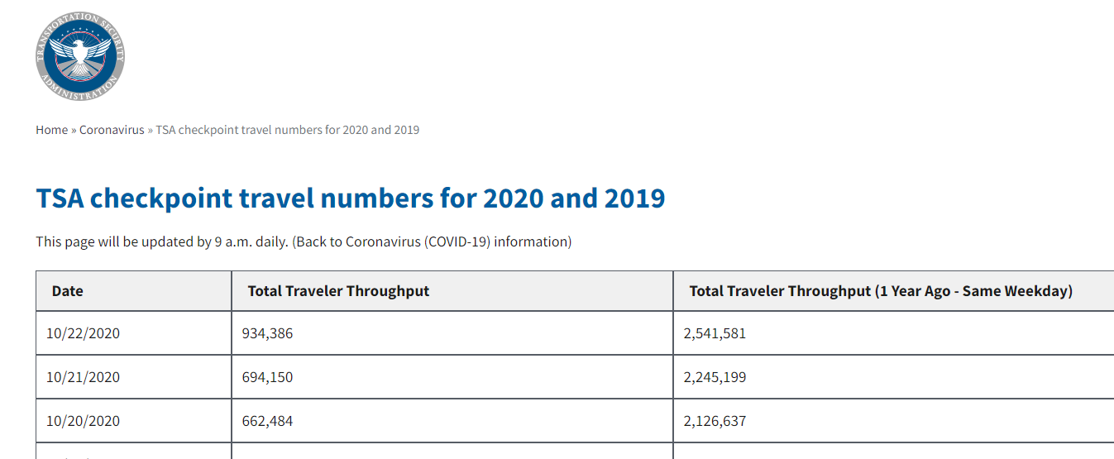
Data Sets
COVID-19 Case Surveillance Public Use Data:
https://data.cdc.gov/Case-Surveillance/COVID-19-Case-Surveillance-Public-Use-Data/vbim-akqf
Transportation Security Agency checkpoint travel numbers for 2020 and 2019:
https://www.tsa.gov/coronavirus/passenger-throughput

Slide 4
Questions for the Group
What additional or different questions does this analysis bring up for you?
Would you have presented the data differently and how?
Which parts of the visualizations are confusing or particularly helpful?

Slide 5
Project questions
What was 'typical' travel like each month in 2019 and 2020?
What were the COVID19 trends in 2020 for those same date ranges?
What was the correlation between COVID and travel in the early, middle, and late parts of the first wave of COVID 2020?
Note: the longer-term plan is to continue to follow the trend through the end of 2020 and into 2021 as the COVID second wave plays out this Fall/Winter.

Slide 6
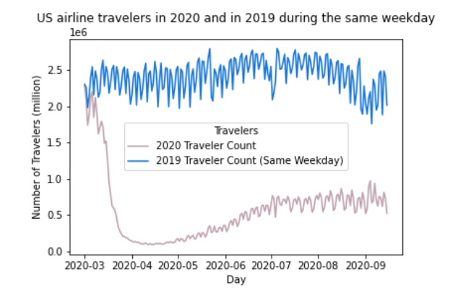
Question 1 What was 'typical' travel like each month in 2019 and 2020?
2019 traveler numbers were fairly consistent across the year.
While 2020 traveler numbers dropped dramatically in mid-March
and then slowly and steadily rose through the year, but not to the 2019 level.
Notes:
Are specific types of travel impacted more than others? (business travel vs. leisure?) It would make sense that travel peaks on the weekend. Is there a July 4 dip showing?

Slide 7
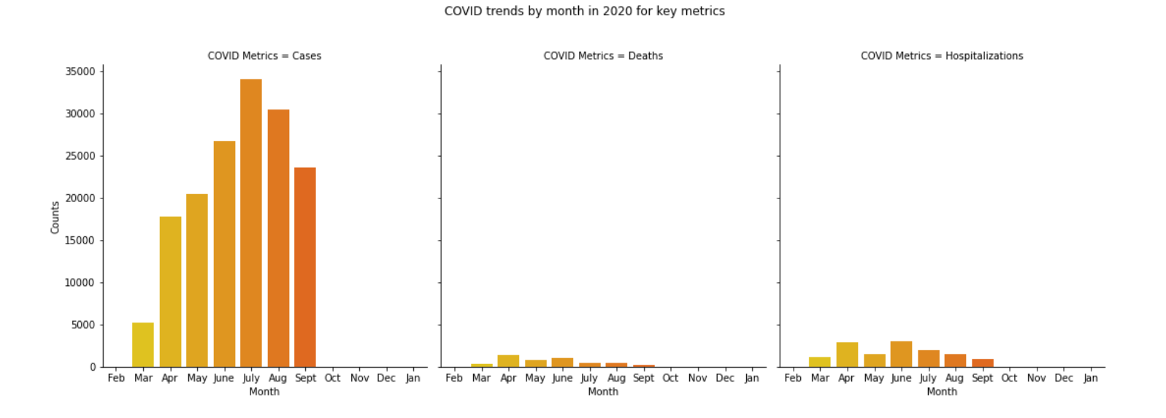
Question 2 What were the COVID19 trends in 2020 for those same date ranges?
1. Number of cases rose sharply from March to peak in July and then decreased each month
2. Number of deaths was highest in April with June slightly behind; these numbers were lowest in March and Sept
3. Number of hospitalizations was highest in April and June also. From June to Sept they decreased each month.
Notes:
Normalize the scales here as a suggestion. Use a logarithmic scale instead of a linear scale. Nice to know overall although cases are going up we haven’t surpass our worse numbers yet I wonder what data will look like by the end of the year.

Slide 8
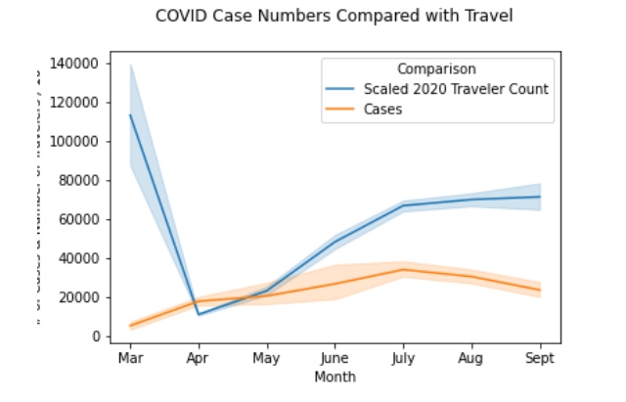
Question 3 What was the correlation between COVID and travel in the early, middle, and late parts of the first wave of COVID 2020?
The 2020 airline traveler numbers did not rise and fall in sync with the COVID19 case numbers.
The number of COVID cases was highest in July and that was also nearly the highest number of travelers since the drop in travelers in April.
However, the number of travelers increased to a smaller degree in July - Sept, while the number of COVID cases declined slightly.
This could indicate that travel slowed after the peak in COVID cases in July.
Notes:
You can plot with two y-axes (dual-axis chart). Relationship between cases and travelers during the low period. For example: it would be interesting to try to focus on a particular hotspot, like NYC or LA, and look at the relationship for that specific area. Did rising cases in NYC reduce travel to NYC airport or LAX airport?

Slide 9
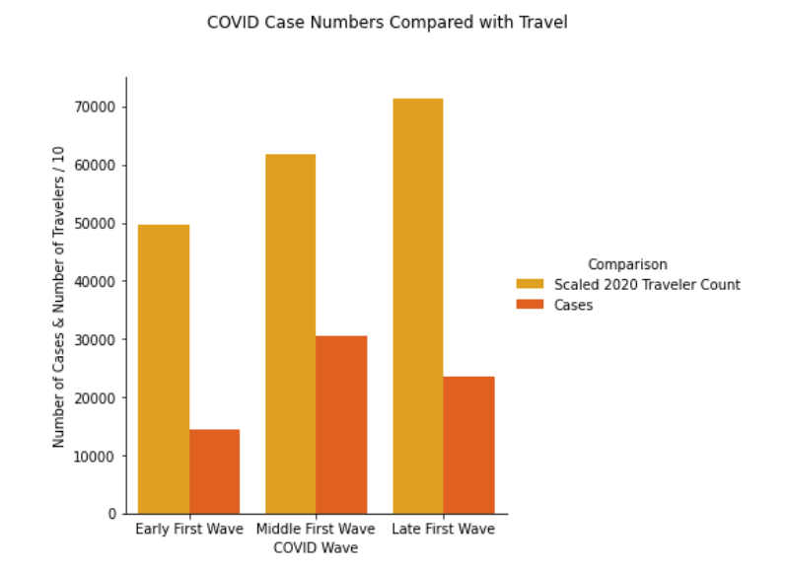
Question 3, con’t What was the correlation between COVID and travel in the early, middle, and late parts of the first wave of COVID 2020?
The 2020 airline traveler numbers did not rise and fall in sync with the COVID19 case numbers.
Between the early and middle part of the first wave, the number of travelers increased while the number of COVID cases increased also.
Between the middle and late part of the first wave, the number of travelers continued to increase, while the number of COVID cases decreased slightly.
Overall, between the early and late first wave the number of travelers increased while the number of COVID cases increased then decreased.

Slide 10


Please give me your feedback

Slide 11
Step 1: Start working through the code needed to collect the data (API), organize the data (DataFrames), and visualize the data
Project process
Step 2: Adapt for the challenges along the way (API call vs. download 4.5 million row dataset) and the length of the code (create multiple notebooks organized around major steps)

Slide 12
Step 3: Once working code is developed, write an overview of what each notebook accomplishes and cleanup any comments so that they make sense (I changed a lot of code along the way, what was I left with?)
Project process
Step 4: Create an Executive summary to highlight the observations and visualizations (I felt the Visualizations notebook was too long and emphasized process vs. product)

Slide 13
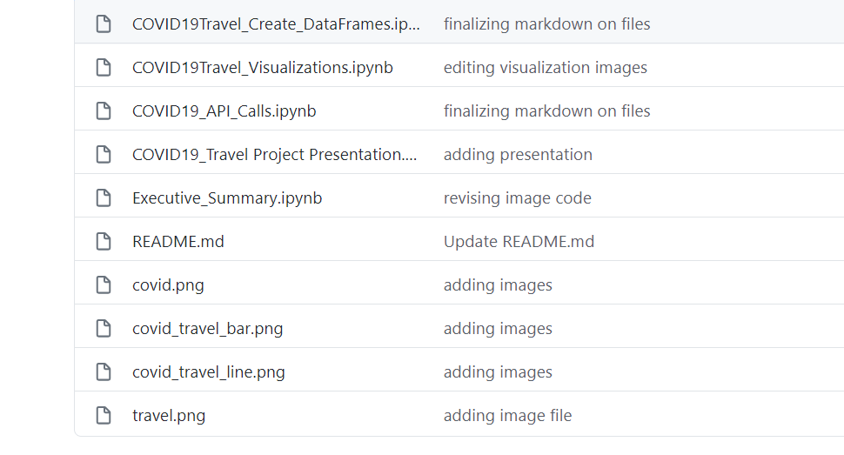
GitHub Repository
https://github.com/abielhammonds/COVID19_TravelStats_Project

