Slide 1
Multicast Key Agreement
Alex Bienstock

Slide 2
Multicast Key Agreement
A key agreement protocol for groups with a trusted group manager
Previously studied, but rigorous efficiency and security properties were lacking
No Post-Compromise Security (PCS) or Forward Secrecy (FS)
No analysis of user or group manager state corruptions
No study of the efficiency of protocols with dynamic group membership
Notes:
Group mgr ops – create, add, rem, update
EACH CREATE EPOCHS – expect all users to agree on output seeds at each epoch!
PRIVACY ADDRESSED (transcript doesn’t reveal any group secrets)
Briefly explain PCS and FS here – group mgr security props not addressed by this implementation
Balanced trees

Slide 3
Applications
PayTV and other forms of media content protection
Group Conferencing
Secure Group Messaging (SGM)
Secure communication between users over untrusted networks
Currently studied under IETF working group in the context of no group manager
CGKA – (asynchronous) key agreement protocol at the center of SGM
Very similar to MKA
Communication on top of key agreement protocol, provided by protocol very similar to Signal
Notes:
Asynch - users perform all operations whenever they want
Signal - Provides optimal security in two-party case

Slide 4
MKA’s Advantages over CGKA
No asynchrony – group manager determines all operations
Very hard problem to solve in CGKA
Symmetric Key Cryptography
More efficient
Optimal efficiency
O(log(n)) vs. O(n) - presence of group manager eliminates asynchrony and permits “omniscient” view
No Public Key Infrastructure (PKI)
Still have out-of-band (OOB) channels, but PKI is just one way to accomplish it
Notes:
(most solutions assume a delivery server which chooses certain user operations at given times and makes sure all users get messages in same order)
If no delivery service, group may split – certain users process one message, others another
CONCURRENCY and Blanks
TIGHT efficiency
In CGKA users need public key every time they come to group
ONLY NEED TO TRUST GM

Slide 5
Our Implementation
Uses generic tree structures,¹ with symmetric key encryption and pseudorandom generators²
Secrets at each node with users at each leaf
Users only store direct paths
Uses skeleton of tree after every (tree) operation to generate secrets and control messages (which include the skeleton)
Skeletons are serialized for network transmission (preorder traversal)
Users use the skeletons to determine which secrets they need to generate or erase
Networks
Plaintext communication over individual TCP sockets for OOB³
Encrypted communication over UDP multicast socket for control messages
Figures and further details on following slides (and demo!)
Notes:
Generic trees in code; Briefly explain SKE, PRG
OOB needed for sending random values for added or updated people

Slide 6
GM
u₁
u₂
…
u_{n}
…
u_{N}
connect (oob and multicast)
Init₁ (assigns ID)
connect
init₂
Init Phase
connect
Init_{n}
connect
init_{N}
oob s₁
oob s₂
oob s_{n}
Group Creation
Encrypted control messages via multicast socket
Group Ops
Same flavor for subsequent ops
Notes:
Group manager is server for both sockets – creates sockets, and for oob, waits for users to connect

Slide 7
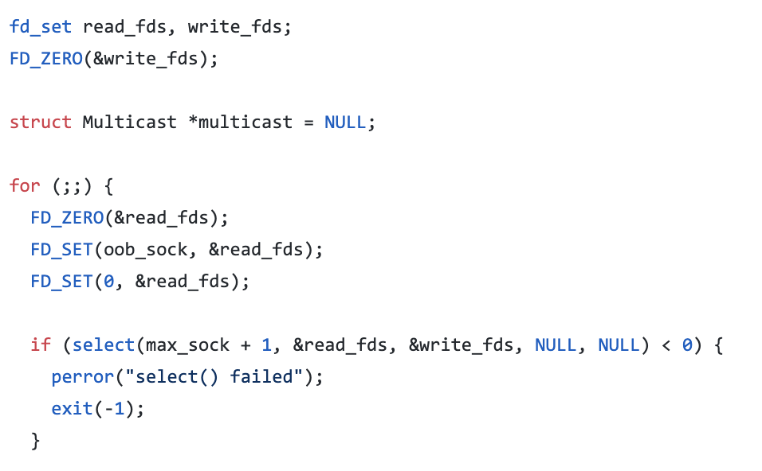
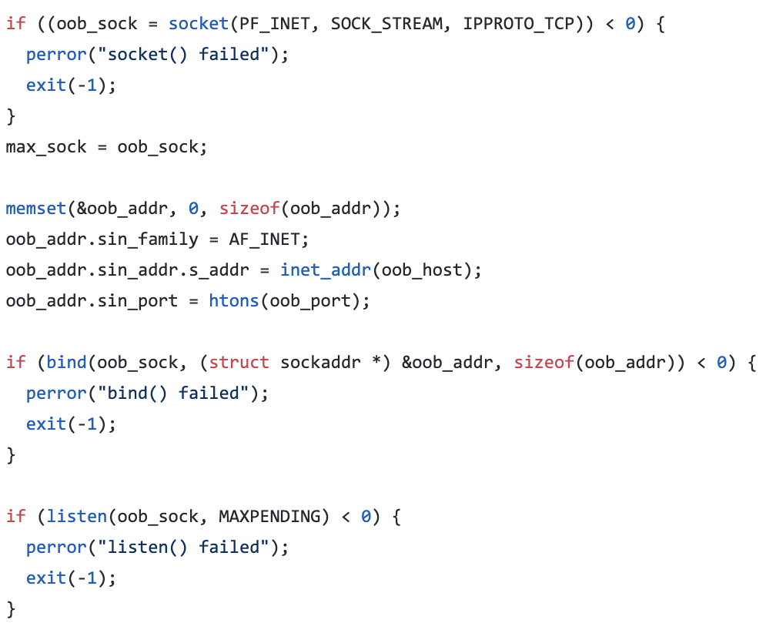
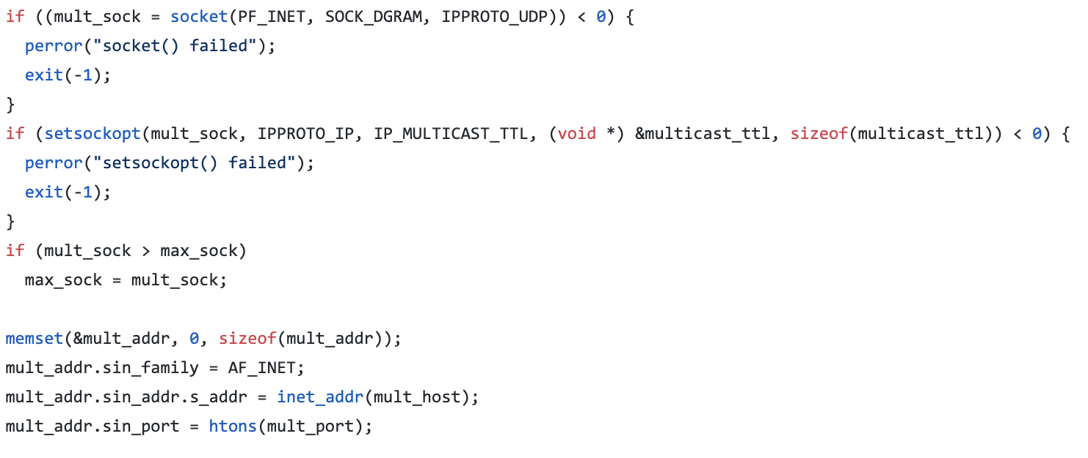
Example Execution
Initialize Manager
Set up OOB socket and Multicast Socket
Select() loop to process incoming connections, GM ops
Associate each user with separate OOB connection
Notes:
GM operations from command line

Slide 8
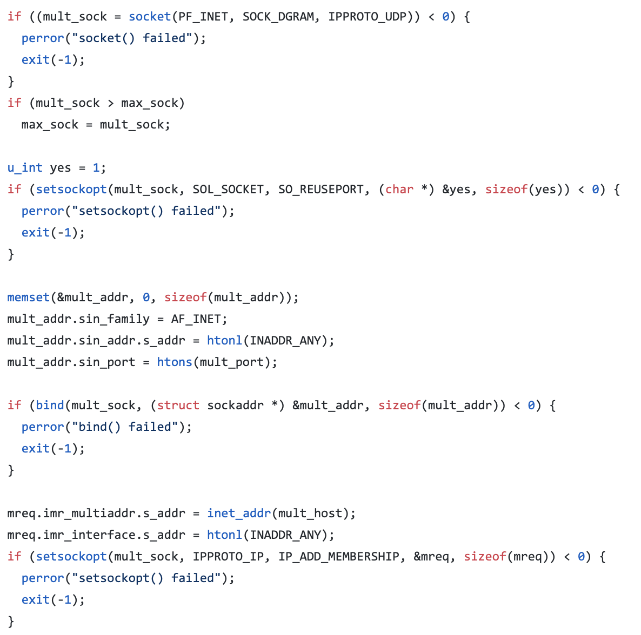
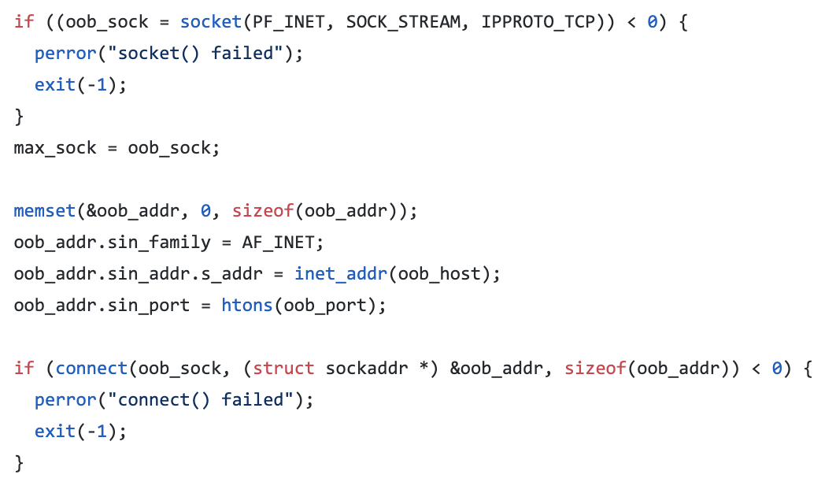
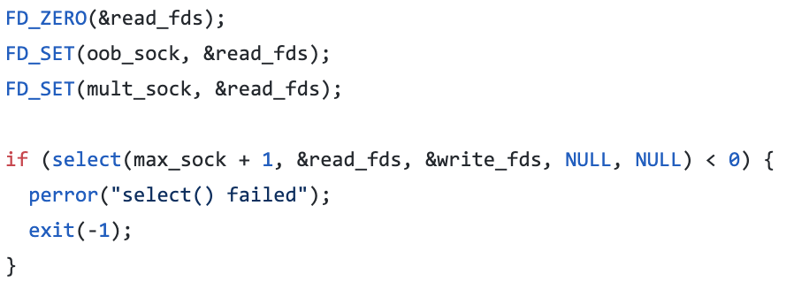
Initialize User
Connect to OOB socket and Multicast Socket
Select() loop to process OOB messages and control messages

Slide 9
Create(3)
GM
s_{r} , k_{r}
skeleton
PRG(s₀) = s_{r} , k_{r}
r
(CT₁, r, 10)
s₀, k₀
0
CT₁ = Enc(k₁₀, s₀)
(CT₀, 0, 01)
CT₀ = Enc(k₀₁, s₀₀)
00
01
10
PRG(s₀₀) = s₀, k₀
u₀
s₀₀, k₀₀
u₁
s₀₁, k₀₁
u₂
s₁₀, k₁₀
u₁
s₀₁’, k₀₁’
u₂
s₁₀’, k₁₀’
u₃
PRG(r₀₀) = s₀₀, k₀₀
PRG(r₀₁) = s₀₁, k₀₁
PRG(r₁₀) = s₁₀, k₁₀
PRG(s₀₁) = s₀₁’, k₀₁’
PRG(s₁₀) = s₁₀’, k₁₀’
Notes:
GROUP MANAGERS OPS!!
R values sampled randomly – NONCES NOT SHOWN!
Explain skeleton
GROUP SECRET DERIVED FROM PRG ON ROOT SEED

Slide 10
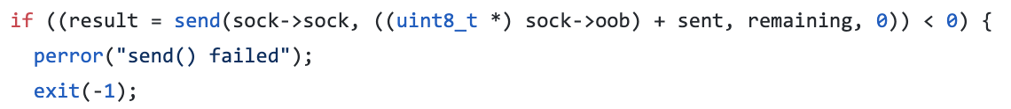
Create(3)
r
(CT₁, r, 10)
GM
0
(CT₀, 0, 01)
00
01
10
r₀₀
r₀₁
r₁₀
u₀
u₁
u₂
u₃
Notes:
USERS SIDE!
Separate oob

Slide 11
r
Create(3)
(CT₁, r, 10)
0
GM
(CT₀, 0, 01)
W = (CT₀ = Enc(k₀₁, s₀₀), CT₁ = Enc(k₁₀, s₀))
00
01
10
s_{r} , k_{r}
s_{r} , k_{r}
PRG(s₀) = s_{r} , k_{r}
PRG(s₀) = s_{r} , k_{r}
s₀, k₀
s₀, k₀
s_{r} , k_{r}
PRG(s₀₀) = s₀, k₀
PRG(s₀) = s_{r} , k_{r}
PRG(s₀₀) = s₀, k₀
Dec(k₀₁, CT₀) = s₀₀
Dec(k₁₀, CT₁) = s₀
u₀
s₀₀, k₀₀
u₁
s₀₁, k₀₁
u₂
s₁₀, k₁₀
u₃
u₁
s₀₁’, k₀₁’
u₂
s₁₀’, k₁₀’
PRG(r₀₀) = s₀₀, k₀₀
PRG(r₀₁) = s₀₁, k₀₁
PRG(r₁₀) = s₁₀, k₁₀
PRG(s₀₁) = s₀₁’, k₀₁’
PRG(s₁₀) = s₁₀’, k₁₀’
Notes:
Multicast public channel

Slide 12
Create(3)
Add(3)
GM
s_{r} , k_{r}
s_{r} ‘, k_{r}’
Skeleton
CT₁ = Enc(k₀, s₁)
PRG(s₁) = s_{r}’, k_{r}’
(CT₁, r, 0)
r
0
1
s₀, k₀
s₁, k₁
PRG(s₀) = s₀’, k₀’
s₀’, k₀’
10
11
CT₀ = Enc(k₁₀’, s₁₁)
PRG(s₁₁) = s₁, k₁
(CT₀, 1, 10)
u₀
s₀₀, k₀₀
u₁
s₀₁', k₀₁’
u₂
s₁₀', k₁₀’
u₃
s₁₁, k₁₁
u₂
s₁₀’’, k₁₀’’
PRG(s₁₀’) = s₁₀’’, k₁₀’’
PRG(r₁₁) = s₁₁, k₁₁
Notes:
Red part is skeleton (along with frontier nodes) – explain rules
Note u0, u1 don’t change - log(n)

Slide 13
Create(3)
Add(3)
r'
(CT₁, r, 0)
GM
0
1
10
11
(CT₀, 1, 10)
s_{r} , k_{r}
s_{r} , k_{r}
r₁₁
s₀, k₀
s₀, k₀
s_{r} , k_{r}
u₀
s₀₀, k₀₀
u₁
s₀₁', k₀₁’
u₂
s₁₀', k₁₀’
u₃
Notes:
Red is PRG, blue is CT

Slide 14
Create(3)
Add(3)
(CT₁, r, 0)
r'
GM
W = (CT₀ = Enc(k₁₀’, s₁₁), CT₁ = Enc(k₀, s₁))
0
1
10
11
(CT₀, 1, 10)
s_{r} , k_{r}
s_{r} ‘, k_{r}’
s_{r} ‘, k_{r}’
s_{r} , k_{r}
PRG(s₁) = s_{r}’ , k_{r}’
s_{r}’, k_{r}’
PRG(s₁) = s_{r}’ , k_{r}’
s_{r}’, k_{r}’
Dec(k₀, CT₁) = s₁
Dec(k₀, CT₁) = s₁
PRG(s₁) = s_{r}’ , k_{r}’
PRG(s₁) = s_{r}’ , k_{r}’
s₀, k₀
s_{r} , k_{r}
s₁, k₁
s₀, k₀
s₀’, k₀’
PRG(s₁₁) = s₁ , k₁
s₁, k₁
PRG(s₀) = s₀’, k₀’
PRG(s₀) = s₀’, k₀’
s₀’, k₀’
Dec(k₀, CT₀) = s₁₁
PRG(s₁₁) = s₁ , k₁
u₀
s₀₀, k₀₀
u₁
s₀₁', k₀₁’
u₂
s₁₀', k₁₀’
u₃
s₁₁, k₁₁
PRG(s₁₀’) = s₁₀’’, k₁₀’
u₂
s₁₀’’, k₁₀’’
PRG(r₁₁) = s₁₁, k₁₁
Notes:
Multicast public channel
PRGS!

Slide 15
Create(3)
Add(3)
Remove(2)
GM
s_{r} ‘, k_{r}’
s₁, k₁
s₀’, k₀’
u₀
s₀₀, k₀₀
u₁
s₀₁', k₀₁’
u₃
s₁₁, k₁₁
u₂
s₁₀’’, k₁₀’’
u₂
s₁₀’’, k₁₀’’
Notes:
Note k00, k01 don’t change (k_0 changed in real implementation for optimal FS)

Slide 16
Create(3)
Add(3)
Remove(2)
GM
s_{r} ‘’, k_{r’}’
s₁', k₁’
s₀’’, k₀’’
u₀
s₀₀, k₀₀
u₁
s₀₁', k₀₁’
u₃
s₁₁', k₁₁’
u₂
s₁₀’’, k₁₀’’
u₂
Notes:
Note k00, k01 don’t change (k_0 changed in real implementation for optimal FS)

Slide 17
Create(3)
Add(3)
Remove(2)
Remove(3)
GM
s_{r} ‘’, k_{r’}’
s₁', k₁’
s₀’’, k₀’’
u₀
s₀₀, k₀₀
u₁
s₀₁', k₀₁’
u₃
s₁₁', k₁₁’
u₂
s₁₀’’, k₁₀’’
u₂
Notes:
Note k00, k01 don’t change (k_0 changed in real implementation for optimal FS)

Slide 18
Create(3)
Add(3)
Remove(2)
Remove(3)
GM
s_{r} ‘’, k_{r’}’
s₁', k₁’
s₀’’, k_{0’}’
u₀
s₀₀, k₀₀
u₁
s₀₁', k₀₁’
u₃
s₁₁, k₁₁
u₂
s₁₀’’, k₁₀’’
u₂
u₃
Notes:
Note k00, k01 don’t change (k_0 changed in real implementation for optimal FS)

Slide 19
Create(3)
Add(3)
Remove(2)
Remove(3)
GM
s₀’’, k₀’’
u₀
s₀₀', k₀₀’
u₁
s₀₁’’, k₀₁’’
u₂
u₃
Notes:
Note k00, k01 don’t change (k_0 changed in real implementation for optimal FS)

Slide 20
Create(3)
Add(3)
Remove(2)
Remove(3)
Broadcast(“test”)
GM
PRG(s₀’’) = k*
s₀’’, k₀’’
u₀
s₀₀, k₀₀
u₁
s₀₁', k₀₁’
u₂
u₃
Notes:
Note k00, k01 don’t change (k_0 changed in real implementation for optimal FS)

Slide 21
Create(3)
Add(3)
Remove(2)
Remove(3)
Broadcast(“test”)
GM
CT = Enc(k*, “test”)
Dec(k*, CT) = “test”
Dec(k*, CT) = “test”
s₀’’, k₀’’
s₀’’, k₀’’
PRG(s₀’’) = k*
PRG(s₀’’) = k*
u₀
s₀₀, k₀₀
u₁
s₀₁', k₀₀’
??
u₂
u₃
Notes:
Multicast public channel
PRGS!

Slide 22
Demo!

Slide 23
Future Work:
Experiment with different data structures for multicast operations to test efficiency
2-3 trees, RB trees, (broadcast encryption methods?)
Implement Application Secret Tree on top of MKA
The actual “messaging” application
Derived from Signal Protocol
One of many things one could implement on top of MKA

Slide 24
MKA Syntax
All control messages sent across public channel
All random values sent over independent OOB channels with all users
Each of 2-5 below define new epochs with new group secrets
Group Manager/User state initialization
Group Creation(u₁, …, u_{n}) – GM creates control message W and random values r₁, …, r_{n}
so that Group n users agree on secret S
Add(u) – GM creates control messages W and T and random value r for a new user u to join the group
Remove(u) – GM creates control message T to remove a user u from group
Update(u) – GM creates control message T and random value r to refresh the state of a group member u
Process(u, T, (r)) – User u takes in a control message T and (possibly) random value r to obtain a new group secret for the epoch that T defines
Notes:
Control messages contain encrypted keys (and skeletons)

Slide 25
MKA Security and Correctness
Correctness – all group members output same secret S in all epochs
Privacy – group secrets look random given transcript of control msgs
User FS – given corruption of a user now, all previous group secrets hidden
User PCS – given corruption of a user now, once their state is updated, group secrets become hidden again
Not accomplished by this implementation, but in formal paper:
GM FS – same as above but for group manager
GM eventual PCS – same as above, but only after all group members updated or removed
Notes:
GM security – future work – briefly describe encrypted RAM

Slide 26



MKA Additional Properties
Messages can be delivered to users at arbitrary points in time
Resilience against (malicious) users that do not delete old secrets
Prevents against double joining – once users are removed, they cannot rejoin no matter what
Notes:
explain double joining

